Slide 1
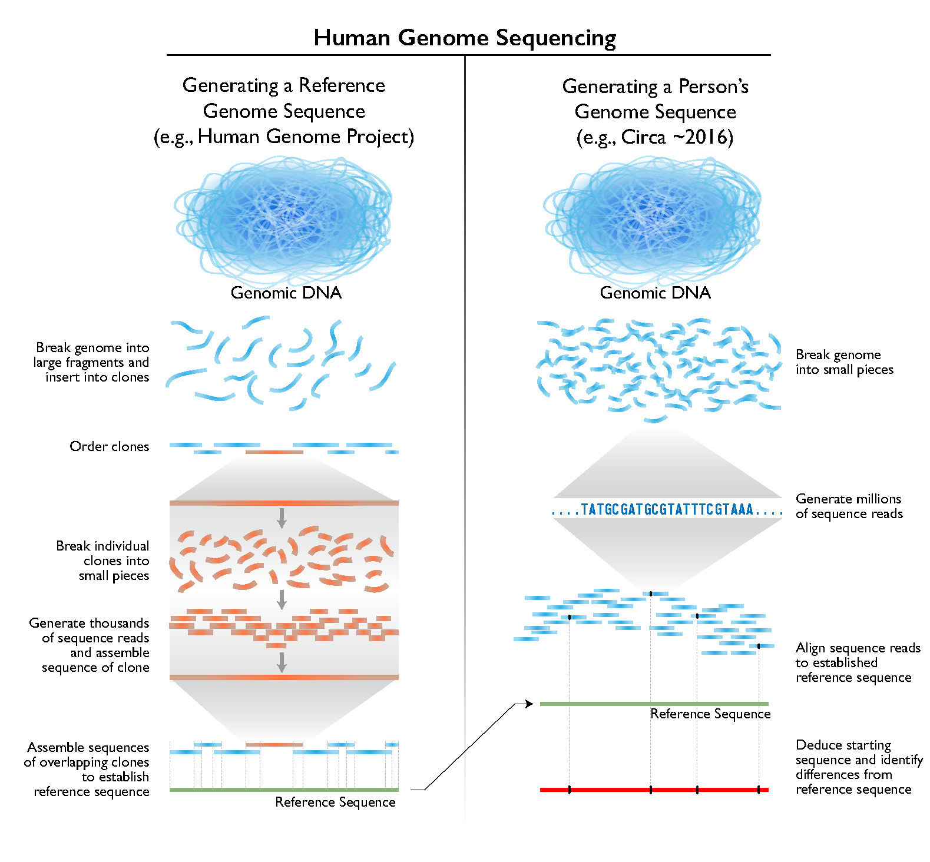

Slide 2
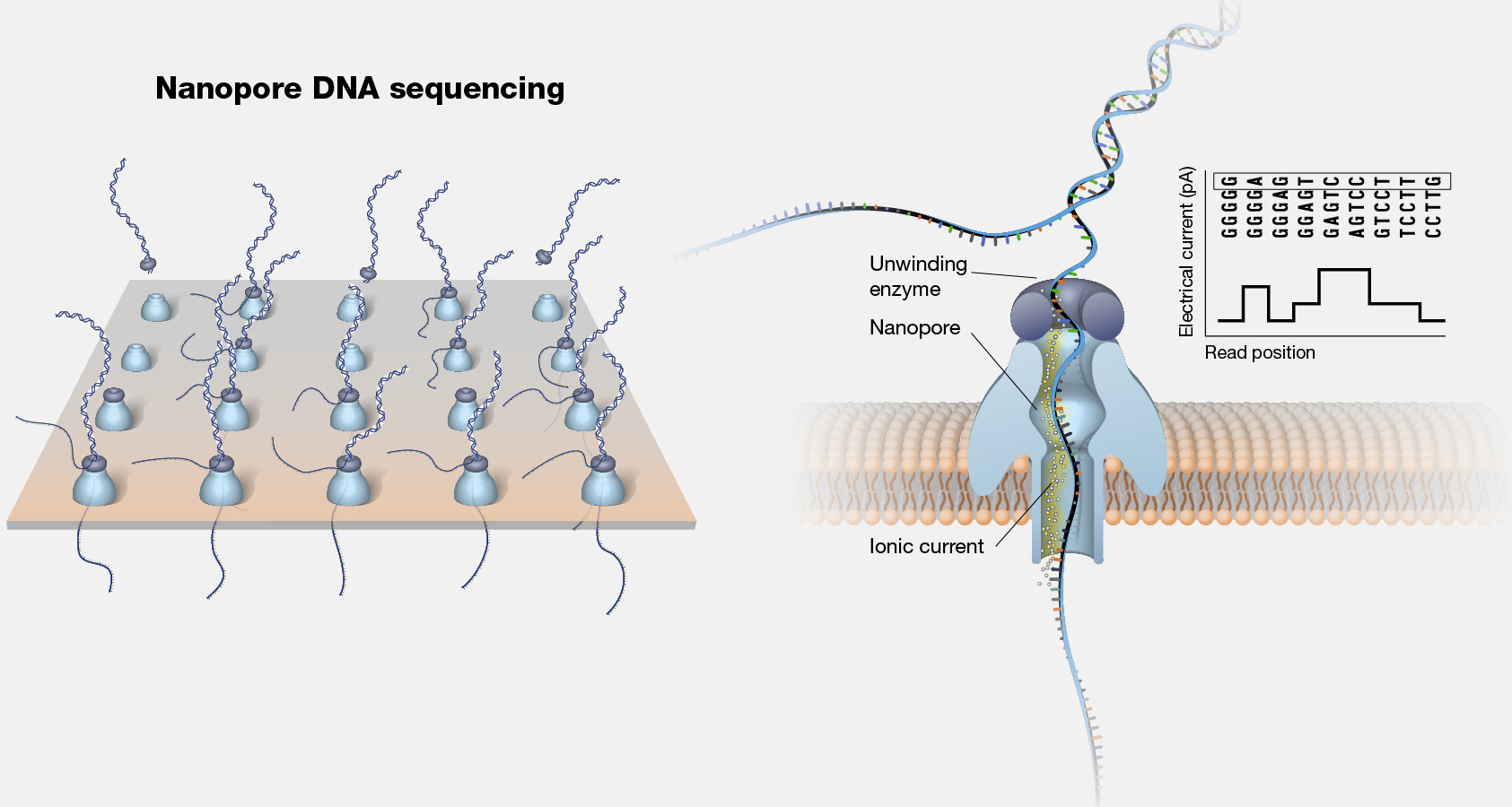

Slide 3
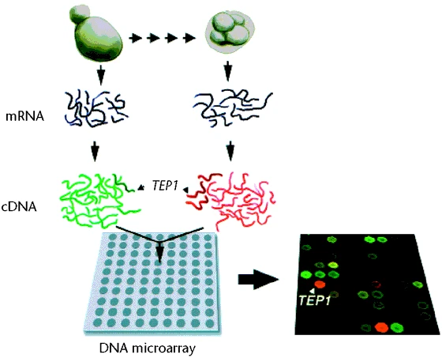

Slide 4
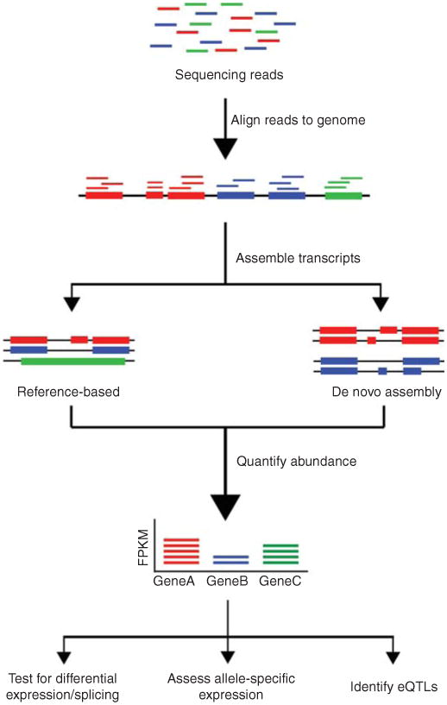

Slide 5

genome
transcriptome
proteome

Slide 6
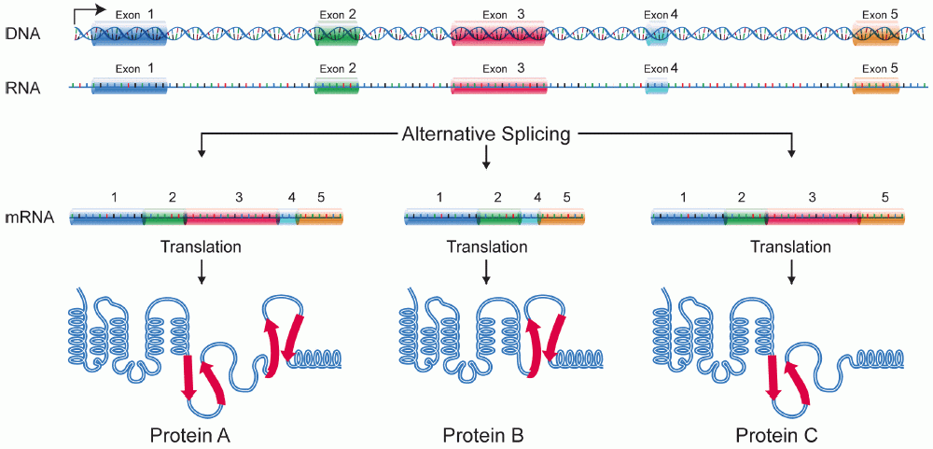
Transcription

Slide 7
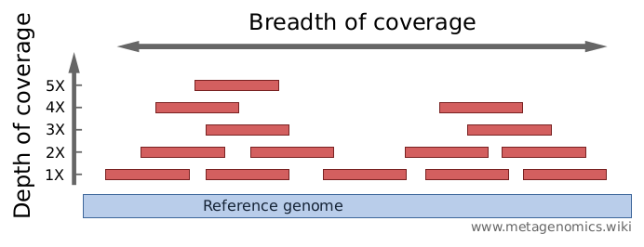

Slide 8
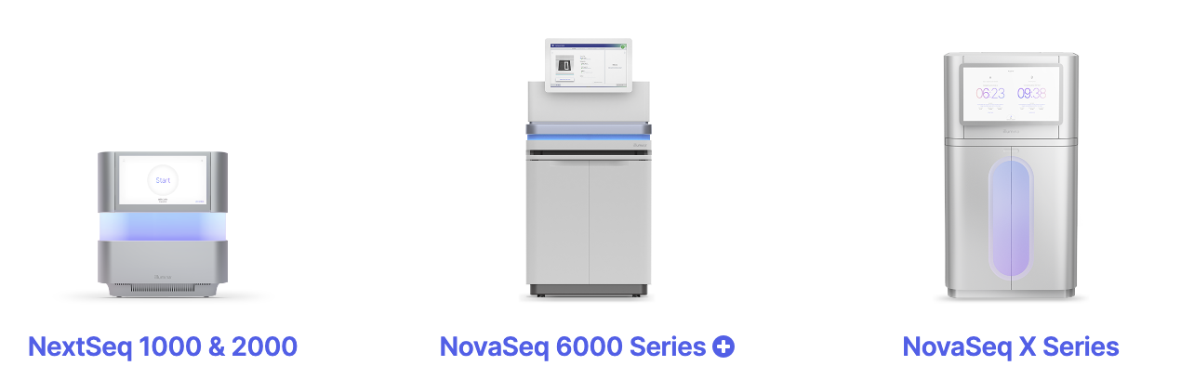
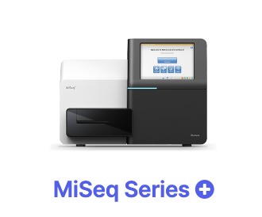
Max. output 15 Gb 360 Gb 6000 Gb 16 Tb
Max. # reads 25 M 1.2 B 20 B 52 B
Max. read length 300 bp 300 bp 250 bp 150 bp
Price per Gb $100-$200 $17-$60 $5-$30 $2-$3

Slide 9
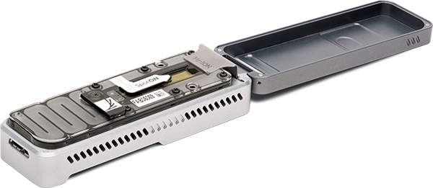
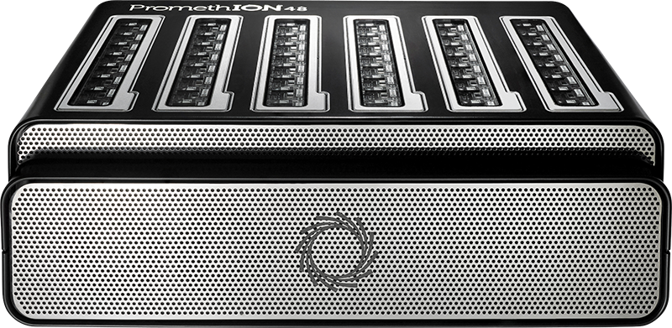
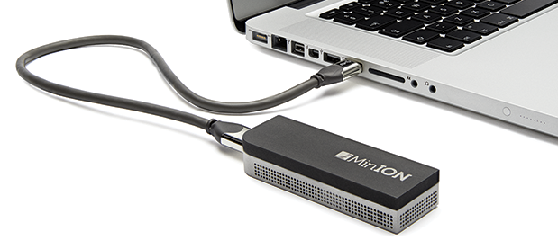
MinION ~15 Gb
PromethION ~90 Gb x 24/48 flowcells

Slide 10
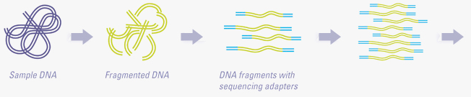
DNA fragmentation
Adapter addition
PCR enrichment
To sequencer

Slide 11
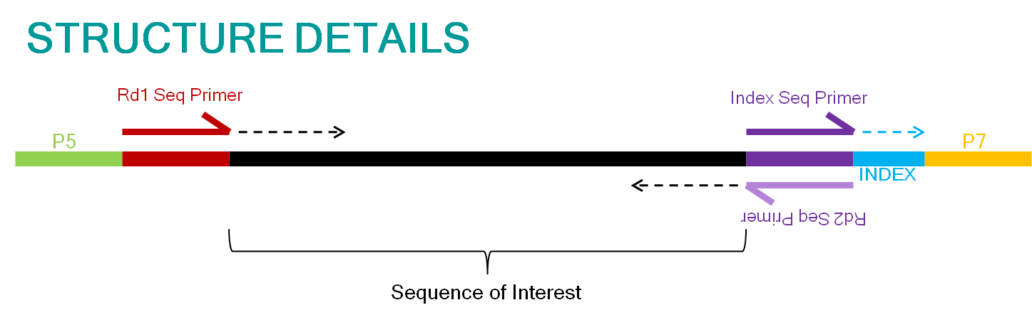
Adapter 1
DNA fragment
Adapter 2

Slide 12
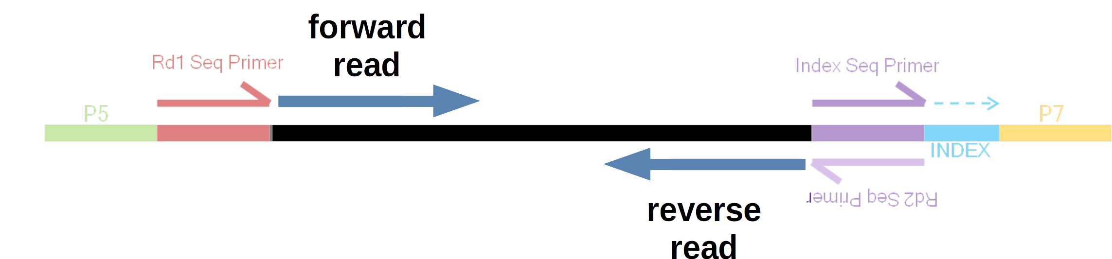
Adapter 1
DNA fragment
Adapter 2

Slide 13
forward read
reverse read
forward read
forward read
reverse read

Slide 14
forward read
reverse read
150 bp
100 bp
150 bp
Insert size: 400 bp
forward read
reverse read

Slide 15
forward read
reverse read

Slide 16
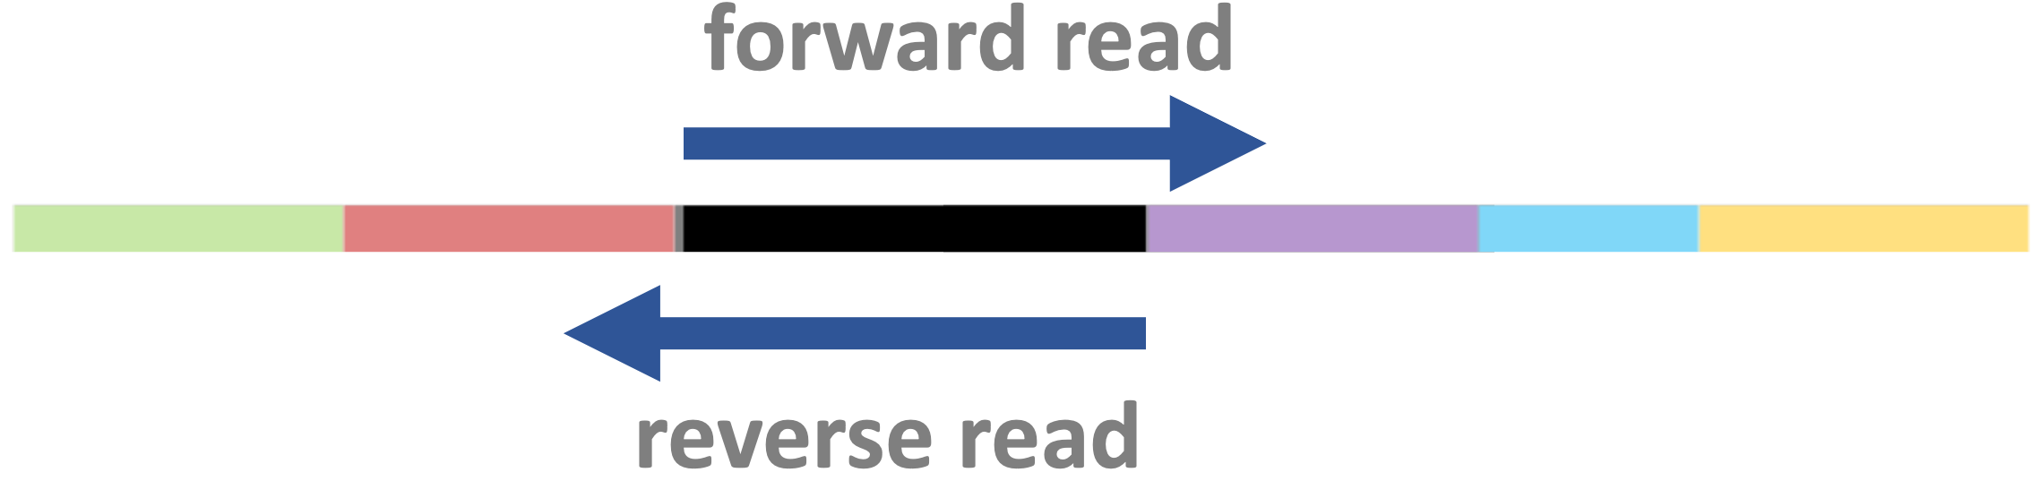


Slide 18
Indicate synthesis start site using sequencing primers
Allow for sample multiplexing using indices (barcodes)
Binding to the flowcell
PCR amplification of fragments

Slide 19
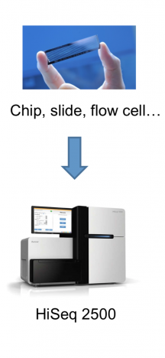

Slide 20
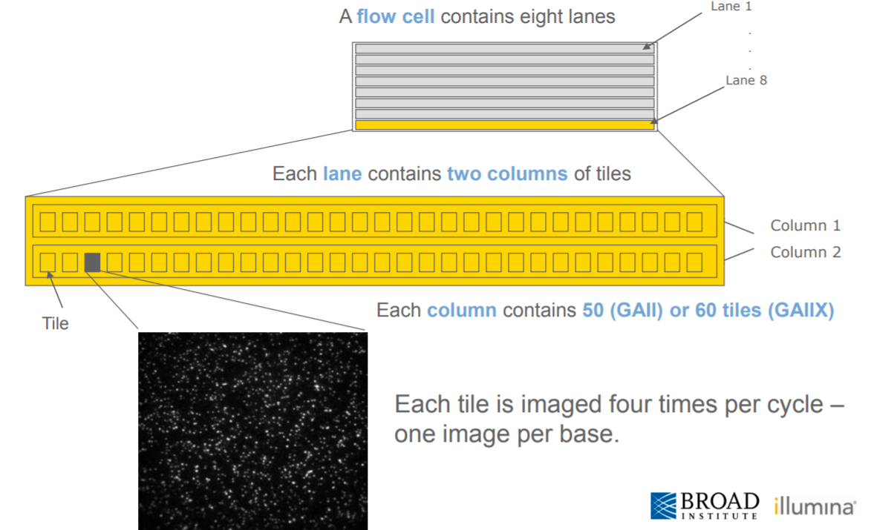
A flow cell contains multiple lanes
A lane contains multiple columns each with many tiles
Each speck in a tile is a cluster (!)

Slide 21
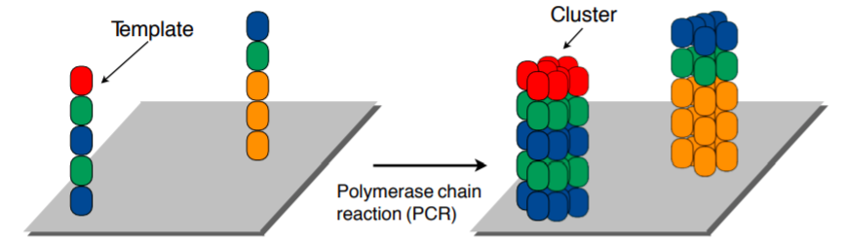
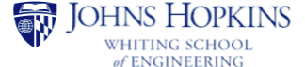

Slide 22
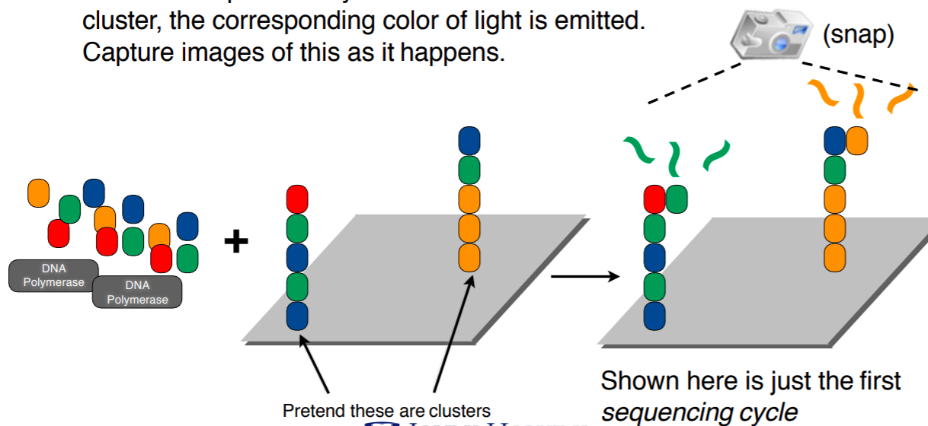
Add color-labeled nucleotides + DNA polymerase
When nucleotide is incorporated: light emitted & pictures taken

Slide 23
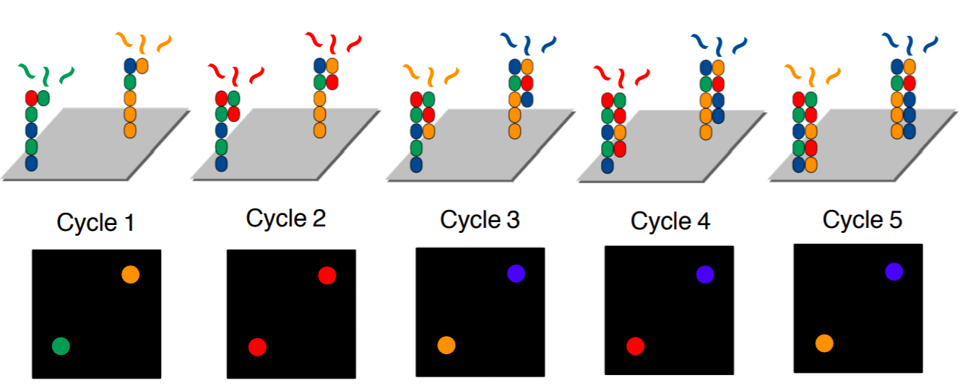
Terminators prevent continuous addition, hence “cycles”
- One cycle = one added nucleotide
- Read length = number of cycles

Slide 24
