Slide 1
HCS7004 – Session 13
Software and containers
September 16th, 2020

Slide 2
Agenda for today
Some commands and concepts:
sudo recap, the $PATH environment variable, and remote file transfer
Avoiding dependency hell
Increasing reproducibility and portability of software environments
using conda and containers

Slide 3
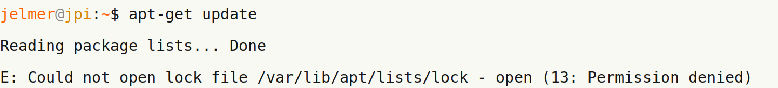
sudo recap
Use sudo to temporarily gain administrative rights
for tasks such as software installation with a package manager
To run a command in sudo mode, simply prepend “sudo”:

Slide 4
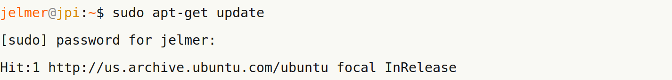
sudo recap
Use sudo to temporarily gain administrative rights
for tasks such as software installation with a package manager
To run a command in sudo mode, simply prepend “sudo”:

Slide 5
sudo recap
Use sudo to temporarily gain administrative rights
for tasks such as software installation with a package manager
To run a command in sudo mode, simply prepend “sudo”:
At OSC, you will not be able to use sudo

Slide 6
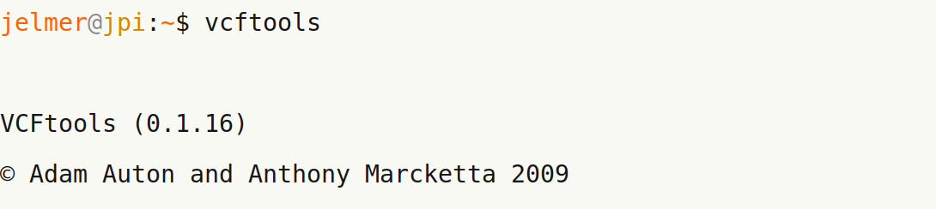
The $PATH environment variable
$PATH is one of several environment variables.
It lists the directories that will be searched when you type a program’s name.
This allows you to run programs without specifying the full path to the executable.

Slide 7
The $PATH environment variable
$PATH is one of several environment variables.
It lists the directories that will be searched when you type a program’s name.
This allows you to run programs without specifying the full path to the executable.
# “which” to check location

Slide 8
The $PATH environment variable
To check which dirs are in your $PATH:

Slide 9
The $PATH environment variable
To check which dirs are in your $PATH:
$PATH is a variable (hence the dollar sign) and can be modified directly.
To add a dir to your path:

Slide 10
The $PATH environment variable
To check which dirs are in your $PATH:
$PATH is a variable (hence the dollar sign) and can be modified directly.
To add a dir to your path:
For lasting changes, edit your bash configuration files (like ~/.bashrc),
from which $PATH is loaded whenever you open a terminal

Slide 11
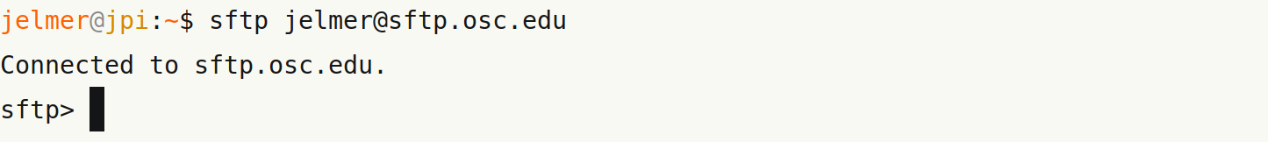
Remote file transfer
Use sftp to establish contact between a local and a remote (OSC) computer:

Slide 12
Remote file transfer
Use sftp to establish contact between a local and a remote (OSC) computer:
Use “put <file> [target-dir]” to upload to remote:
# No target dir specified: goes to home

Slide 13
Remote file transfer
Use sftp to establish contact between a local and a remote (OSC) computer:
Use “put <file> [target-dir]” to upload to remote:
# No target dir specified: goes to home

Slide 14
Remote file transfer
Use sftp to establish contact between a local and a remote (OSC) computer.
Other, even simpler methods include the command “scp” (and “rsync”),
but OSC prefers you to use sftp so as to use nodes specifically reserved for file transfer.

Slide 15
Dependency hell
As you heard in the previous session, many pieces of software have several dependencies, sometimes so many that installation can become tricky
It gets worse: different (versions of) software can have mutually exclusive dependencies – “dependency hell”

Slide 16
Software management in Ubuntu
In Ubuntu, the Advance Package Tool automatically handles
dependencies and updates – for instance with the apt-get command.
# Update package index first
# Install

Slide 17
Software management in Ubuntu
In Ubuntu, the Advance Package Tool automatically handles
dependencies and updates – for instance with the apt-get command.
# Update package index first
# Install
-y: don’t prompt for confirmation
>1 package at once works

Slide 18
Software management in Ubuntu
In Ubuntu, the Advance Package Tool automatically handles
dependencies and updates – for instance with the apt-get command.
# Update package index first
# Install
# Update a package
# Update all packages
# Search for a package

Slide 19
Software management in Ubuntu
In Ubuntu, the Advance Package Tool automatically handles
dependencies and updates – for instance with the apt-get command.
This is very useful, but what if:
    Software isn’t available in the package manager?
    You need a specific (older) version of software?
    You need different versions at different times?
    There are mutually exclusive dependencies for software you all want?

Slide 20
Similarly, at OSC
Using specific versions & version switching is made easy with module
But, when software isn’t installed, lack of admin rights makes software installation at OSC even more challenging than usual...

Slide 21
The alternatives
Two main alternatives:
        conda
        containers (Docker and Singularity)
These alternatives are useful not only at OSC – but more generally, for:
        Reproducible environments
        Portable environments (especially containers)
        Avoidance of dependency hell

Slide 22
conda: a software and environment manager
Creates environments with one (= best-practice) or more software packages
Lots of bioinformatics software is available as a conda package
Handles dependencies but does not require admin rights
Environments are activated and deactivated – much like Lmod at OSC

Slide 23
conda: benefits and limits
Benefits of conda:
    Easy to use specific software versions
    Easy to have multiple versions of the same software available
    Easy to use mutually incompatible software
    Save and share environment instructions
    Not much of a learning curve
    Available at OSC

Slide 24
conda: benefits and limits
Benefits of conda:
    Easy to use specific software versions
    Easy to have multiple versions of the same software available
    Easy to use mutually incompatible software
    Save and share environment instructions
    Not much of a learning curve
    Available at OSC
Limits of conda – it does not:
    Create an isolated environment that can be exported and used anywhere
    Allow running software requiring a different OS / OS version

Slide 25
Using conda
To create a new environment for multiqc, activate it, and install multiqc:
# Load Python+conda module
# Create a new environment
arbitrary environment name

Slide 26
Using conda
To create a new environment for multiqc, activate it, and install multiqc:
# Load Python+conda module
# Create a new environment
arbitrary environment name
# Activate the environment
# Install multiqc

Slide 27
Using conda
To create a new environment for multiqc, activate it, and install multiqc:
# Load Python+conda module
# Create a new environment
arbitrary environment name
# Activate the environment
# Install multiqc
specify “channel” – bioconda has
bioinformatics software
Tells us the conda environment we’re in

Slide 28
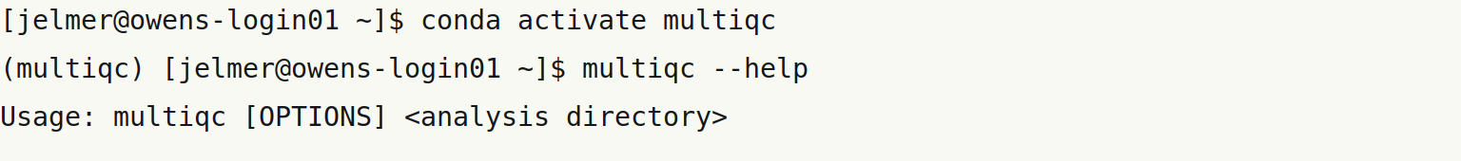
Using conda
To create a new environment for multiqc, activate it, and install multiqc:
# Load Python+conda module
# Create a new environment
arbitrary environment name
# Activate the environment
# Install multiqc

Slide 29
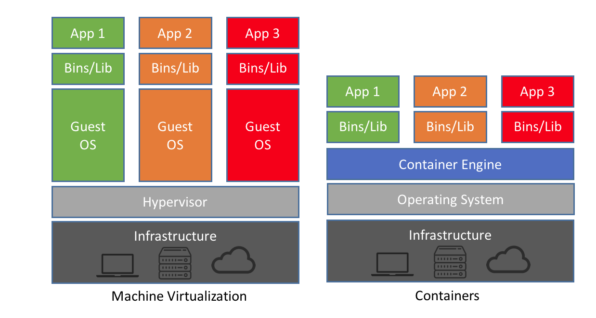
Containers: isolated environment for software
VMs versus containers:
Containers don’t virtualize
entire Operating Systems:
  Containers are smaller
  Containers are more lightweight to run
Use a VM for long interactive sessions with multiple programs
Use a container to run one
or a few programs non-interactively

Slide 30
What can I do with containers
Run an application with complicated stack dependencies in a few keystrokes.
Package a workflow so that it can run on your laptop, in the cloud, and at OSC.
Publish a paper and include a link to a container with all of the data and software.
Create a workflow where different programs run on different operating systems.
After https://github.com/ArangoGutierrez/Singularity-tutorial

Slide 31
Docker versus Singularity
Docker and Singularity are two different container platforms
Docker is by far the most widely used

Slide 32
Docker versus Singularity
Docker and Singularity are two different container platforms
Docker is by far the most widely used
However, Singularity:
      Was specifically designed for HPCs & available at OSC
      Needs no admin rights to run containers
      Can work with Docker images but not vice versa
      Integration with several host directories by default
      Has single-file container images
      Is open-source

Slide 33
Getting a container
Container images for most software can be found at these registries:
      Docker Hub: https://hub.docker.com/
      Sylabs Cloud Library: https://cloud.sylabs.io/
      Biocontainers (for bioinformatics software): https://biocontainers.pro/
If no suitable image is available, you can build your own!

Slide 34
Getting a container
Container images for most software can be found at these registries:
      Docker Hub: https://hub.docker.com/
      Sylabs Cloud Library: https://cloud.sylabs.io/
      Biocontainers (for bioinformatics software): https://biocontainers.pro/
If no suitable image is available, you can build your own!
Container terminology
Image File(s) containing the container application
Container A running container image
Definition file (Singularity)
Dockerfile (Docker)
Recipe to build a container image

Slide 35
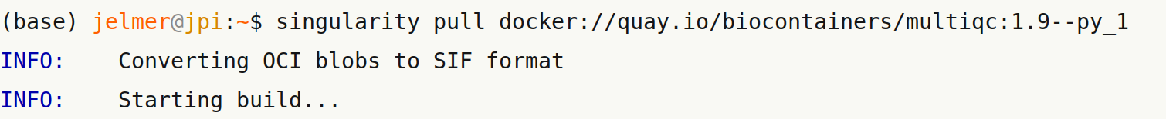
Downloading a container image
Download (“pull”) a container with multiqc:

Slide 36
Downloading a container image
Download (“pull”) a container with multiqc:
Registry://user/project/image-name:image-tag
(version)

Slide 37
Downloading a container image
Download (“pull”) a container with multiqc:
Registry://user/project/image-name:image-tag
(version)
Conversion necessary because it is a Docker image

Slide 38
Downloading a container image
Download (“pull”) a container with multiqc:
# Now we have a “.sif”
# container image

Slide 39
Downloading a container image
Download (“pull”) a container with multiqc:
Download a container from Singularity hub (“shub”):

Slide 40
Running a container
“run” the container (= run the default script):
# In this case, we get a
# terminal inside the container

Slide 41
Running a container
“run” the container (= run the default script):
# In this case, we get a
# terminal inside the container

Slide 42
Running a container
“run” the container (= run the default script):
# In this case, we get a
# terminal inside the container
The shell sub-command always opens a terminal in the container:

Slide 43
Running a container
“run” the container (= run the default script):
# In this case, we get a
# terminal inside the container
The shell sub-command always opens a terminal in the container:
The exec sub-command lets you directly execute a shell command – and exits:

Slide 44
“Containerizing” an analysis / script
Running a locally installed program:
Run the same program using a container:

Slide 45
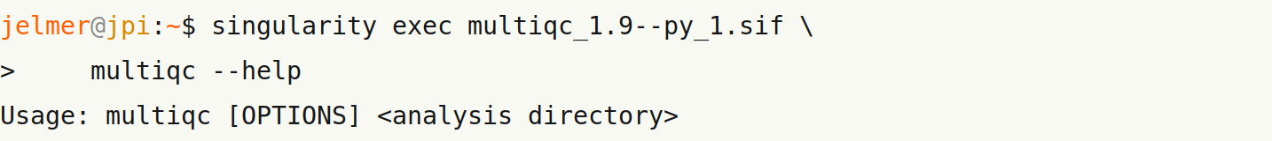
“Containerizing” an analysis / script
Running a locally installed program:
Run the same program using a container:

Slide 46
Building your own container
Building a container does require admin rights –
Need to do this on your own computer or VM with A Linux operating system
    Download a suitable base image (e.g., Ubuntu 20.04)

Slide 47
Building your own container
Building a container does require admin rights –
Need to do this on your own computer or VM with A Linux operating system
    Download a suitable base image (e.g., Ubuntu 18.04)
    Run the image and enter the container in interactive, writeable mode
    Install the required software
    When you exit the container, the image will have been updated

Slide 48
Building your own container
Building a container does require admin rights –
Need to do this on your own computer or VM with A Linux operating system
    Download a suitable base image (e.g., Ubuntu 18.04)
    Run the image and enter the container in interactive, writeable mode
    Install the required software
    When you exit the container, the image will have been updated
    Best-practice – next create a Dockerfile:
          Reproduce commands that worked & were necessary for installation
          Add some metadata and formalities

Slide 49
Recap
sudo, $PATH, and remote file transfer with sftp
Use of apt-get and Lmod (module)
Alternatives to package managers and manual installation:
    conda
    Containers – Singularity for working at HPCs such as OSC

