Slide 1

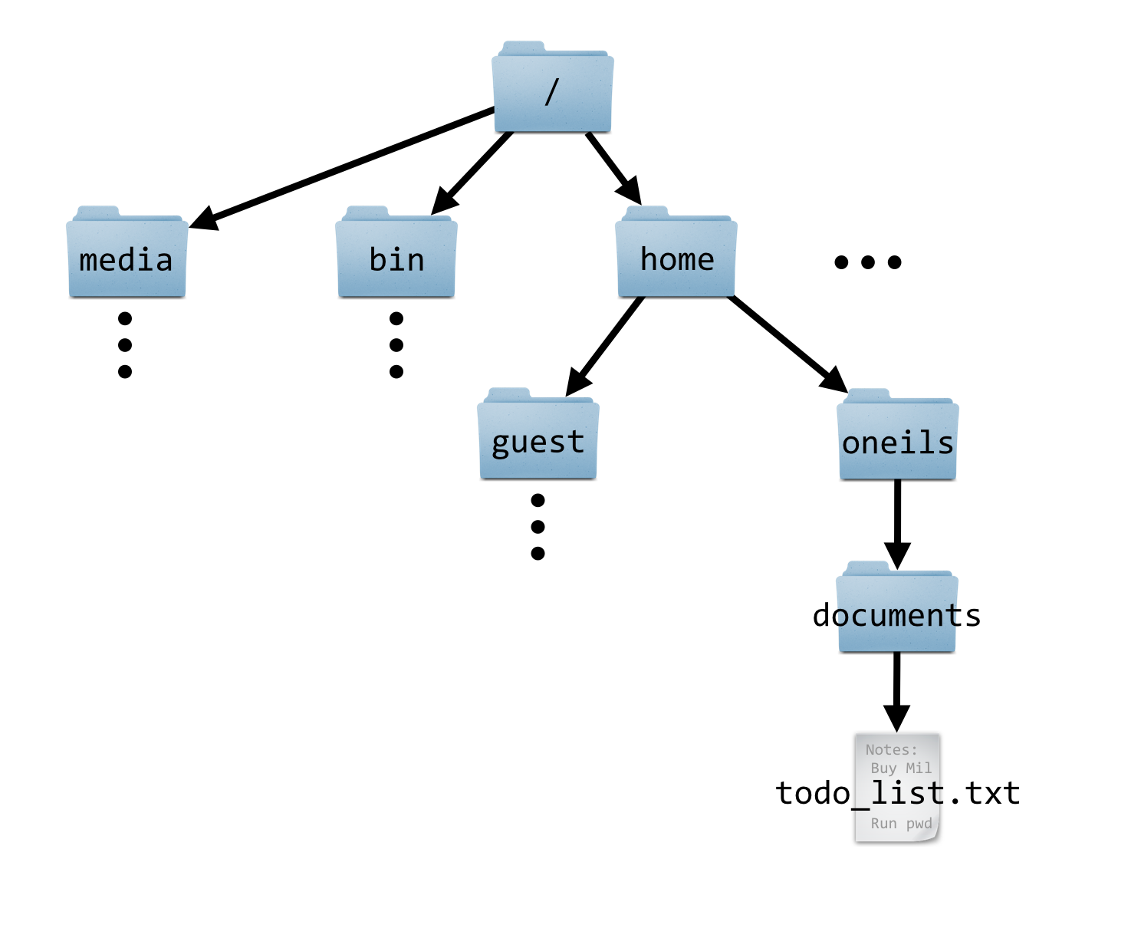
/
fs
users
scratch
ess
PAS2700

