Slide 1
Oracle PL/SQL
Code Review Agent
Standards
DOCX
LLM
Review
LLM-powered code review driven by an external
PL/SQL standards document
PL/SQL
Source
Proof of concept

Slide 2
1. Problem & Opportunity
Why explore AI-assisted PL/SQL review?
Standards are external
Review effort is manual
Context matters
Coding standards can evolve over time.
Hardcoding every review rule creates
maintenance overhead.
Developers and reviewers spend time
checking repetitive standards and explaining
findings.
Some review findings need code context,
an explanation, and a practical
recommendation—not just a pattern match.
Opportunity
• Use an LLM to interpret the supplied standards in the context of PL/SQL code.
• Keep the review policy outside the application code.
• Return structured, actionable findings for developers.
Oracle PL/SQL Code Review Agent | G2E / US Office PoC
2

Slide 3
2. Proposed Solution
A standards-driven PL/SQL review workflow
1
Upload Standards
2
Provide PL/SQL
3
Extract Standards
4
LLM Review
5
Structured Findings
Core design principle
The standards document is read at review time and passed to the LLM as context.
Result: standards can change without changing the Python code.
Oracle PL/SQL Code Review Agent | G2E / US Office PoC
3

Slide 4
3. PoC Architecture
What each component is responsible for
standards_reader.py
Read DOCX
Standards
DOCX
llm_reviewer.py
Build review context
Groq LLM
Structured JSON
Streamlit
Dashboard
rule_extractor.py
Create StandardRule[]
PL/SQL
Source
Structured output fields include Rule ID, severity, line, code, issue, standard and recommendation.
Oracle PL/SQL Code Review Agent | G2E / US Office PoC
4

Slide 5
4. Technologies Used
- Python
- Streamlit
- Oracle PL/SQL
- Groq API
- Large Language Model (openai/gpt-oss-120b)
- python-docx
Oracle PL/SQL Code Review Agent | G2E / US Office PoC
4

Slide 6
4. Live Demo
The strongest proof point: change the standard, not the application
Scenario A — Standard V1
Result
Scenario B — Standard V2
DOCX says:
Local Variable → l_
Code uses:
l_employee_name
No violation
Same Python, same PL/SQL
Code complies with the standard.
DOCX changes:
Local Variable → lv_
Same code remains:
l_employee_name
Observed result after changing only the DOCX
Violation detected
The LLM flags l_employee_name against the new lv_ standard and recommends a fix.
Key message: policy change → review behavior change → no Python code change.
Oracle PL/SQL Code Review Agent | G2E / US Office PoC
5

Slide 7
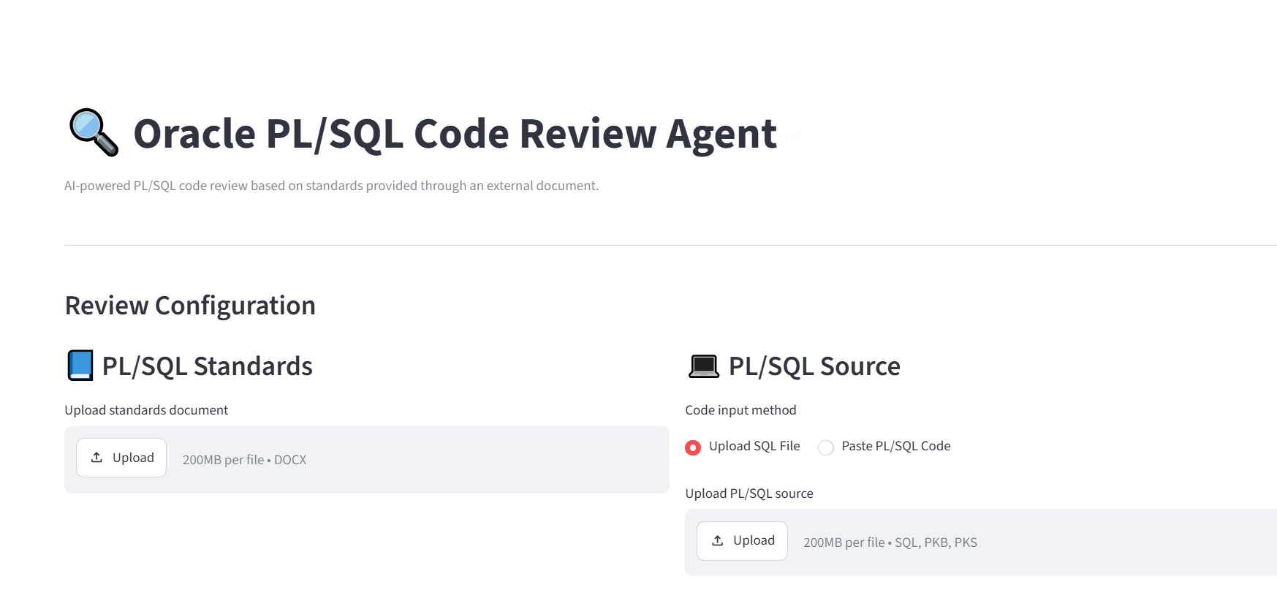
4.1 Demo — Upload standards
Oracle PL/SQL Code Review Agent | G2E / US Office PoC
6

Slide 8
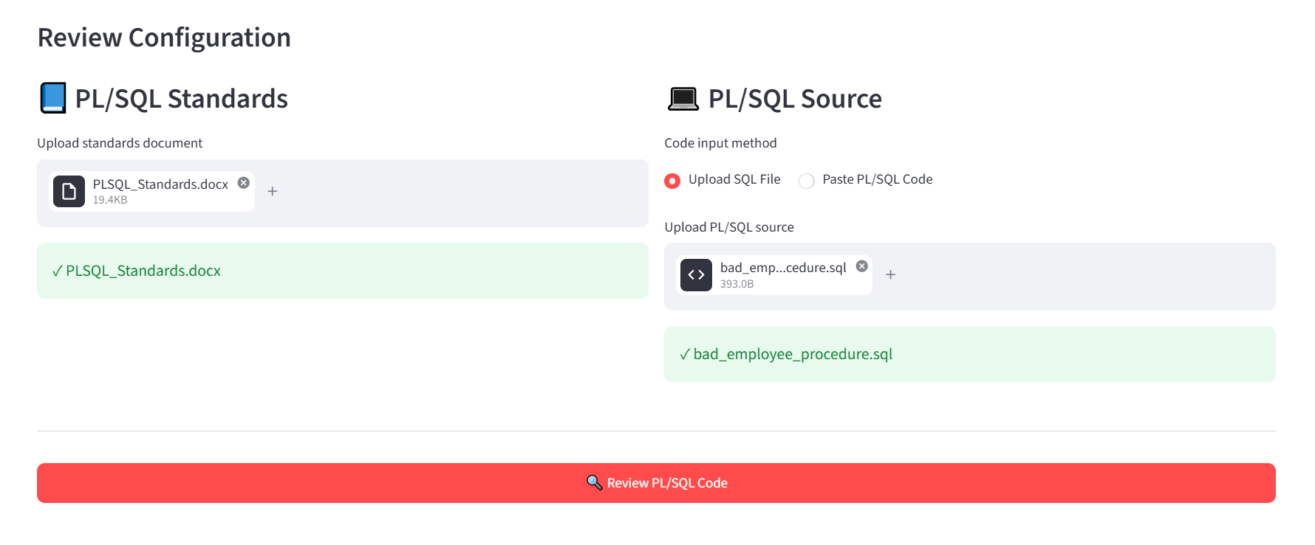
4.2 Demo — Review a PL/SQL file
Oracle PL/SQL Code Review Agent | G2E / US Office PoC
7

Slide 9
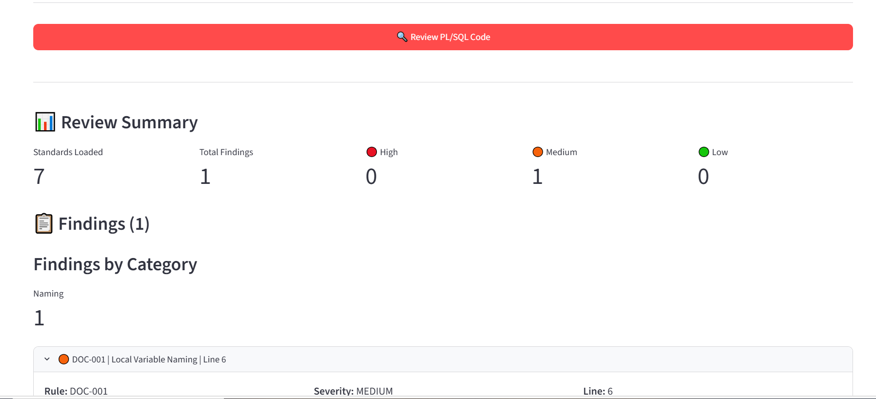
4.3 Demo — Findings dashboard
Oracle PL/SQL Code Review Agent | G2E / US Office PoC
8

Slide 10
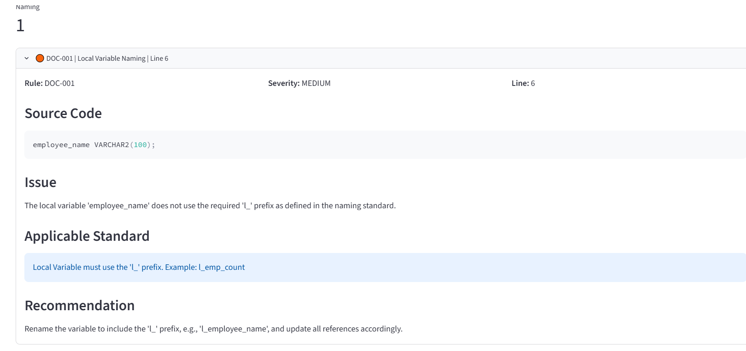
4.4 Demo — Standard changed, violation raised
Oracle PL/SQL Code Review Agent | G2E / US Office PoC
9

Slide 11
5. Review Output
Actionable findings rather than a generic pass/fail
Standards Loaded
7
Total Findings
3
High
0
Medium
3
Low
0
DOC-003 | MEDIUM | Line 2
Parameter 'employee_id' does not use the required p_ prefix.
Recommendation: rename to p_employee_id.
DOC-001 | MEDIUM | Line 6
Local variable 'employee_name' does not use the required prefix.
Recommendation is tied to the standard supplied in the document.
DOC-001 | MEDIUM | Line 7
Local variable 'bad_count' is reported with its source line and recommendation.
Oracle PL/SQL Code Review Agent | G2E / US Office PoC
10

Slide 12
6. Why an LLM?
Where LLM-based review adds value
Rule-based checks
LLM-based review
Future hybrid option
Strong for deterministic patterns:
• Naming conventions
• Simple syntax/pattern validation
• Fast and predictable
Useful when the rule needs context:
• Interpret the supplied standard
• Explain why code violates it
• Generate practical recommendations
Production can combine both:
• Deterministic checks for certainty
• LLM for contextual review and explanation
PoC choice
Review logic stays LLM-driven so policy changes need only a document edit.
Oracle PL/SQL Code Review Agent | G2E / US Office PoC
11

Slide 13
7. Guardrails & Limitations
What the PoC does—and what it does not claim
Grounding
Structured output
Human review
Use only the supplied standards; cite a Rule ID for every finding.
A strict JSON schema gives the dashboard a predictable result contract.
An assistant, not an approval gate. Findings are validated by a reviewer.
Known PoC limitations
• LLMs can still make incorrect judgments; evaluation and test suites are required.
• The current document parser is tailored to the prototype standards format.
• Confidential source code requires an approved/private model and security architecture before production.
Oracle PL/SQL Code Review Agent | G2E / US Office PoC
12

Slide 14
8. Future Production Architecture
A path from PoC to an internal developer capability
Standards
Repository
Deterministic
Checks
Review Engine
Findings +
Audit
Developer / SVN
PL/SQL
Parser
Private / Approved
LLM
Potential next steps
• Use approved internal/private model and enterprise security controls.
• Build a representative PL/SQL evaluation dataset and measure precision/recall-style quality metrics.
• Integrate with SVN for developer feedback before merge.
Oracle PL/SQL Code Review Agent | G2E / US Office PoC
13

Slide 15
9. Business & Developer Value
What this could enable if the PoC is productized
Consistency
Developer productivity
Maintainability
Documented standards applied the same way across all PL/SQL work.
Less repetitive review effort, with instant explanations.
Change standards centrally, never inside application code.
Potential long-term extension
• Extend beyond naming conventions into contextual SQL, exception-handling, performance and security standards.
• Use repository history and review feedback to improve evaluation and developer guidance.
• Provide review results through IDE, pull-request or CI/CD integrations.
Oracle PL/SQL Code Review Agent | G2E / US Office PoC
14

Slide 16
10. Key Takeaway
The PoC demonstrates a practical path to
AI-assisted PL/SQL development.
Externalized standards • LLM reasoning • Structured findings • Human-in-the-loop
Next: validate on real code, strengthen security, plan workflow integration.
Thank you
Oracle PL/SQL Code Review Agent | G2E / US Office PoC
15

