Slide 1


Air Quality Prediction in Urban Areas
College: Acharya Institute of Graduate Studies
Student names :Jelvin Soji(U18AJ22S0393)
Abhinanth S Pillai(U18AJ22S0409)
Austine Siby(U18AJ22S0303)
Aswindev MD(U18AJ22S0393)

Slide 2
Problem Statement
Brief Overview:
Air pollution is a growing concern in urban areas, posing significant risks to public health and the environment. Traditional air quality monitoring systems rely on physical sensors, which have limited coverage and real-time reporting constraints. To address these challenges, this project leverages machine learning to predict air quality based on historical data, weather conditions, and traffic patterns. By accurately forecasting pollution levels such as PM2.5, PM10, NO2, CO, and AQI, the system aims to provide timely insights that help city officials, environmental agencies, and the public take proactive measures to reduce pollution and safeguard health.
Key Objectives:
Develop a predictive model to forecast air quality using machine learning.
Utilize historical data, weather, and traffic patterns for accurate predictions.
Enhance real-time monitoring beyond traditional sensor limitations.
Provide actionable insights for city officials and environmental agencies.
Improve public awareness and preparedness for air pollution risks.

Slide 3
Dataset Overview
Dataset Description:
The dataset contains 30 days of air quality data, including pollution levels, weather conditions, and traffic patterns. Each row represents a daily observation with the following attributes.
Date – The recorded date of the observation.
PM2.5 – Fine particulate matter (≤2.5 µm), a key air pollutant.
PM10 – Coarse particulate matter (≤10 µm), affecting air quality.
NO2 – Nitrogen Dioxide levels, a major urban pollutant.
CO – Carbon Monoxide concentration in the air.
Temperature – Ambient temperature in degrees Celsius.
Humidity – Percentage of moisture in the air.
Traffic – Estimated traffic density, which influences pollution levels.
AQI – Air Quality Index, an overall measure of pollution severity.
Source :
www.Kaggle.com

Slide 4
Methodology
Approach:
This system follows a machine learning workflow to predict air quality based on uploaded data. The methodology includes:
Data Processing: Users upload a dataset, missing values are handled, and data is standardized.
Model Training: A Random Forest Regressor is trained on selected features and saved.
Evaluation: Model accuracy is checked using MAE and R² Score, and feature importance is displayed.
Prediction: Users input values, and the model predicts air quality in real time.

Slide 5
Algorithms Used:
Data Preprocessing Algorithms
Handling Missing Data → dropna() (removes empty values) or fillna(df.mean()) (fills missing values).
Feature Scaling → StandardScaler() (standardizes data for better model performance).
Train-Test Split → train_test_split() (splits data into 80% training and 20% testing).
Machine Learning Model
Random Forest Regressor → An ensemble learning algorithm that combines multiple
decision trees for accurate air quality prediction.
Model Evaluation MetricsMean Absolute Error (MAE) → Measures prediction accuracy.
R² Score → Measures how well the model explains variations in air quality.

Slide 6
Source Code

Slide 7
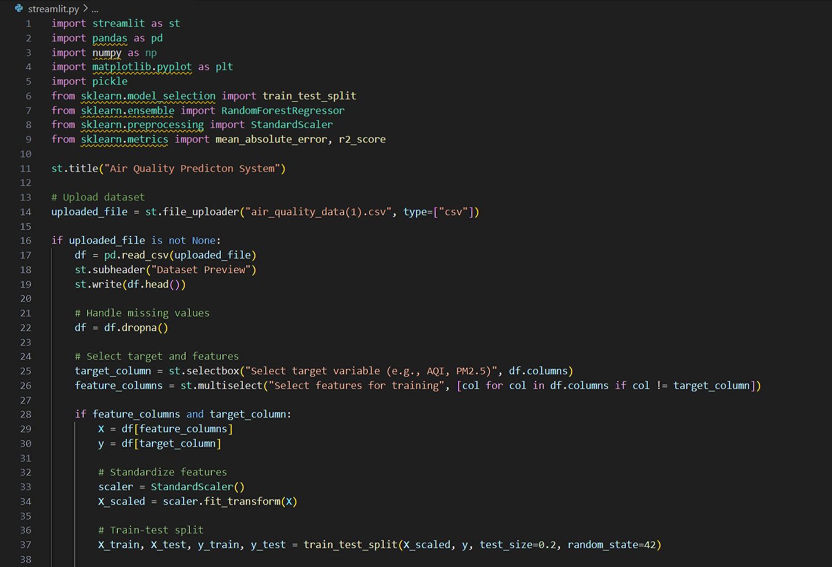

Slide 8
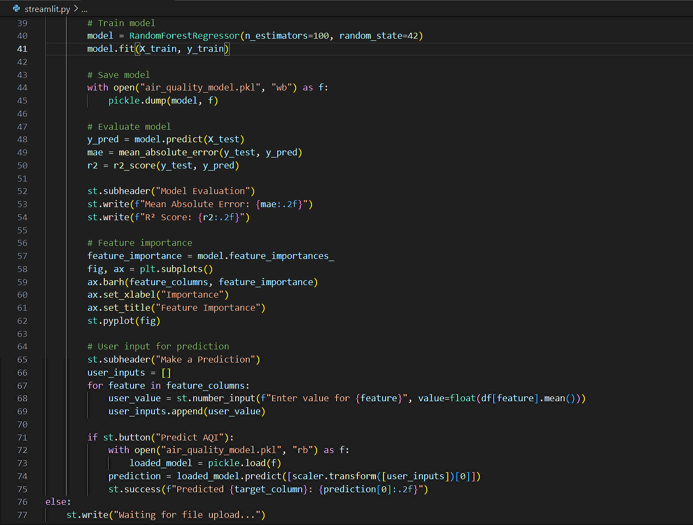

Slide 9
Output

Slide 10
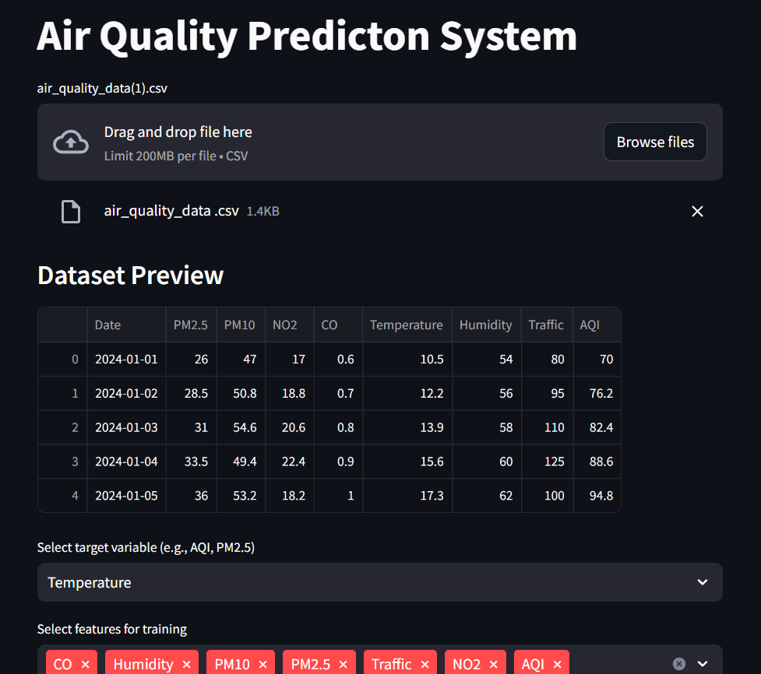

Slide 11
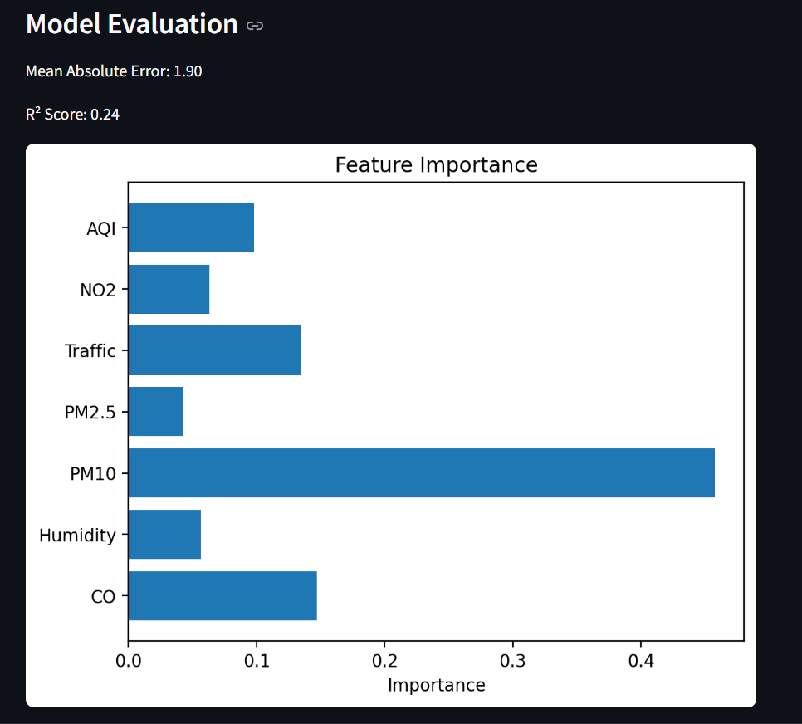

Slide 12
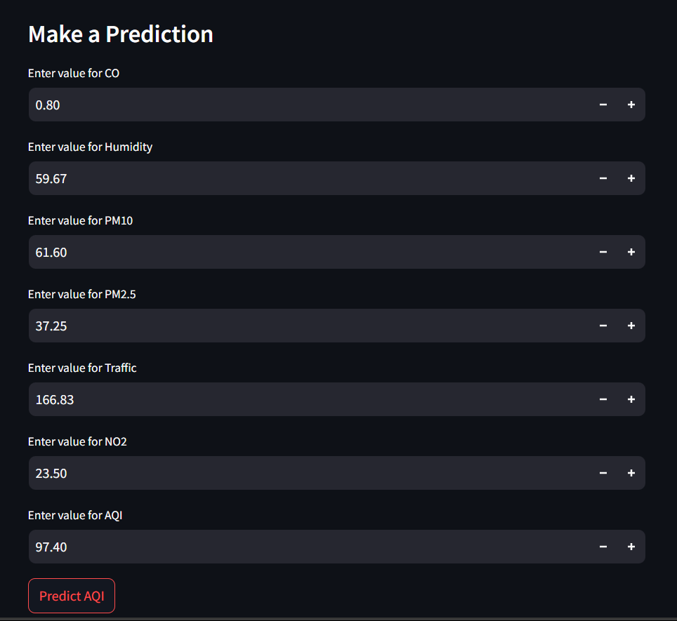


Slide 13

Conclusion
Summary:
This project utilizes machine learning to predict air quality levels in urban areas based on pollution, weather, and traffic data. By using Random Forest Regression, the model provides accurate AQI forecasts, helping authorities and the public take proactive measures. The Streamlit dashboard allows users to visualize trends and make real-time predictions.
Future Work: With proper data preprocessing, feature selection, and evaluation, the model ensures reliability. Future improvements can include real-time data integration, deep learning models (LSTMs), and expanded datasets for better accuracy and scalability. This project offers a data-driven solution to mitigate air pollution and promote public health awareness.

Slide 14
References
www.Kaggle.com
https://scikit-learn.org/stable/documentation.html

Slide 15
Thank You
Notes:
Thank You !!

