Slide 1


ARCH LINUX
Steven Alejandro Sánchez López – 160004734
Daniel Ricardo Montero Carrillo – 160004719
2023
BASIC SCIENCES AND ENGINEERING FACULTY
Course: Operating Systems [603402]
Tel: (8)6616800 Ext. 124 Fax: (8)6616800 Ext. 141
http://fcbi.unillanos.edu.co
Basic Sciences and Engineering Faculty.
University of los Llanos.

Slide 2
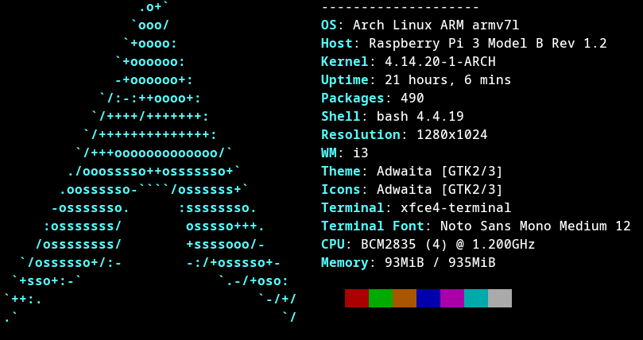
INTRODUCTION
Do you know that with Arch Linux you can configure everything to your style and have the most recent version of all software that won't break your system?
It targets competent Linux users by giving them complete control and responsibility over the system.
Keep It Simple, Stupid!
2
Basic Sciences and Engineering Faculty.
University of los Llanos.

Slide 3
HARDWARE REQUIREMENTS
The ISO download image burned to a CD, written to a USB flash drive or mounted on a virtual machine [1].
Internet connection to download packages.
Command Line Interface
Graphic User Interface
Compatible machine of more than 512 MB RAM.
A basic installation should take less than 2 GB of disk space.
Compatible machine with a minimum of 1000 - 2000 MB RAM
A basic installation should take 10 – 20 GB of disk space.
3
Basic Sciences and Engineering Faculty.
University of los Llanos.

Slide 4
SUPPORTED HARDWARE
Arch Official Distribution
Arch-Based Distributions
The x86_64
Supports up to 16 EB of RAM and its 64 bits bus allows parallel transmit of large data amounts [2].
Both 32-bit and 64 bit software
Desktops, Laptops and Servers
ARMv7 (Arch Linux ARM)
Embedded systems and Single Board Computers
I686 (Arch Linux 32)
Older desktop computers and some embedded systems
……[3]
Supported
Not Supported
4
Basic Sciences and Engineering Faculty.
University of los Llanos.

Slide 5

TECHNICAL FEATURES
Rolling Release
Arch Linux is based in the Linux kernel (6.2.8) (Monolithic Kernel). [5]
Support EXT2 / EXT3 / EXT4 / XFS / JFS file systems. [6]
Arch Linux uses the GNU Compiler Collection (GCC). [7]
Shell (Bash, Dash, Zsh, ksh).
Use grub as a bootloader
X Windows System
Pacman is the package manager of Arch Linux.
Pacman is able to automatically download, install all the necessary packages and .pkg.tar.xz is its packaging format. [4]
5
Basic Sciences and Engineering Faculty.
University of los Llanos.

Slide 6
FUNCTIONAL APPROACH
Defines simplicity as without unnecessary additions or modifications.
Design decisions are made on a case-by-case basis through developer consensus.
The distribution is intended for experienced GNU/Linux users, or anyone with a do-it-yourself attitude who is willing to read the documentation and solve problems themselves.
Encourage users to perform most of the system configurations from the shell and a text editor [8].
6
Basic Sciences and Engineering Faculty.
University of los Llanos.

Slide 7






APPLICATIONS AND SERVICES
Internet | Multimedia | Utilities
Network Connection Web Browsers Web Servers | Codecs Image, Audio and Video Media Servers | Terminal Files Development
Documents | Security | Science
Text Editors Office Markup Languages | Network Security Firewall Management Cryptography | Mathematics Physics Chemistry [9]
7
Basic Sciences and Engineering Faculty.
University of los Llanos.

Slide 8

LICENSE
Archlinux is a GNU system.
GNU is entirely free software.
Has a GPL (General Public License).
8
Basic Sciences and Engineering Faculty.
University of los Llanos.

Slide 9


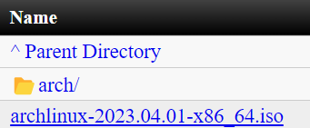
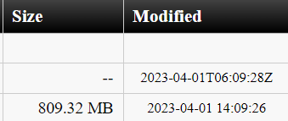
ACQUISITION METHODS AND COST
Download Section
HTTP downloads
ISO file
[10]
9
Basic Sciences and Engineering Faculty.
University of los Llanos.

Slide 10
ADVANTAGES
The Arch allows you to develop your OS to your taste. If you are able to achieve this, you will end up with a system that will be able to do exactly as you wish.
The Arch Wiki is a super library of everything you need to know about the installation and maintenance of every component in the Linux system.
The AUR is maintained by users who compile and install packages. Users can vote on packages which give them higher rankings that make them more visible.
Archinstall is a helper library which automates the installation. It is packaged with different pre-configured installers, such as a "guided" installer [11].
10
Basic Sciences and Engineering Faculty.
University of los Llanos.

Slide 11
DISADVANTAGES
The installation of the operating system is a complicated process
You must know your hardware.
You will need to have an understanding of various terminal commands and the components you will be working with since you are to pick them yourself [12].
Arch is only officially supported with x86_64 architecture.
11
Basic Sciences and Engineering Faculty.
University of los Llanos.

Slide 12

DEVELOPER
Judd Vinet, a Canadian programmer, began developing Arch Linux in early 2001. Its first formal release, Arch Linux 0.1, was on March 11, 2002
Aaron Griffin, an American programmer, managed the project during the growth of the operating system.
The people in charge of the development of Arch Linux is the community itself, anyone is free to join and contribute their ideas for the operating system.
Here we can see the list of the most important developers of the Arch Linux project: https://archlinux.org/people/developers/
12
Basic Sciences and Engineering Faculty.
University of los Llanos.

Slide 13
CHRONOLOGY OF VERSIONS
Versions | Release Date | Description
0.1 | 11/03/2002 | Frist version
0.5 | 21/06/2003 | PAM, GRUB support
2007.05 | 16/05/2007 | Pacman 3.0
2008.06 | 25/06/2008 | USB availability
2009.08 | 10/08/2009 | Pacman 3.3
2010.05 | 17/05/2010 | Dual image availability
2017.01.25 | 25/01/2017 | X86_32 support ends
2023.04.01 | 2023/04/01 | Pacman 6.0.2-6, PAM 1.5.2-2
13
Basic Sciences and Engineering Faculty.
University of los Llanos.

Slide 14

OFFICIAL WEBSITE
The official website is https://archlinux.org/, In it, we can:
Download the operating system.
Report or help to fix bugs.
Download or see how to create packages.
Interact with the community exchanging opinions in the forums, mailing lists or IRC channels
Search information or improve documentation
14
Basic Sciences and Engineering Faculty.
University of los Llanos.

Slide 15
COMPARISON WITH DEBIAN
15
Basic Sciences and Engineering Faculty.
University of los Llanos.

Slide 16
REFERENCES
1. “Arch Linux Downloads - Download.” https://archlinux.org/download/
2. “x64 vs. x86: Key Differences.” https://wiki.archlinux.org/index.php/installation_guide
3. “Arch Based Distributions.” https://wiki.archlinux.org/title/Arch-based_distributions
4. “pacman - ArchWiki.” https://wiki.archlinux.org/index.php/pacman
5. “Kernel - ArchWiki.” https://wiki.archlinux.org/index.php/Kernel
6. “File systems - ArchWiki.” https://wiki.archlinux.org/index.php/file_systems
7. “GNU Compiler Collection - ArchWiki.” https://wiki.archlinux.org/index.php/GNU_Compiler_Collection
8. “Arch Linux” https://wiki.archlinux.org/title/Arch_Linux
9. “List of Applications” https://wiki.archlinux.org/title/Arch-based_distributions
10. “Arch Linux Downloads” https://archlinux.org/download/
11. “archinstall” https://wiki.archlinux.org/title/archinstall
12. “Why is Arch Linux So Challenging and What are its pros and cons” https://www.fossmint.com/why-is-arch-linux-so-challenging-what-are-pros-cons/
16
Basic Sciences and Engineering Faculty.
University of los Llanos.

Slide 17

.
QUESTIONS!
17
Basic Sciences and Engineering Faculty.
University of los Llanos.
Notes:
17

Slide 18

.
THANKS FOR YOUR ATTENTION!
18
Basic Sciences and Engineering Faculty.
University of los Llanos.
Notes:
18

