Slide 1
Introduction to Big Data Programming Models
Big data programming models define how data is processed, stored, and analyzed in distributed environments. They abstract infrastructure complexities and enable developers to focus on writing scalable, high-performance code.

Slide 2
Purpose and Importance of Programming Models
Programming models provide the computational backbone for big data systems. They support parallelism, fault tolerance, data distribution, and the 5 Vs of big data. Examples include MapReduce, DAG, and NoSQL systems.

Slide 3
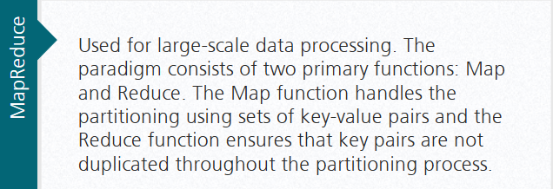
MapReduce Programming Model

Slide 4
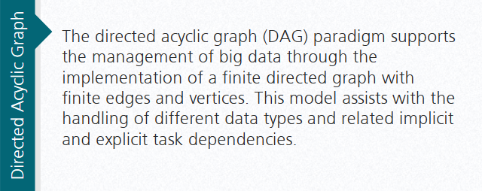
Directed Acyclic Graph (DAG) Programming Model

Slide 5
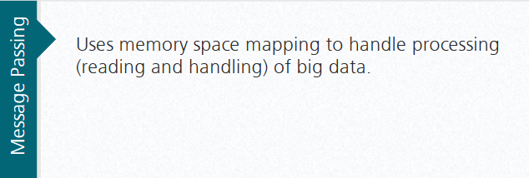
Message Passing Programming Model

Slide 6
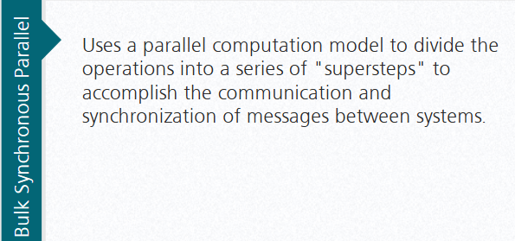
Bulk Synchronous Parallel Programming Model

Slide 7
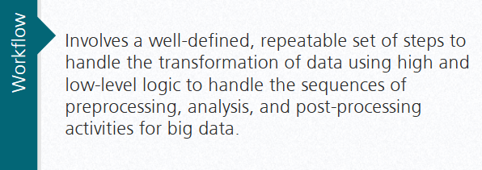
Workflow Programming Model

Slide 8
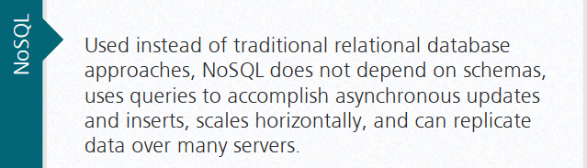
NoSQL Programming Model

