Slide 1
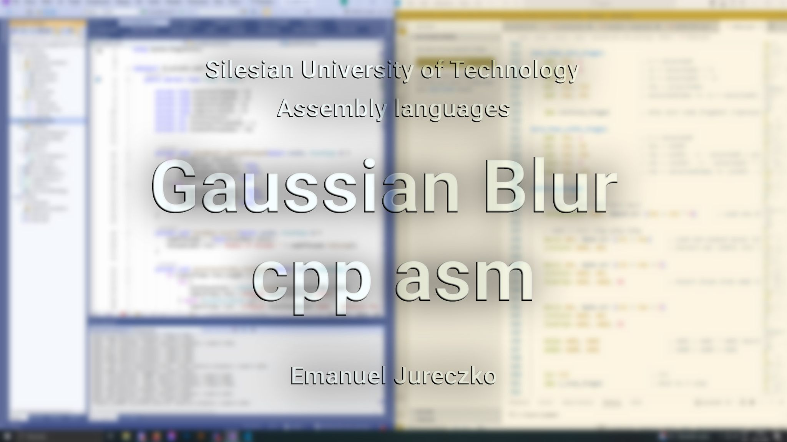

Slide 2

Agenda
Gaussian blur explanation and visualization
Cpp implementation
Multithreading issue
Desktop application
Cpp & Asm performance
Observations and conclusions

Slide 3

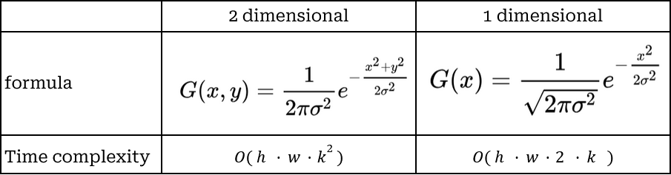
Gaussian blur explanation
Image-blurring filter that uses a Gaussian function for calculating the transformation applied to each pixel
Using 2 dimensional or 1 dimensional kernel
h - image height
w - image width
k - kernel size

Slide 4



Separable Convolution Method
Using a 1 dimensional kernel going through all pixels of the image two times. Ones horizontally, ones vertically (kernel flipped 90°) on the result of the previous transformation.
Just a visualization. The actual pipeline is on the next slide.
+
=
only horizontal
only vertical
outcome
Catfish image - https://rybyswiata.pl/ryby-slodkowodne/sum-smazony-czy-pieczony/

Slide 5

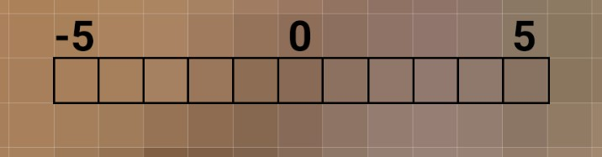

Process explanation
horizontal blur
Kernel of size = 11
Kernel is an array of uneven elements. Each cell contains a floating-point number calculated from the Gauss formula, where - sigma must be given as a parameter - x is the "index" of the cell (e.g. -5 ... 5) and later normalised.
- Standard deviation (sigma) to kernel size relation
vertical blur

Slide 6
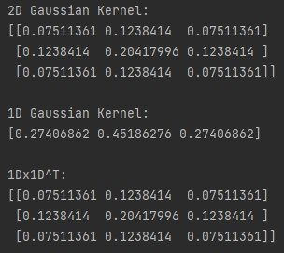

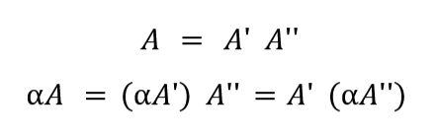
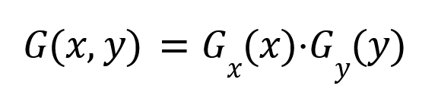
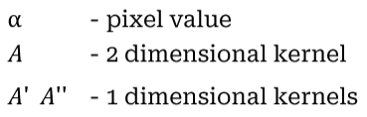
Why does 1 dimensional kernel work?
Simple but sufficient answer
Mathematically
Additional explanation

Slide 8
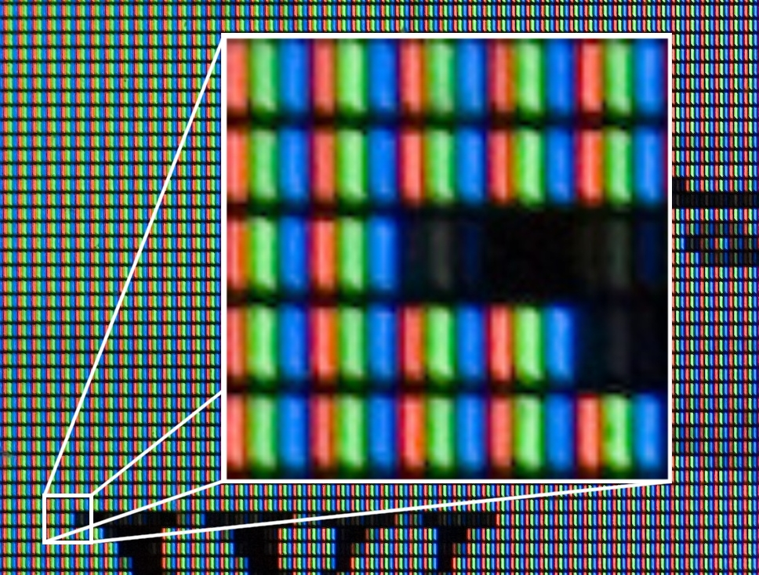
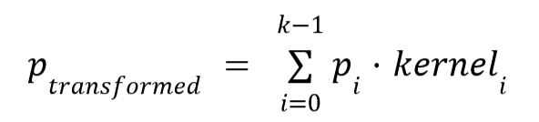
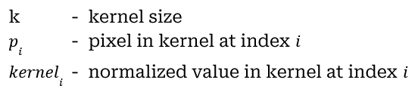
Transformation
Is performed on each pixel element (RGB values)
Authors User:Diliff, User:Ravedave - User:Diliff, CC BY 2.5, https://commons.wikimedia.org/w/index.php?curid=2896827

Slide 9
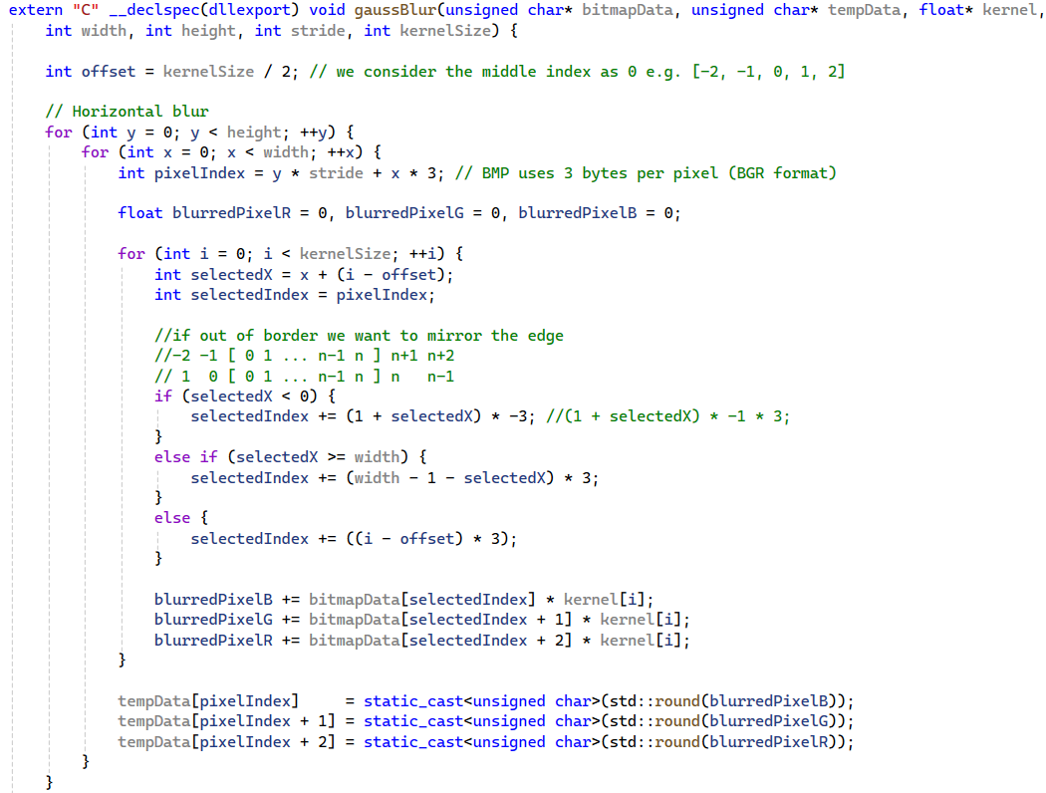
Code 1/2
This is an implementation of a Gaussian blur in cpp, adapted for use with a single thread. The implementation of multithreading introduces minor alterations to the boundary-checking process.

Slide 10
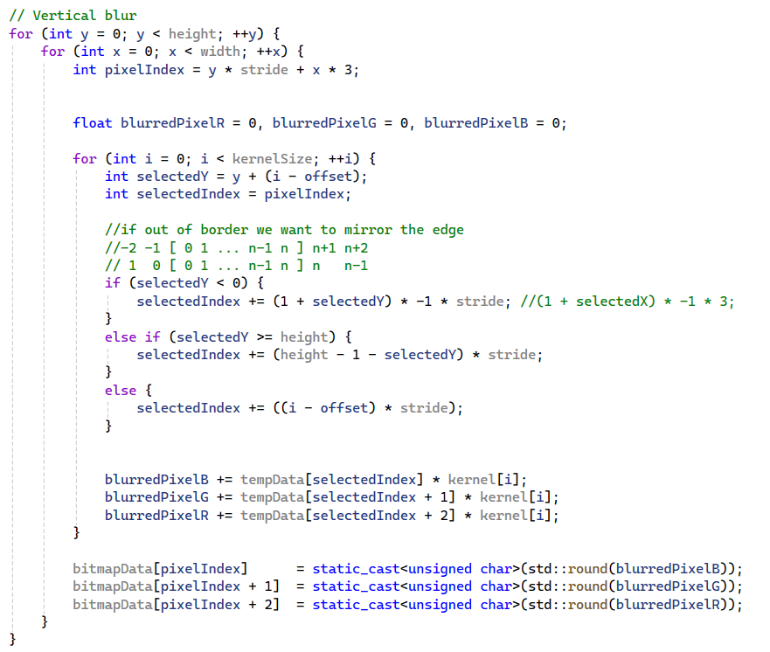

Code 2/2

Slide 11
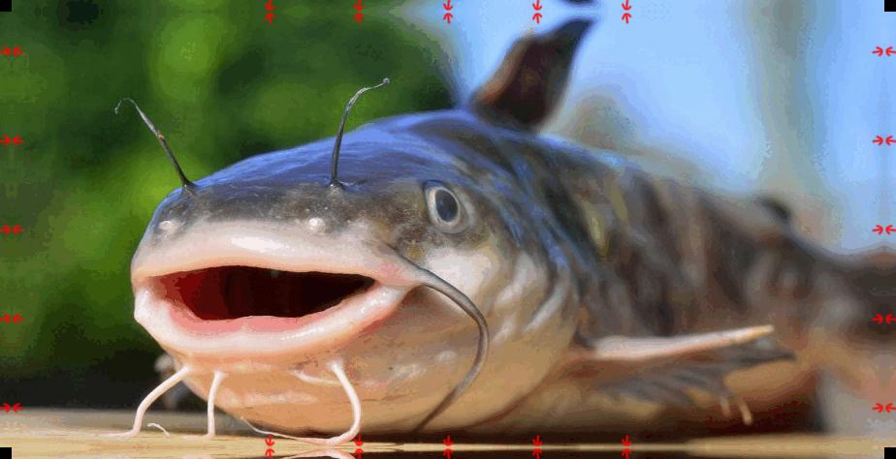
Out of boundary handling visualization
Once over the image edge, pixels are being mirrored.

Slide 12
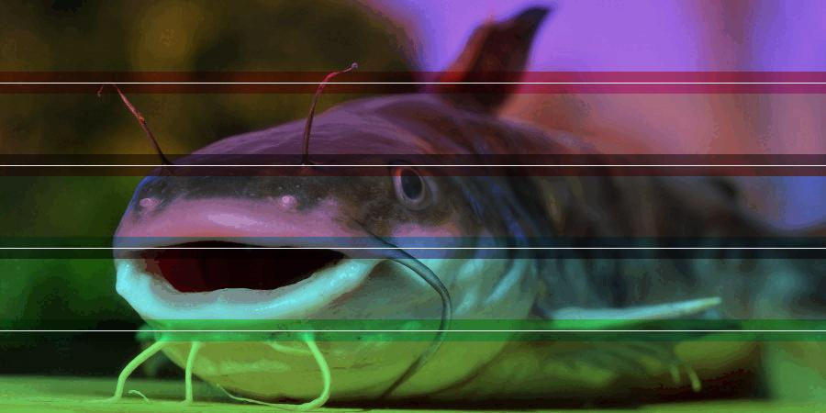
Multithreading issue
While each thread writes data in distinct area, they also read data from neighbouring areas. It must be ensured that no thread while performing the 2nd stage (vertical blur) reads a neighbouring area pixel that has not undergone transformation.
The image is split into sub-images. White lines represent borders. More saturated areas represent pixels accessed by neighbouring threads

Slide 13
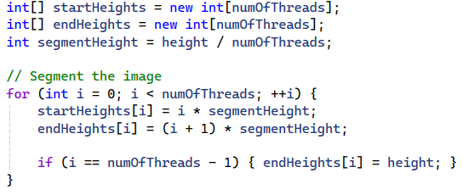
Segmentation

Slide 14

Solution
Stage 1 - horizontal blur
Before starting stage 2 every thread must complete stage 1. While losing time by waiting for the slowest thread, time is saved by not needing to supervise neighbour areas data access.
Wait for all threads
Stage 2 - vertical blur

Slide 15
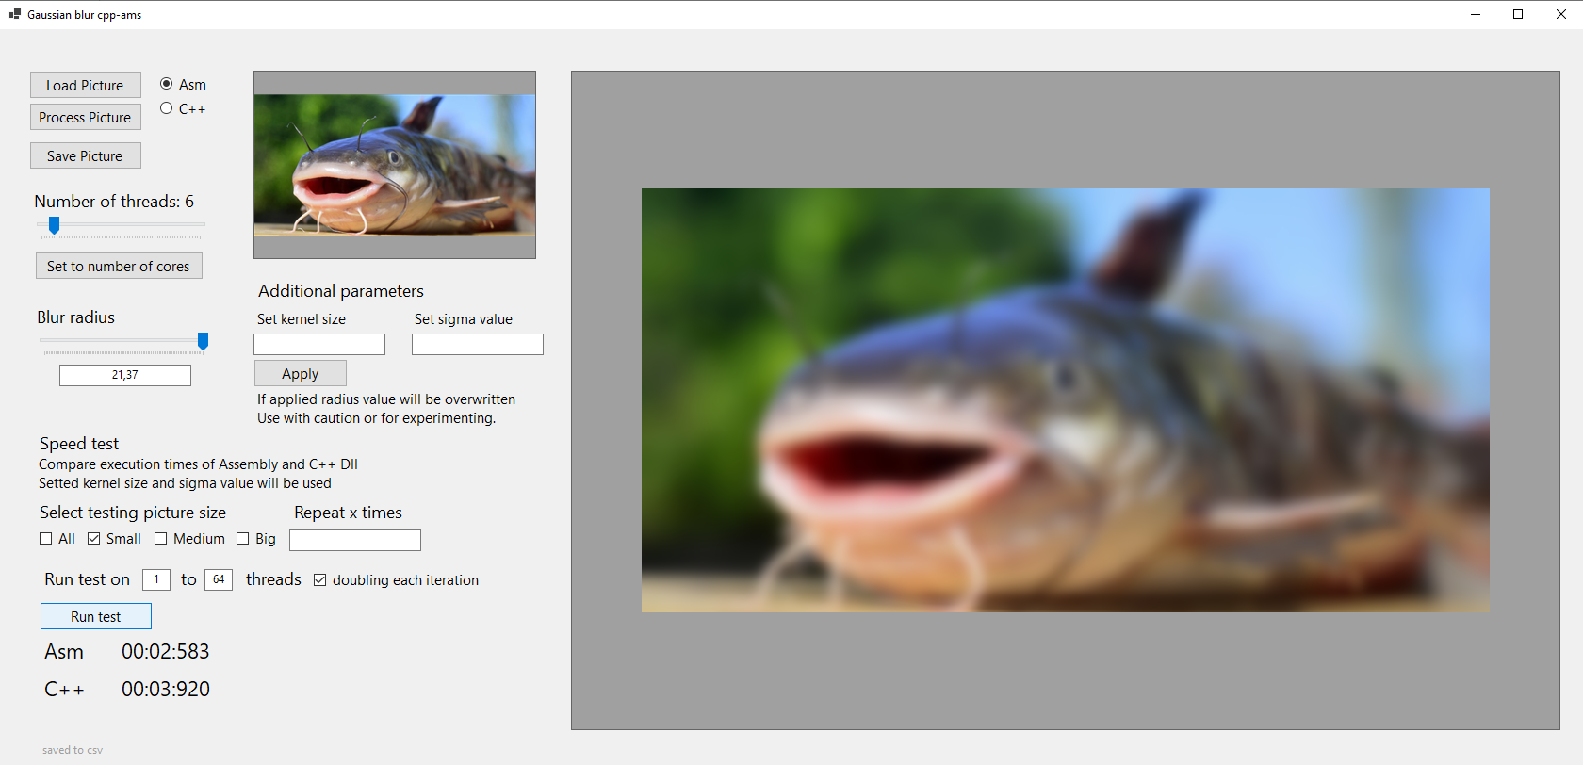
Desktop application

Slide 16
Functionality
Applying Gaussian blur
Adjusting blur settings
Saving blurred image
Selecting number of threads to be used
Choosing implementation between cpp and asm
Performing a speed test between implementations
Saving test result in csv files

Slide 17
Cpp & Asm performance
Cpu used for measurements
Name AMD FX(tm)-6300 Six-Core Processor Number of cores 3 Number of logical processors 6
Test data size
small 900x450 medium 2600x1462 big 4624x3472
Cpp optimization
Maximize Speed (/O2)

Slide 18
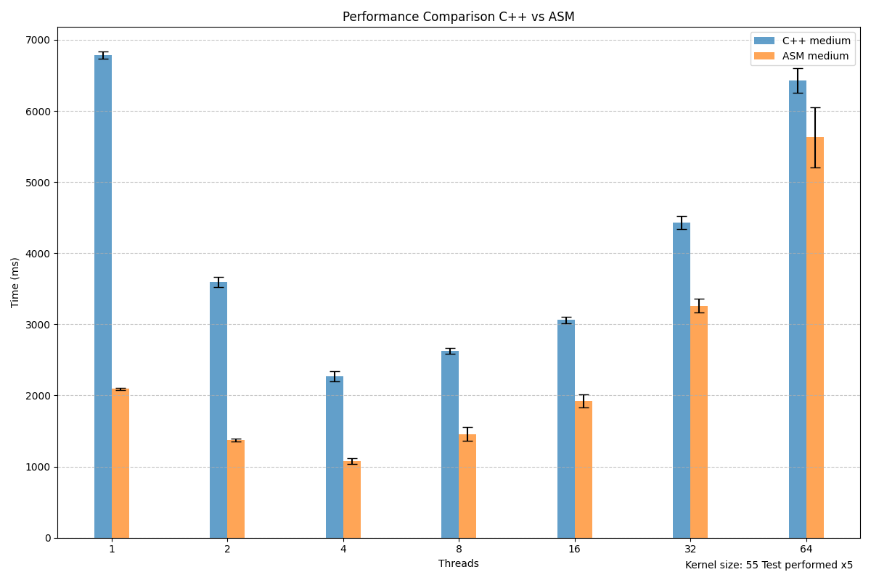
Medium data 1 - 64 threads

Slide 19
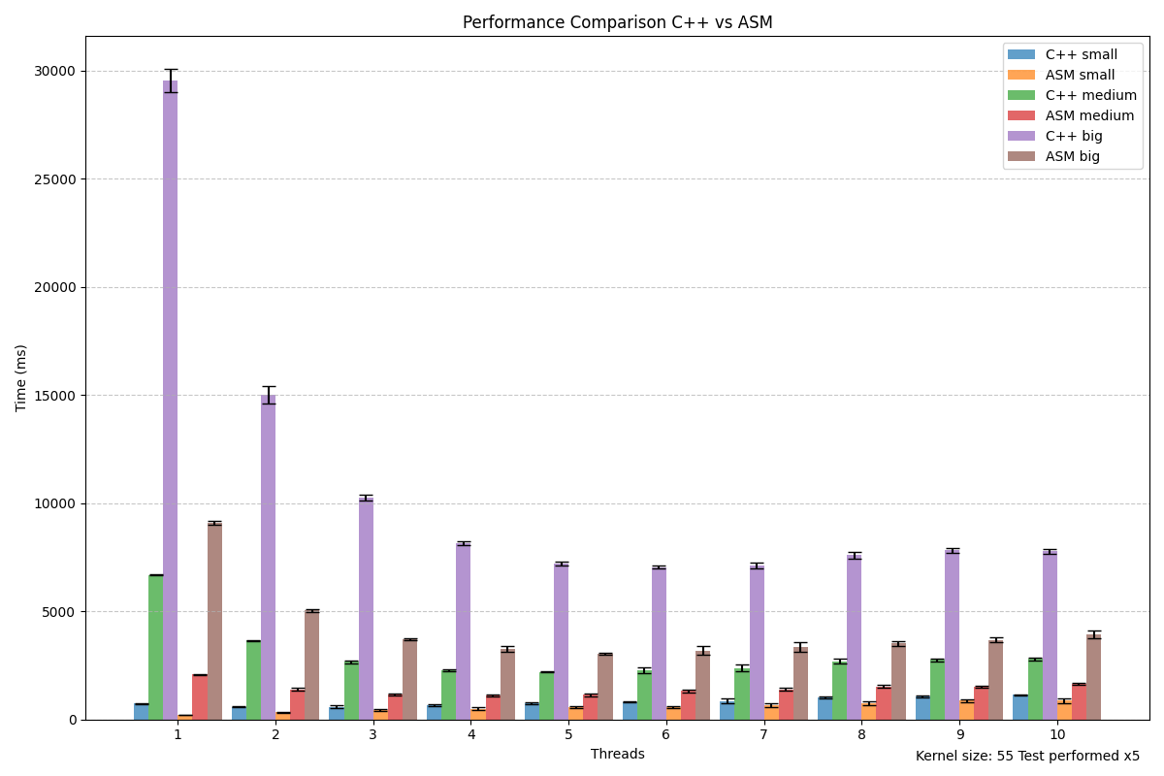
Big, medium, small data 1 - 10 threads

Slide 20
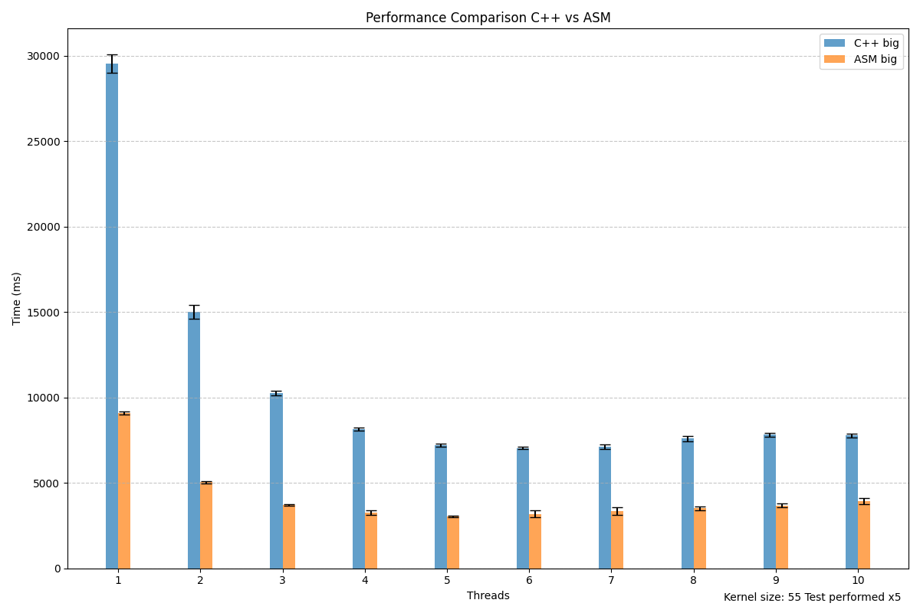
Big data 1 - 10 threads

Slide 21
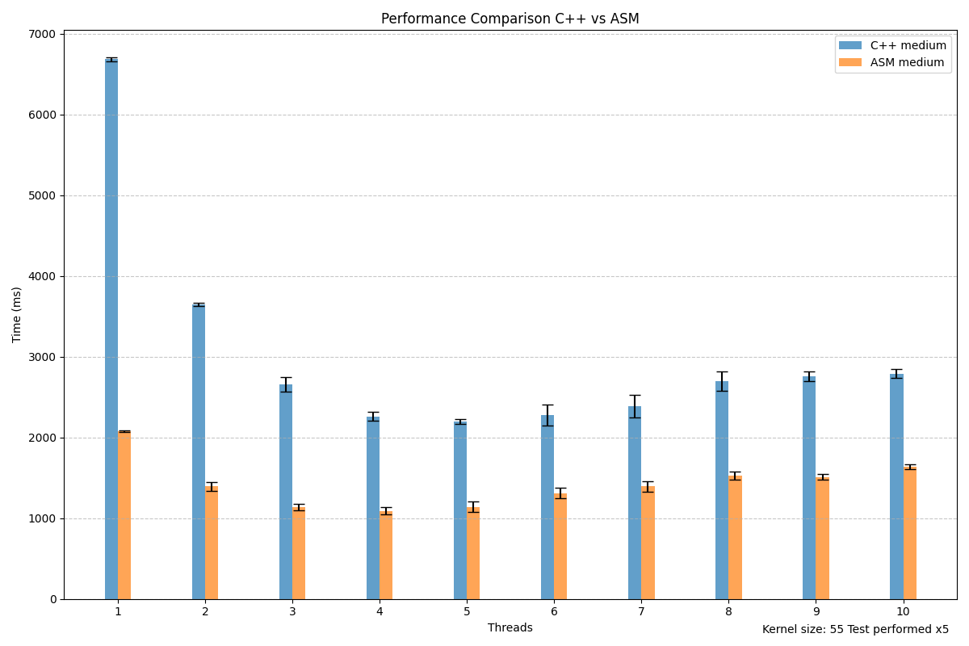
Medium data 1 - 10 threads

Slide 22
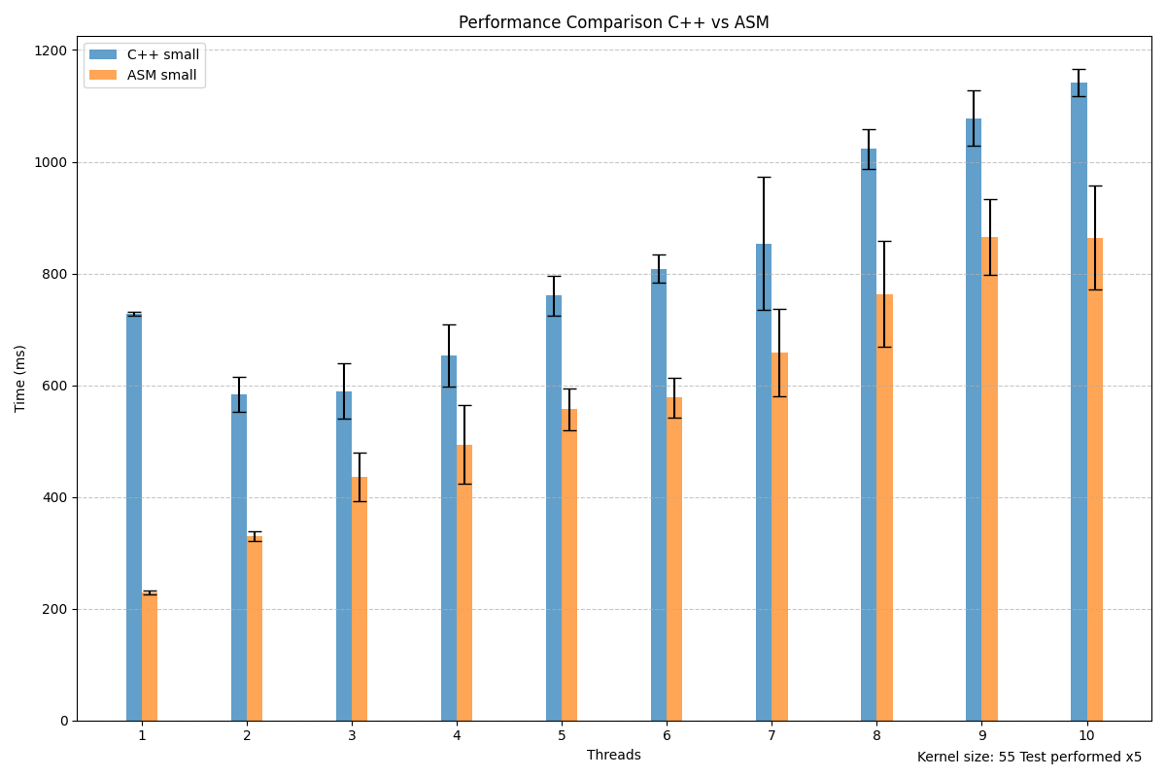
Small data 1 - 10 threads

Slide 23

Observations
Only larger data should be segmented.
If the number of logical processors is exceeded, performance will suffer.
More time-consuming processes may benefit more from multithreading.

Slide 24
Conclusions
Although Asm is faster, the time spent writing it may not be worth it. It may be more beneficial to spend extra time optimising the Cpp code rather than writing in Asm.
The fact that Cpp is that much slower may be a sign of poor code quality. Compilers usually do a good job.

