Slide 1
OFDM_14b -- Continuous Pilot Sync
WES269
J Eldon

Slide 2
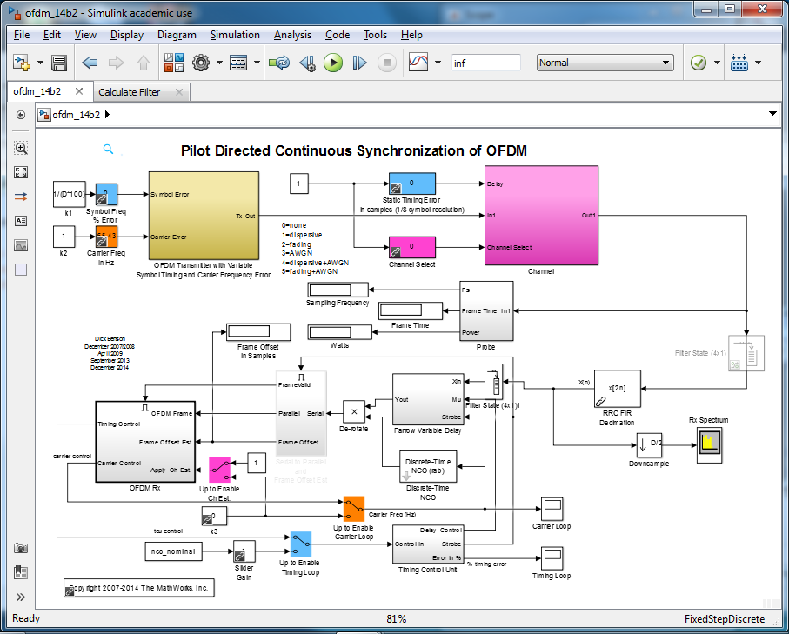
System

Slide 3
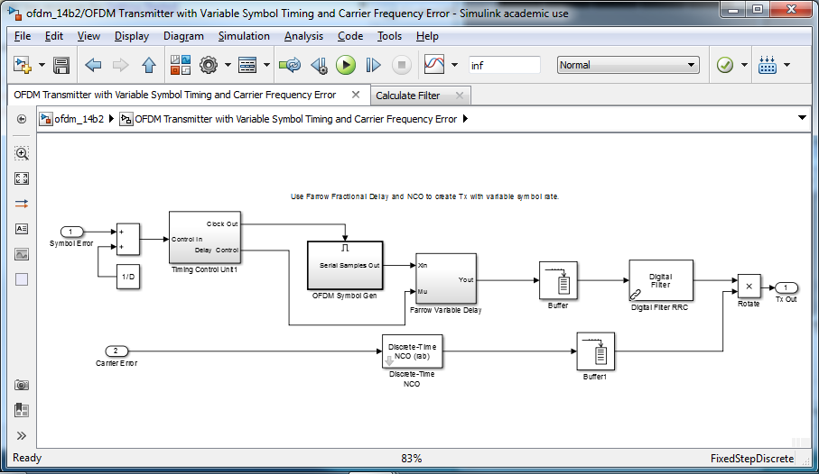
TX

Slide 4
TX
Timing Control Unit
OFDM Symbol Gen
Farrow Filter (Timing Offset)
RRC
Carrier Offset

Slide 5
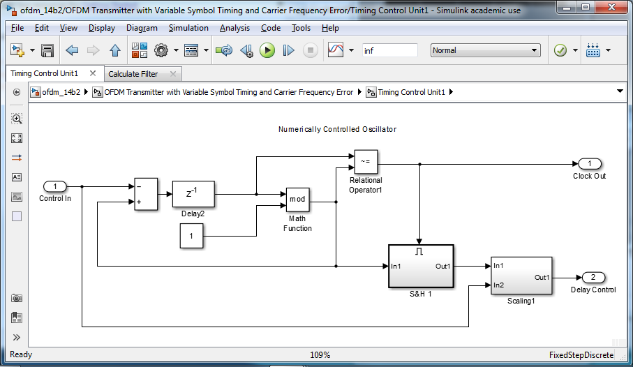
TX -- Timing Control Unit

Slide 6
TX -- TCU
NCO
Accumulates "Control In"
When modulo 2π != in, get clk out

Slide 7
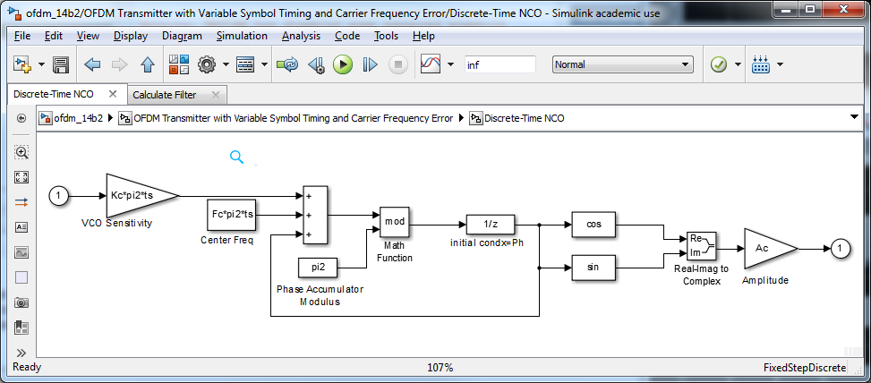
Discrete Time NCO

Slide 8
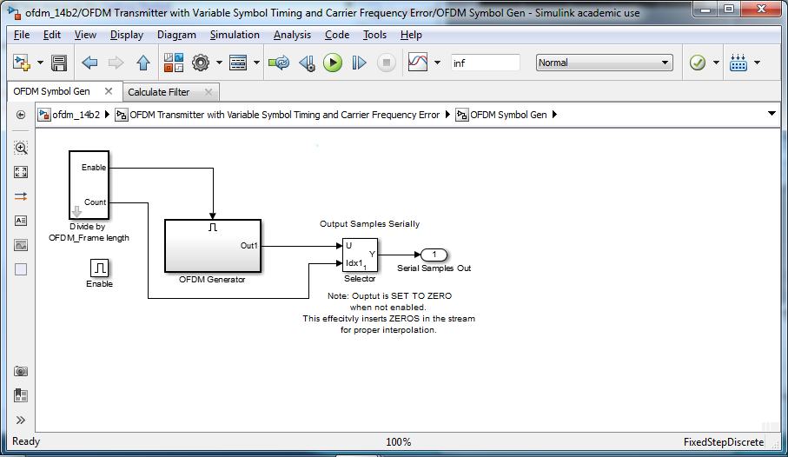
OFDM Symbol Generator

Slide 9
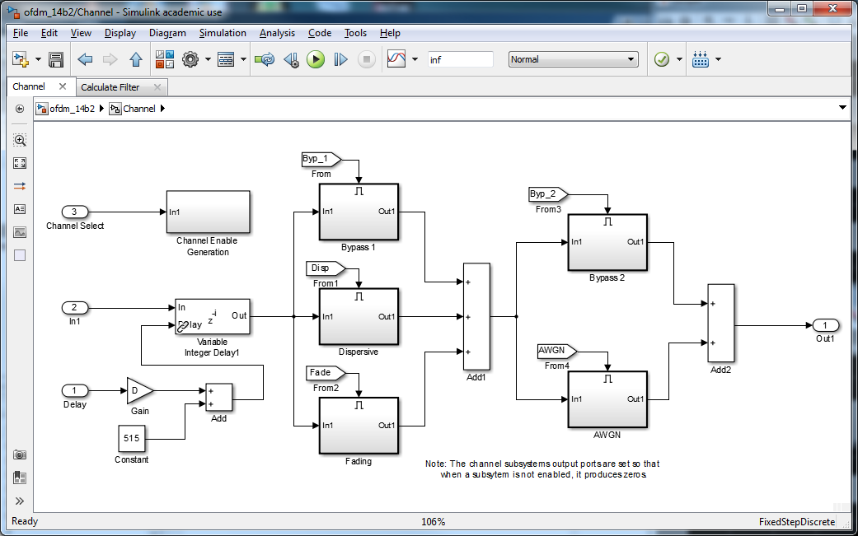
Channel Simulator

Slide 10
Channel Simulator
Dispersive --
  FIR filter
  [1 0 0 0.8 0 0 0 -0.7 j*.500 0 0 0 0 0 0 0 -.5 0 0 0 0 0 0 0 0 .5]/1.8
Rayleigh Fading --
  set delay path vector (seconds)
AWGN

Slide 11
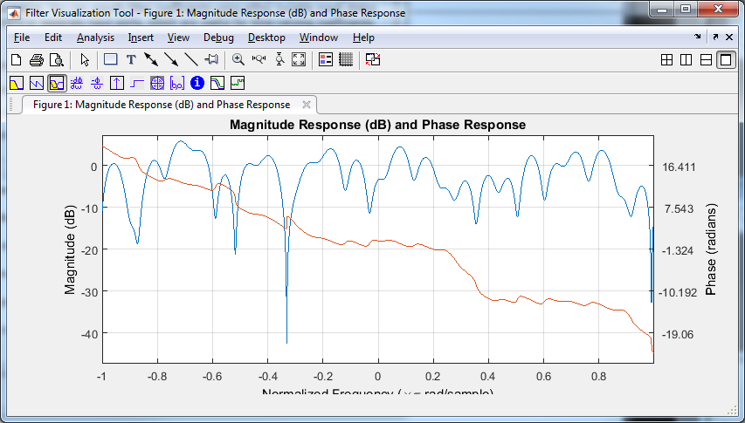
Dispersive FIR Response

Slide 12
RX
Farrow Variable Delay
Frame Offset Estimator
OFDM RX
Timing Control Unit

Slide 13
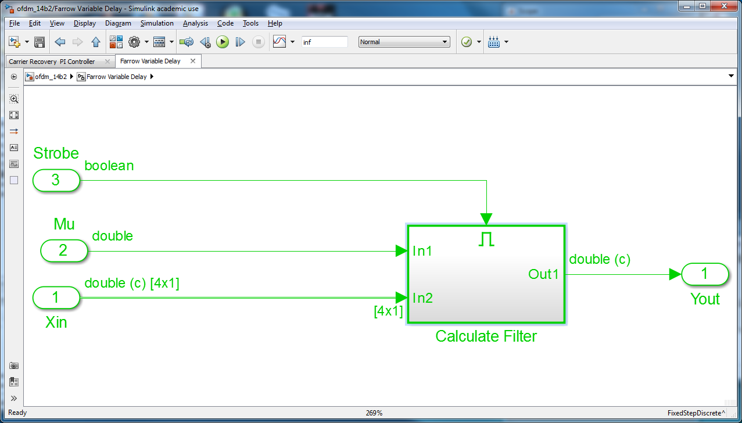
Farrow Variable Delay

Slide 14
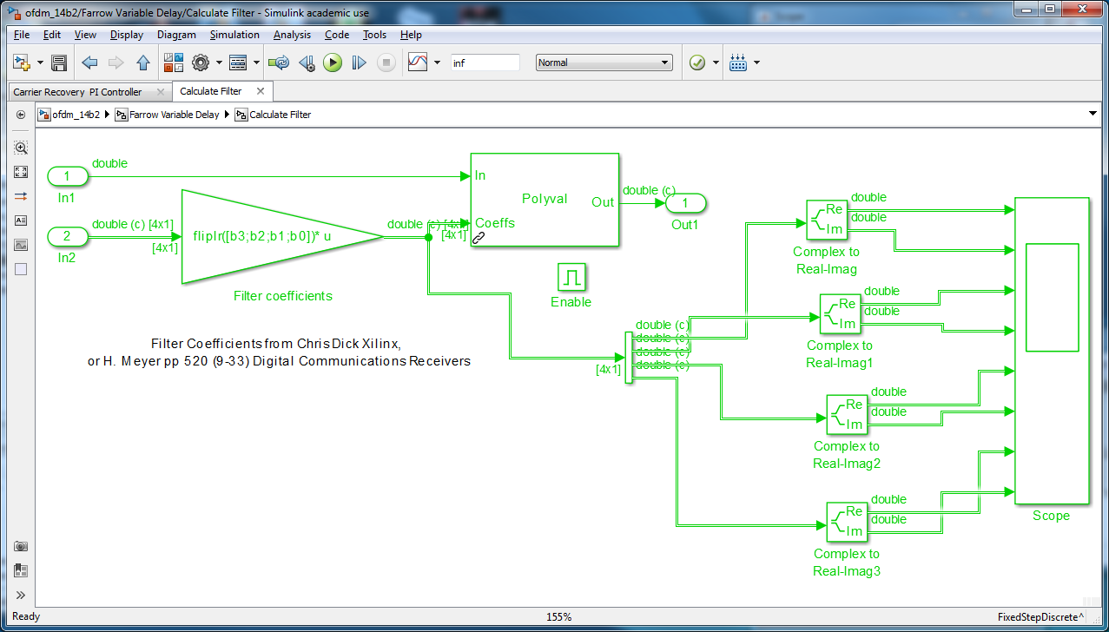
Farrow Filter

Slide 15
Farrow Coefs
% coefficents for Farrow filter
b3 = [1/6 -1/2 1/2 -1/6];
b2 = [1/2 -1 1/2 0];
b1 = [1/3 1/2 -1 1/6];
b0 = [0 1 0 0];

Slide 16
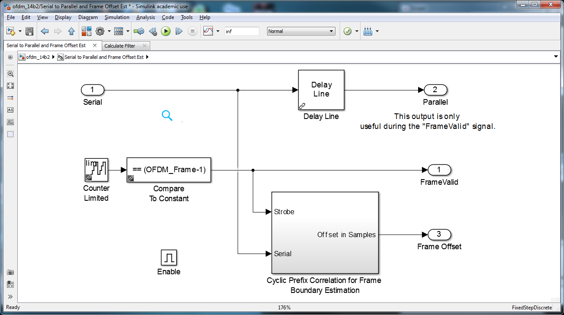
Frame Offset Estimator

Slide 17
Frame Offset Estimator
Delay by Frame Length (64 taps)
  64 FFT + 16 CP
Autocorrelate w/ Frame Length Delay
Recursive Running Sum
  16 taps = length of CP
Phase Estimator in Parallel

Slide 18
Correlate w/ Delay 64
Autocorrelating incoming signal w/ one FFT delay of itself
When CP hits, it aligns w/ itself
D[1:16] D[17:32] D[33:48] D[49:64] D[1:16]

Slide 19
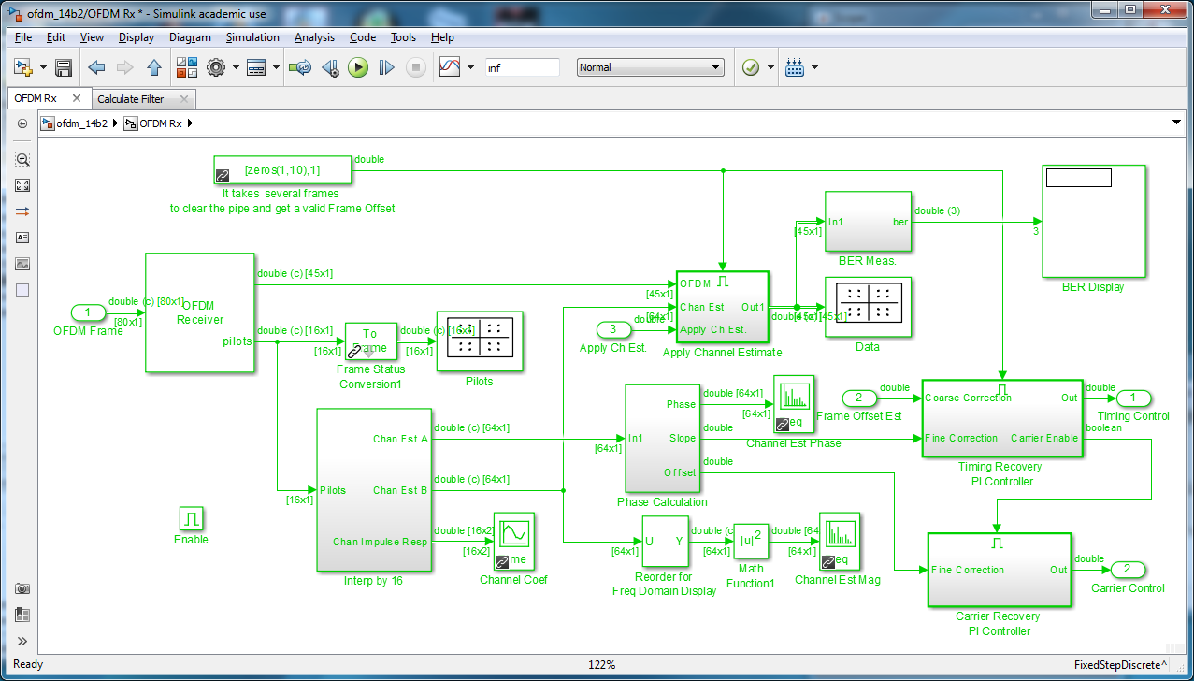
OFDM RX

Slide 20
OFDM RX
OFDM -- data and pilots
interp pilots
equalization of data
calculate phase
carrier recovery

Slide 21
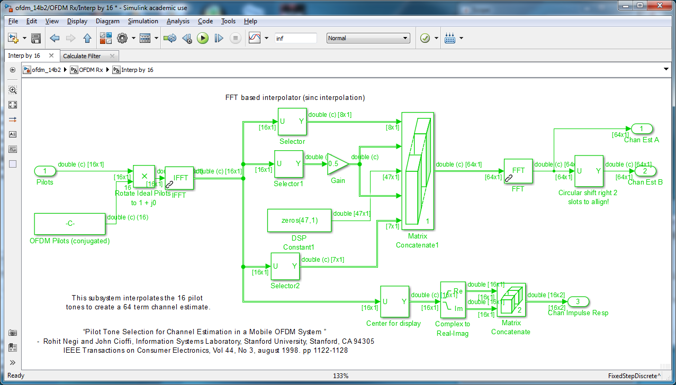
Interpolate w/ FFT

Slide 22
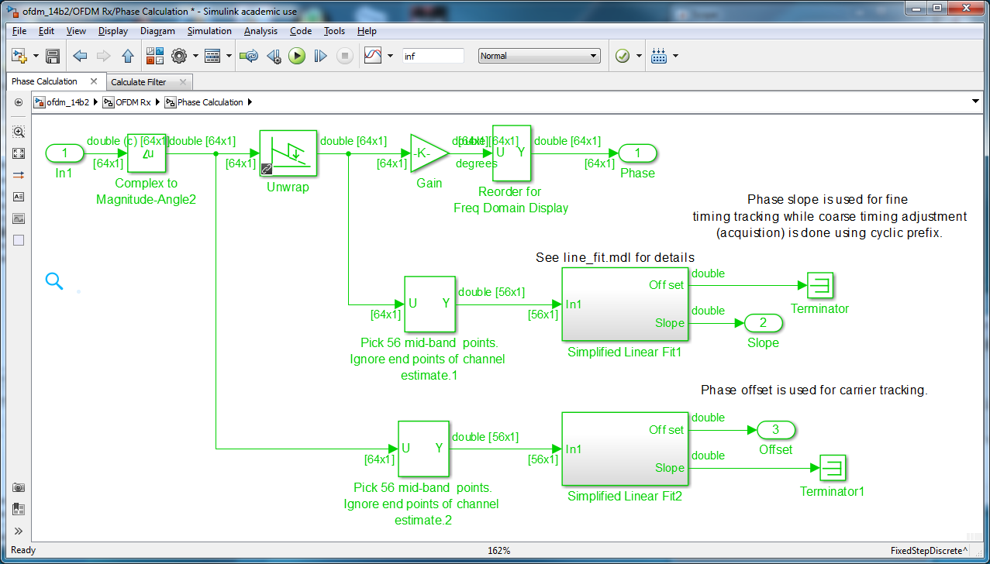
Phase Calculator

Slide 23
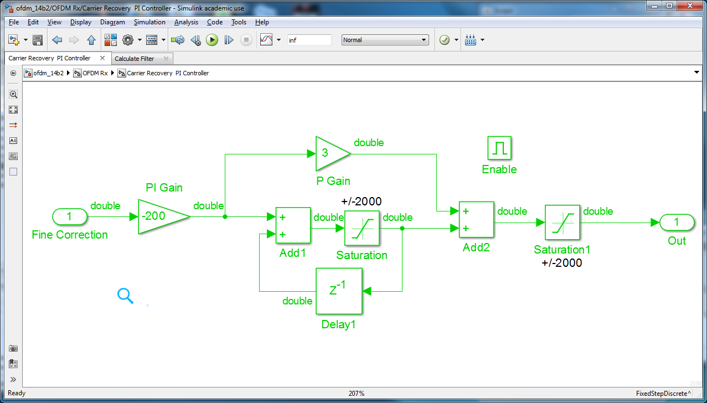
Carrier Recovery PI

Slide 24
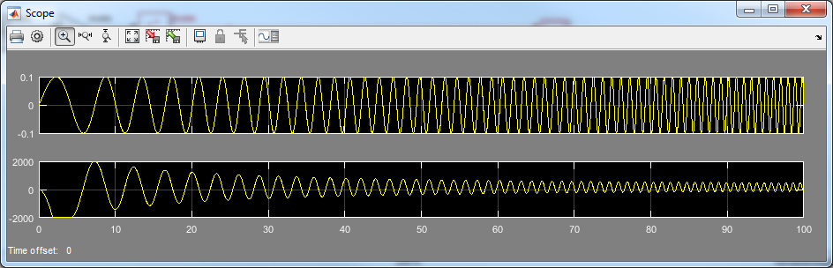
Carrier Recovery PI
PI filter
3:1 P/I ratio

