Slide 1


Capstone Project
Interactive Digital Cultural Map and Local Tourism Information System
Team B3
Jem Carlo Austria
Mary Jane Dalas
Rea Solis
Joy De Guzman
For the Municipality of Mangatarem, Pangasinan
2026
Bachelor of Science in Information Technology

Slide 2




Introduction & Background
Current Challenges
The Need for Digital Transformation
The LGU of Mangatarem struggles with outdated tourism management systems Paper-based records lead to data loss and inefficiency Scattered information across barangays with no central hub Delayed updates and conflicting tourist information Manual processes hinder tourism promotion efforts
Modernizing tourism management is essential to preserve Mangatarem's rich cultural heritage and natural attractions like Manleluag Spring National Park. Research Insight: Towns with strong web presence receive significantly more tourist attention (Wilson, 2025)
Solution: A centralized digital system to bridge the gap between traditional heritage preservation and modern
technology

Slide 3




Purpose & System Description
System Purpose
Facilitate easy access to cultural and tourism information via a digital platform. Display attractions dynamically, improve visitor experience, and promote heritage development for Mangatarem, Pangasinan.
Administrative & Stakeholder Users
General Public
LGU Tourism Office: Centralized platform for promotion & content moderation Barangay Representatives: Dedicated portal to upload local content
Tourists & Visitors: Interactive map to discover landmarks & plan visits Business Owner: Showcase local dining & lodging services to boost tourist visibility

Slide 4

Objectives of the Study
Main Objective
Design and develop an Interactive Digital Cultural Map and Local Tourism Information System for the LGU of Mangatarem, Pangasinan
Specific Objectives
Analyze Existing Processes
Identify Key Features
01
Evaluate current tourism data collection and sharing methods to identify improvements
02
Define system features for Administrative/Stakeholder and Public/Academic user categories
Test System Quality
Prepare Implementation Plan
03
Evaluate functionality, performance, security, usability, and acceptability standards
04
Create deployment strategy for effective LGU adoption and system rollout

Slide 5








Conceptual Framework: IPO Model
INPUT
PROCESS
OUTPUT
Technical: HTML, CSS, JavaScript, Python, Flask, PostgreSQL, Supabase
Phase 1: Requirements Planning
System: Interactive Digital Cultural Map & Tourism Information System
Phase 2: User Design & Prototyping (Figma)
Physical: Development machines, LGU workstations
→
→
Features: Public map, Admin dashboard, Content moderation
Phase 3: Construction & Coding
Domain: Tourism policies, Cultural heritage data
Impact: Centralized heritage data for Mangatarem
Phase 4: Cutover (Testing & Deployment)
Stakeholder: LGU staff, Barangay representatives
RAD Methodology: Iterative
feedback cycles
Feedback Loop: Continuous
refinement & improvement

Slide 6













Scope & Limitations
Scope
Limitations
Technology: HTML, CSS (Tailwind), JavaScript, Python (Flask), PostgreSQL (Supabase)
No Transactions: No booking, reservation, or payment processing
Public Portal: Interactive map for browsing and filtering tourist attractions
Online Required: No offline capabilities or cached maps
Traffic Limits: Designed for municipal traffic, not extreme surges
Contributor Portal: Content submission for barangay representatives
Restricted Access: Content submission limited to authorized personnel
Admin Dashboard: Content moderation and user management for LGU staff
Geographic Boundaries: Limited to Mangatarem only
Coverage: Municipality of Mangatarem, Pangasinan

Slide 7












Sources of Data
Primary Sources
Secondary Sources
Techniques
LGU Tourism Office: Official policies, manual records, promotional materials
Municipal Archives: Tourism brochures, municipal profiles
Interviews Face-to-face talks with tourism staff about daily tasks and pain points
Barangay Officials: Localized cultural data, landmark descriptions, community events
Historical Documents: Past tourism reports, heritage records
Observation On-site workflow analysis at LGU office to identify bottlenecks
Physical Records: Printed profiles, archived documents
Tourist Sites: Mapping coordinates, photographic documentation

Slide 8
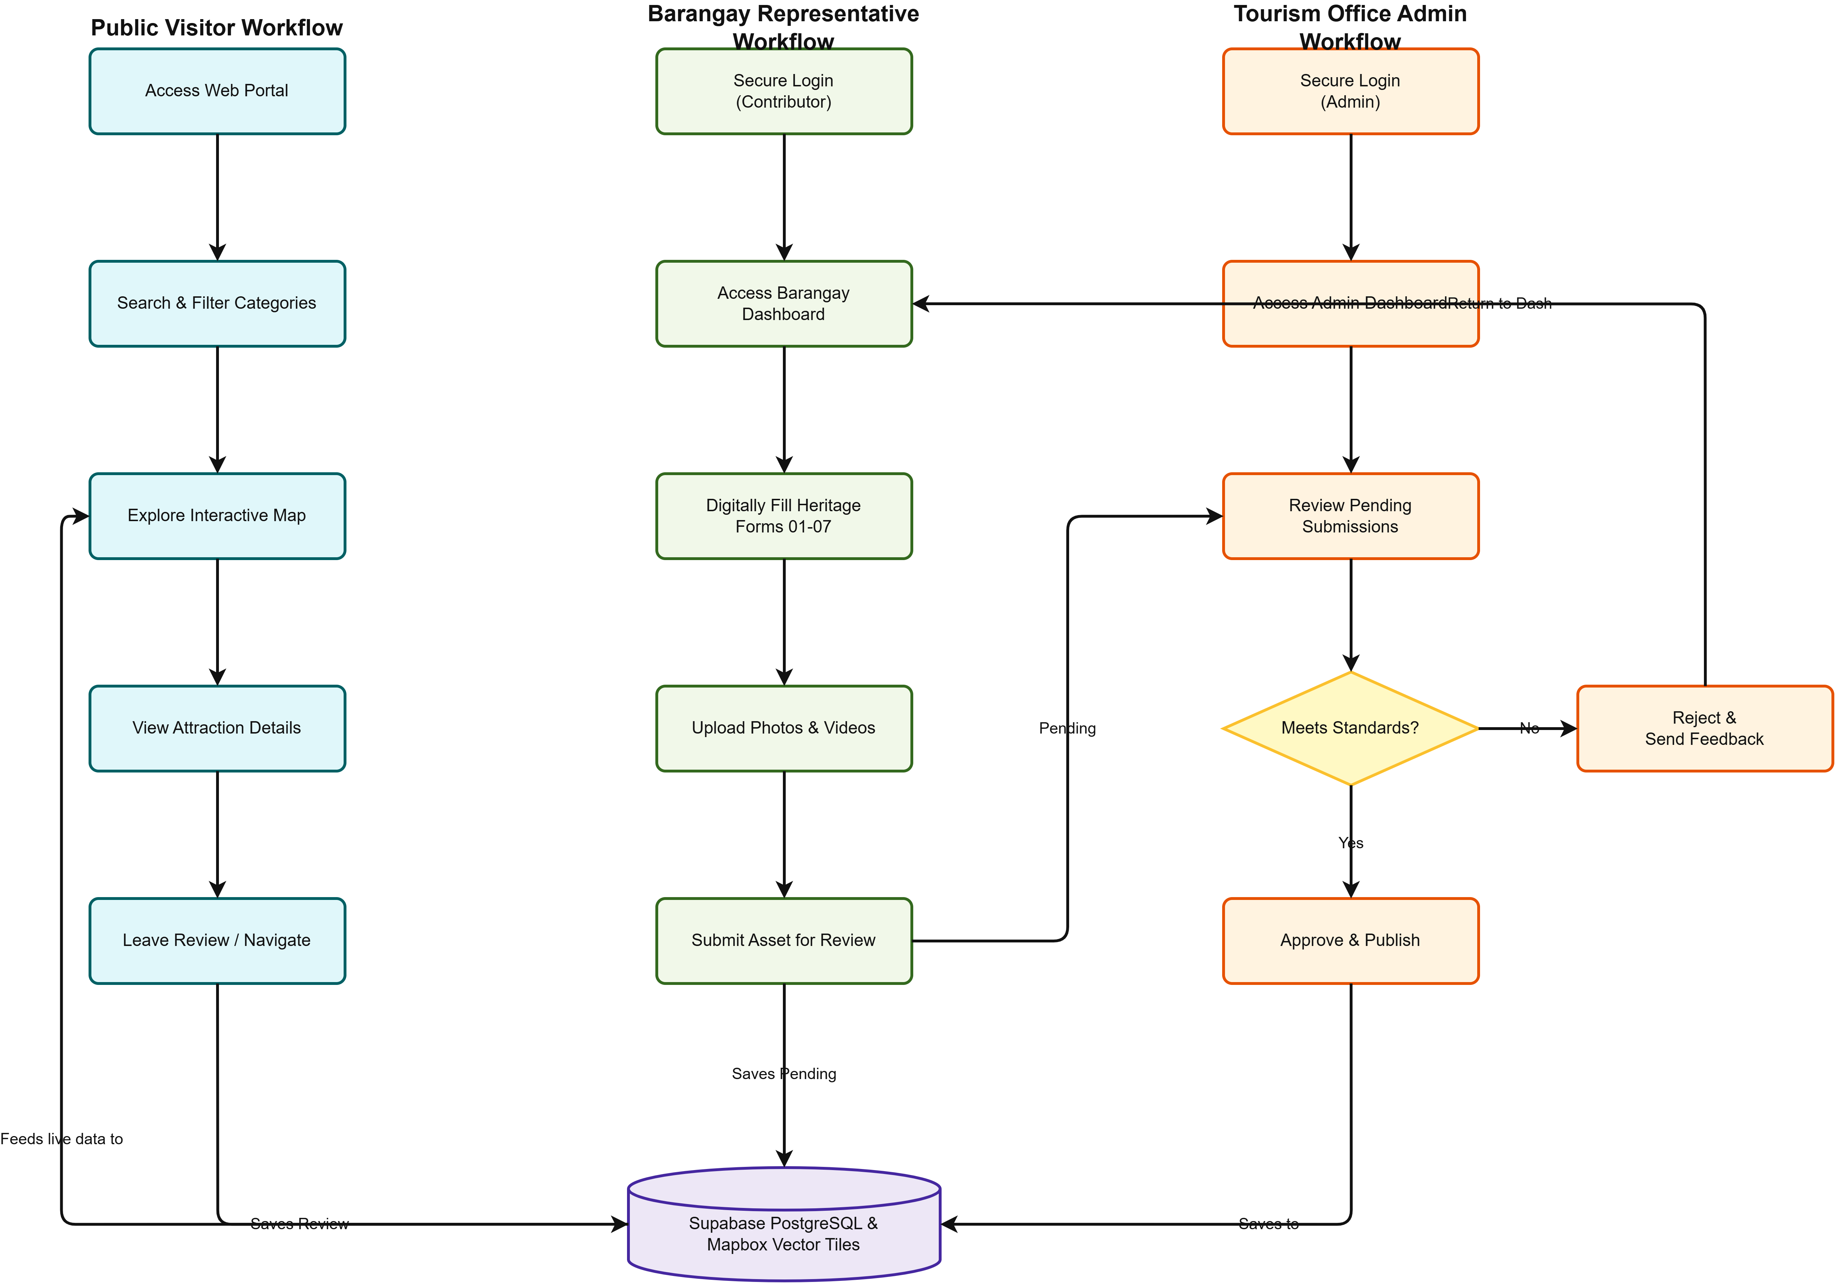
Proposed System Flowchart

Slide 9

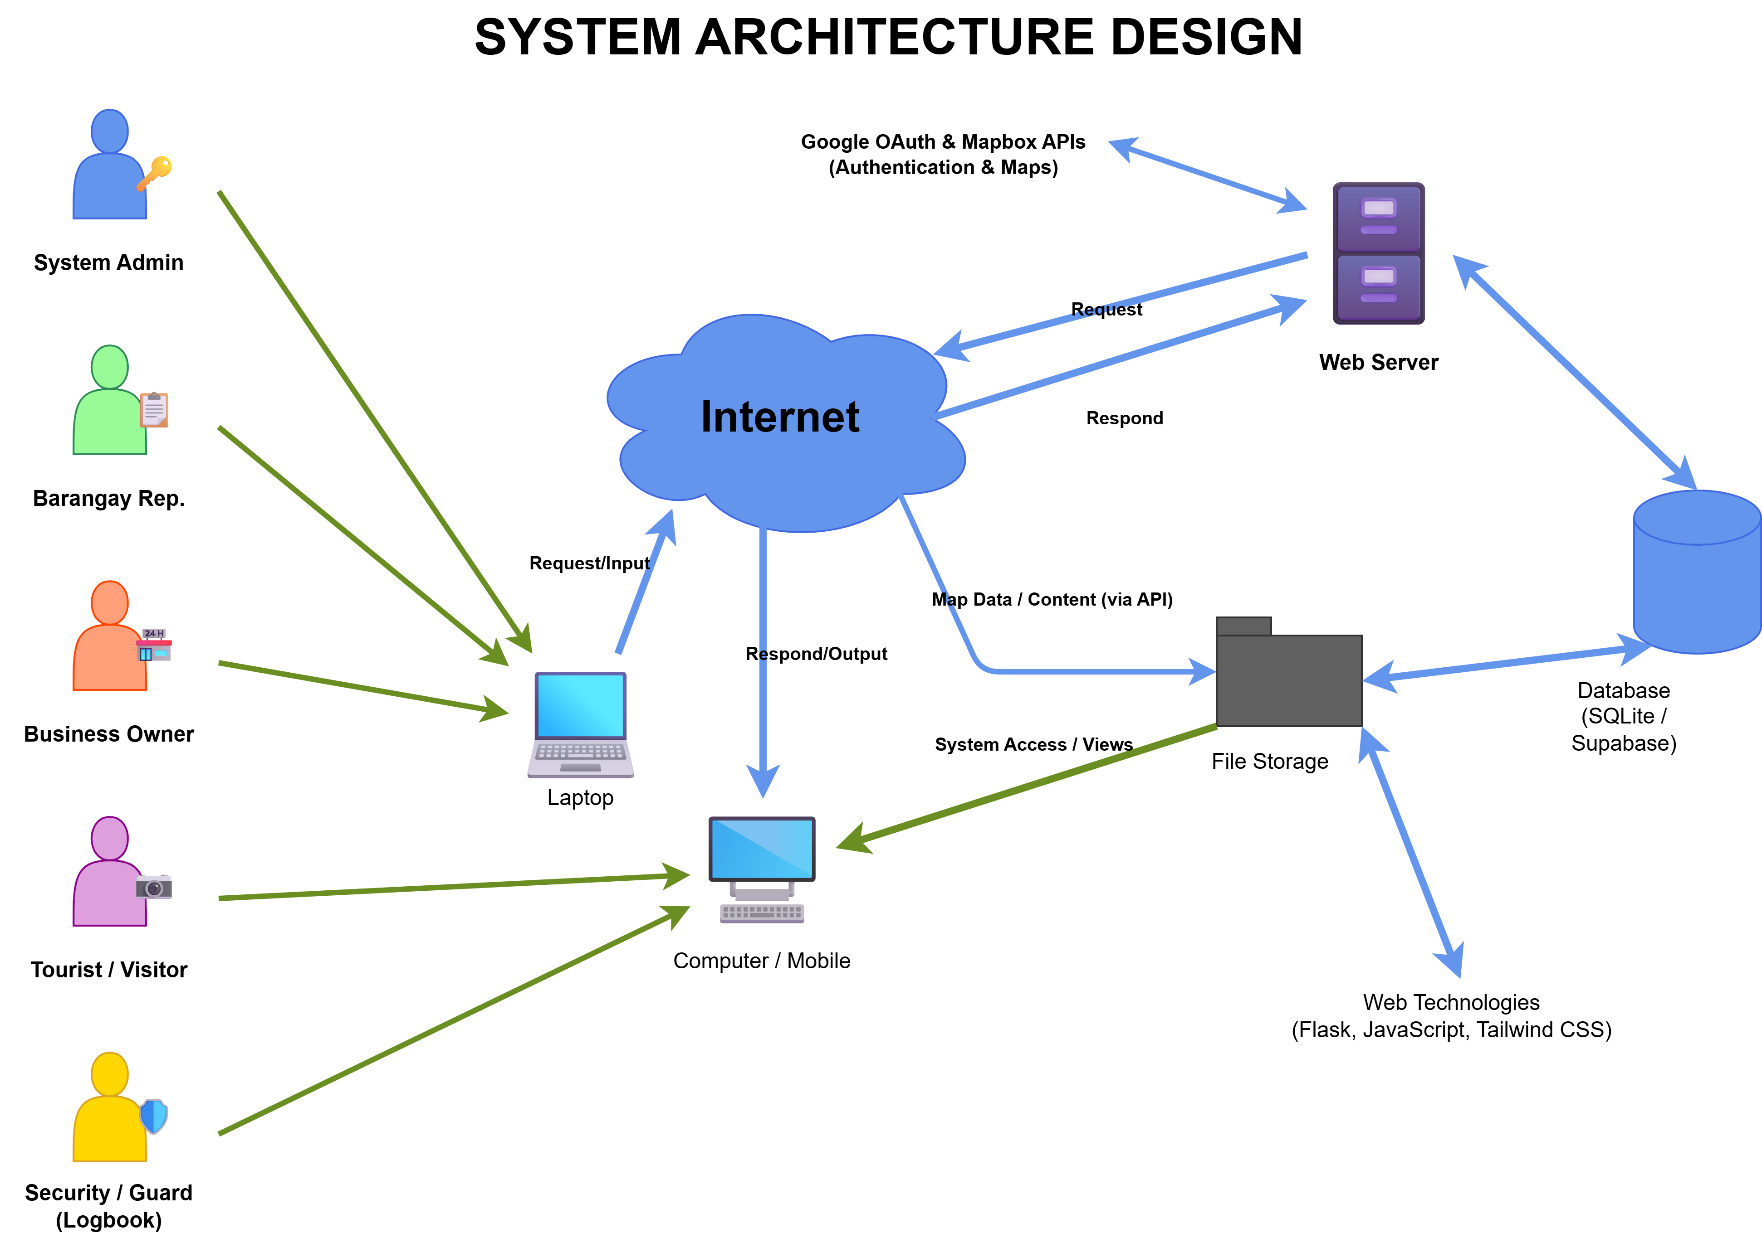
System Architecture Design

Slide 10

Data Flow Diagram (DFD)

Slide 11
Entity Relationship Diagram (ERD)

Slide 12




System Testing & Deployment
Testing Results
Deployment Plan
All Tests Passed Successfully
1
Pilot Testing (Internal)
Staging environment for LGU staff and select barangay representatives. Validate end-to-end content moderation workflow.
Functional Testing
Performance Testing
100% PASS
100% PASS
2
Production Deployment
Migrate to live environment on Vercel with Supabase backend. Configure SSL/TLS and security headers.
4/4 tests passed
3/3 tests passed
3
User Training & Launch
Conduct training sessions for admins, barangay reps, and business owners. Distribute user manuals.
Security Testing
Usability Testing
100% PASS
4.34/5.0
3/3 tests passed
High user satisfaction
4
Post-Launch Support
30-day support period for bug fixes and adjustments. Establish maintenance schedule for updates.

