Slide 1
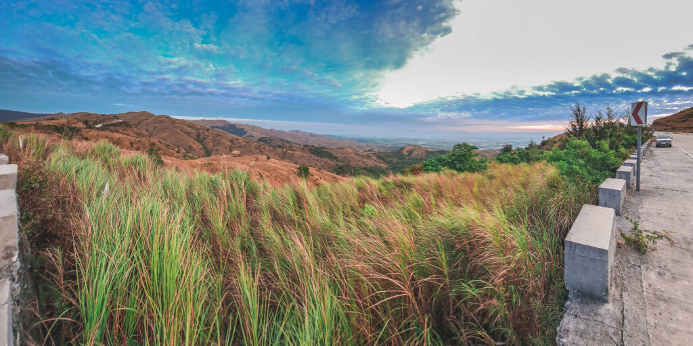





Interactive Digital Cultural Map
and Local Tourism Information
System
Interactive Cultural Mapping
Tourism Information Portal
Events & Festival Directory
Multimedia Gallery
Advanced Search & Filter Tools
A comprehensive solution for Mangatarem, Pangasinan tourism
Team Members:Jem Carlo Austria, Maryjane Dalas, Joy De Guzman, Rea Solis
Team: B3
Notes:
Sample

Slide 2
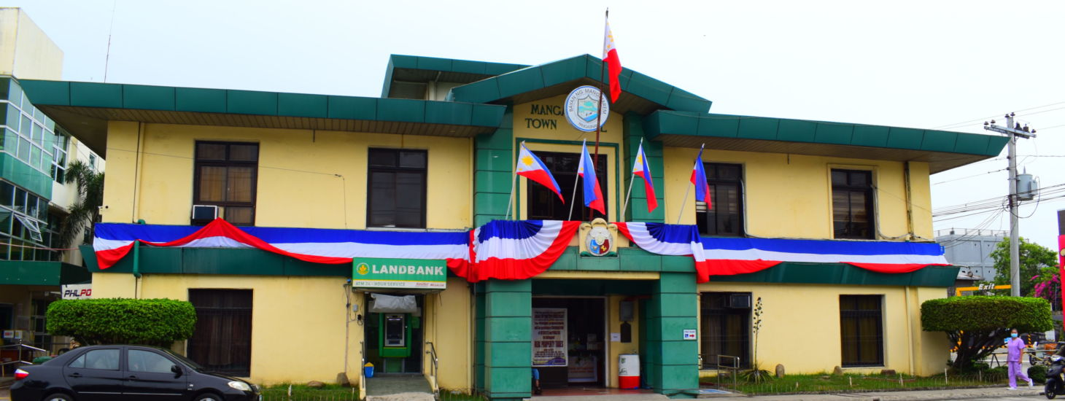











Company/Organization Background
Mangatarem LGU Profile
1st-class landlocked municipality in Pangasinan
Largest town in Pangasinan by land area (317.50 km²)
Population: 79,323-79,648 residents (2020 census)
82 barangays across the municipality
Promotes eco-tourism initiatives and hosts festivals like the Tupig Festival
Rachelle T. Cabornay
Senior Tourism Operations Officer
Tourism Relevance
Municipal Economic Enterprise Office (M.E.O.)
Hosts Tupig Festival highlighting local farmers
Develops eco-tourism sites like Manleluag Spring
Features scenic Daang Kalikasan road linking to Zambales
Participates in Pangasinan-wide agri-tourism expos

Slide 3



Issues and Challenges Identified
Current Tourism Information Challenges
Information management is currently fragmented and largely manual, resulting in irregularly updated online content
Lack of a Unified Hub There is no single "source of truth" for Mangatarem’s tourism. Information is scattered across various unofficial social media pages.
Slow coordination with stakeholders relying on traditional communication methods delays the sharing of accurate information
Limited accessibility for students and researchers seeking cultural information

Slide 4









Background of the Study
The Problem (Current State)
Fragmented & Manual: Reliance on disconnected, non-digital processes.
Data Inconsistency: Conflict in information across various tourism platforms.
Information Lag: Slow coordination and delayed updates for travelers.
Accessibility Barriers: Limited resources for students, researchers, and tourists.
The Solution (Proposed System)
Centralized Platform: A unified Interactive Digital Cultural Map.
Digital Preservation: Modernizing the documentation of Mangatarem’s heritage.
Enhanced Accuracy: Real-time, standardized updates for the LGU and public.
Efficient Promotion: Streamlined tourism management and local data access.
Cost-Effective Technologies
Stimulates local economic activity and cultural awareness
Increased attraction visibility
Python (Flask)
Leaflet.js
SQLite/MySQL
Educational resource
HTML/CSS
JavaScript
Cultural preservation

Slide 5
Main Objective/Purpose of the System
System Purpose
The primary objective of this capstone project is to design and develop the Interactive Digital Cultural Map and Local Tourism Information System, a centralized web-based platform dedicated to showcasing the cultural identity and tourism assets of Mangatarem, Pangasinan. This system addresses the information gap by integrating an interactive mapping interface with a comprehensive information portal, allowing users to easily locate and explore barangay-level cultural spots, historical landmarks, and local festivities. Built using cost-effective and scalable open-source technologies like Python (Flask) and Leaflet.js or mapbox, the system provides a viable solution for implementation by the Local Government Unit. The significance of this project lies in its ability to bridge the information gap for tourists requiring navigation and students conducting cultural research, thereby transforming how local heritage is accessed and preserved. Ultimately, the system aims to stimulate local economic activity by increasing the visibility of community attractions while fostering a deeper sense of pride and cultural awareness among the residents of Mangatarem.
Cost-Effective Technologies
Stimulates local economic activity and cultural awareness
Increased attraction visibility
Python (Flask)
Leaflet.js
SQLite/MySQL
Educational resource
HTML/CSS
JavaScript
Cultural preservation

Slide 6
Specific Objectives
The primary goal of this study is to develop a comprehensive digital platform
for Mangatarem. Specifically, it aims to:
1. Digitized Cultural Repository
To design and develop a centralized database that stores and organizes Mangatarem’s cultural heritage data and tourism information, replacing fragmented manual records.
2. Interactive Geospatial Mapping
To implement an interactive digital map interface using [mention tech like Leaflet or Mapbox] that allows users to visualize and navigate local tourist spots and heritage sites in real-time.
3. Unified Information Hub
To create a web-based portal that serves as the "Official Source" of tourism information, providing verified details, history, and directions for both local and foreign travelers.
Cost-Effective Technologies
Stimulates local economic activity and cultural awareness
Increased attraction visibility
Python (Flask)
Leaflet.js
SQLite/MySQL
Educational resource
HTML/CSS
JavaScript
Cultural preservation

Slide 7
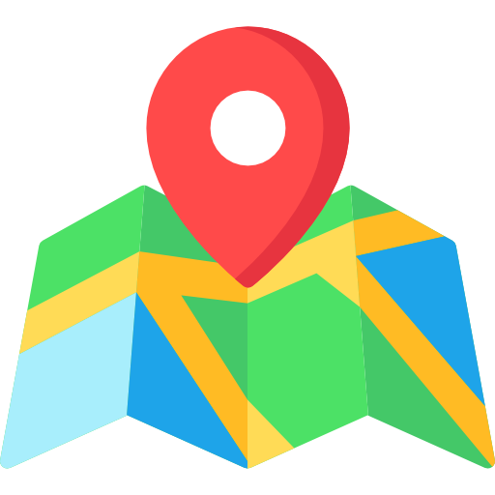







Scope of the System
Interactive Cultural Map
Cultural Information Portal
Navigable map displaying barangay-level cultural highlights with zoom, pan, and location details
Central repository for barangay profiles, cultural assets, traditions, and points of interest
Events and Festival Directory
Multimedia Gallery
Calendar view of local festivities and citywide celebrations with scheduling details
Organized collection of photos and videos showcasing local traditions and community activities
Search and Filter Tools
Admin and Contributor Module
Quick retrieval of information by barangay, category, or attraction type
Content management with approval workflow for authorized barangay representatives
Tourist Guide and Routes
Analytics Dashboard
Recommended themed itineraries for exploring the municipality efficiently
Visualizes system usage data and engagement trends for decision-makers

Slide 8

Scope of the System
82 barangays across the municipality
Enables digital coordination for all 82 barangays to independently submit and update their local cultural events and profiles
Real-time fare budget estimation
Enables tourists to select attractions and services to instantly generate an itemized cost breakdown —tricycle/jeepney fares
Promotes eco-tourism initiatives and hosts festivals like the Tupig Festiva
Facilitates organized planning and efficient sharing of specific cultural events, such as the Tupig Festival, directly from the source

Slide 9
Out of Scope
No Financial Transactions
Financial Processing: The system will not facilitate online payments, bank transfers, or credit card processing for any tourism-related fees.
No Real-time Inventory
Live Availability: The system will not provide real-time updates on hotel room availability or restaurant table status

Slide 10
















Users of the System
System Administrator
Barangay Representative
Tourism Office Staff / IT Staff
Contributor
Manages user accounts and system access permissions
Submits content about local attractions and events
Approves/rejects content submissions from contributors
Updates information within their jurisdiction
Oversees platform maintenance and technical operations
Uploads photos and videos of community activities
Public User
Students and Researchers
Tourists / Visitors
Academic Users
Navigates interactive map to locate attractions
Accesses historical data and cultural profiles
Searches and filters for specific points of interest
Gathers research data on local heritage
Views suggested routes and cultural information
Studies cultural traditions and community practices

Slide 11


Stakeholders
Local Government Unit (LGU) of Mangatarem Primary
Main beneficiary and decision-maker for tourism promotion and cultural data management
Direct Users of the System
Administrators, Contributors, Tourists, and Students who directly interact with the platform

Slide 12

Use Cases
Tourists Exploring Local Attractions
Academic Research and Data Gathering
Students access barangay profiles for academic studies Historical data Traditions Local practices
Navigate the Interactive Map to locate specific spots (Manleluag Spring) View pop-up details Get directions Discover landmarks
Content Contribution by Barangay Officials
Content Moderation
Authorized Representatives log in to update local information Upload photos Update history Add events
System Administrator uses Admin Dashboard to review submissions Approve content Reject incorrect info Manage users

Slide 13
Use Cases
System Management
Tourist/resident views the tourism and cultural map to locate sites and learn history/cultural context.
Tourism staff updates destination/site details and publishes official announcements/articles.
Administrator creates staff accounts, manages access roles, and generates printable reports.

Slide 14







Hardware, Software and Service Requirements
Development Requirements
Hardware: Intel Core i5/i7, 8GB+ RAM
Languages: Python, HTML5, CSS3, JavaScript
Frameworks: Flask, Tailwind CSS, Leaflet.js or mapbox
Database: SQLite(development) and supabase(postgresql)
Version Control: Git and GitHub
Code Editor: VS Code
Client Device
Web Browser
Connectivity
Smartphone, Tablet, Laptop, or Desktop Computer
Chrome, Firefox, Safari, or Edge
Stable Internet Connection or Mobile Data Service

Slide 15




Hardware, Software and Service Requirements
Deployment Requirements (Online)
Web Hosting Service
Database Server
Map Tile Service
SQLite or PostgreSQL for production
OpenStreetMap or CartoDB via Leaflet or mapbox
Vercel

Slide 16




Hardware, Software and Service Requirements
User Access Requirements
Client Device
Web Browser
Connectivity
Smartphone, Tablet, Laptop, or Desktop Computer
Chrome, Firefox, Safari, or Edge
Stable Internet Connection or Mobile Data Service

Slide 17
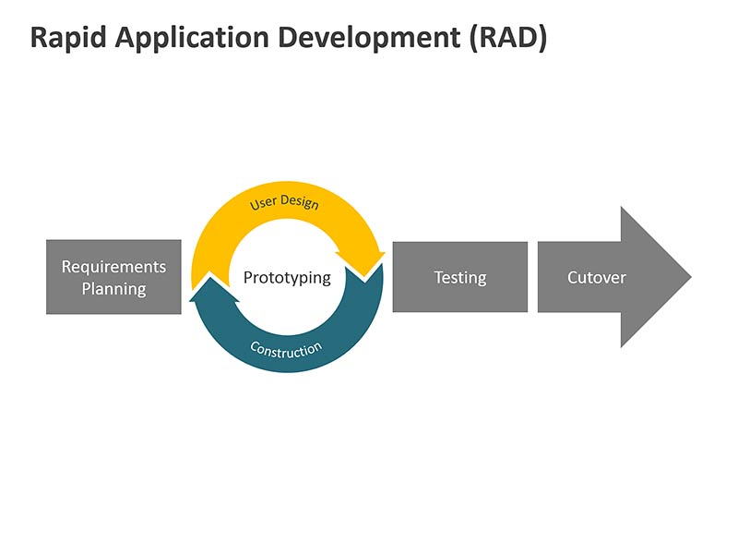






Methodology
RAD Key Benefits
Rapid Prototyping
Iterative Feedback
User-Centered Design
Reduced Development Time
Flexible Requirements

Slide 18
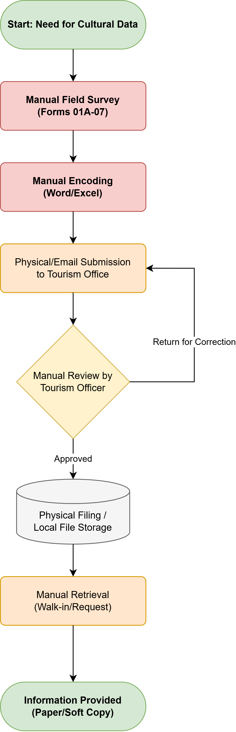
Flowchart
Legacy Process: Key Bottlenecks
Manual Surveys: Staff use paper forms for on-site data collection.
Manual Entry: Typing data into Word or Excel is slow and leads to errors.
Traditional Delivery: Data is submitted via physical handovers or simple dashboards.
Slow Verification: Manual approvals cause long delays if corrections are needed.
Isolated Storage: Data stays in local databases, making public access difficult.

Slide 19
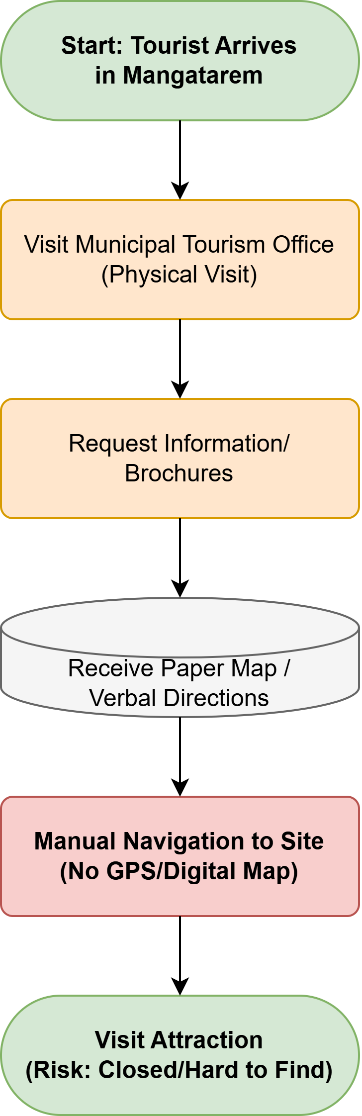
Flowchart
Legacy Tourism Issues
Office Visits Tourists must go to the office for info
Broken Info Brochures and talk are hard to follow
Manual Maps Paper maps make it easy to get lost
No Updates You only see if a place is shut when you arrive

Slide 20
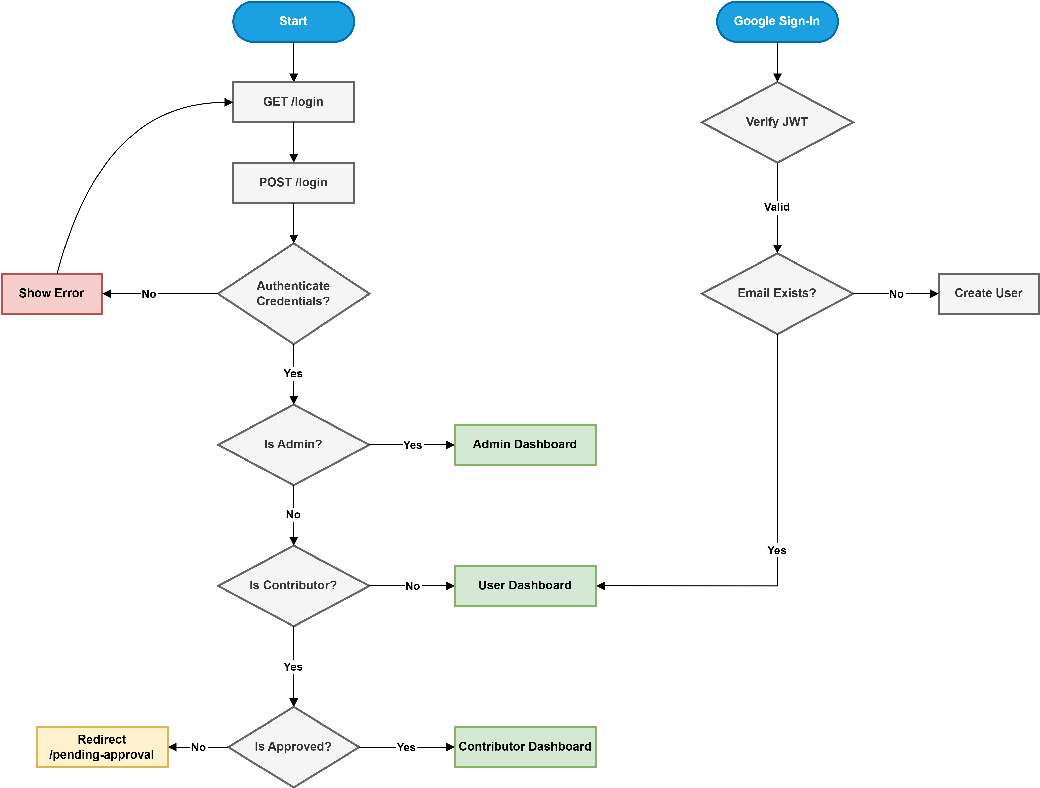
Flowchart
Login and Security Flows
Standard Login Entry for admins and users Checks roles to open the correct dashboard
Google Login Fast one tap access for visitors Admins must use standard login for safety Creates new profiles automatically
Password Reset Users get back in via email links No need for admin help
Logging Out Ends the session and clears tokens Sends users back to the home page

Slide 21
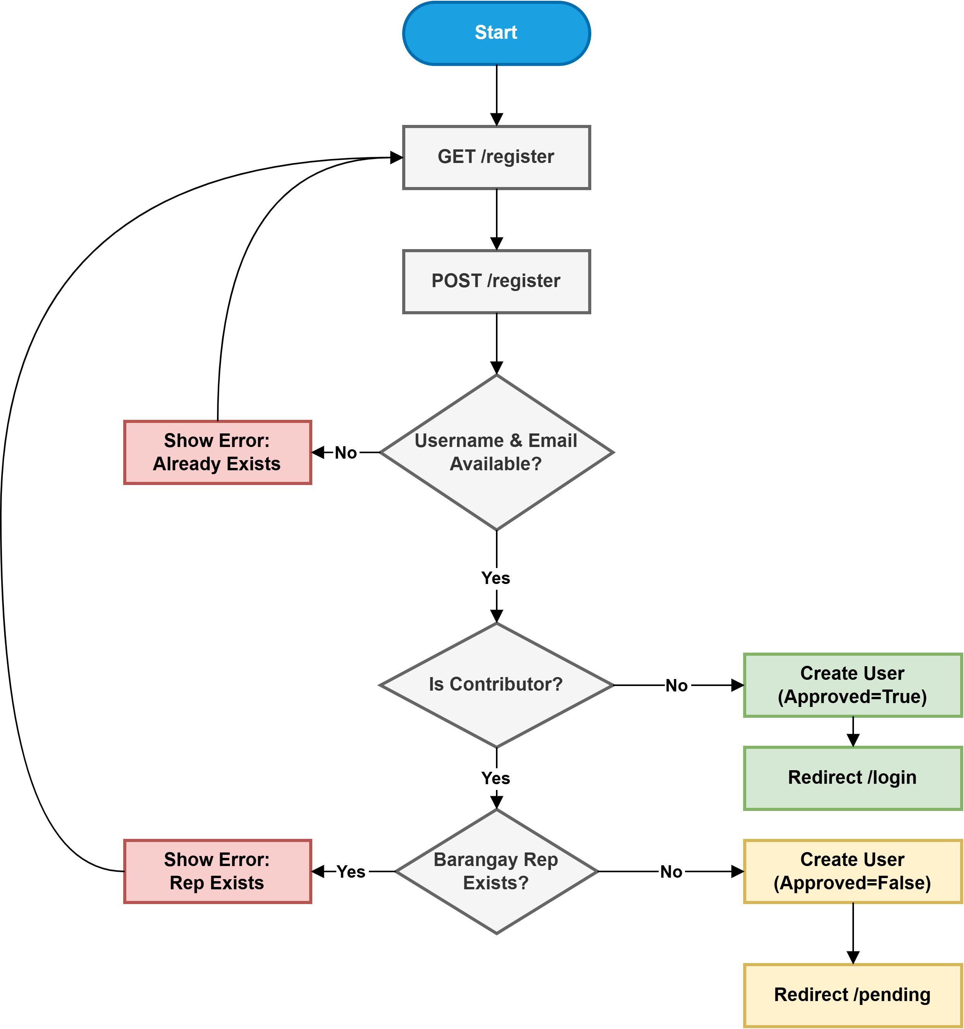
Flowchart
Registration & Validation Logic
Identity Check Checks for unique names and emails to prevent duplicate accounts.
User Roles Visitors get in fast while contributors go through extra checks.
One Rep Limit Only one person can represent a barangay at a time. New signups are blocked if a spot is already full.
Admin Approval Contributors stay "Pending" and cannot edit map data until an admin confirms their account.

Slide 22
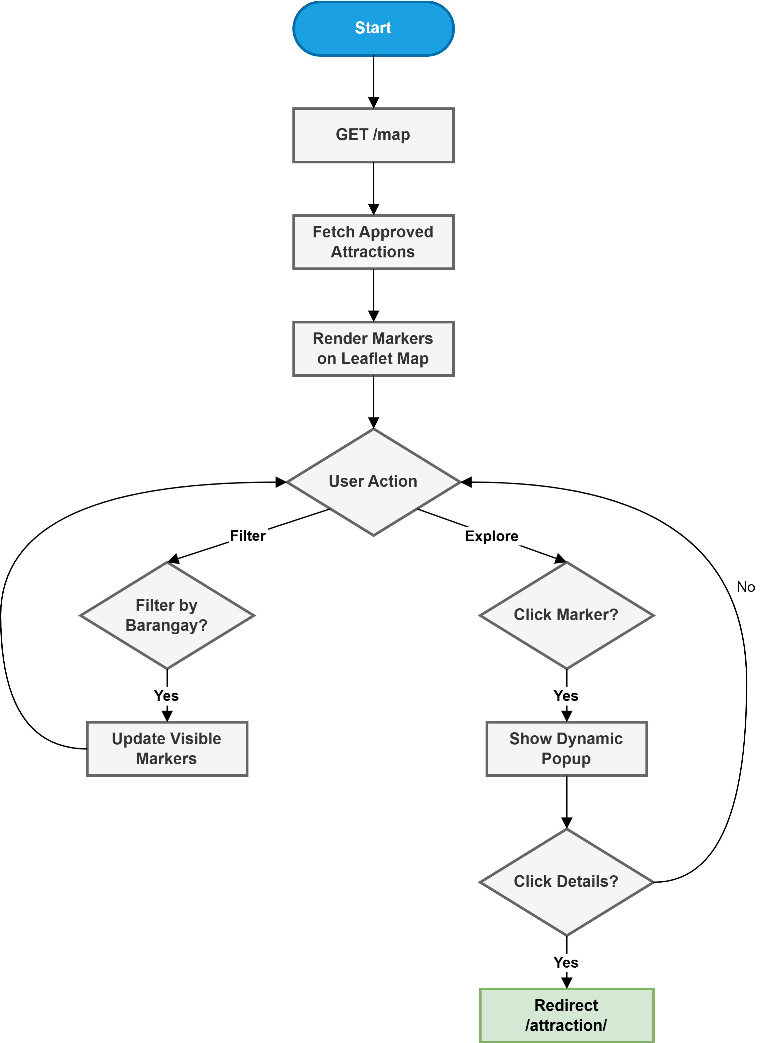
Flowchart
Map Exploration Flow
Auto Loading The system pulls all verified spots from the database instantly
Interactive Markers Leaflet JS renders icons across the town map
Barangay Filters The sidebar lets users sort markers by specific areas
Fast Previews Clicking an icon opens a popup with a photo and info
Full Pages The View Details link leads to the complete attraction page

Slide 23
Entity Relationship Diagram

Slide 24
Data Flow Diagram

Slide 25
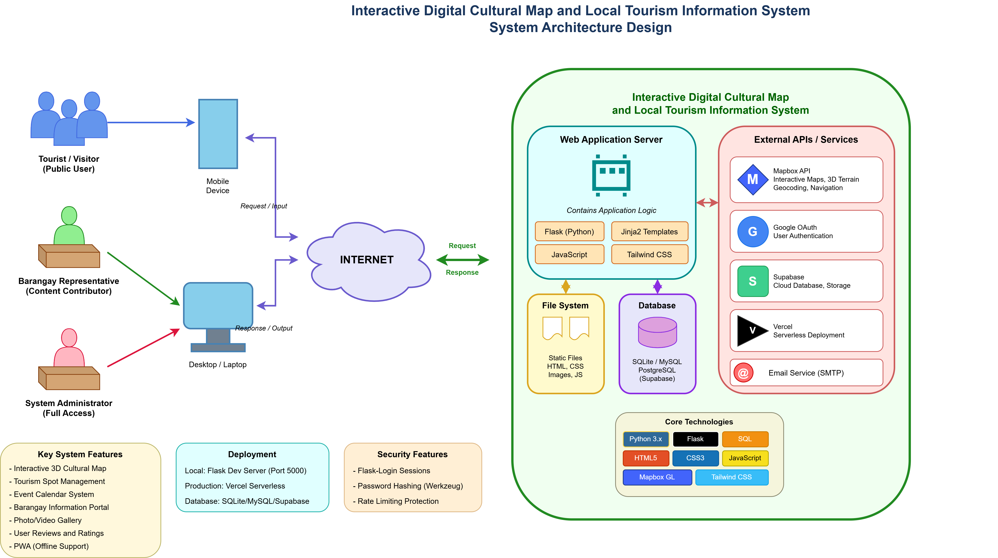
System Architecture Design

Slide 26
Proto type

Slide 27
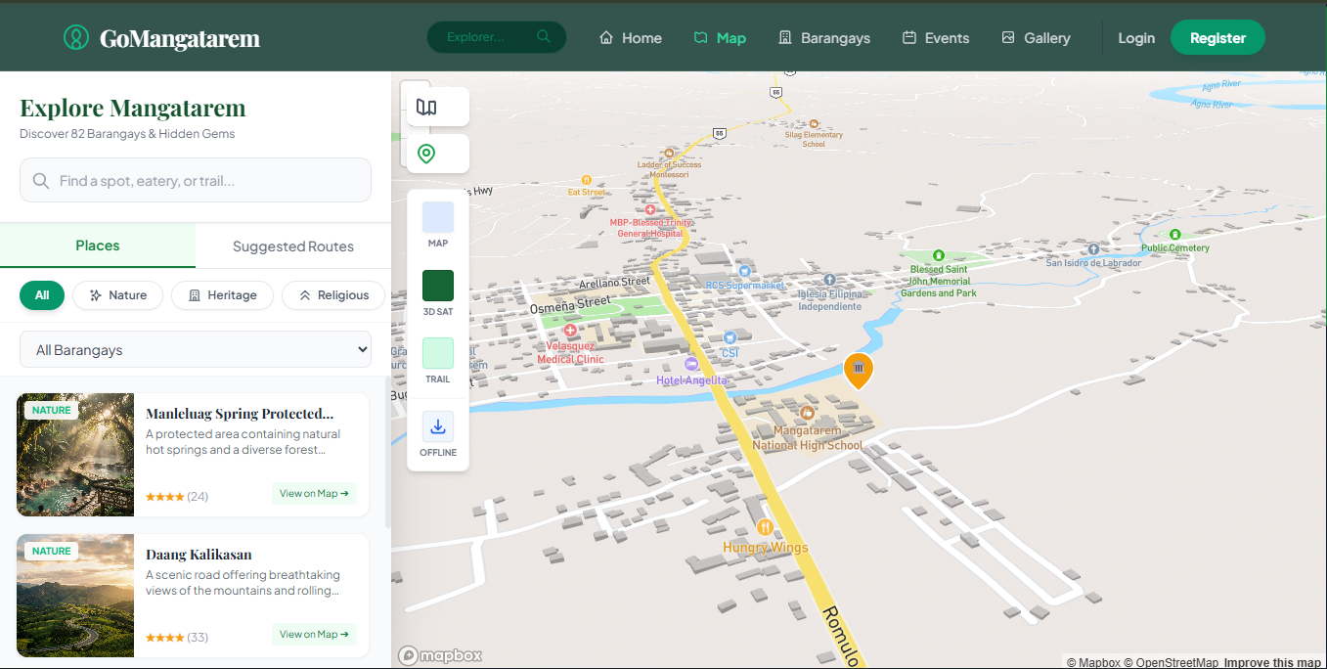

Slide 28
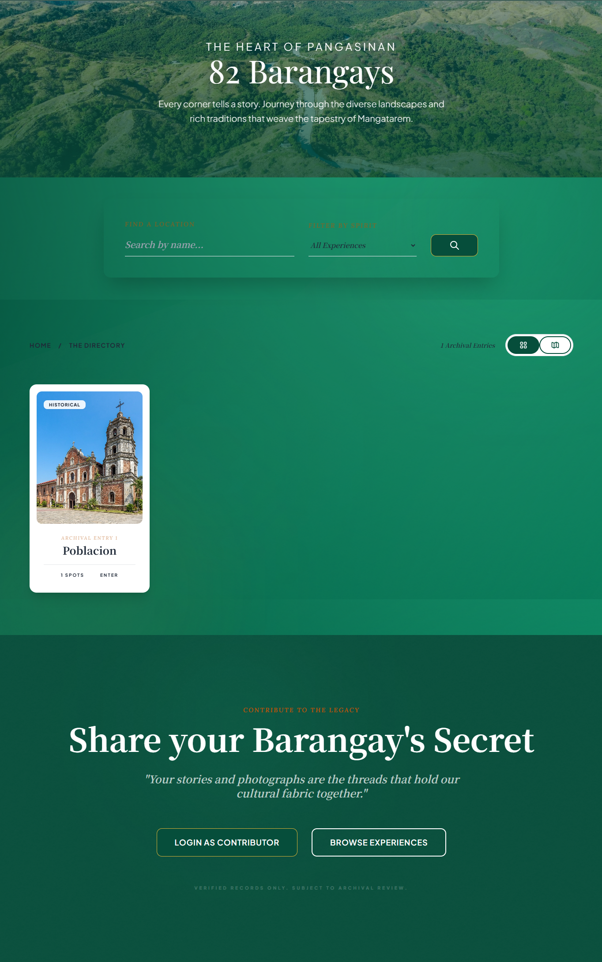

Slide 29
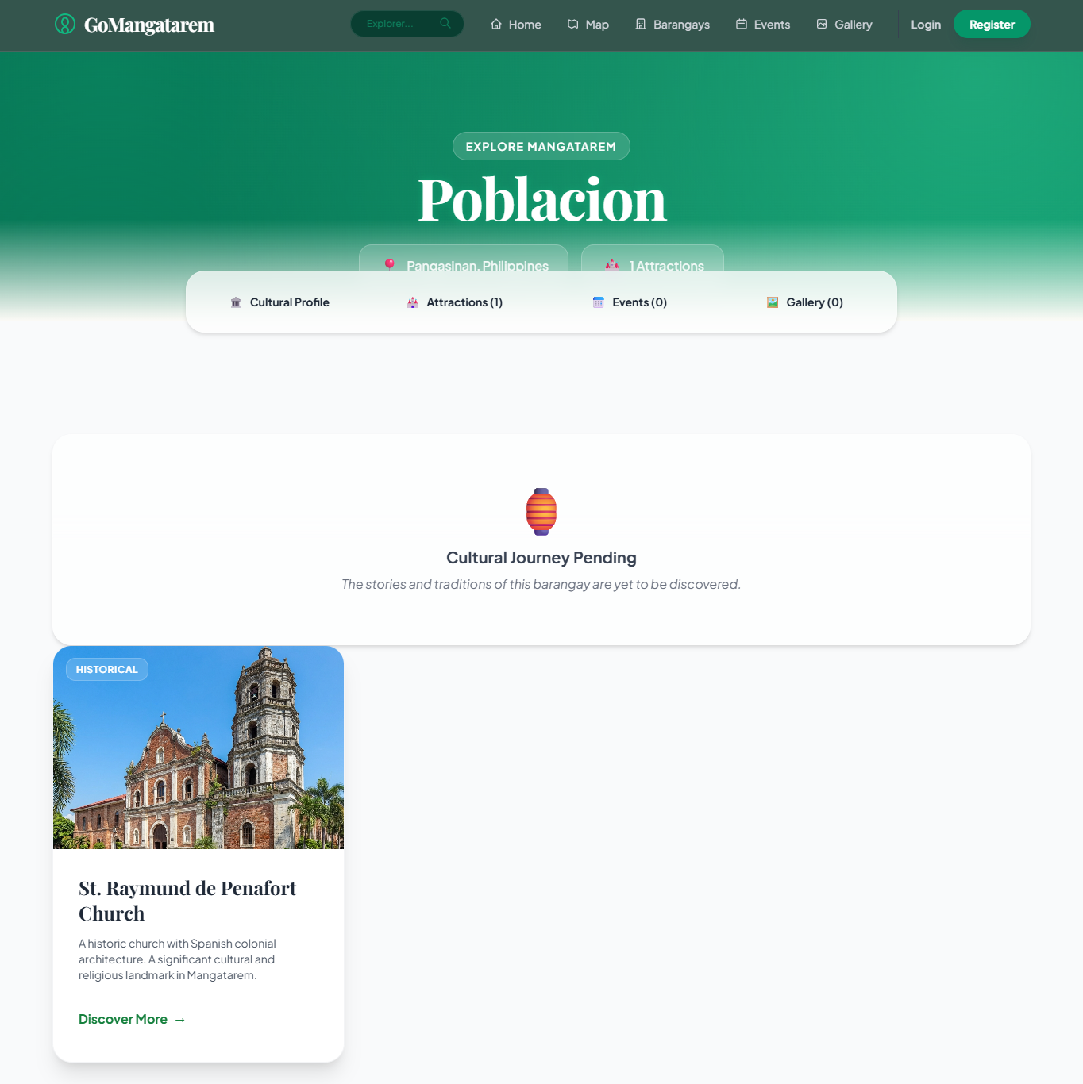
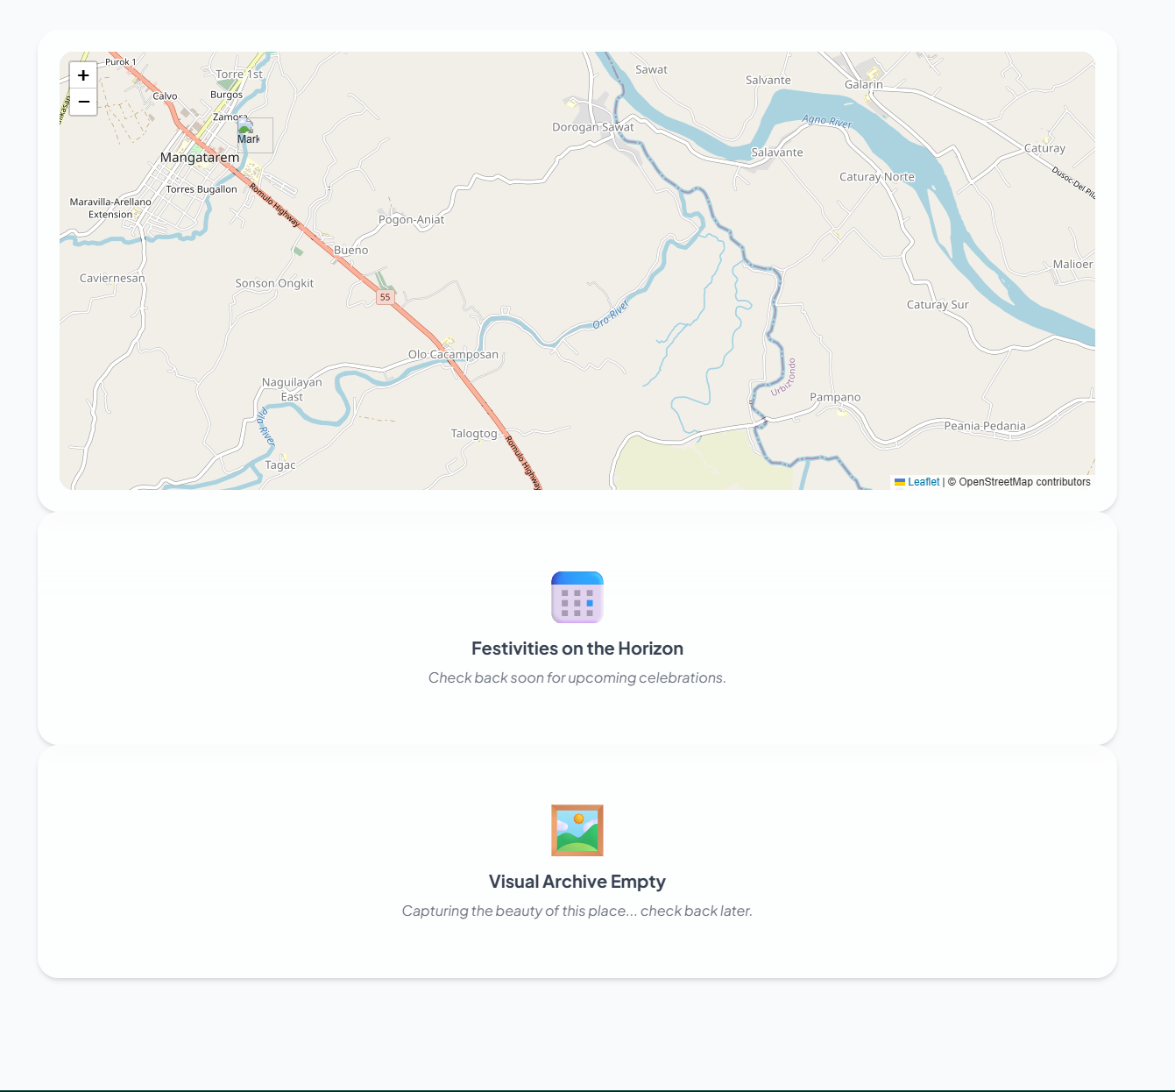

Slide 30
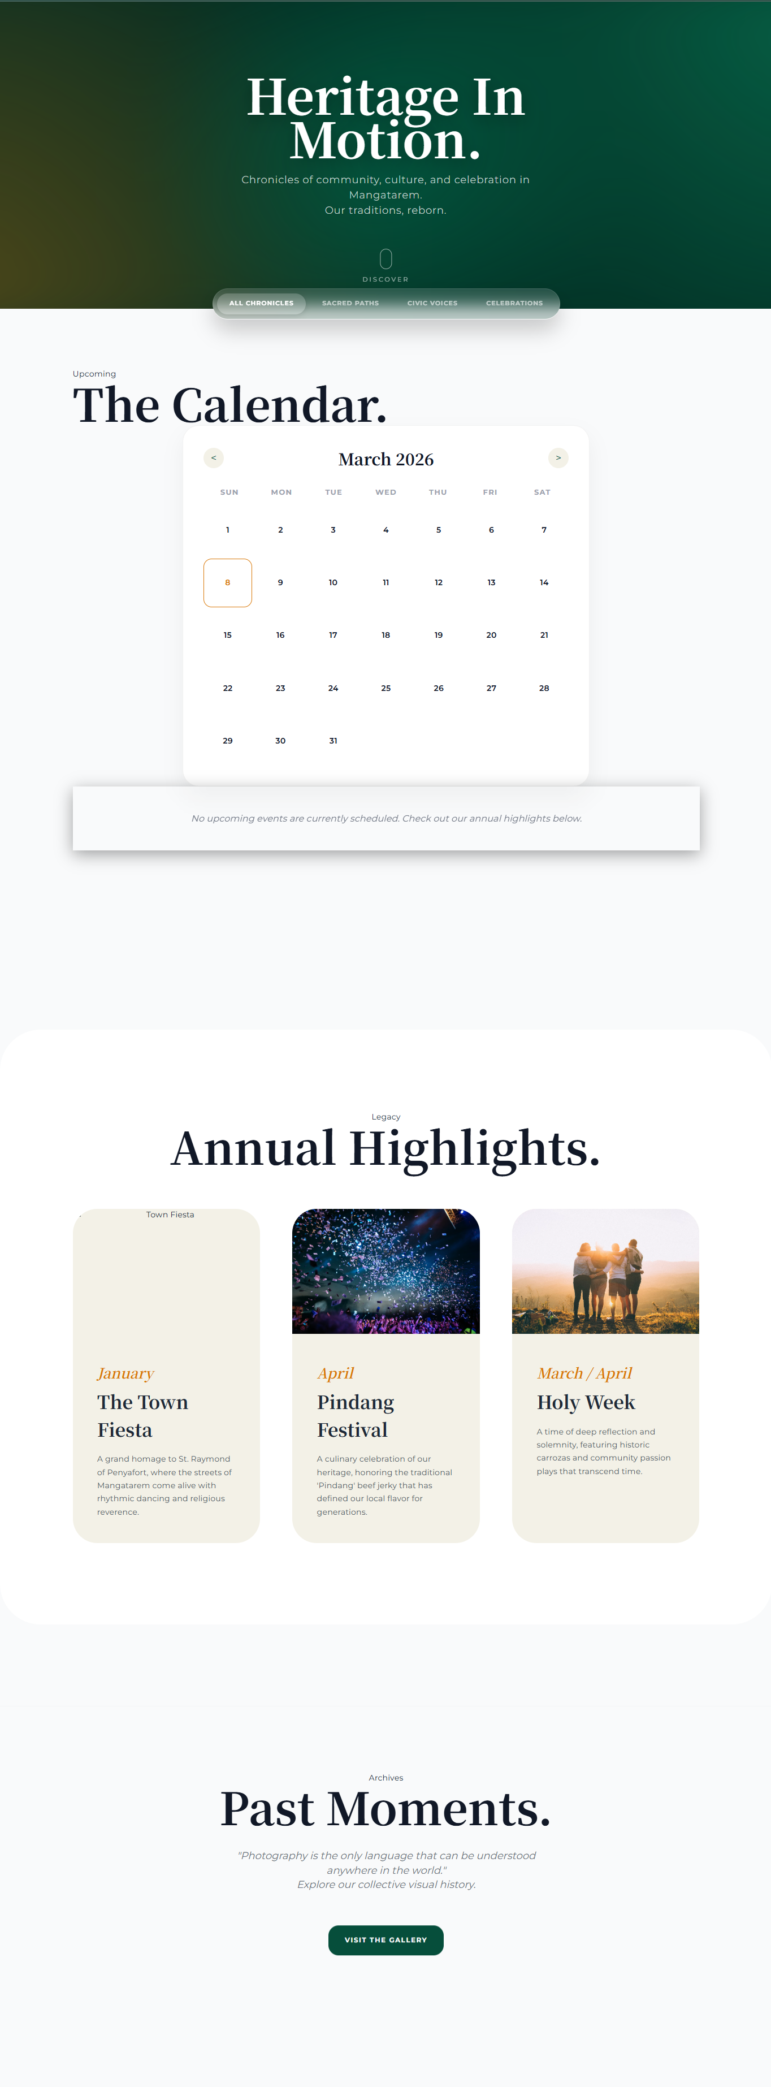

Slide 31
Thank You!

