Slide 1


Cybersecurity Should Be a Mandatory Course for All IT Students
Building a Secure Future

Slide 2
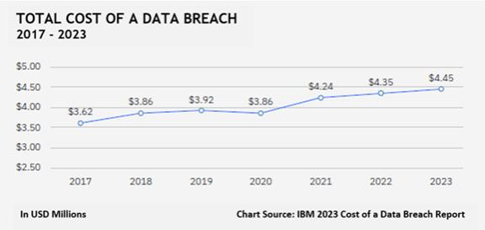

Average cost of a data breach
Can we afford to ignore security?
$4.5M

Slide 3
Current Threat Landscape
A cyber attack occurs every 39 seconds
95% of breaches caused by human error
Ransomware attacks doubled in 2023

Slide 4
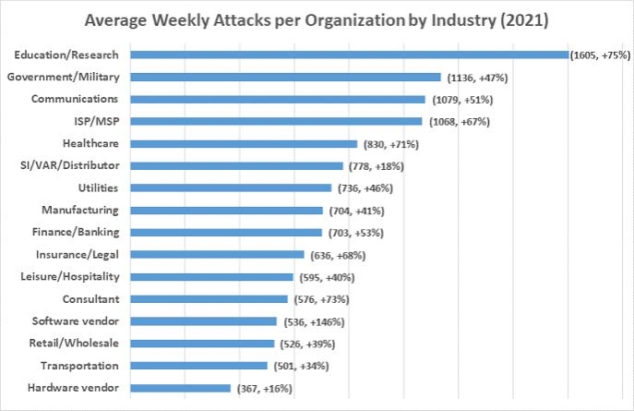
The Current Gap

Slide 5
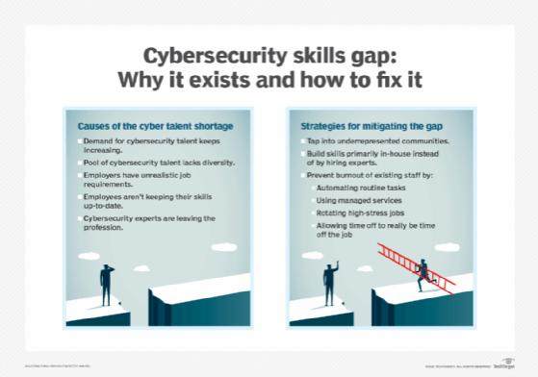
When Security Knowledge Gaps Strike

Slide 6

Why Mandatory?
“Every IT Role = Security Role”
“Security from Day One”
“One Weak Link → Whole System at Risk”

Slide 7
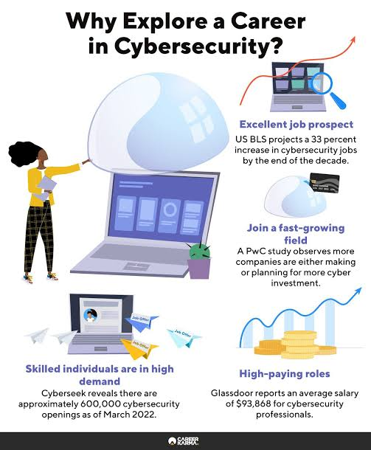
Benefits to Students (Career Focus)
“3.5 million unfilled positions”
“15-20% salary increase”
“Essential skill for advancement”
“Stand out in job market”

Slide 8
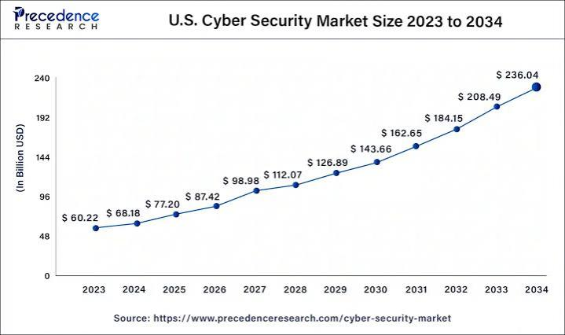
Job Market Demand

Slide 9

“Making It Happen”
Integration
Add to existing courses
Security modules
Practical exercises
Core Topics
Basic principles
Common vulnerabilities
Security testing
. Hands-on Approach
Real case studies
Lab exercises
Team projects

Slide 10
“We cannot afford to graduate IT professionals without cybersecurity knowledge”

Slide 11

“We cannot afford to graduate IT professionals without cybersecurity knowledge”
Thank you for listening

