Slide 1
The AI Doctor Blueprint
AI-Powered Healthcare Assistant
Presented by: Jemi Jose
Course: Capstone Project
Instructor(s): __________

Slide 2
Roadmap
Problem Statement
Literature Gap
System Contribution
Architecture Overview
Algorithms & Models
Workflow Demo
Key Takeaways

Slide 3
Problem & Literature Gap
Delayed Healthcare Access
Limited Remote Diagnosis
High Consultation Costs
Lack of AI Integration
Need for Faster Predictions

Slide 4
Project Contribution
AI-Based Symptom Analysis
Real-Time Recommendations
User-Friendly Dashboard
Secure Patient Workflow
Scalable Healthcare Solution

Slide 5
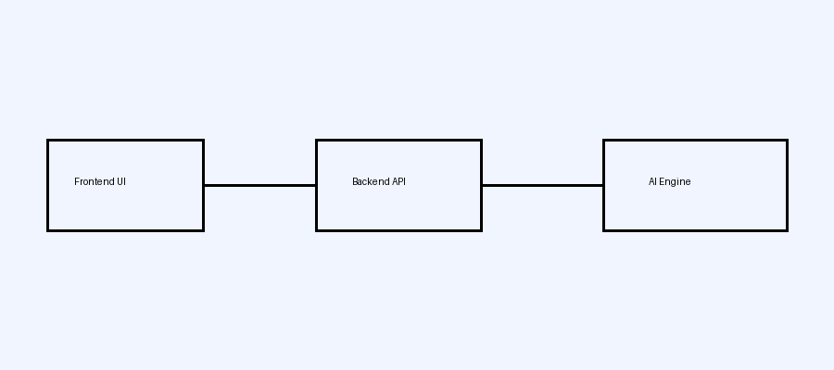
System Architecture
Frontend: React / Web UI
Backend: FastAPI / Node.js
AI Engine: ML Models
Database: MongoDB / SQL
API Communication Layer

Slide 6
Technical Workflow
User Inputs Symptoms
Data Sent to Backend
ML Model Processes Input
Prediction Generated
Result Displayed to User

Slide 7
Algorithms & Equations
Natural Language Processing
CNN / Classification Models
Feature Extraction
Confidence Score Equation
Prediction Optimization

Slide 8

Frontend & Backend Demo
Technical User Workflow
General User Interface
Backend API Monitoring
Database Connectivity
Prediction Output Display

Slide 9
Results & Advantages
Fast Medical Insights
Improved Accessibility
Reduced Response Time
Scalable Architecture
Enhanced User Experience

Slide 10
Key Takeaways
AI Improves Healthcare
Real-Time Medical Support
Efficient Decision Making
Secure & Scalable System
Future AI Healthcare Impact

