Slide 1
Git and Github: Version Control and Collaboration
James R. Bradley

Slide 2
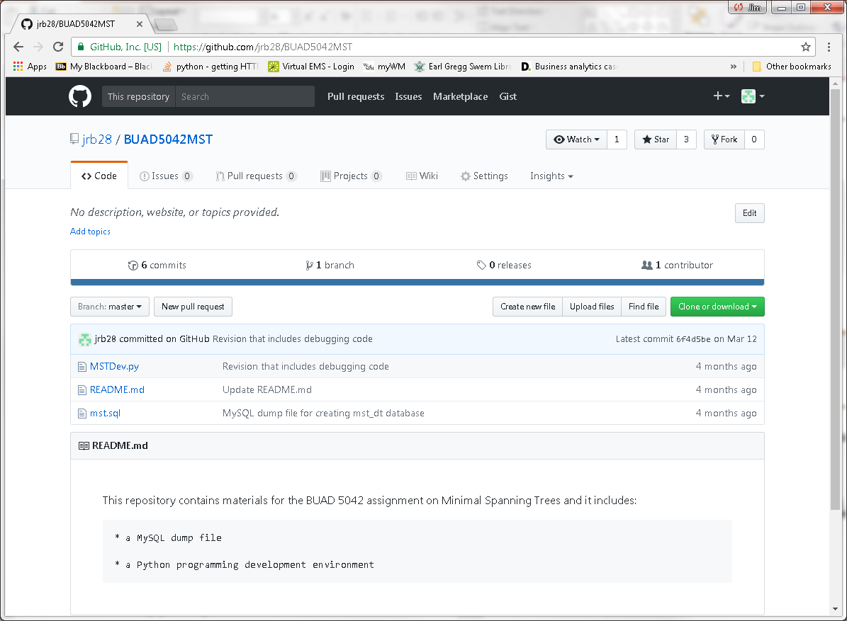
Git and Github
You may well have been to github.com
Place for storing/distributing files: repository (repo)
Git is integrated with Github site
Git provides for version control

Slide 3
Portfolio
Github can be important for another reason
Publish a portfolio of work for use in your job search

Slide 4
Version Control
Have you revised a working program, and then it didn’t work anymore?
Version control permits program development while avoiding breaking a program
You can always revert to a previous functional copy
Git
For a sole developer:
Install git on your computer
For collaboration
Use desktop git with github.com

Slide 5
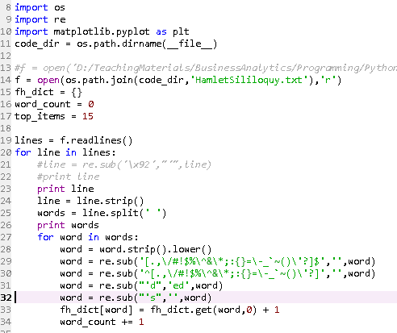



Version Control
Collaboration
Multiple people cannot edit software simultaneously
Conflicts
Corrupted Code

Slide 6
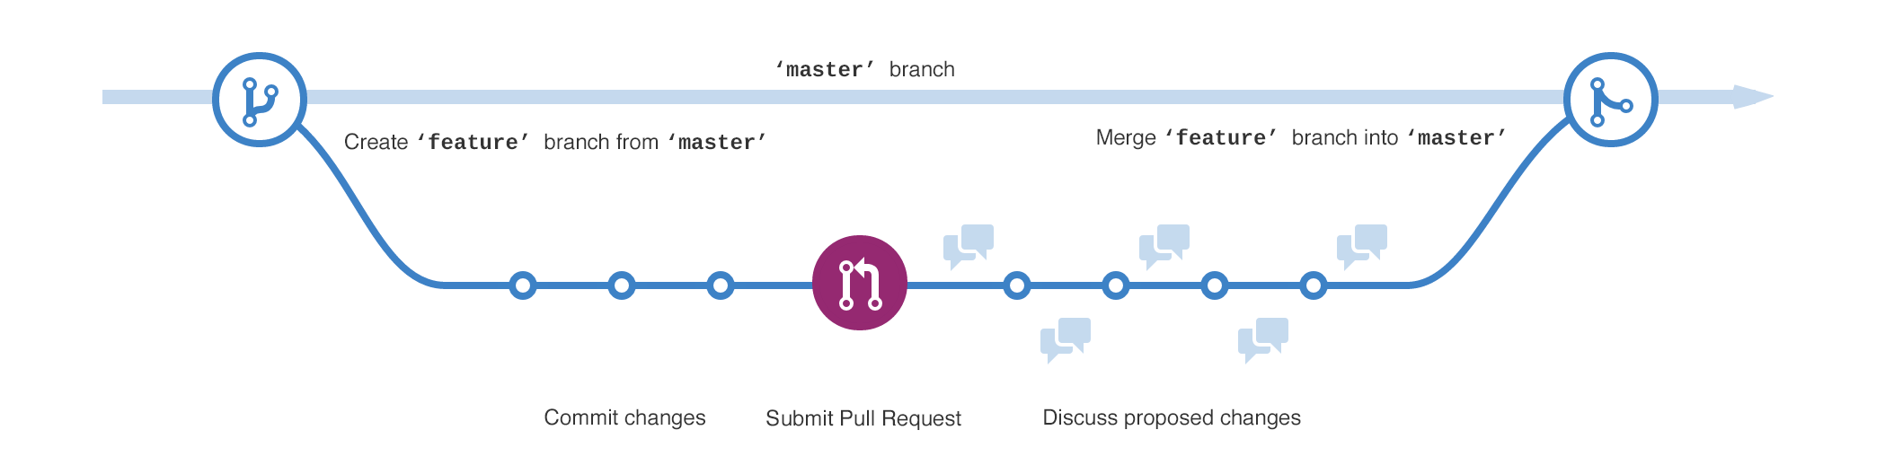
Version Control
Git permits a temporary copy of code to be created
A branch; can be multiple branches
Changes are made to branches
Discussed, debugged, then merged back into the master branch
Master branch code is never disrupted

Slide 7
Version Control
We’ll focus on git in the context of a sole developer
… and Github as a portfolio repository
Relatively small step from there to collaboration
Extra session later for this, time permitting

Slide 8

Git on Your Laptop
Download and install git:
https://git-scm.com/download/win
Use all default configuration settings
Download and unzip git_tutorial.zip
See Blackboard
Folder has one file: my.py
This session:
We’ll step through a basic sequence of git commands

Slide 9
Git on Your Laptop
Conceptually what’s happening…
We’ll be working on a Python program: my.py in a folder called git_tutorial
We’ll create a master branch and a test branch
The master branch works, but we want to make changes
We’ll make changes to the test branch
Git keeps track of multiple versions master and test by logging changes made in each version

Slide 10
Git on Your Laptop
′test ′
′test ′
work on ′test ′ version

Slide 11
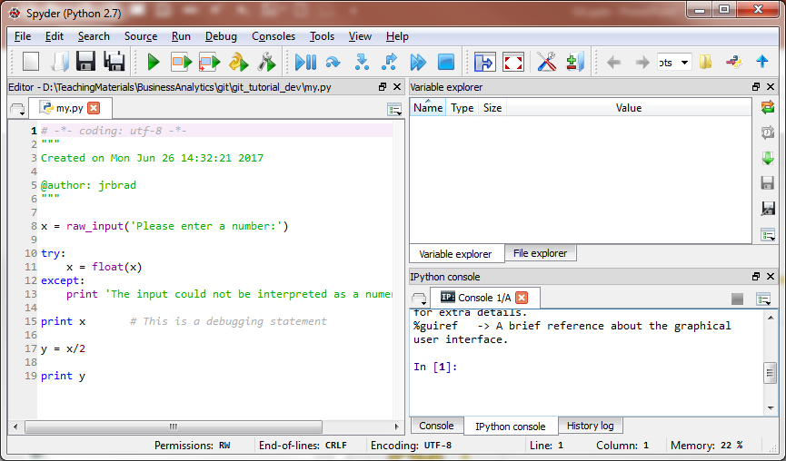
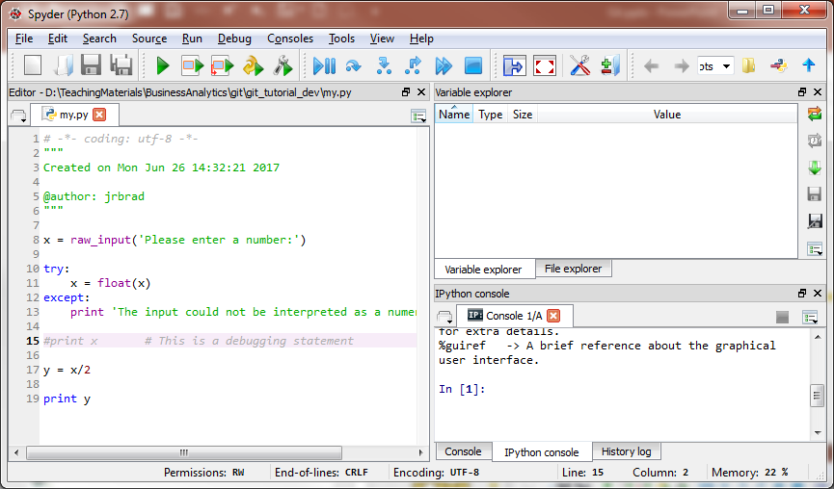
Git on Your Laptop
master
test
Only one my.py will ever appear in git_tutorial
Git permits switching between versions (branches)
Git will apply whatever changes are appropriate for the version you want to use

Slide 12
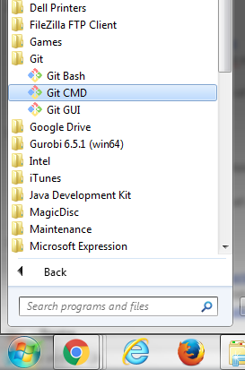
Git on Your Laptop
Open the Git Command window

Slide 13
Git on Your Laptop
Change directory to the git-tutorial folder
Type drive letter corresponding to the location of the git_tutorial folder, then a colon and Enter
Copy file path for my.py from Windows Explorer, Ctrl-c
Paste into Git Command window with cd command
cd = change directories
Pasting requires right-clicking on upper left Git icon
See subsequent slides for screenshots

Slide 14
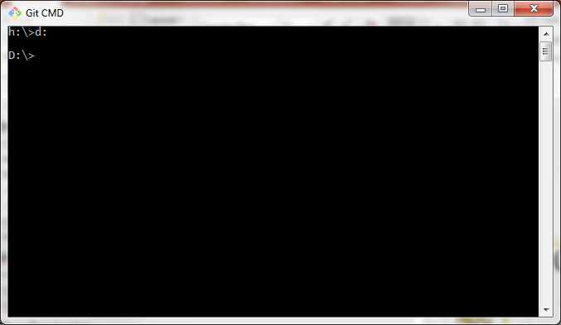
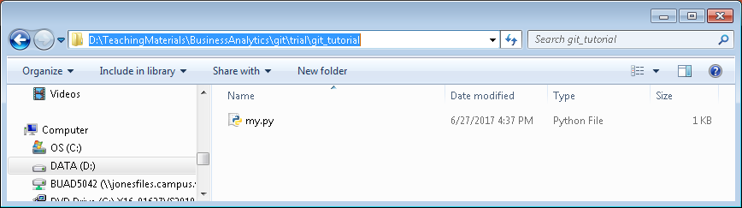
Git on Your Laptop
Your drive will most likely be c:

Slide 15
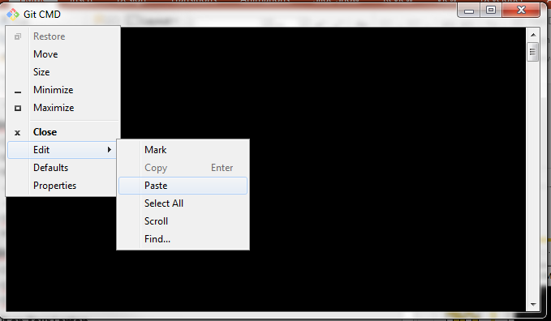
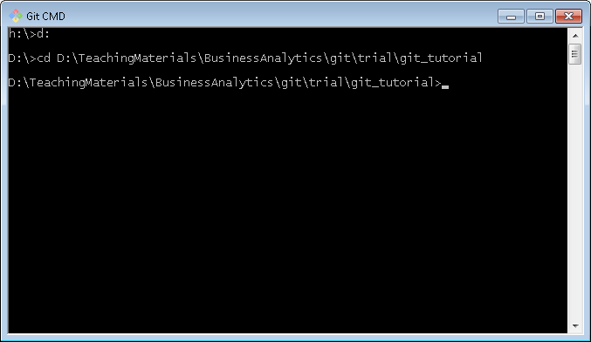
Git on Your Laptop

Slide 16
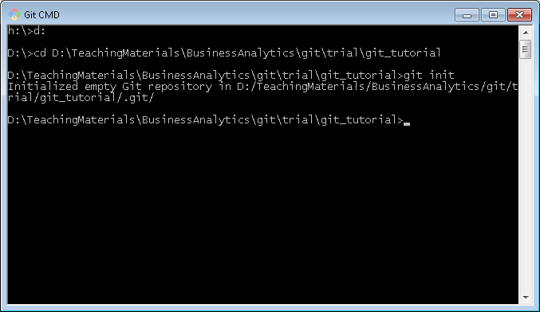
Git on Your Laptop
Initialize the folder as a git folder
This tells git to start tracking changes
Type git init in Git Command window, then Enter

Slide 17
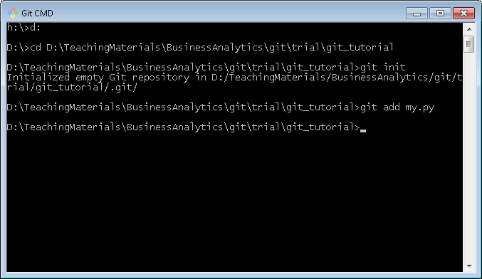
Git on Your Laptop
Add my.py as a file for git to keep track of
Type git add my.py, then Enter

Slide 18
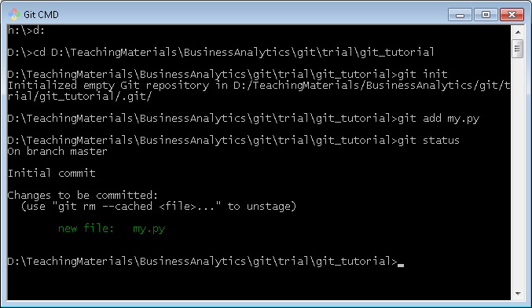
Git on Your Laptop
Check status of folder
Type git status, then Enter

Slide 19
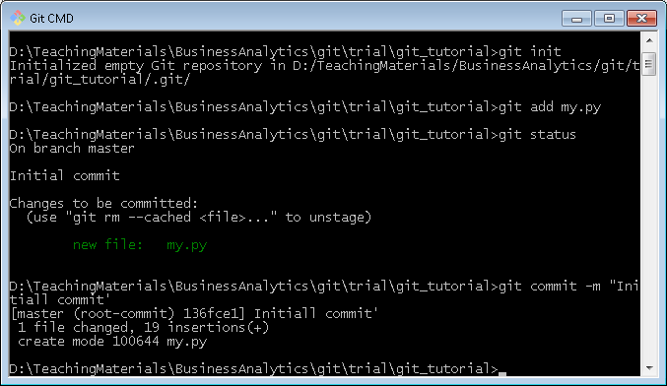
Git on Your Laptop
Commit initial version of my.py
Type git commit my.py –m “message”, then Enter
The message give a brief description of the change
… our message will be “Initial commit”

Slide 20
Git on Your Laptop
You’ll need to perform a git add command each time you want to commit changes to a file

Slide 21
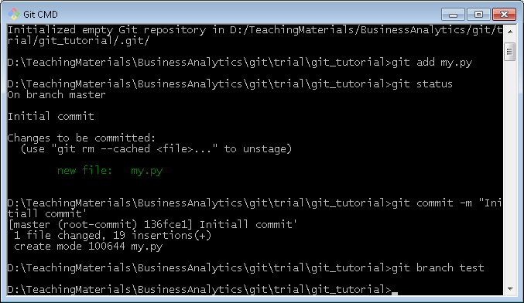
Git on Your Laptop
We will revise my.py so create a test branch
git branch test, then Return

Slide 22
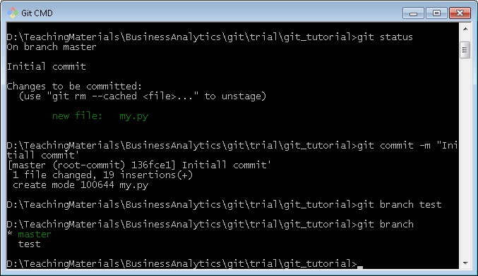
Git on Your Laptop
Check to make sure you created a branch
git branch gets list of branches
The * shows which branch you are working on

Slide 23
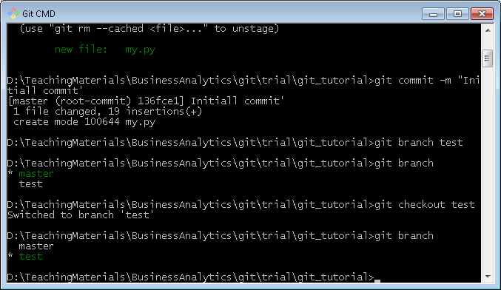
Git on Your Laptop
Change to test branch
git checkout test, then Return
git branch, then Return

Slide 24
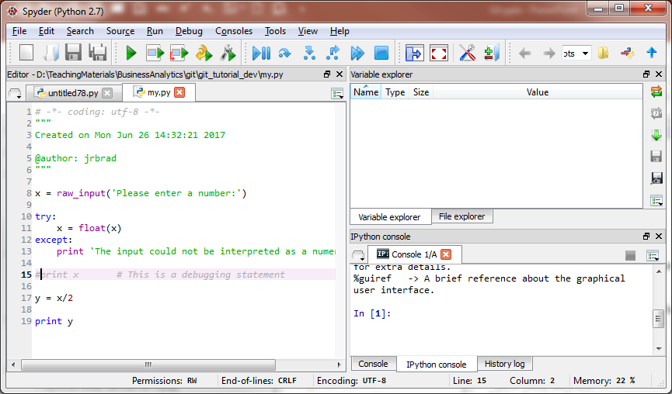
Git on Your Laptop
Revise the Python Program in Spyder, and save, close

Slide 25
Git on Your Laptop
Make desired revisions in the test branch
… so the working code in master branch is not disrupted
… make sure revisions work in test branch
… then merge back into the master branch when you want to finalize them

Slide 26
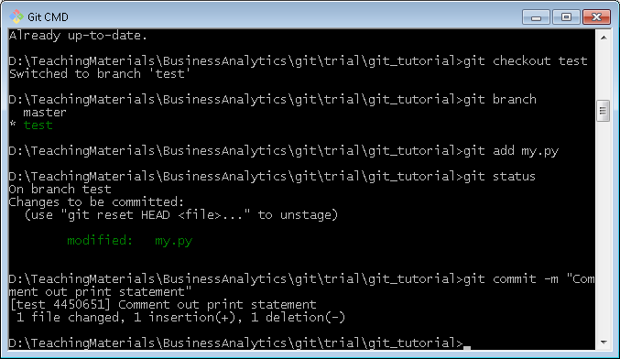
Git on Your Laptop
git add my.py, then Return
git status
git commit –m “Comment out print statement”

Slide 27
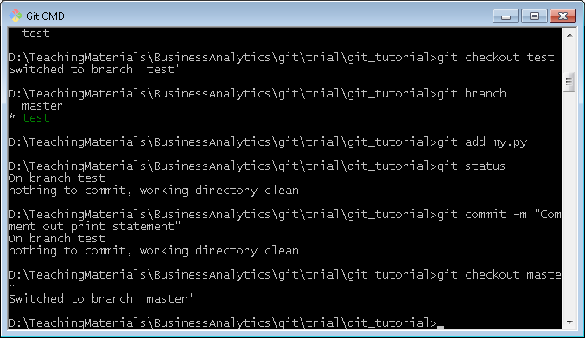
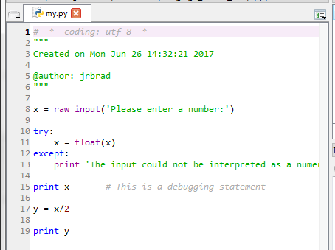
Git on Your Laptop
For illustration, go back to master branch
git checkout master, then Return
Reopen my.py in Spyder
Code is master branch
is untouched

Slide 28
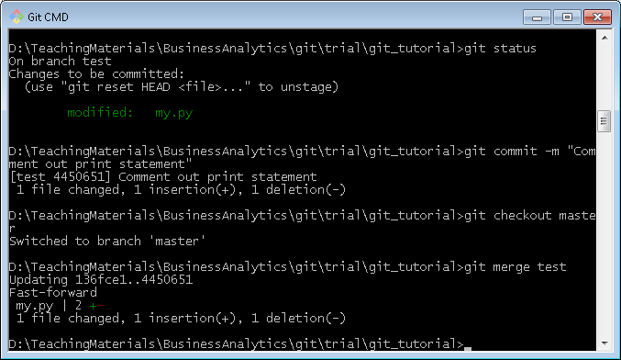
Git on Your Laptop
Merge changes from test branch into master
git merge test, then Return

Slide 29
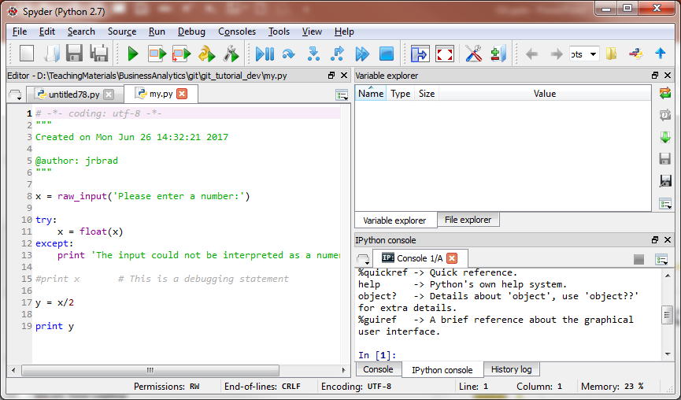
Git on Your Laptop
Now check out my.py in master branch
It reflects the change made in test branch

Slide 30
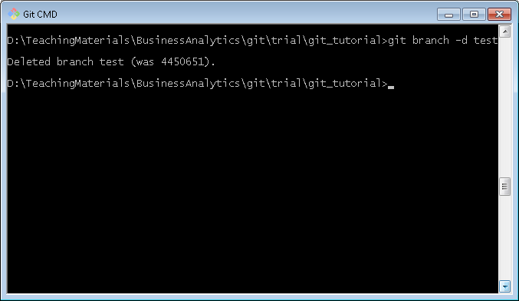
Git on Your Laptop
Delete test branch
git branch –d test, then Return
git branch, then Return to verify deletion

Slide 31
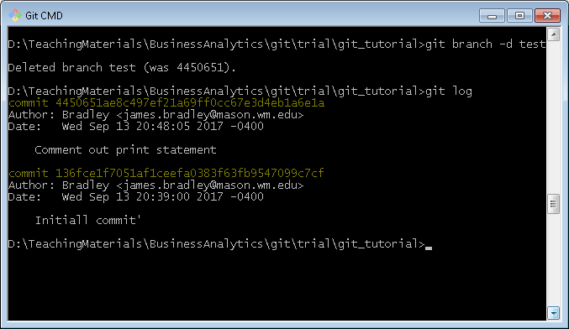
Git on Your Laptop
Revert to a former commit level
git log, then Return to see commit history

Slide 32
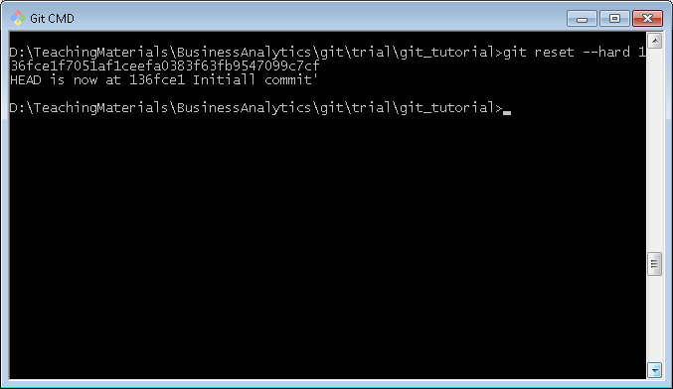
Git on Your Laptop
git reset --hard commit-hash-number

Slide 33
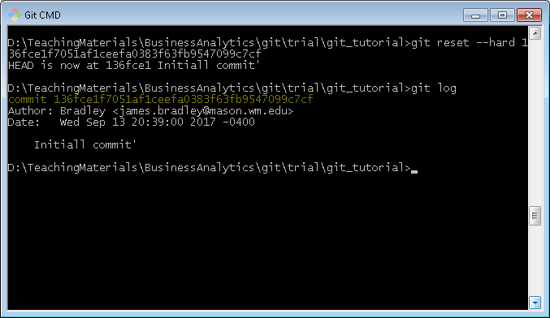
Git on Your Laptop
git log

Slide 34
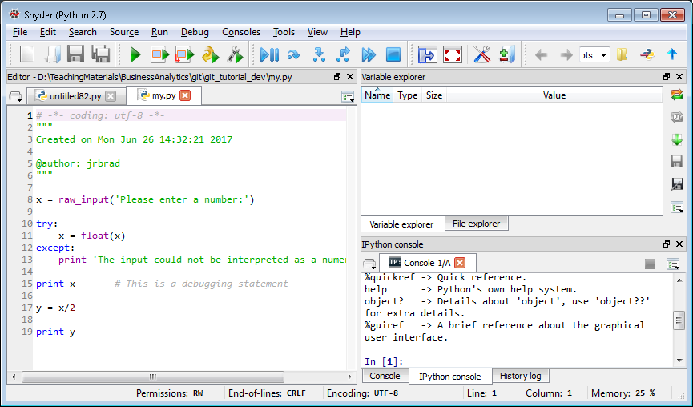
Git on Your Laptop
Check out the file in Spyder… back to original
You need to close the file in Spyder, then reopen

Slide 35
Git Resources
Install desktop git
https://desktop.github.com/
https://git-scm.com/download/win
udacity.com course
https://in.udacity.com/course/how-to-use-git-and-github--ud775/
Online interactive tutorial
https://try.github.io/levels/1/challenges/1

Slide 36
Git Resources
Cheat Sheet
https://services.github.com/on-demand/downloads/github-git-cheat-sheet.pdf
Written tutorials
https://git-scm.com/book/en/v2/Getting-Started-Git-Basics
Branching & merging
https://git-scm.com/book/en/v2/Git-Branching-Basic-Branching-and-Merging

Slide 37
Git Resources
Other tutorials
Udacity:http://blog.udacity.com/2015/06/a-beginners-git-github-tutorial.html
http://blog.scottlowe.org/2015/01/14/non-programmer-git-intro/
http://blog.scottlowe.org/2015/01/27/using-fork-branch-git-workflow/

Slide 38
Portfolios on Github
Github Repositories (Repos)
Github Web Pages

Slide 39


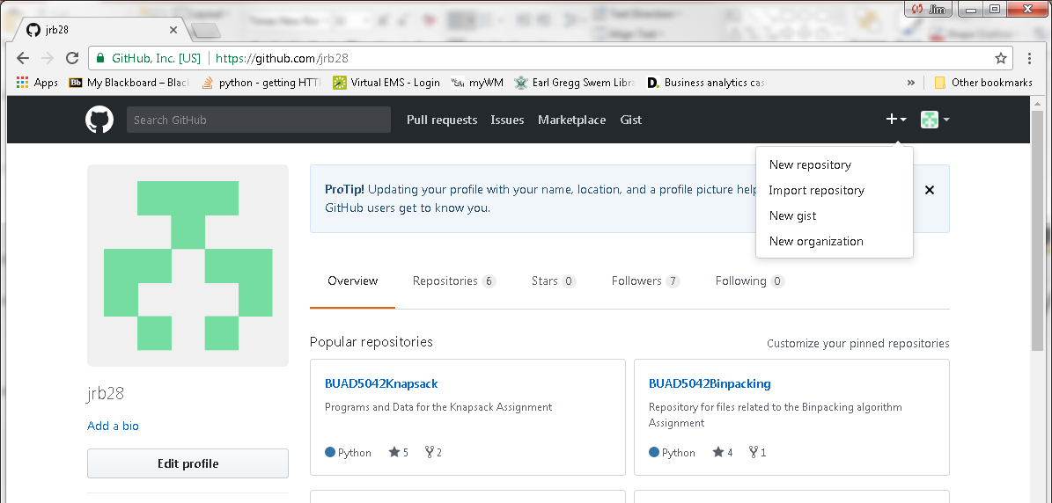
Portfolio on Github
Create account: go to https://github.com/
Create a repository

Slide 40
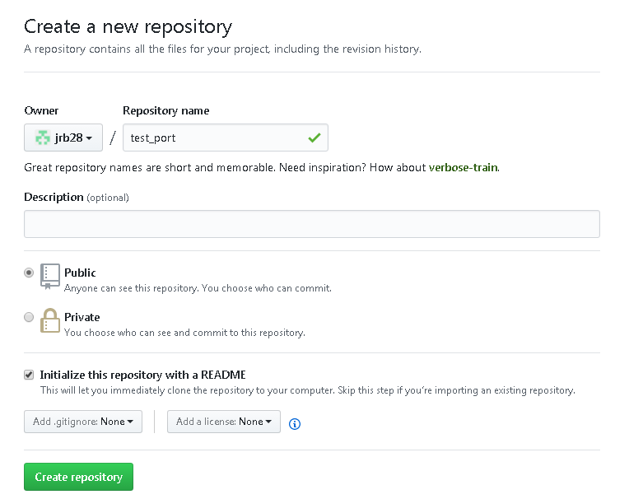
Portfolio on Github
Choose Public repository (free)
Choose Initialize this repository with a README

Slide 41
Portfolio on Github
Click on Upload Files button
Select files or drag to browser
Change commit message if desired
Click on Commit Changes button

Slide 42
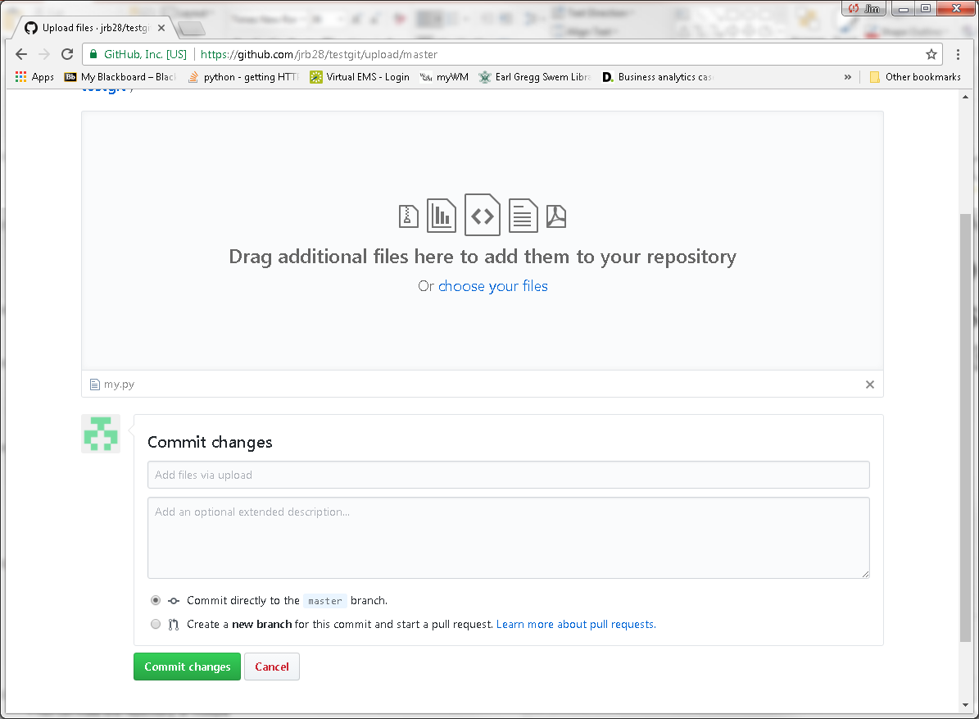
Portfolio on Github

Slide 43
Portfolio on Github
Good artifacts of your experience in a Github repo:
Code, Jupyter notebooks, presentations, reports, etc.
Use multiple repos
Focus each on different topics, job searches
Jupyter notebooks in repos are rendered as html web pages
Opportunity to show your work and explain what you did

Slide 44
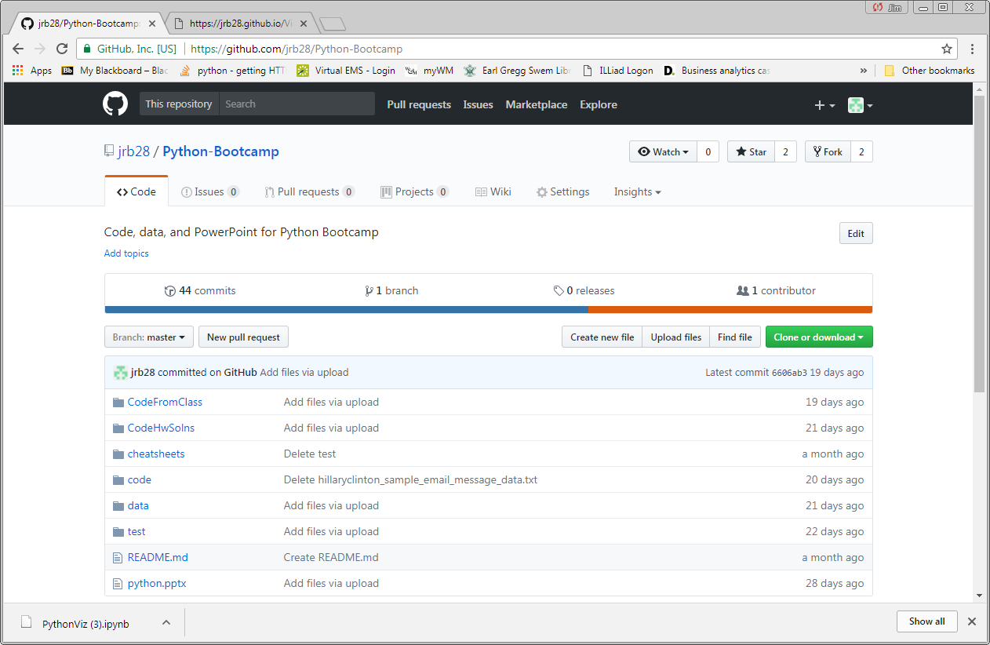
Portfolio on Github
Github repo

Slide 45
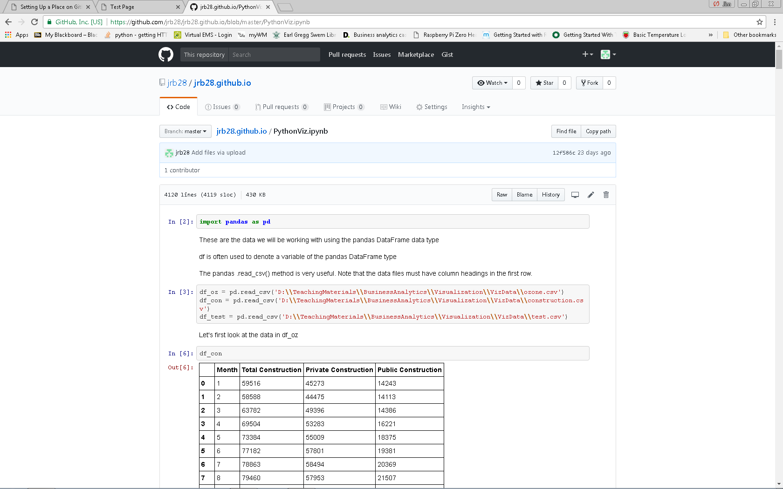
Portfolio on Github
Jupyter notebook example

Slide 46
Portfolio on Github
Github.com also allows a web page
Create a GitHub repository with this name:
your_username.github.io
Browse to your web page
your_username.github.io

Slide 47
Portfolio on Github
Edit web page by creating html document in your web page repo
Create/use index.html as landing page (default page)
Within your_username.github.io you’ll need to save Jupyter notebooks as html documents for them to be rendered properly
Stored a .ipynb files they will be downloaded

Slide 48
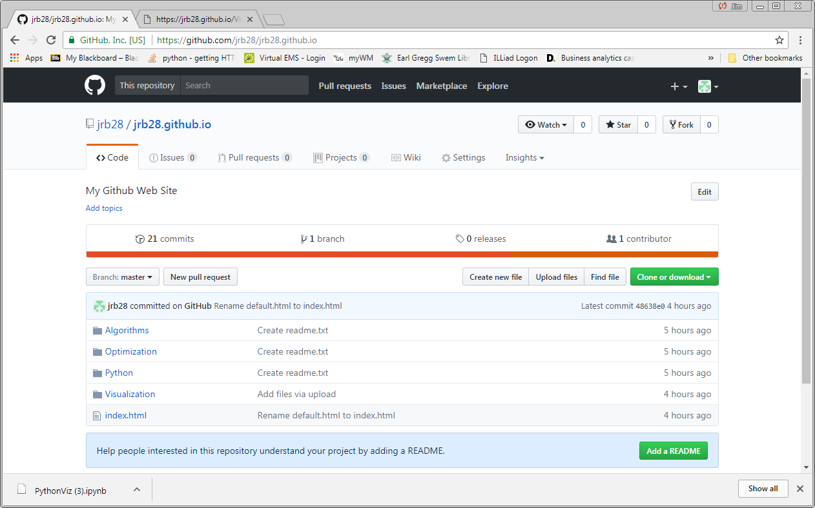
Portfolio on Github

Slide 49
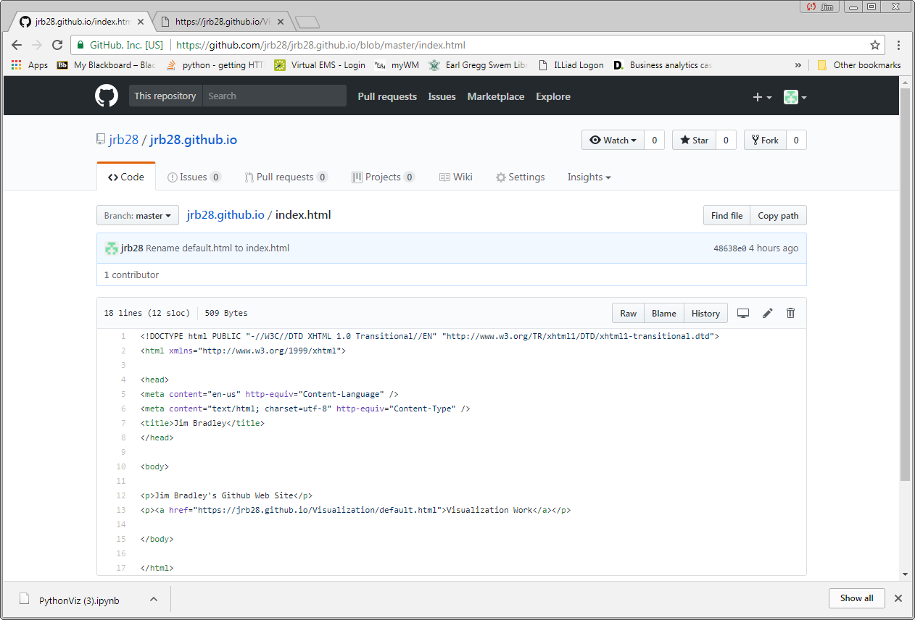
Portfolio on Github
HTML coding is beyond scope of this session/course

Slide 50
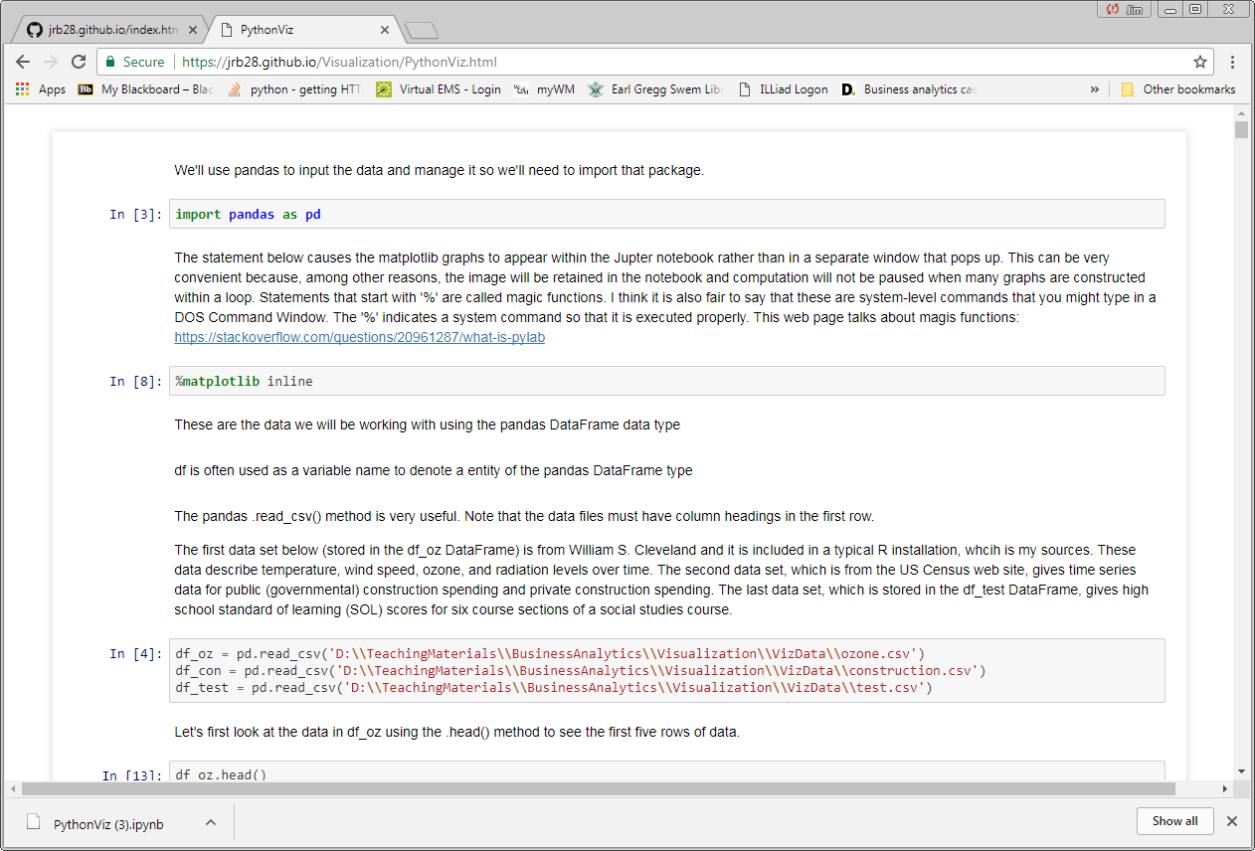
Portfolio on Github
Jupyter from a Github web page Notice URL

Slide 51
Portfolio on Github
One HTML editing option
Microsoft Web Expressions
Available for free through Mason School
HTML code reference
www.w3schools.com/html/

Slide 52
Portfolio on Github
Resources & Ideas
https://dannguyen.github.io/github-for-portfolios/
See first tutorial for basics of setting up a Github web page
http://blog.udacity.com/2016/02/how-to-build-a-data-analysis-portfolio-that-will-get-you-hired.html
https://techbeacon.com/what-do-job-seeking-developers-need-their-github
https://help.github.com/articles/working-with-jupyter-notebook-files-on-github/
Jupyter and Github

Slide 53
Portfolio on Github
Other possibly useful links:
https://www.dataquest.io/blog/how-to-share-data-science-portfolio/
http://theindustry.cc/2013/01/14/show-your-code-use-github-to-maintain-your-code-portfolio/

