Slide 1
R .Jemima Gladys
Thangam
Final Project

Slide 2
HEART DISEASE PREDICTION USING CONVOLUTIONAL NEURAL NETWORK

Slide 3

AGENDA 1.Problem statement 2.Project Overview 3.Who are the end users 4.Your Solution and its value proposition 5.The wow in the project 6.Modelling 7.Results

Slide 4

PROBLEM STATEMENT Developing a CNN-based predictive model to accurately identify individuals at high risk of developing heart disease, utilizing patient data including medical history, diagnostic tests, and imaging data, to improve early intervention and personalized patient care.

Slide 5

PROJECT OVERVIEW The project overview for heart disease prediction using Convolutional Neural Networks (CNNs) involves leveraging advanced machine learning techniques to develop a predictive model capable of accurately assessing an individual's risk of heart disease. By integrating diverse patient data such as medical history, diagnostic tests, and imaging data, the CNN-based model aims to provide healthcare professionals with a powerful tool for early detection and personalized intervention strategies. Through comprehensive data collection, preprocessing, model training, and rigorous evaluation, the project seeks to contribute to the advancement of predictive analytics in healthcare, ultimately improving patient outcomes and reducing the burden of heart disease on society.

Slide 6
WHO ARE THE END USERS? 1.Patients: Individuals concerned about their heart health could use the prediction system to assess their risk of developing heart disease. This information could empower them to make lifestyle changes or seek medical intervention to mitigate their risk. 2. Healthcare Providers: Cardiologists, general practitioners, and other healthcare professionals could use the prediction system as a decision support tool. It could assist them in interpreting medical imaging data more accurately and efficiently, leading to better diagnosis and treatment planning for their patients. 3. Hospitals and Clinics: Healthcare institutions could implement the heart disease prediction system as part of their diagnostic workflow. This could improve the efficiency of their services by enabling faster and more accurate diagnosis of heart-related conditions. .

Slide 7
YOUR SOLUTION AND ITS VALUE PROPOSITION The solution of heart disease prediction using Convolutional Neural Networks (CNNs) involves developing a robust model trained on diverse medical imaging data and patient information to accurately assess the risk of heart disease. By leveraging CNNs, the system can analyze complex patterns in medical images, providing healthcare professionals with valuable insights for early detection and personalized treatment planning. The value proposition lies in its ability to offer accurate and timely predictions, facilitating early intervention, reducing healthcare costs, and ultimately improving patient outcomes. Additionally, the integration of such a system into healthcare workflows empowers healthcare providers with advanced diagnostic tools, enhancing the overall quality of care delivered to patients.

Slide 8
THE WOW IN YOUR SOLUTION The end users of a project like heart disease prediction using CNNs represent a diverse array of stakeholders, and addressing their needs and expectations is crucial for the success and adoption of such a system. If you have any more questions or need further assistance, feel free to ask!
3/21/2024 Annual Review

Slide 9
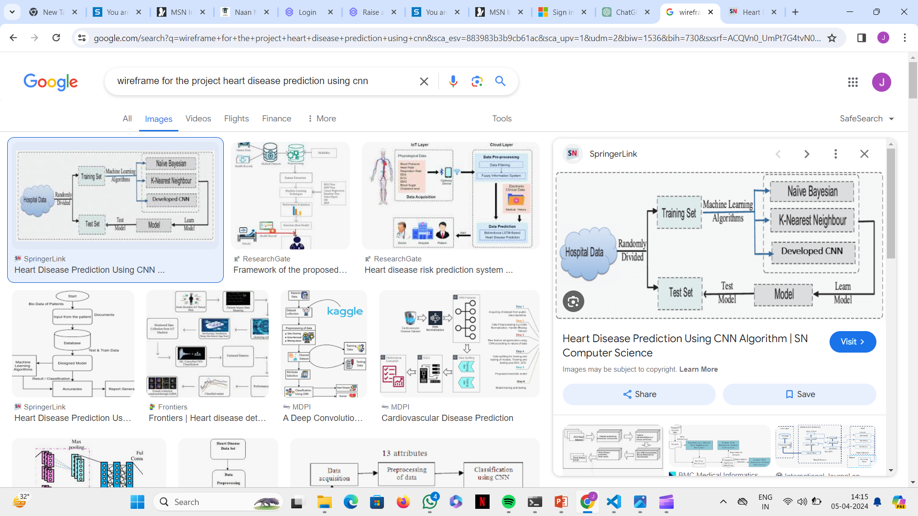
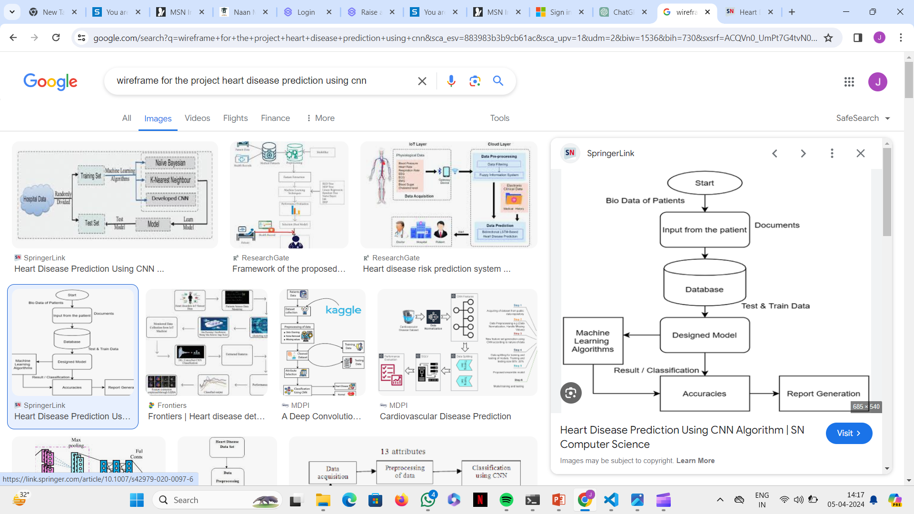
MODELLING

Slide 10
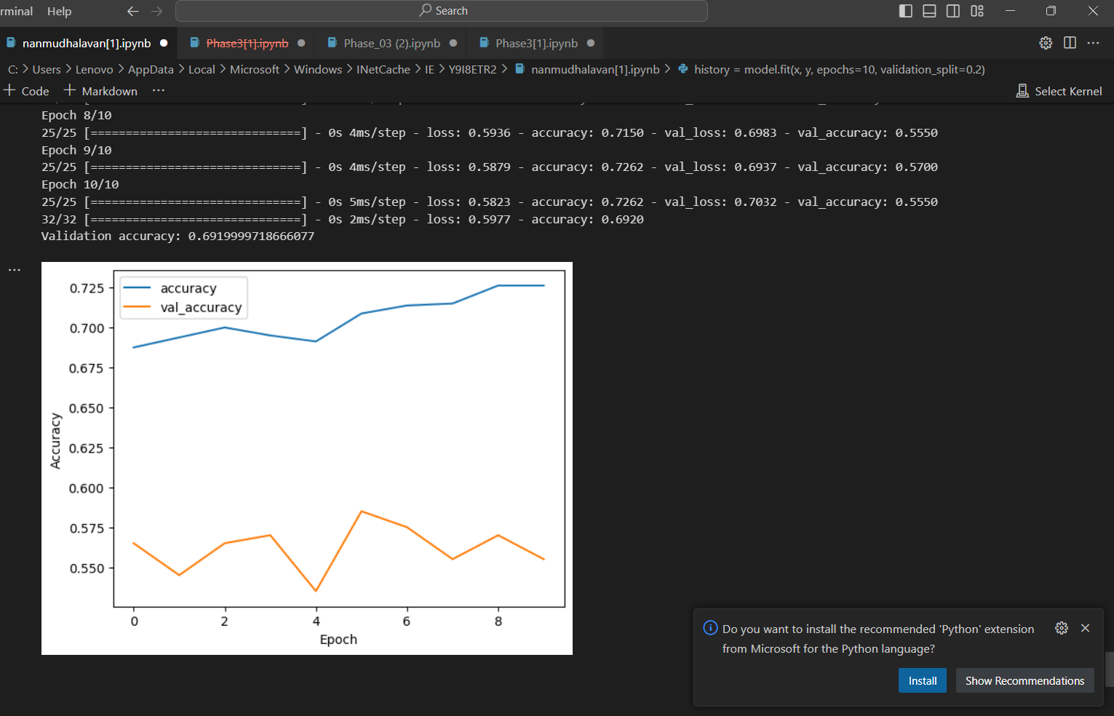
RESULTS

