Slide 1
Team-Image
IMAGE DETECTION APPLICATION
Je Min Son | Jim Lee | Yunhua Luo

Slide 2
Design of Application
User Input
Detecting Object Process
Output

Slide 3
User INPUT
Image
Image
Image
Video

Slide 4


Detecting Object Process

Slide 5
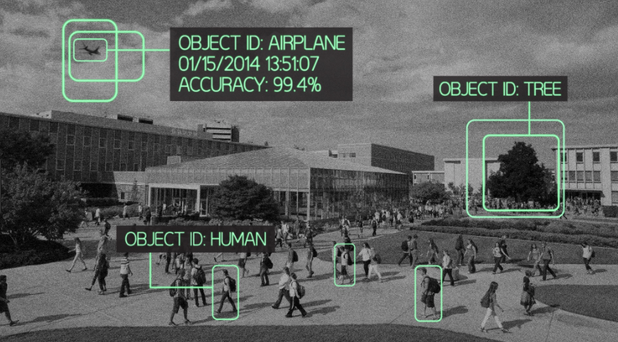
Output

Slide 6
MVP
Detecting one object from input video
Record the time
Display the output

Slide 7
Ideal Product
Find different types of object at the same time
Detecting all similar types of object with one input image
Recognize the object automatically

Slide 8
Timeline
Week 5
Decide the team
Week 6
Initial proposal
Research
Week 7
?
Week 8
Interim status meeting
Week 9
?
Week 10
Final presentation and demonstration
Week 11
Final report

Slide 9
Thank You

