Slide 1
Team-Image
IMAGE DETECTION APPLICATION
Je Min Son | Jim Lee | Yunhua Luo
Notes:
Introduction
1. Team name
2. members name
3. Our purpose

Slide 2
Design of Application
User Input
Detecting Object Process
Output
Notes:
Our design of application is

Slide 3
User INPUT
Positive
Image
Negative
Image
Video
Notes:
User inputs two images; one positive & one negative
Then, use those provided images to set the model which detects the image inside each frame

Slide 4


Detecting Object Process

Slide 5
Algorithm

Slide 6
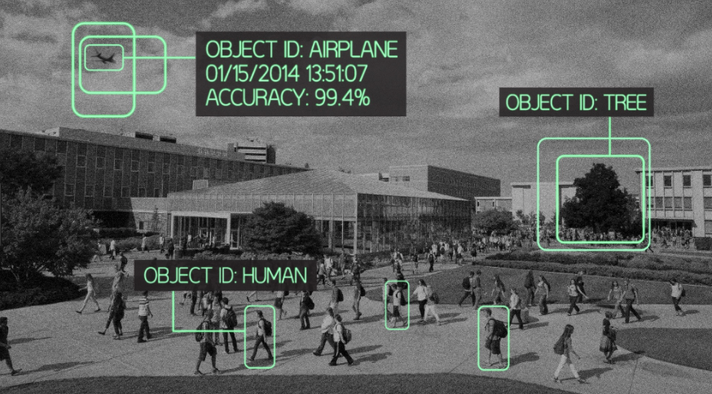
Output

Slide 7
MVP
Splitting the video
Training the model
Tracking the time
Notes:
Split the video into single frames
Training the model to detect one single image using the positive and negative images
Tracking the time using parallelization

Slide 8
Ideal Product
Detect a static image/object from a video
Make it into mobile application to access more conveniently
Make it accessible to the mobile camera to detect the object
Detecting more images at the same time
Notes:
Detect not only images but also object from the video
Trying to make it into mobile application so we can use the camera right away to detect the object
Detecting more than one images at the same time

Slide 9
Timeline
Week 5
Decide the team
Week 6
Initial proposal
Research
Week 7
Start working project
Week 8
Interim status report
Week 9
Finishing up MVP
Week 10
Final presentation and demonstration
Week 11
Final report

Slide 10
Thank You

