Slide 1
Team-Image
IMAGE DETECTION APPLICATION
Je Min Son | Jim Lee | Yunhua Luo
Notes:
Introduction
1. Team name
2. members name
3. Our purpose

Slide 2
Design of Application
User Input
Detecting Object Process
Output
Notes:
Our design of application is

Slide 3
User INPUT
Positive
Image
Negative
Image
Video
Notes:
User inputs two images; one positive & one negative
Then, use those provided images to set the model which detects the image inside each frame

Slide 4


Detecting Object Process
Notes:
Using OpenCV to detect images

Slide 5
Algorithm

Slide 6
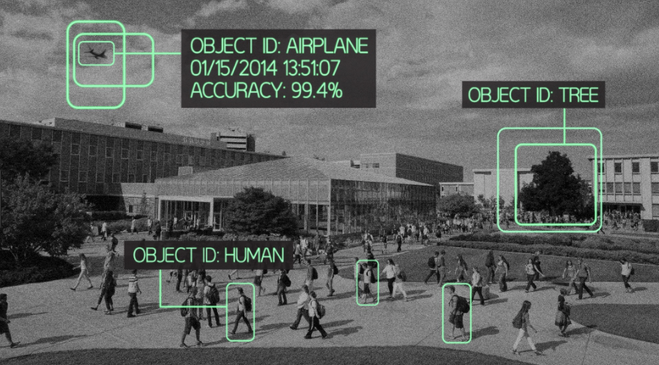
Output

Slide 7
MVP
Detecting one object from input video
Record the time
Display the output

Slide 8
Ideal Product
Find different types of object at the same time
Detecting all similar types of object with one input image
Recognize the object automatically

Slide 9
Timeline
Week 5
Decide the team
Week 6
Initial proposal
Research
Week 7
?
Week 8
Interim status meeting
Week 9
?
Week 10
Final presentation and demonstration
Week 11
Final report

Slide 10
Thank You

