Slide 1
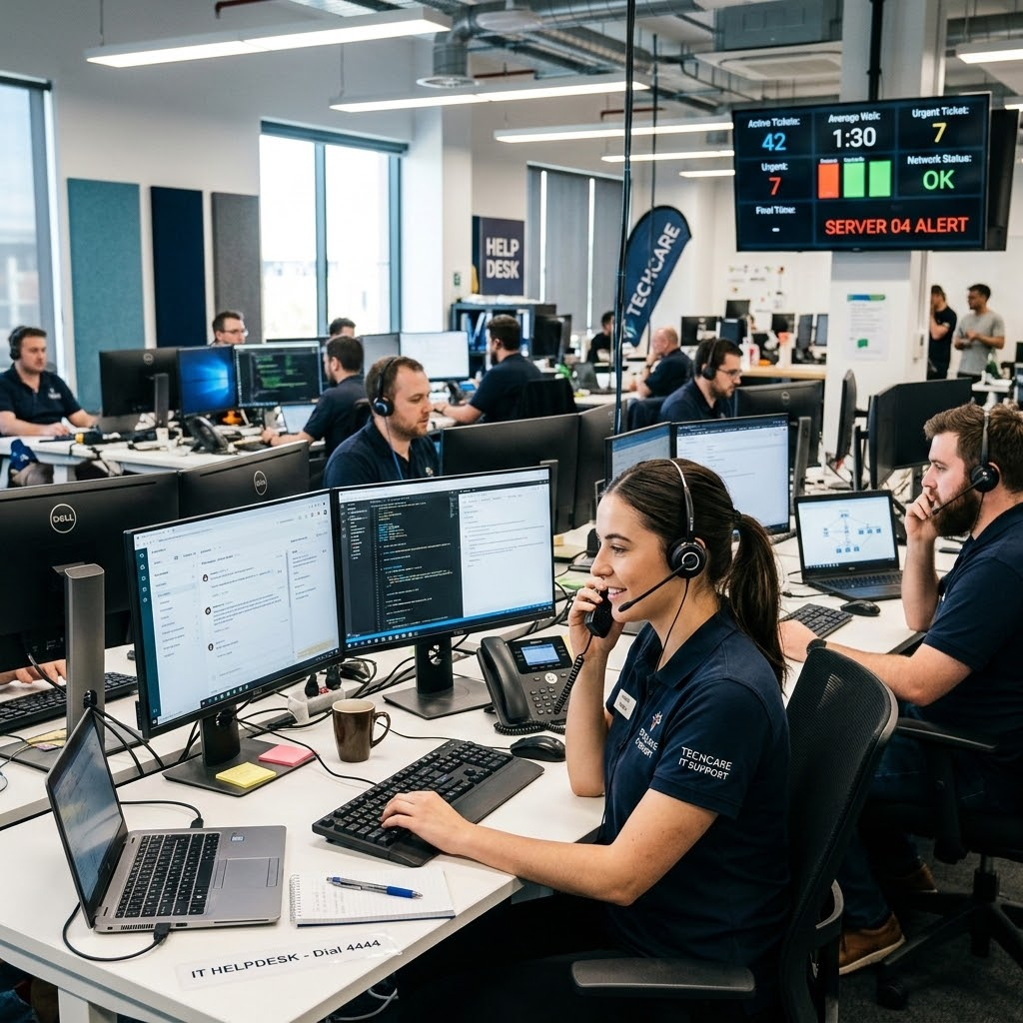
IT Ticket Analysis
- By Jemish Mangukiya
21st May, 2026

Slide 2

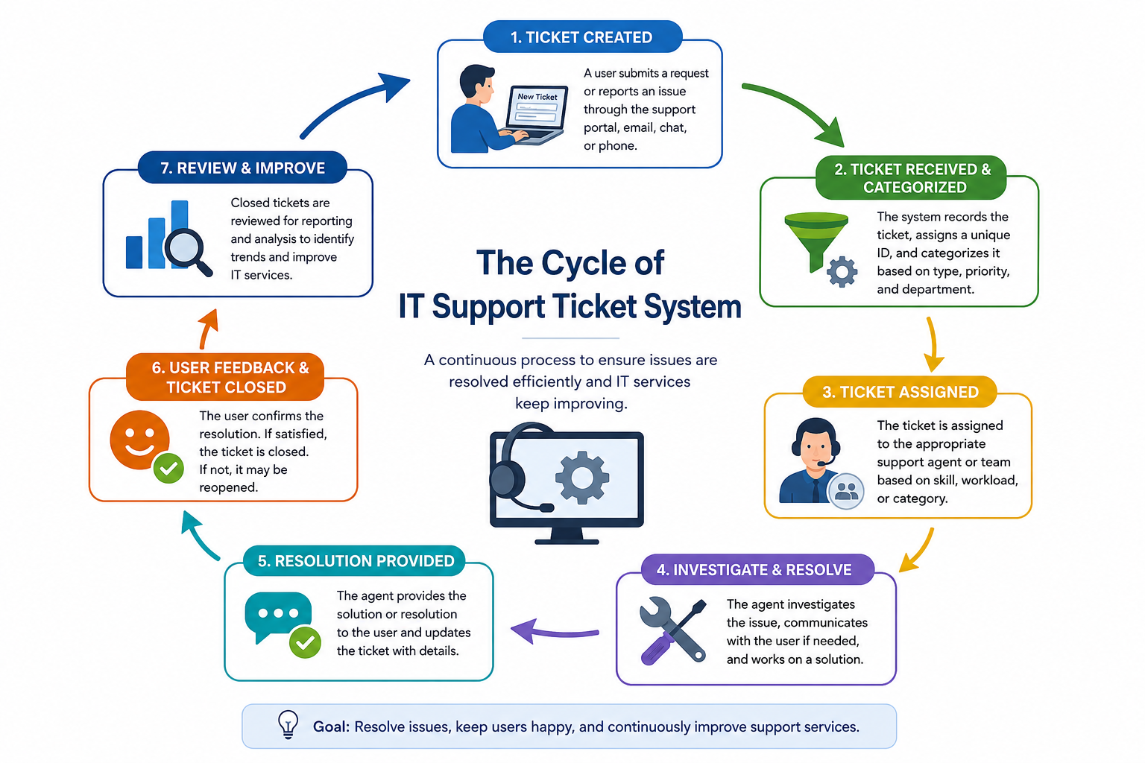
What is IT Tickets?
An IT Ticket is a record or a document which is issued by an IT support system to track the request made for issues related to technology or services.
An IT Ticket is a record or a document which is issued by an IT support system to track the request made for issues related to technology or services.
How IT Ticket Support Cycle Works ?

Slide 3
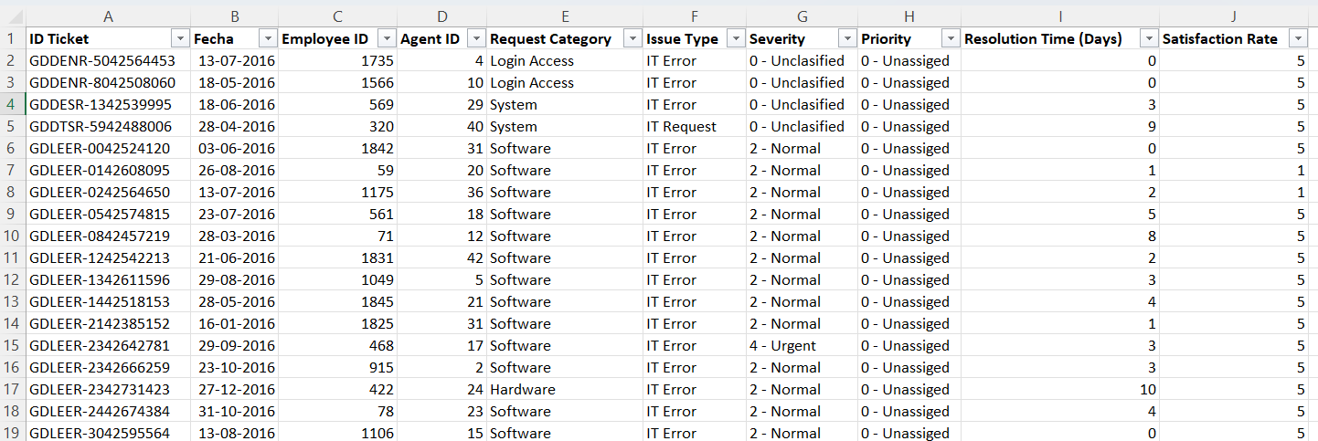
Problem Statement
The objective is to analyse the IT support ticket management system to understand the performance of IT agents, the efficiency of ticket resolution, and the satisfaction levels of employees. The analysis to identify high and low performers among IT agents, assess the overall effectiveness of the team, and pinpoint areas for improvement in the ticket resolution process. The ultimate goal is to make informed staffing decisions, including hiring, firing, and training to enhance overall service quality and team performance.

Slide 4
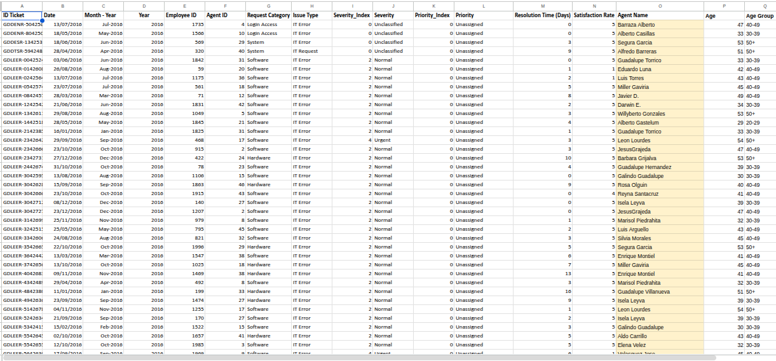
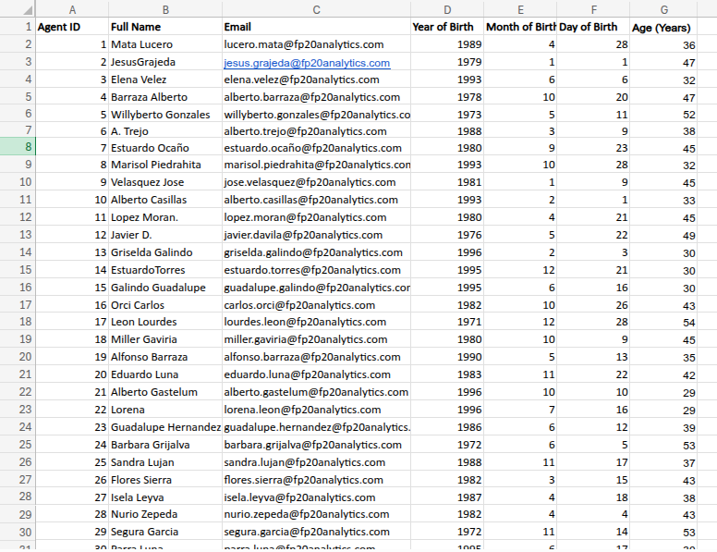
Data Highlights
Tickets Data Sheet
Total Tickets: 97498
No. of Attributes: 10
IT Agents Data Sheet
Total Agents: 50
No. of Attributes: 6

Slide 5

Data Cleaning
Missing Values | Agent Name – Filled using VLOOKUP using IT Agents Sheet.
Duplicate Records | All records are unique.
Spelling Errors | Unassiged Unassigned Unclasified Unclassified Mayor Major
Severity | Numeric conversion for scattering analysis.
Attributes Added | Age, Age Group, Year, Month-Year

Slide 6





Key Performance Indicators
97498
Number of tickets logged during 2016 - 2020
50
Number of Agent
~ 4.6 Days
Average Resolution Time
~ 4.1 / 5
Average Satisfaction Rate
~ 53
Average Daily Ticket Volume

Slide 7
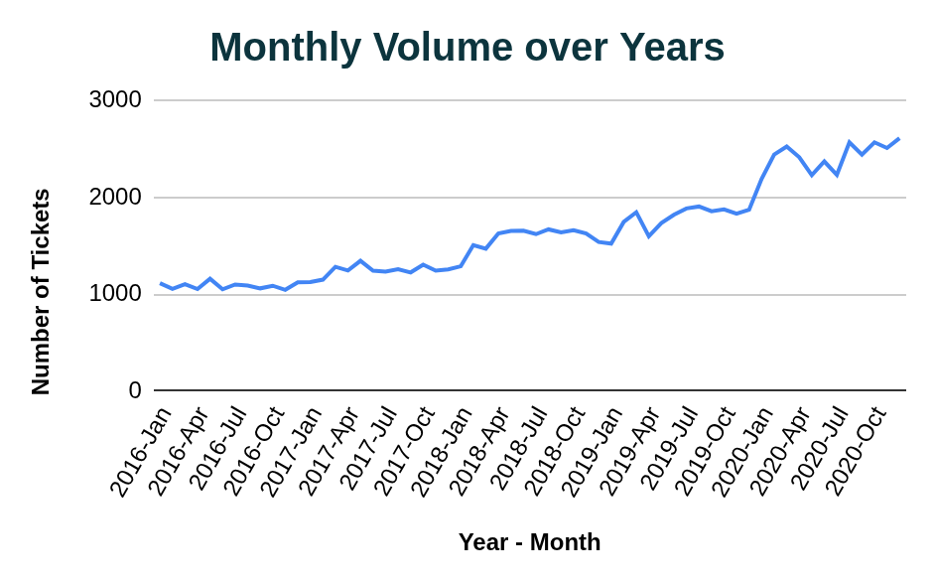
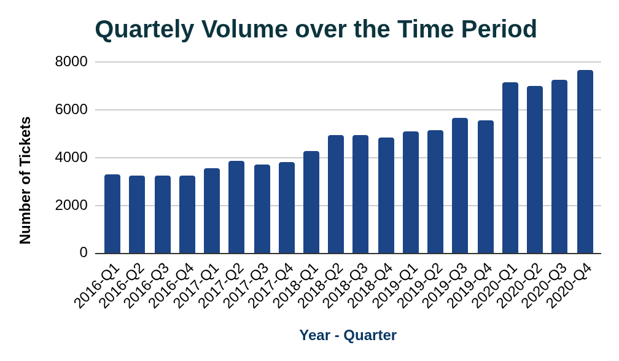
TICKET VOLUME TREND
Ticket volume increased significantly
Peak operational periods observed later in the year
Indicates growing support demand

Slide 8
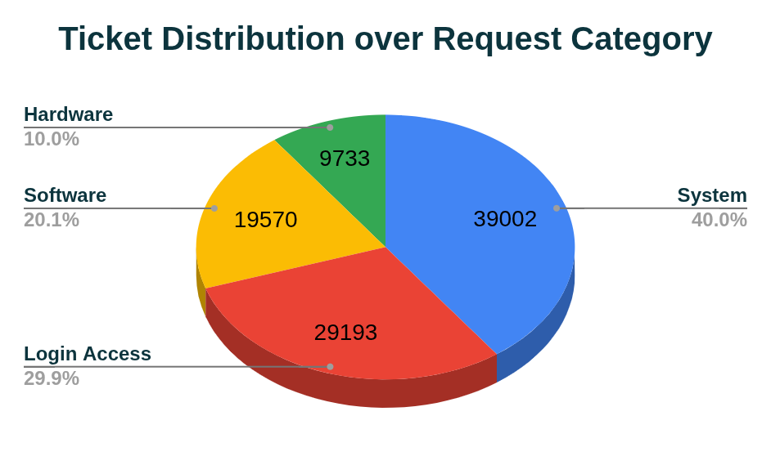
Category Performance Analysis
Category | Avg. Resolution Time (Days)
Hardware | 7.6
System | 6.6
Software | 5.2
Login Access | 0.3
Hardware and System categories are operational bottlenecks.

Slide 9
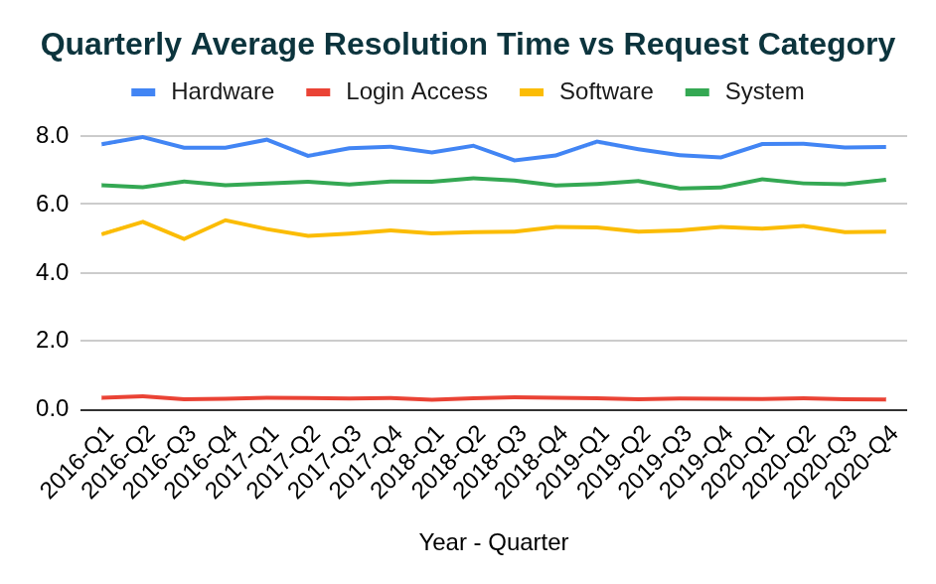
Resolution Time over Request Category
Hardware and Software has higher resolution time as compared to overall average resolution time.
However, the “Login Access” issues are resolved quickly almost within same day.

Slide 10
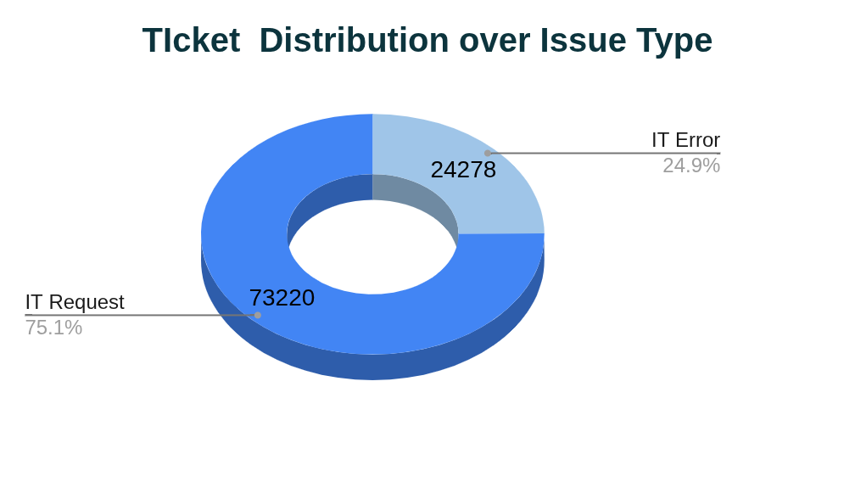
Ticket Distribution Over Issue Type
Almost more than 75% tickets were from IT Request probably consisting of Hardware and Software issues which are major bottlenecks.

Slide 11
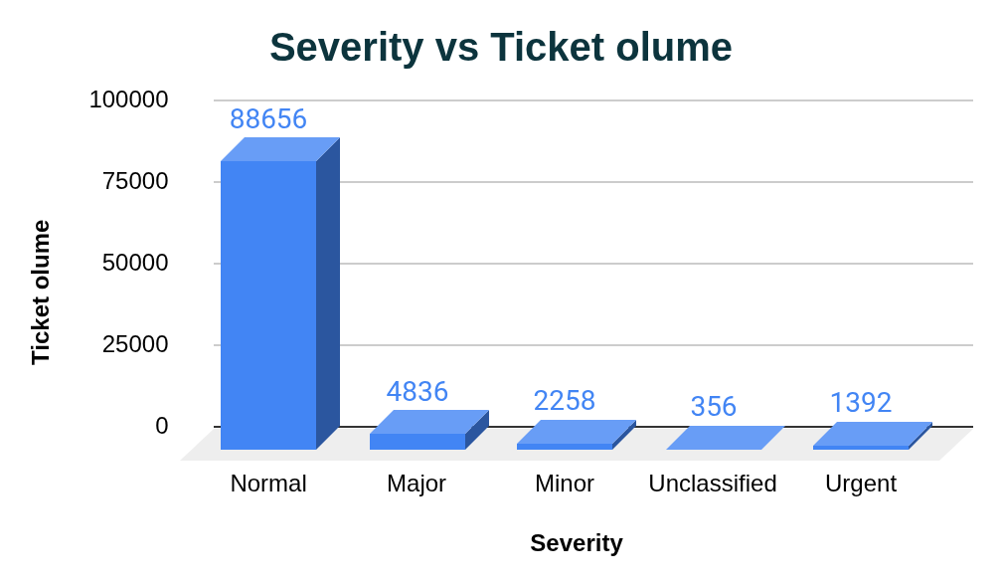
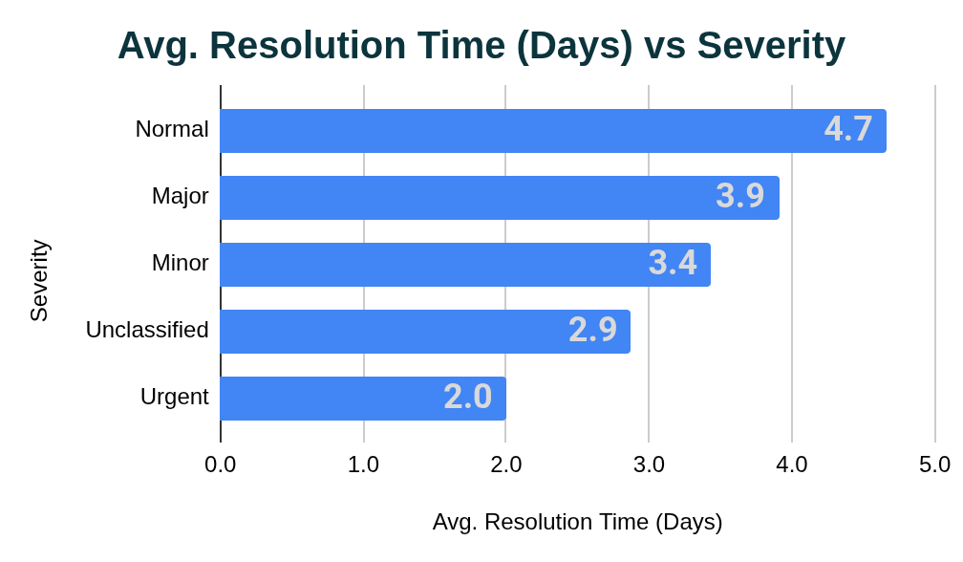
Severity Analysis
Urgent tickets are resolved faster, showing effective prioritization.
Ticket distribution based on severity is uneven. Most of the tickets are marked as Normal which has the highest average resolution time.

Slide 12
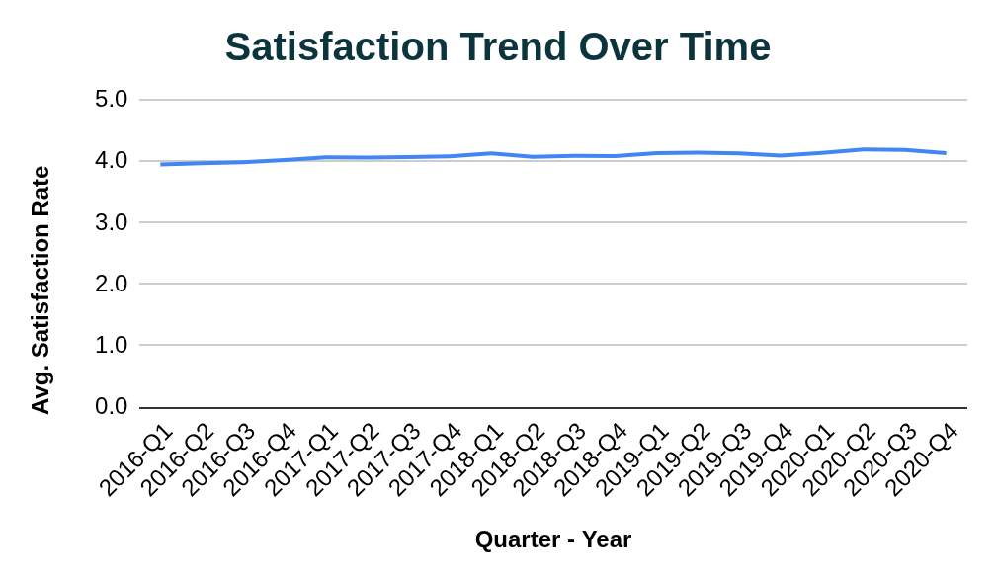
Satisfaction Rate over Time
The chart clearly demonstrates the steadiness of the satisfaction level over the years which is around 4.1 .
This indicates that requesters are satisfied with the services which IT support team provides.

Slide 13
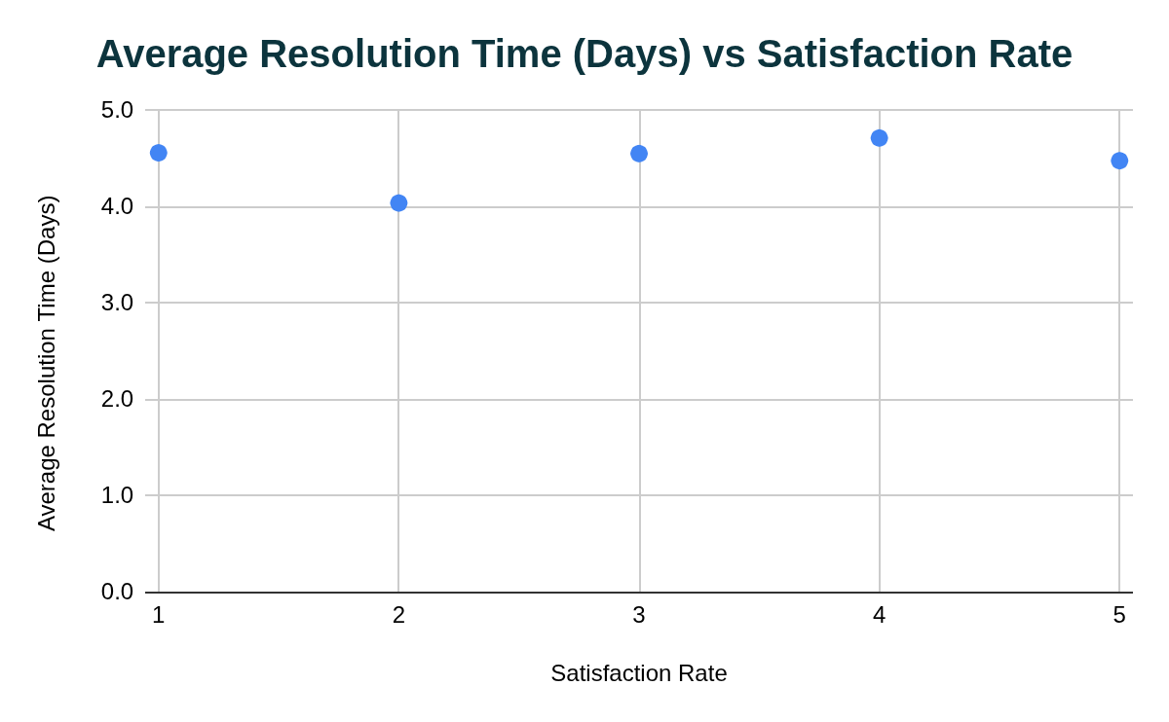
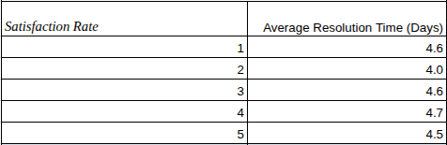
Customer Satisfaction Analysis
Faster resolution does not always guarantee higher satisfaction.

Slide 14
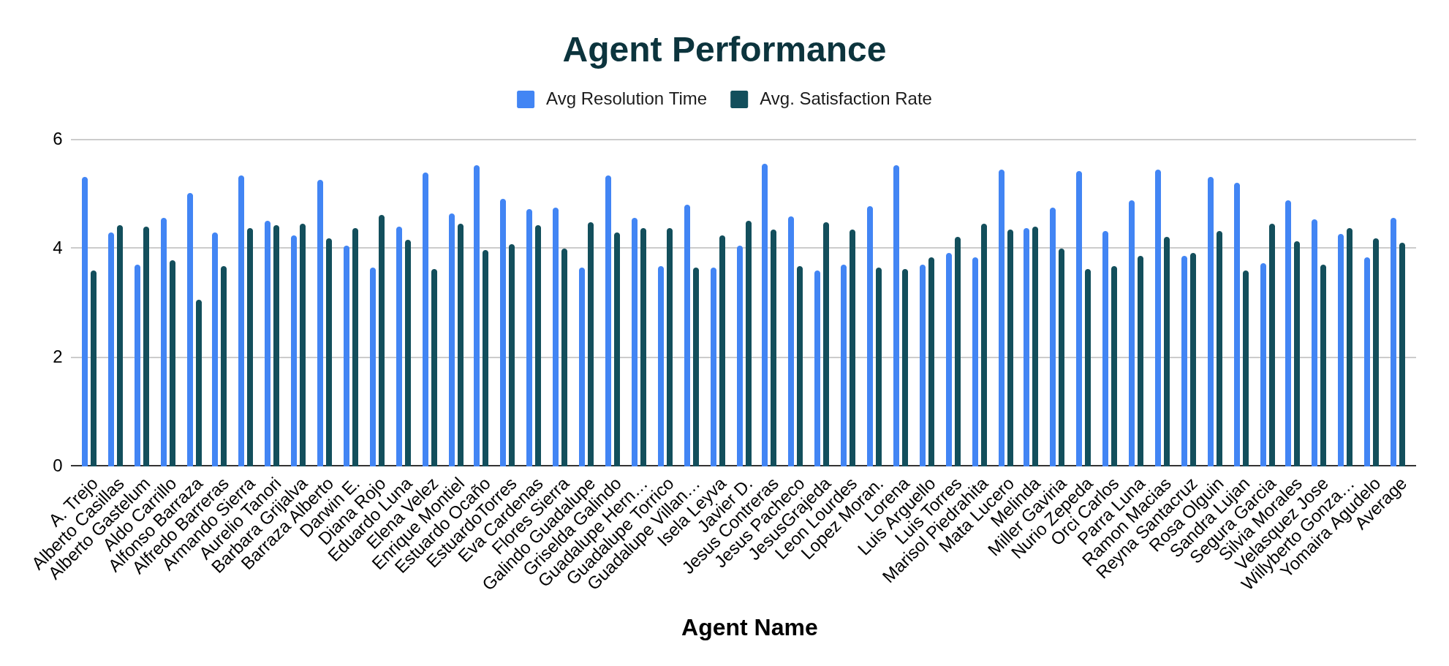
Agent Performance Analysis

Slide 15
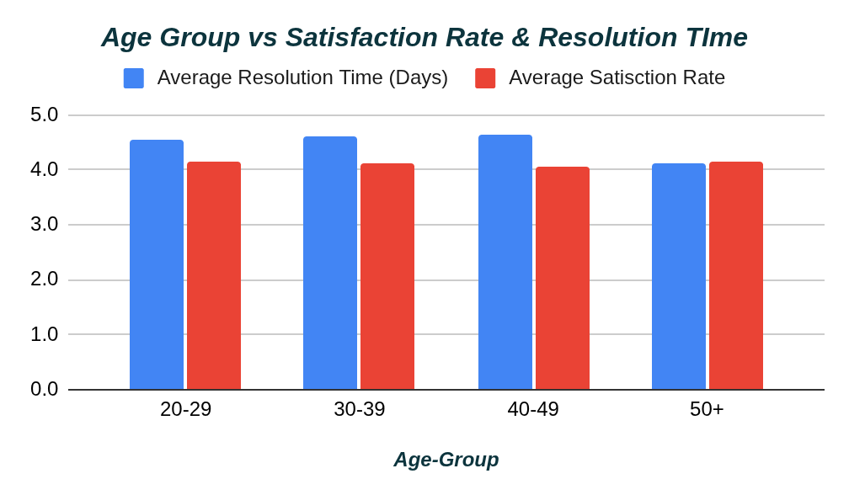
Performance Analysis on Agent’s Age Group
Average satisfaction rate for all age groups are almost equal.
Most senior agents (50+) has lowest average resolution time roughly around 4.1 days.
Other age groups has higher resolution time about 4.5 days.

Slide 16
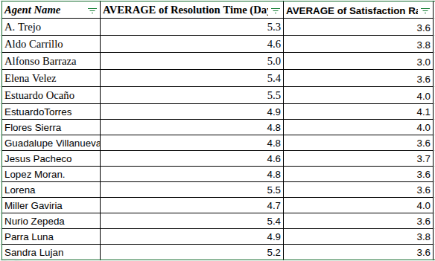
Insights:
Performance variation exists among agents
Some agents require targeted training
Workload distribution is uneven
These are some agents who requires training to improve their average resolution time.
The matrix shows the agents with average resolution time above the overall average and has less satisfaction rate that average satisfaction rate

Slide 17
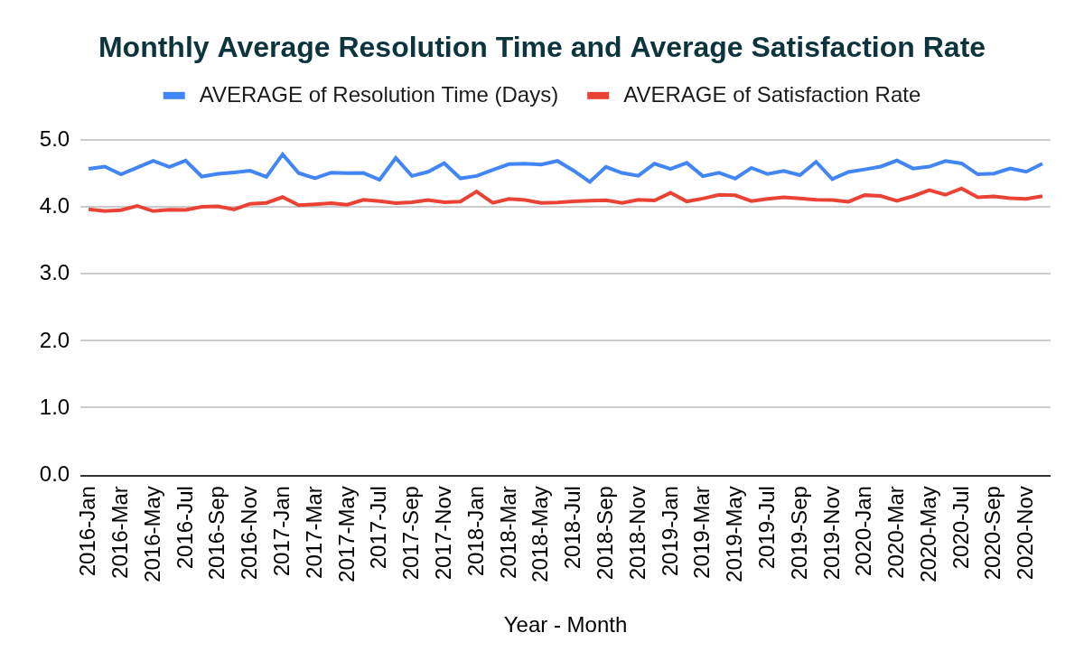
Operational Trends
• Team performance remained stable under increasing workload • Resolution time improvements are limited • Operational pressure is increasing

Slide 18
INVESTMENT DECISION ANALYSIS
Where Should the Company Invest?
Investment | Impact
More Agents | Medium
Training Programs | High
Software & Hardware Upgrade | Highest
Upgrade ticket management Hardware and software first, then improve training programs.

Slide 19
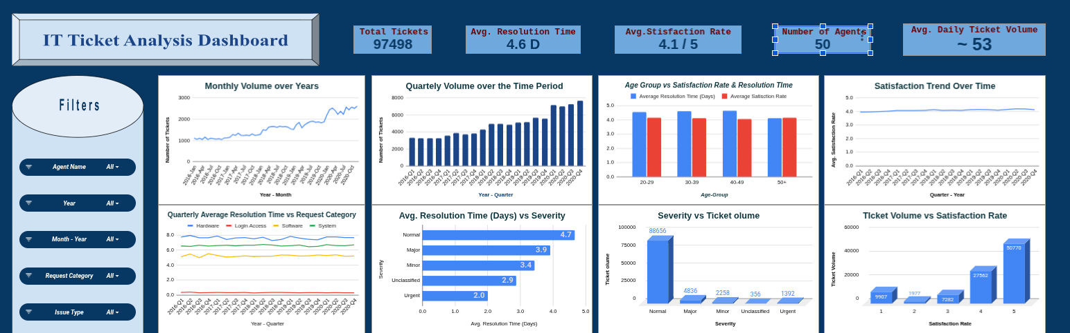
Visualization Dashboard

Slide 20
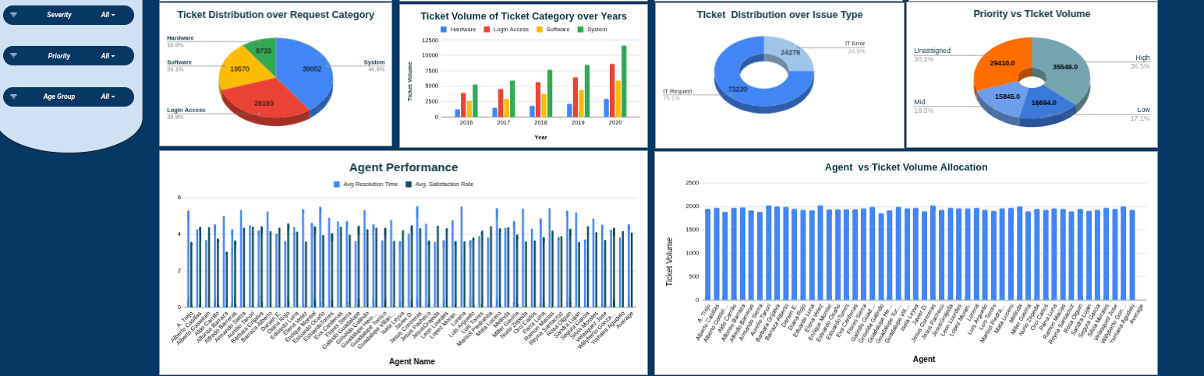

Slide 21

KEY INSIGHTS
Ticket volume is increasing steadily
Hardware tickets are slowest
Urgent tickets are prioritized effectively
Some agents require training
Process inefficiency is a bigger issue than manpower shortage
Technology investment offers best ROI

Slide 22
Conclusion
The analysis demonstrates that the IT support team is handling growing workloads effectively, but operational inefficiencies remain in specific categories and workflows.
Strategic investments in automation, software upgrades, and targeted training can significantly improve resolution efficiency and service quality.

Slide 23

"Data-driven decisions lead to operational excellence."

