Slide 1
Spreadsheet Project:
IT Ticket Analysis

Slide 2

Agenda
Problem Statement
Data Description
Objective Key Metrics and Visualizations
Subjective Question for Insights

Slide 3
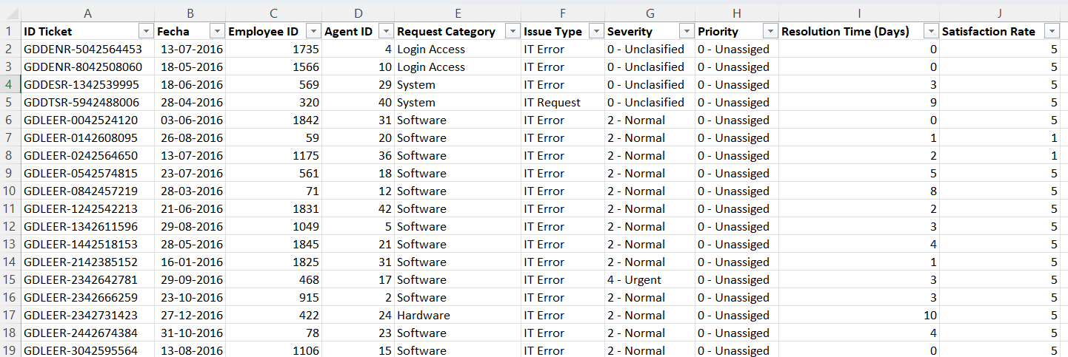
Problem Statement
The objective is to analyze the IT support ticket management system to understand the performance of IT agents, the efficiency of ticket resolution, and the satisfaction levels of employees. The analysis aims to identify high and low performers among IT agents, assess the overall effectiveness of the team, and pinpoint areas for improvement in the ticket resolution process. The ultimate goal is to make informed staffing decisions, including hiring, firing, and training, to enhance overall service quality and team performance.

Slide 4
The image above displays details about IT Ticket Information, including:
Tickets Sheet: Contains information about IT support tickets.
ID: Unique identifier for the ticket.
Ticket Fecha: Date of the ticket.
Employee ID: ID of the employee who raised the ticket.
Agent ID: ID of the agent assigned to the ticket.
Request Category: Category of the request (e.g., Login Access, System, Software).
Issue Type: Type of issue (e.g., IT Error, IT Request).
Severity: Severity of the issue.
Priority: Priority level of the issue.
Resolution Time (Days): Time taken to resolve the ticket.
Satisfaction Rate: Satisfaction rate provided by the employee (1-5 scale).
IT Agents: Contains information about IT agents.
Agent ID: Unique identifier for the agent.
Full Name: Full name of the agent.
Email: Email address of the agent.
Year of Birth: Year the agent was born.
Month of Birth: Month the agent was born.
Day of Birth: Day the agent was born.

Slide 5

Use this Link for copying and then manipulating the dataset.

Slide 6
Submission
There is a series of tasks/questions mentioned ahead in the Project, in order to guide the candidates to have suggestions, insights for the management.
Imagine you have to present the submitted PPT file to the senior management using which you are giving the suggestions as per the requirement with the reasoning/help of dashboard, visualizations or tables you’ve created.
The submission Zip file should consist of the following three documents:
Excel File (.xlsx) (consisting of dashboard)
Document File (.docx) (consisting of Answers and suggestions for Objective and subjective questions)
Presentation File (.pptx) (consisting of the presentation which you want to present to the management)

Slide 7

Tasks
…Tasks in order to come up with expansion suggestions

Slide 8
Objective Questions
What is the total no. of attributes present in the data?
Which columns have inconsistent or missing values, and what is the count of such values?
What is the average daily ticket volume over time?
What is the distribution of ticket categories (e.g., Login Access, System, Software)?
How many tickets has each agent handled?
How can you extract the domain from the email addresses in the IT Agents sheet?
How can you find the full name of an agent given their Agent ID?
What is the count of each issue type (e.g., IT Error, IT Request)?
What is the daily average resolution time for tickets?

Slide 9
Objective Questions (Cont..)
How has the volume of tickets changed over time?
What is the average age of the IT agents?
Is there a correlation between the severity of issues and the resolution time?
How many categorical columns are there in the data? [Search about categorical and continuous data, and try to answer this question]

Slide 10
In order to answer the next data analysis questions you will have to create Dashboards and visualizations (Can choose few pivot tables as well ).
For answering these questions you need to properly analyze the data through summarization, dashboard and visualizations to give the insights. Back your suggestions/insights with proper reasoning considering the data.

Slide 11
Data Analysis and Visualizations (Subjective Question)
If there is an investment, should it be used to hire more IT agents, improve training programs, or upgrade ticket management software?
Analysis: Perform a cost-benefit analysis using ticket resolution and satisfaction metrics.
Which agents need additional training based on their performance metrics?
Analysis: Identify agents with the lowest satisfaction ratings and longest resolution times.
Do certain categories of requests have longer resolution times?
Analysis: Analyze the resolution times by request category.
How effective are the current software tools in managing IT tickets?
Analysis: Evaluate performance metrics before and after the implementation of new tools.

Slide 12
Data Analysis and Visualizations (Subjective Question)
How has the performance of the IT support team changed over time (e.g., monthly or quarterly)?
Analysis: Trend analysis using time series charts.
If we invest more on tech (Hardware, software, etc), do you think it will improve the ticket resolution times and employee satisfaction?
Analysis: Use historical data to project potential improvements.
What are the key performance metrics for IT agents, and how can they be improved, do we need to fire any agents?
Analysis: Define and analyze metrics such as average handling time, satisfaction scores, and number of tickets resolved.
How do employee demographics (e.g., department, seniority) impact satisfaction and ticket outcomes?
Analysis: Segment analysis using filters and pivot tables.

Slide 13
Identify the trends for IT support operations based on ticket volumes and satisfaction, and mention the peak and stable times?
Analysis: Use pivot tables and charts to identify peak and off-peak hours.
What metrics should be included in the final dashboard to provide a comprehensive view of call center performance and guide investment decisions?
Ensure that you put the slicers for choosing the priority wise and year in order to observe the dashboard since the management will be having a long discussion which can go for weeks.
Note: The dashboard would be more interactive and user-friendly, allowing management to explore data in detail and make informed decisions.

Slide 14
SUBMISSION DEMONSTRATION
Refer to the video released in the batch
One can use this link in order to understand the sample
approaches for each section of the project.

Slide 15
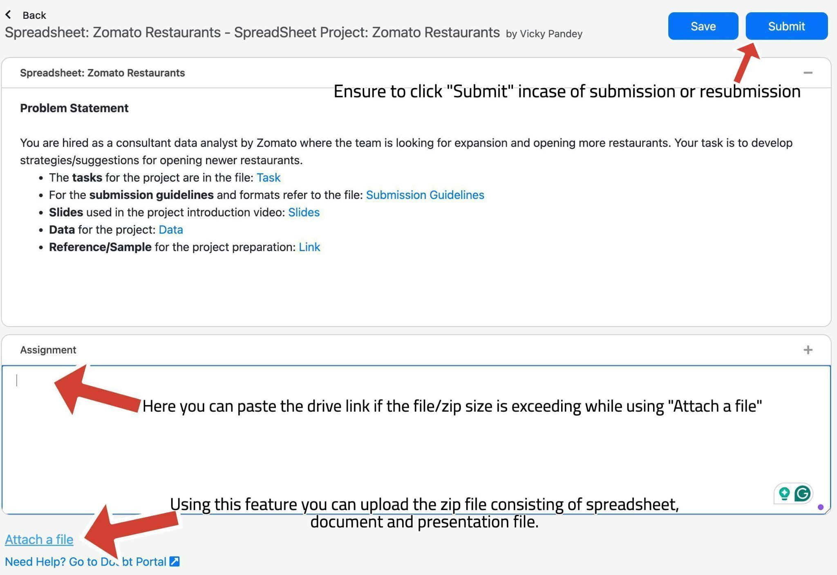
Submission UI
The submission UI can be changed a bit from the video, kindly refer here.
Look at the arrows and the comments to get familiar with the UI while submission and uploading the files on the platform. There is a space to paste the drive link and upload the zip file.

Slide 16
SUBMISSION FLOW
The candidates are supposed to have the first submission for the project within the 10-day deadline
After the submission, candidates will receive feedback on their project, which they are supposed to incorporate and re-submit within 1 week of feedback.
All the candidates are supposed to get a total of 8 marks to be prioritized in placements since is is necessary in Placements.
The re-submissions after 3 weeks of launch in the batch will be de-prioritised for evaluations.
  Candidates will have to give the reason for their delay, in order to make sure that team picks up their evaluation.
  This will create backlogs as the project for next module will also be releasing around the same time.
So make sure to submit the project (with the requirements) within timeline.
Candidates have to submit the zip of Excel, Docx and Presentation files.

Slide 17
GUIDELINES:
Ensure to submit the project within the deadline.
TA support won’t be answering any direct questions regarding project, they can help in the approach but not with the exact soln.
Plagiarism will be checked during evaluation.
Queries regarding submission should be asked to success champions.
Candidates must score >=8 out of 10 in order to be picked for referrals.

Slide 18
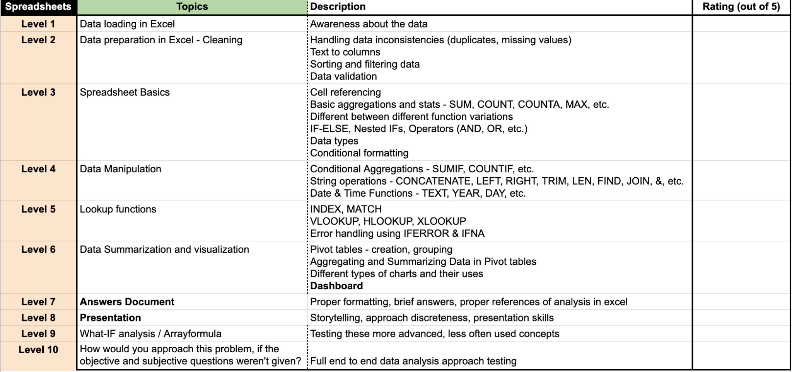

EVALUATION
The projects will be evaluated on 10 levels (Each learner will receive a detailed feedback).
On each level, learners will get a rating out of 5 and if the rating is smaller than 4, he won’t be considered as passed at that level.
Learners have to get >=4 (or passed) in at least 8 levels to get >=8 as the final rating in the project.
In the final feedback, only the final feedback out of 10 will be considered.
The ratings of level 9-10 will only be considered and included in the final feedback if someone is passing in all the Levels from 1 - 8. They (levels 1-8) are compulsory, in order to get passed in the final feedback.

Slide 19


