Slide 1
Automating SMS (with Twilio)
Christopher Sauer
Notes:
Sauer to introduce

Slide 2

Christopher Sauer
Senior Consultant
Improving
Twitter: @csauer
Email: Christopher.Sauer@improving.com

Slide 3
Automated SMS
Notes:
Steele

Slide 4
Automated SMS
A look into the Twilio platform
Send an automated SMS text (C#)
Setup a webhook to handle (and respond to) received SMS texts
Notes:
Steele

Slide 5
Twilio
An API Service for SMS, MMS, and Voice
Notes:
Steele

Slide 6
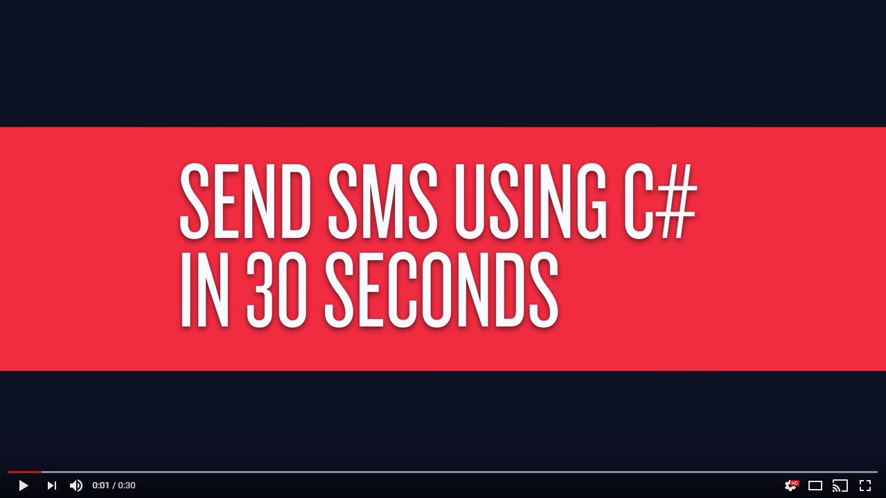
Send your first SMS
https://www.youtube.com/watch?v=jh_E4st5T9Q
https://www.twilio.com/blog/2016/04/send-an-sms-message-with-c-in-30-seconds.html

Slide 7
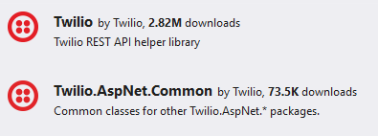
Nuget Packages
Twilio
Twilio REST API helper library
Twilio.AspNet.Common
Handle Twilio Webhooks

Slide 8
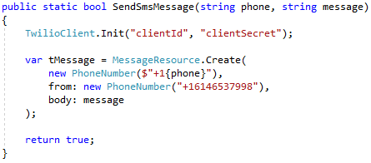
Send your first SMS

Slide 9
Send your first SMS

Slide 10
Send your first SMS

Slide 11
Send your first SMS

Slide 12
Send your first SMS

Slide 13
Send your first SMS

Slide 14
Twilio Webhooks
Can you hear me now?
Notes:
Sauer
Transition to Game

Slide 15
Twilio Webhooks
Receive and respond to messages and voice

Slide 16
Bringing it all together
Let’s have some fun!
Notes:
Sauer
Transition to Game

Slide 17
Text
“hello”
to
614-653-7998
Notes:
Sauer

Slide 18
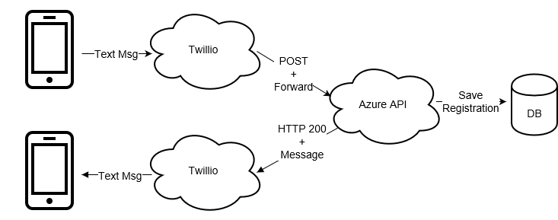
Behind the scenes
Text
“hello”
to
614-653-7998
Notes:
Sauer

Slide 19
Twilio
An API Service for SMS, MMS, and Voice
http://twilio.com
Setup Account and first Phone Number
https://www.twilio.com/console/phone-numbers/PN3b47abda64cabec860468a4c0e03aa72
Notes:
Steele

Slide 20
Twilio
An API Service for SMS, MMS, and Voice
http://twilio.com
Setup Account and first Phone Number
https://www.twilio.com/console/phone-numbers/PN3b47abda64cabec860468a4c0e03aa72
Phone Numbers: $1 / month
Texts (SMS): $0.0075 / each
About 1,300 texts per $10
Texts (MMS): $0.01 receive / $0.02 send
Notes:
Steele

Slide 21
Sample Code
Notes:
Sauer
Transition to Game

Slide 22
Bonus Round – Voice!
Notes:
Sauer
Transition to Game

Slide 23

Questions? Christopher Sauer
Senior Consultant
Improving
Twitter: @csauer
Email: Christopher.Sauer@improving.com

