Slide 1
Web API 2
Christopher Sauer and Chris Steele
Notes:
Sauer to introduce

Slide 2

Christopher Sauer
Twitter: @csauer
Email: Christopher.Sauer@improving.com

Slide 3
Chris Steele
Twitter: @csteele86
Email: Chris.Steele@Improving.com
<Insert Funny Picture>

Slide 4
The Basics
Success starts with the fundamentals!
Notes:
Steele

Slide 5
The Basics
Success starts with the fundamentals!
Convention over configuration
Built with testing in mind
Lightweight, robust, and scalable
HTTP Service – Industry standard
Cross-platform
Notes:
Steele

Slide 6
Routing
Where does it all go?
Notes:
Sauer

Slide 7
Routing
Where does it all go?
Routing Tables
Attribute Routing
Convention-based
Declared on app start
Specified routing
Declared on Controllers and Actions
Notes:
Sauer

Slide 8
HTTP Verbs
It’s time to bring back memories of your high school English teacher!
Notes:
Sauer

Slide 9
HTTP Verbs
It's time to bring back memories of your high school English teacher!
GET - Read
POST – Create
PUT – Create/Update (Idempotent)
PATCH - Update/Modify
DELETE – Delete....
Notes:
Sauer
Patch – modify a specific part of an object – i.e. first name on person

Slide 10
Modeling and Return Types
No, not the modeling your thinking!
Notes:
Sauer

Slide 11
Modeling and Return Types
No, not the modeling your thinking!
Typical C# Objects
IHttpActionResult wraps models
Returns HTTP Status Codes with objects
Notes:
Sauer

Slide 12
Validation
<insert witty comment>
Notes:
Steele

Slide 13
Route Constraints
<insert witty comment>
Further defines the properties of a URL
Examples: int, decimal, range, length, bool, etc.
Will return an HTTP 404 Not Found to client if not satisfied
Notes:
Steele

Slide 14
Component Validation
<insert witty comment>
Out-of-the-box input/parameter and model validations
Input/Parameter returns HTTP 400 Bad Request when violated
Model validations set's ModelState to invalid
Requires manual handling
Can create custom validations
Notes:
Steele

Slide 15
Error Logging and Handling
Yes, the thing that always get’s pushed aside
Notes:
Steele

Slide 16
Error Logging and Handling
Yes, that thing that always get's pushed aside
IExceptionLogger
IExceptionHandler
Last minute exception logging
Added as a service
Can be multiple
Interface or abstract class available
Molds the exception response to client
Added as a service
Can only be one
Interface or abstract class available
Notes:
Steele

Slide 17
Testing
The other thing that gets pushed to the side
Notes:
Steele

Slide 18
Testing
The other thing that gets pushed to the side
Swagger
Postman
Nuget Package
API Documentation
API Tester
Schema Generation
Built around OpenAPI Specifications
Glorious API Tester
Environments
Variables
Tests
Collections
Automated tests
API Monitoring, etc…
Notes:
Steele

Slide 19
Now Your Turn
Can I get a volunteer from the audience?
Notes:
Sauer
Transition to Game

Slide 20
Text
“game <your name>”
to
614-653-7998
Notes:
Sauer

Slide 21
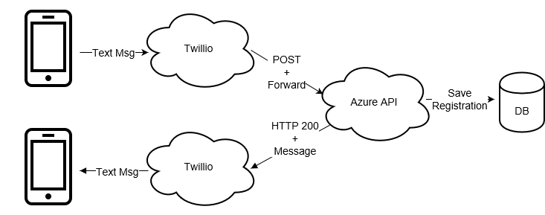
API Call Lifecycle
Text
“game <your name>”
to
614-653-7998
Notes:
Sauer

Slide 22
Publishing
Because every app wants to live too!
Notes:
Sauer
Briefly discuss ease of Azure Publish

Slide 23
Postman
Ready for a live demo?!
Notes:
Sauer

Slide 24
Helpful Resources
This Presentation and code samples
https://tinyurl.com/WebAPI2Demo
What is Azure App Service?
API Apps Overview
API Apps, ASP.NET, and Swagger in Azure App Service
Web API 2
Transition Azure Mobile Service to App Service

Slide 25
Even More Resources!
https://docs.microsoft.com/en-us/aspnet/web-api/overview/web-api-routing-and-actions/routing-in-aspnet-web-api
https://docs.microsoft.com/en-us/aspnet/web-api/overview/web-api-routing-and-actions/attribute-routing-in-web-api-2#route-constraints
https://docs.microsoft.com/en-us/aspnet/web-api/overview/formats-and-model-binding/model-validation-in-aspnet-web-api
https://docs.microsoft.com/en-us/aspnet/web-api/overview/error-handling/web-api-global-error-handling
https://github.com/domaindrivendev/Swashbuckle
https://www.getpostman.com/
https://github.com/OAI/OpenAPI-Specification/blob/master/versions/3.0.0.md

Slide 26
? Questions ?

