Slide 1
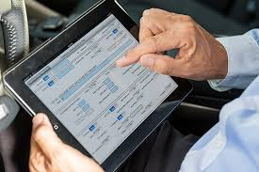
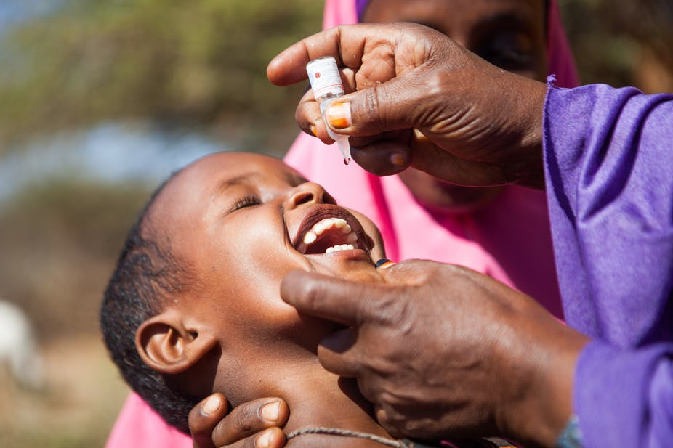
Phalanx Your Finger, Your Data and Good Health!
Presented by:
Akinpelu Oluwatobi
Muritala Jeminat
Damilola George

Slide 2
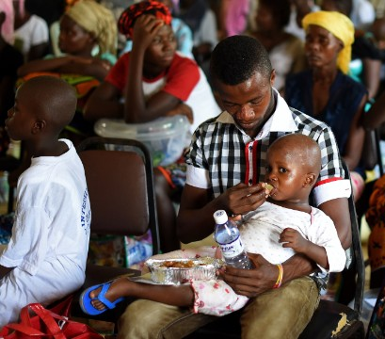
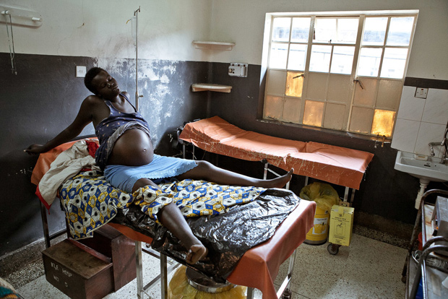
In most African countries like Nigeria, preservation and conservation of hospital documents and records has posed a serious problem. The health records in most Nigerian health institutions especially in hospitals has been facing some numbers of problems; these had affected the accessibility and utilization of health information in the treatment of people that have health challenges in those hospitals, as information needed on each patient is not being accessible on time or is not even available.
This burden is primarily affecting the maternal and child in the health sector.

Slide 3
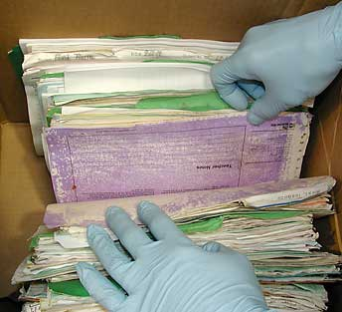


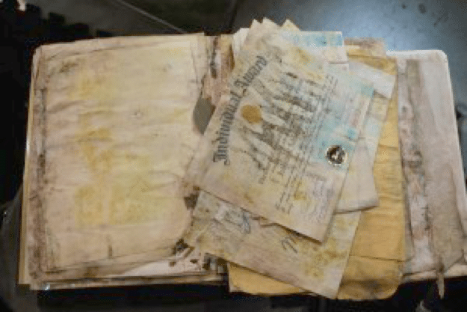
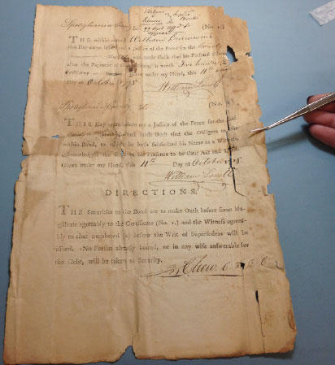
Problems being faced by hospital authorities in preservation and management of records in most African countries
Delay in transfer of records:
Shortage of experienced personnel
Lack of determination of records retention period:
Need of effective storage and control of in- active records
Other various types of damage that affect paper documents.

Slide 4
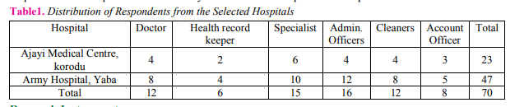
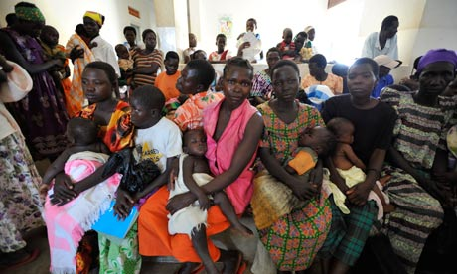
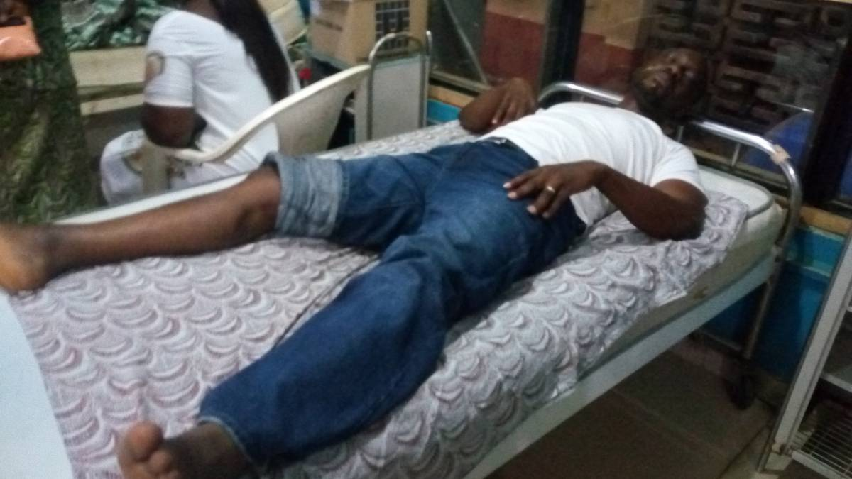
Source: Yaya, Japheth Abdulazeez et al. “Challenges of Record Management in two Health Institutions in Lagos State, Nigeria”

Slide 5

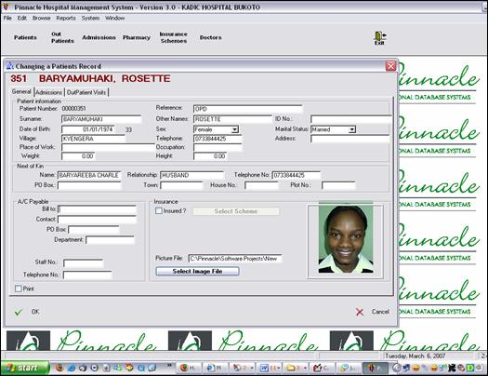
Existing System Features
Digital Record Managing System in private hospitals
Patient Record Management information System

Slide 6

WHY
Phalanx Your Finger, Your Data, Good Health!

Slide 7
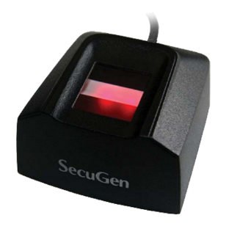
FEASIBILITY:
The Feasibility study was performed on the basis of various criteria and parameters.
Rural Community:
No internet accessibility needed before use
Operational Feasibility:
it is scalable and easy to use.
Technical Feasibility:
Android mobile phones, Tablets and Secugen Scanner

Slide 8
Phalanx
A Biometric android application that is use to collate and validate data of patients in other to retrieve past health histories, with their identity digitalized.
Thereby eradicating:
Loss of records

Slide 9

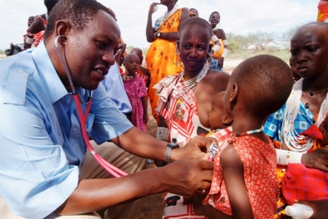
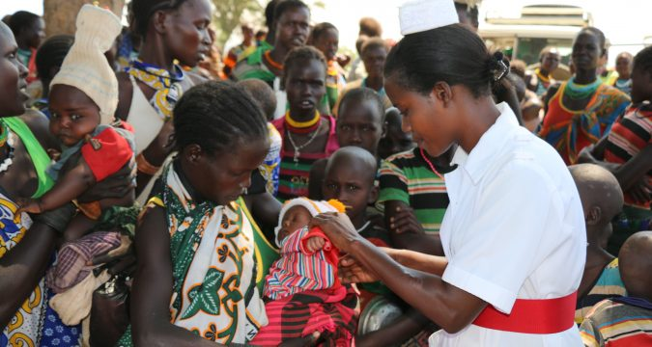
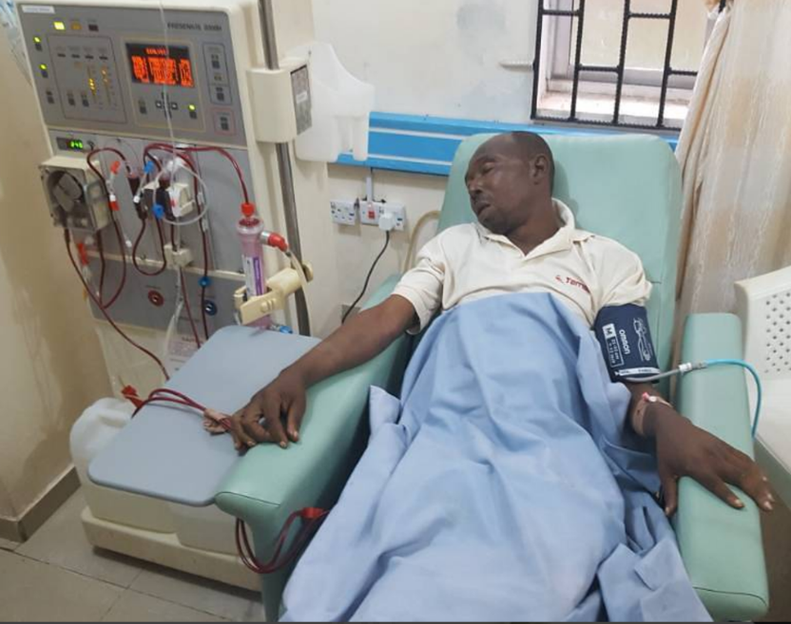


With Phalanx

Slide 10
CONCLUSION:
The growing quality demand in the health sector makes it necessary to exploit the whole potential of stored data efficiently, not only the clinical data, in order to improve diagnoses and treatments, but also on management, in order to minimize costs and improve the care given to the patients.
In this sense, Phalanx can contribute with important benefits to the health sector, as a fundamental tool to analyze the data gathered by hospital information systems (HIS) and obtain models and patterns which can improve patient assistance and a better use of resources.

