Slide 1
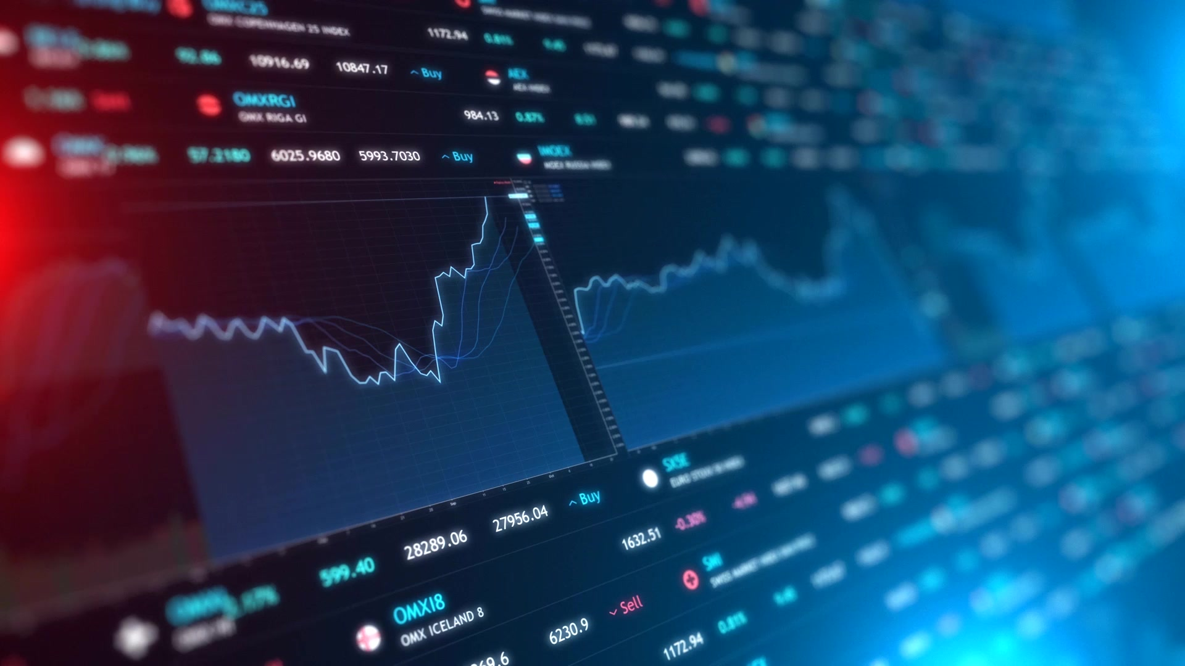
Risk & COVID-19
Josh Morgan
William Espanoza

