Slide 1
MIRI WFSS SPEC File

Slide 2
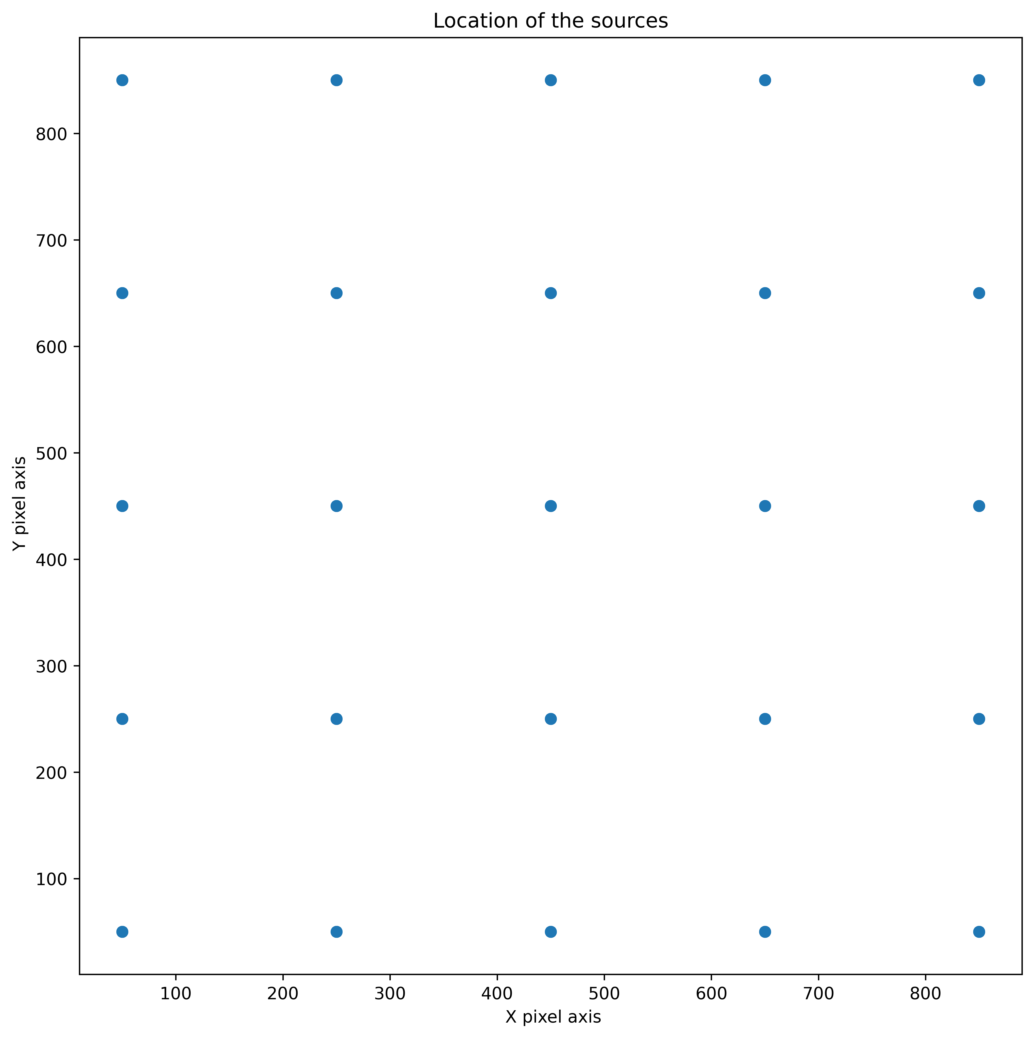
From real data: location of X, Y sources and Spectra
Trace for each source orange, wavelength red
Location of spectra and wavelength at each location

Slide 3
Fitting routine (based on NIRISS method)
Routine used: Create_miri_wfss_conf.py
Read in trace_grid_output.txt containing X0, Y0, wavelength, dx, dy (data on slide 2)
Fit_order = 2
Use curve_fit ( scipy.optimize)
curve fit takes a python function that represents the mathematical model to fit. This function must take the independent variables as its first argument and the parameters to fitted as subsequent arguments.
We have used curve_fit in two different ways.
Method 1: (delivered specwcs uses this method)
Independent variables : (X0, Y0, dx)
Dependent variable: dy
Method 2 (solve for dx and then solve for dy)
Solve for dx
Independent variables: (X0, Y0, t), where t = (df.lam.values-3.25)/(14.01-3.25)
Dependent variable: dx
Solve for dy
Independent variables: (X0, Y0, t), where t = (df.lam.values-3.25)/(14.01-3.25)
Dependent variable: dy

Slide 4
Fitting routine (based on NIRISS method)
Curve fit function (fit_2D26_2):
Represents the independent variables as (x,y,t) , where t varies in definition depending if we are using Method 1 or Method 2.
In Method 1: t= dx
in Method 2: t = trace parameter
Dependent variables are dx (Method 1) and dy and dx (separately for Method 2) . In the equation below the dependent variable is represented by e.
n = len(e)//6
f = 0
for i in range(n):
f = f + t**i * (e[i*6] + x*e[i*6+1] + y*e[i*6+2] + x**2*e[i*6+3] + x*y*e[i*6+4] + y**2*e[i*6+5])
return f

Slide 5
Additional details on Method 1
Curve_fit finds the ‘disply’ coefficients from the fit.
The ‘displx’ : linear solution ind1,ind0 = np.min(dx), np.max(dfx) coefficents written for dx are ind0 and (ind1-ind0)
The ‘displl’: solution is hard coded to: c0 = 3.125, c1 = 10.893 (min, range) t = c0 + c1*lambda
The ‘inv_displ’ determined from ‘displl’: c0=-0.28688148, c1=0.09180207
Lambda = c0 + c1*t

Slide 6
How to use these values to find dx, dy
Given X0, Y0, and wavelength
Use inv_displ and wavelength to find t
Given t find dx
Given X0, Y0, and dx find dy

Slide 7
Results of using specwcs reference file
Orange: trace from in the input: trace_grid_output.txt
Green – derived points using specwcs.

Slide 8
Method 2: using wavelengths in fit
Currently working on this.

