Slide 1

Draft
AI Monitoring and Observability Strategy
New Key Control Family: Capabilities, Target State, and Phased Delivery
Extends the Prompt Observability and Monitoring control to every CNB AI use case, with what CNB builds and what RBC provides.

Slide 2

Why CNB Needs Its Own Monitoring and Observability Capabilities
Problems to solve, what is in scope, and the capabilities that answer them
Problems to solve
What is in scope
Eight capabilities
Different jurisdictional requirements from RBC
Build only what the enterprise has not built; reuse enterprise capabilities
Monitor the risk that comes with widespread deployment of RBC Assist Pro
Proactive monitoring: near real time prompt observability
An agent kill switch
Visibility into tool calling; terminate a process when token consumption crosses a threshold
A CNB architecture we can state, and the superset of risks CNB is subject to
Position today: CNB cannot consume RBC's M&O tooling; RBC shares anonymized agent metadata on request
RBC Assist Pro used by CNB staff (RBC gateway path)
Vendor applications with vendor hosted models: Salesforce Agentforce, nCino Banking Advisor, Emburse, WRITER
Vendor and internal applications on the RBC gateway: AgilLink, Atlassian Rovo AI, Helios
CNB built applications and agents on Microsoft Foundry; CNB hosted MCP tools
Third party tools: Microsoft 365 Copilot, Claude Code; Workato under evaluation
To confirm: Functions Assist; Omilia Voice Biometrics (non LLM)
Every use case is observed at a control point CNB owns, or through a named RBC or vendor capability
Usage and Access
Prompts and Content
Agents and Tool Calls
Retrieval and Data (RAG)
Quality and Drift
Cost and Performance
Security and Threats
Compliance and Audit
Each capability states what is monitored, what is observed, and what action follows. Prompt Observability and Monitoring, the control already defined for RBC Assist, is the Prompts and Content capability maturing from detective to preventative.
Observe what CNB owns, meter what CNB routes, contract with RBC for what CNB cannot see
2

Slide 3
Monitoring and Observability Capabilities
What we monitor and what we observe, across every AI use case
Usage and Access
Prompts and Content
Agents and Tool Calls
Retrieval and Data (RAG)
Who uses which AI application, and how much
Unsanctioned AI and shadow tool use detection
Entitlement violations; CNB population view
License and seat consumption by application
Prompt patterns and topics over time
Injection and jailbreak attempt detection
Sensitive data in prompts or responses
Key word, toxic combination, and sentiment matches; guardrail hit rates
Which agent called which tool, with what arguments
Runaway loops and token thresholds
Unauthorized tool or data access; kill switch events
Agent to agent and MCP call chains
Documents, chunks, and embeddings behind each answer
Retrieval query audit trail
Retrieved content checked against user entitlement
Stale, missing, or unindexed sources
Quality and Drift
Cost and Performance
Security and Threats
Compliance and Audit
Evaluation scores and hallucination rate
Model, prompt, and index version changes
Approved model conformance; user feedback
Groundedness against retrieved content
Tokens and spend per use case and user
Latency, errors, availability
Vendor SLA and quota tracking
Capacity and rate limit headroom
Exfiltration and secret exposure attempts
Anomalous access; malicious tool calls
Model and plugin provenance; SIEM feed
Vendor LLM applications: security event feeds
Redacted record of every interaction
Every control action recorded
Retention; regulator ready reporting
Model risk documentation and evidence
Risk and control capability
Operational capability
Each capability is delivered at increasing maturity through V1 Detective, V2 In-line control, and V3 Preventative (pages 9 and 10).
3

Slide 4
Capabilities in Scope by Use Case
AI applications inventory, model path, control point, and how each is observed
Use case | Type | Model path | CNB control point | Observability route
RBC Assist Pro | Productivity | RBC LLM gateway, RBC hosted | None in the request path; identity and egress | RBC capabilities: usage metadata, guardrail events, agent registry, retrieval traces, evals, escalation path
AgilLink | Productivity | Vendor application, RBC gateway | None in the request path; vendor administration | RBC gateway telemetry for CNB integrations; vendor exports
Atlassian Rovo AI | Productivity | Vendor application, RBC gateway | Tenant administration | RBC gateway telemetry; vendor exports
Helios | Productivity | Internal platform, RBC gateway | Platform owner | RBC gateway telemetry; platform logs
Salesforce Agentforce | Productivity | Vendor hosted LLM | Vendor administration; SSO | Vendor exports; identity; data side access records
nCino Banking Advisor | Productivity | Vendor hosted LLM | Vendor administration; SSO | Vendor exports; identity; data side access records
Emburse | Productivity | Vendor hosted LLM | Vendor administration; SSO | Vendor exports; identity; data side access records
WRITER (EDD) | Fraud and Security | Vendor hosted LLM | Vendor administration; SSO | Vendor exports; identity; data side access records
Microsoft 365 Copilot | Productivity | Microsoft 365 tenant | Tenant administration; Purview | Purview interaction audit; sensitivity labels and DLP
Claude Code | Developer productivity | Developer tool | Managed settings | OTLP metrics, events, and traces to the collector
Workato | Automation, under evaluation | To confirm | Vendor administration | Job history and audit logs, if adopted
Functions Assist | Productivity | To confirm | To confirm | To confirm
Omilia Voice Biometrics | Client Services | Non LLM model | Vendor administration | Model performance metrics: false accept and false reject rates, drift
CNB built apps, agents, MCP tools | Future use cases | Microsoft Foundry or RBC gateway via Apigee | Apigee: quotas, Model Armor, MCP tools with OAuth | Full telemetry: OpenTelemetry traces, Apigee analytics, Snowflake audit joins
4

Slide 5













AI Monitoring and Observability: Proposed Target State, Conceptual View
Risk and control domain
Operational domain
Draft
AI Use Cases in Scope
RBC Assist Pro
AgilLink
Atlassian Rovo AI
Helios
Salesforce Agentforce
nCino Banking Advisor
Emburse
WRITER (EDD)
Microsoft 365 Copilot
Claude Code
Workato
Functions Assist
Omilia Voice Biometrics
via RBC gateway
via RBC gateway
via RBC gateway
via RBC gateway
vendor hosted LLM
vendor hosted LLM
vendor hosted LLM
vendor hosted LLM
M365 tenant
developer tool
under evaluation
to confirm
to confirm, non LLM
Monitoring Capabilities
Usage & Access
Prompts & Content
Agents & Tool Calls
Retrieval & Data (RAG)
Quality & Drift
Cost & Performance
Security & Threats
Compliance & Audit
RBC gateway path
Vendor hosted LLM
CNB built on Foundry
Third party tools
Who uses which AI app, and how much
Prompt patterns and topics over time
Which agent called which tool, with what
Documents, chunks, embeddings per answer
Evaluation scores and hallucination rate
Tokens and spend per use case and user
Exfiltration and secret exposure attempts
Redacted record of every interaction
Unsanctioned AI and shadow tool use
Injection and jailbreak attempts
Runaway loops and token thresholds
Retrieval query audit trail
Model, prompt, and index version changes
Latency, errors, availability
Anomalous access; malicious tool calls
Every control action recorded
Entitlement violations; CNB population view
Sensitive data in prompts or responses
Unauthorized tool or data access; kill switch
Retrieved content vs user entitlement
Approved model conformance; user feedback
Vendor SLA and quota tracking
Model and plugin provenance; SIEM feed
Retention; regulator ready reporting
License and seat consumption by app
Guardrail hit rates and refusals
Agent to agent and MCP call chains
Stale, missing, or unindexed sources
Groundedness against retrieved content
Capacity and rate limit headroom
Vendor LLM apps: security event feeds
Model risk documentation and evidence
RBC Capabilities
CNB scoped usage metadata: agents, creators, activity by CNB population.
Gateway guardrail events and injection detections; aggregated prompt topics for CNB users.
Assist Pro agent registry: tools, connectors, data sources, owners; tool call traces.
Retrieval traces per query: knowledge base, documents, chunks, embedding model, index version, scores; query audit.
Evals results for CNB agents; model and prompt version history.
Per app gateway telemetry for CNB integrations: tokens, latency, errors, model version.
Gateway injection and DLP detections; model allowlist changes; platform incidents.
Audit export at CNB cadence; alert forwarding; escalation path (kill switch for Assist Pro).
Technology
Entra ID
Apigee
Apigee MCP endpoints
Snowflake ACCESS_HISTORY
Snowflake AI Observability
Datadog
Purview DLP
Snowflake audit views
Microsoft Purview
Model Armor policies
Apigee LLM token policies
OTel retrieval spans
Foundry evaluations
Datadog monitors
Entra conditional access
Records retention policy
Zscaler (confirm)
Azure AI Content Safety
Kill switch runbook
Retrieval query log
Langfuse self hosted
Application Insights
Model Armor policies
Snowsight or Power BI
Snowflake usage views
Datadog (confirm modules)
Azure API Management
Foundry Observability
OpenAI Evals hosted
Apigee analytics
SIEM feed (confirm)
Datadog dashboards
Foundational
Identity as a Service (IDaaS, Entitlement Engine)
Apigee (API gateway standard)
Telemetry pipeline (OpenTelemetry, Collector, Snowpipe)
Snowflake (system of record)
Datadog (observability platform)
RBC LLM Gateway (black box)
Legend
New
Sunset or not selected
Existing
RBC provided
Vendor hosted LLM applications are observed through vendor audit exports, identity, and data side access records.
5

Slide 6
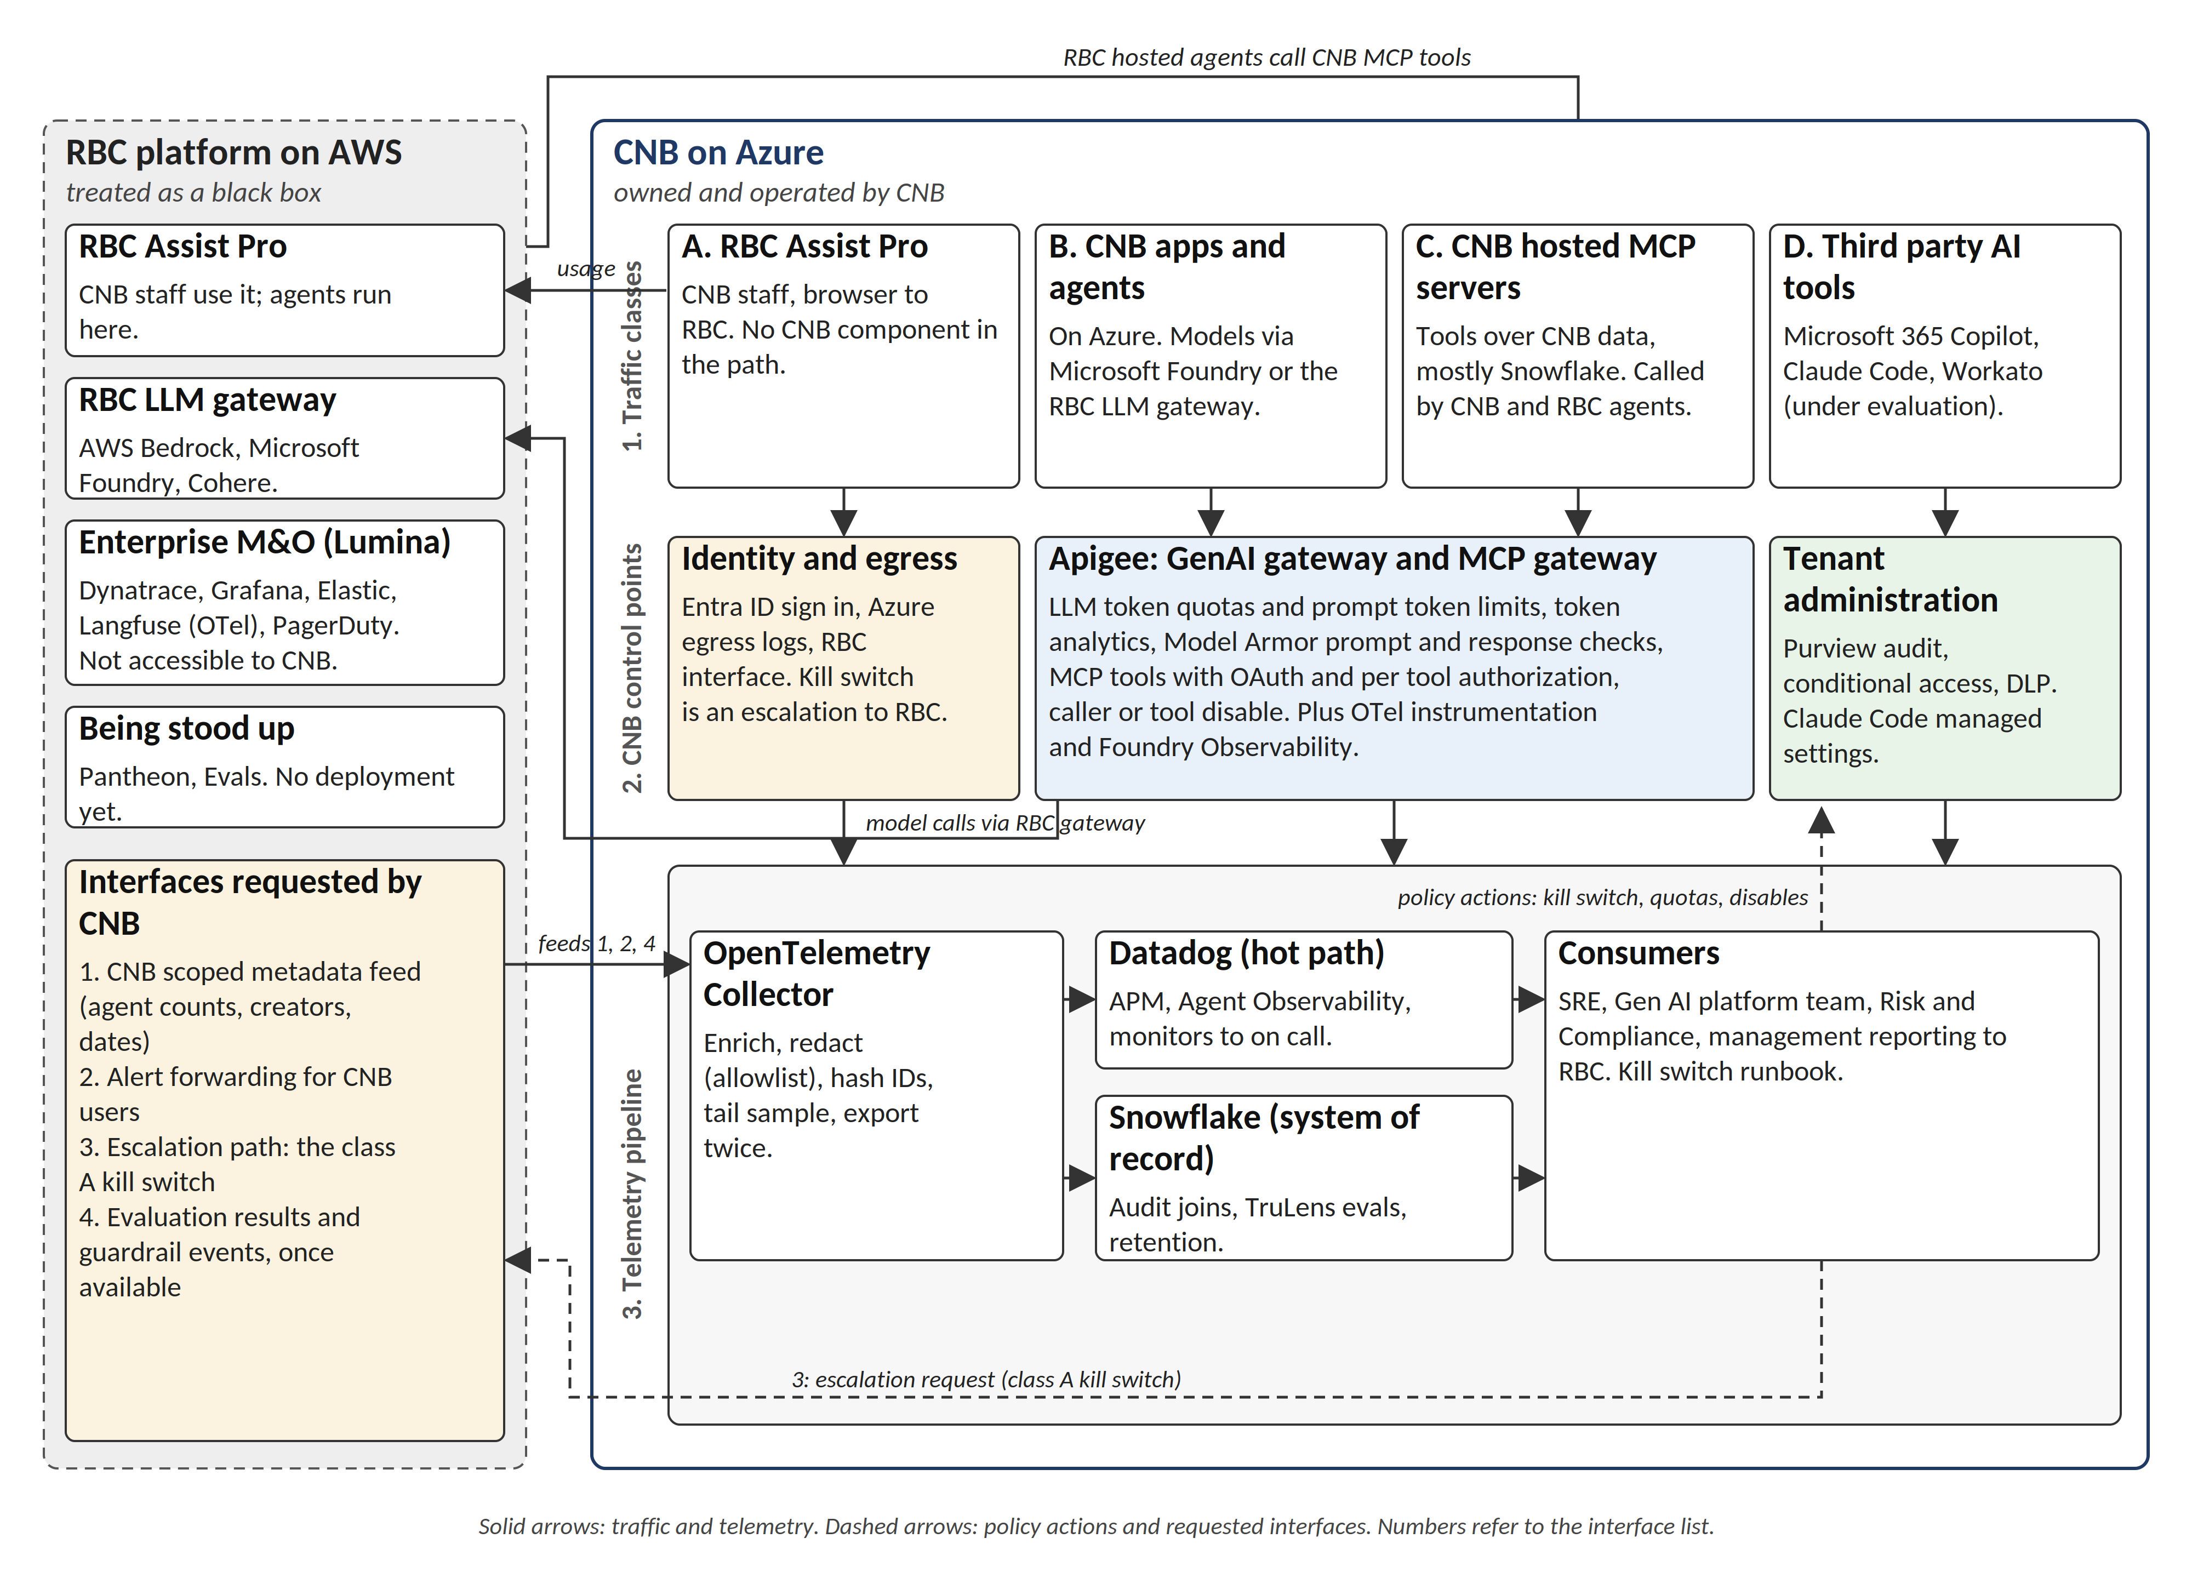
Reference Architecture: Control Points and Telemetry Pipeline
Where each workflow class is observed and controlled, and the shared pipeline behind it
Class A, RBC Assist Pro: no CNB component in the request path; observed through the RBC capabilities on page 7
Classes B and C, CNB apps and MCP tools: Apigee is the control point with LLM token quotas, prompt token limits, Model Armor, and MCP tools with OAuth
Vendor hosted and third party tools: vendor and tenant administration, Purview, managed settings
Shared pipeline: OpenTelemetry Collector with redaction, Datadog hot path, Snowflake system of record
Kill switch: policy actions flow back to the control points; escalation to RBC for class A
6

Slide 7
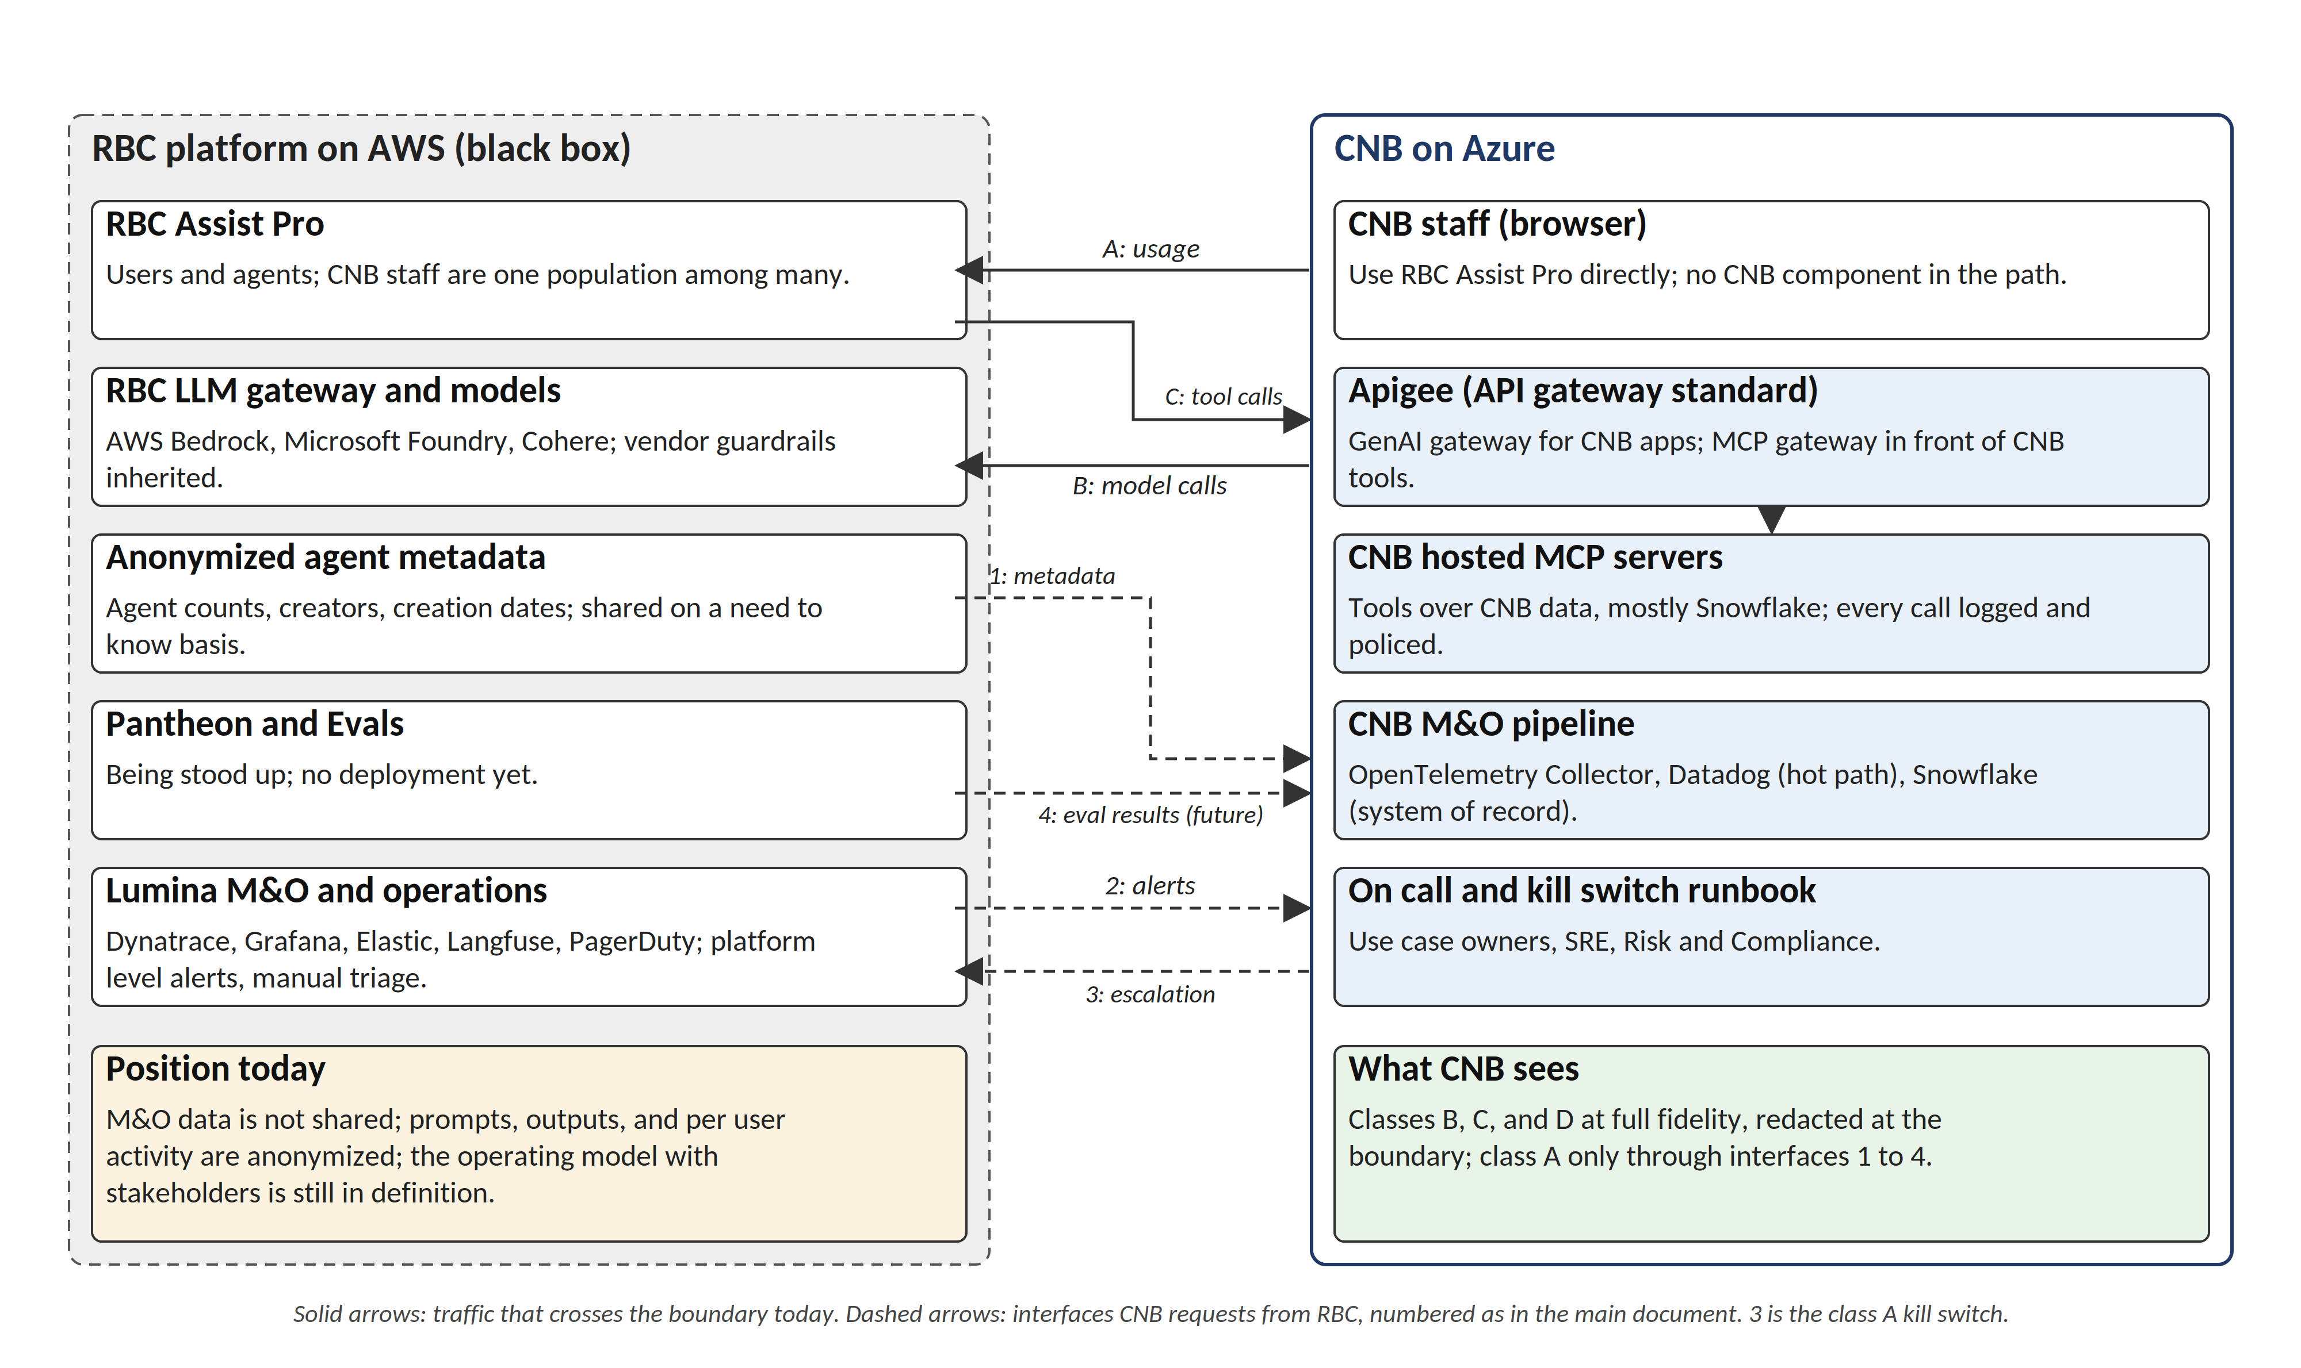
CNB and RBC: Interaction Model and RBC Capabilities
What crosses the boundary today, and the capabilities CNB asks RBC to provide
RBC Capabilities
Usage: CNB scoped usage metadata, agents, creators, activity by CNB population
Prompts: gateway guardrail events and injection detections; aggregated prompt topics for CNB users
Agents: Assist Pro agent registry (tools, connectors, data sources, owners); tool call traces
Retrieval (RAG): retrieval traces per query, with knowledge base, documents, chunks, embedding model, index version, scores; query audit
Quality: Evals results for CNB agents; model and prompt version history
Cost and performance: per application gateway telemetry for CNB integrations: tokens, latency, errors, model version
Security: gateway injection and DLP detections; model allowlist changes; platform incidents
Compliance: audit export at CNB cadence; alert forwarding; escalation path, the kill switch for Assist Pro
Status of each capability (available, in RBC pipeline, or to be agreed) is settled under the RBC operating model.
7

Slide 8
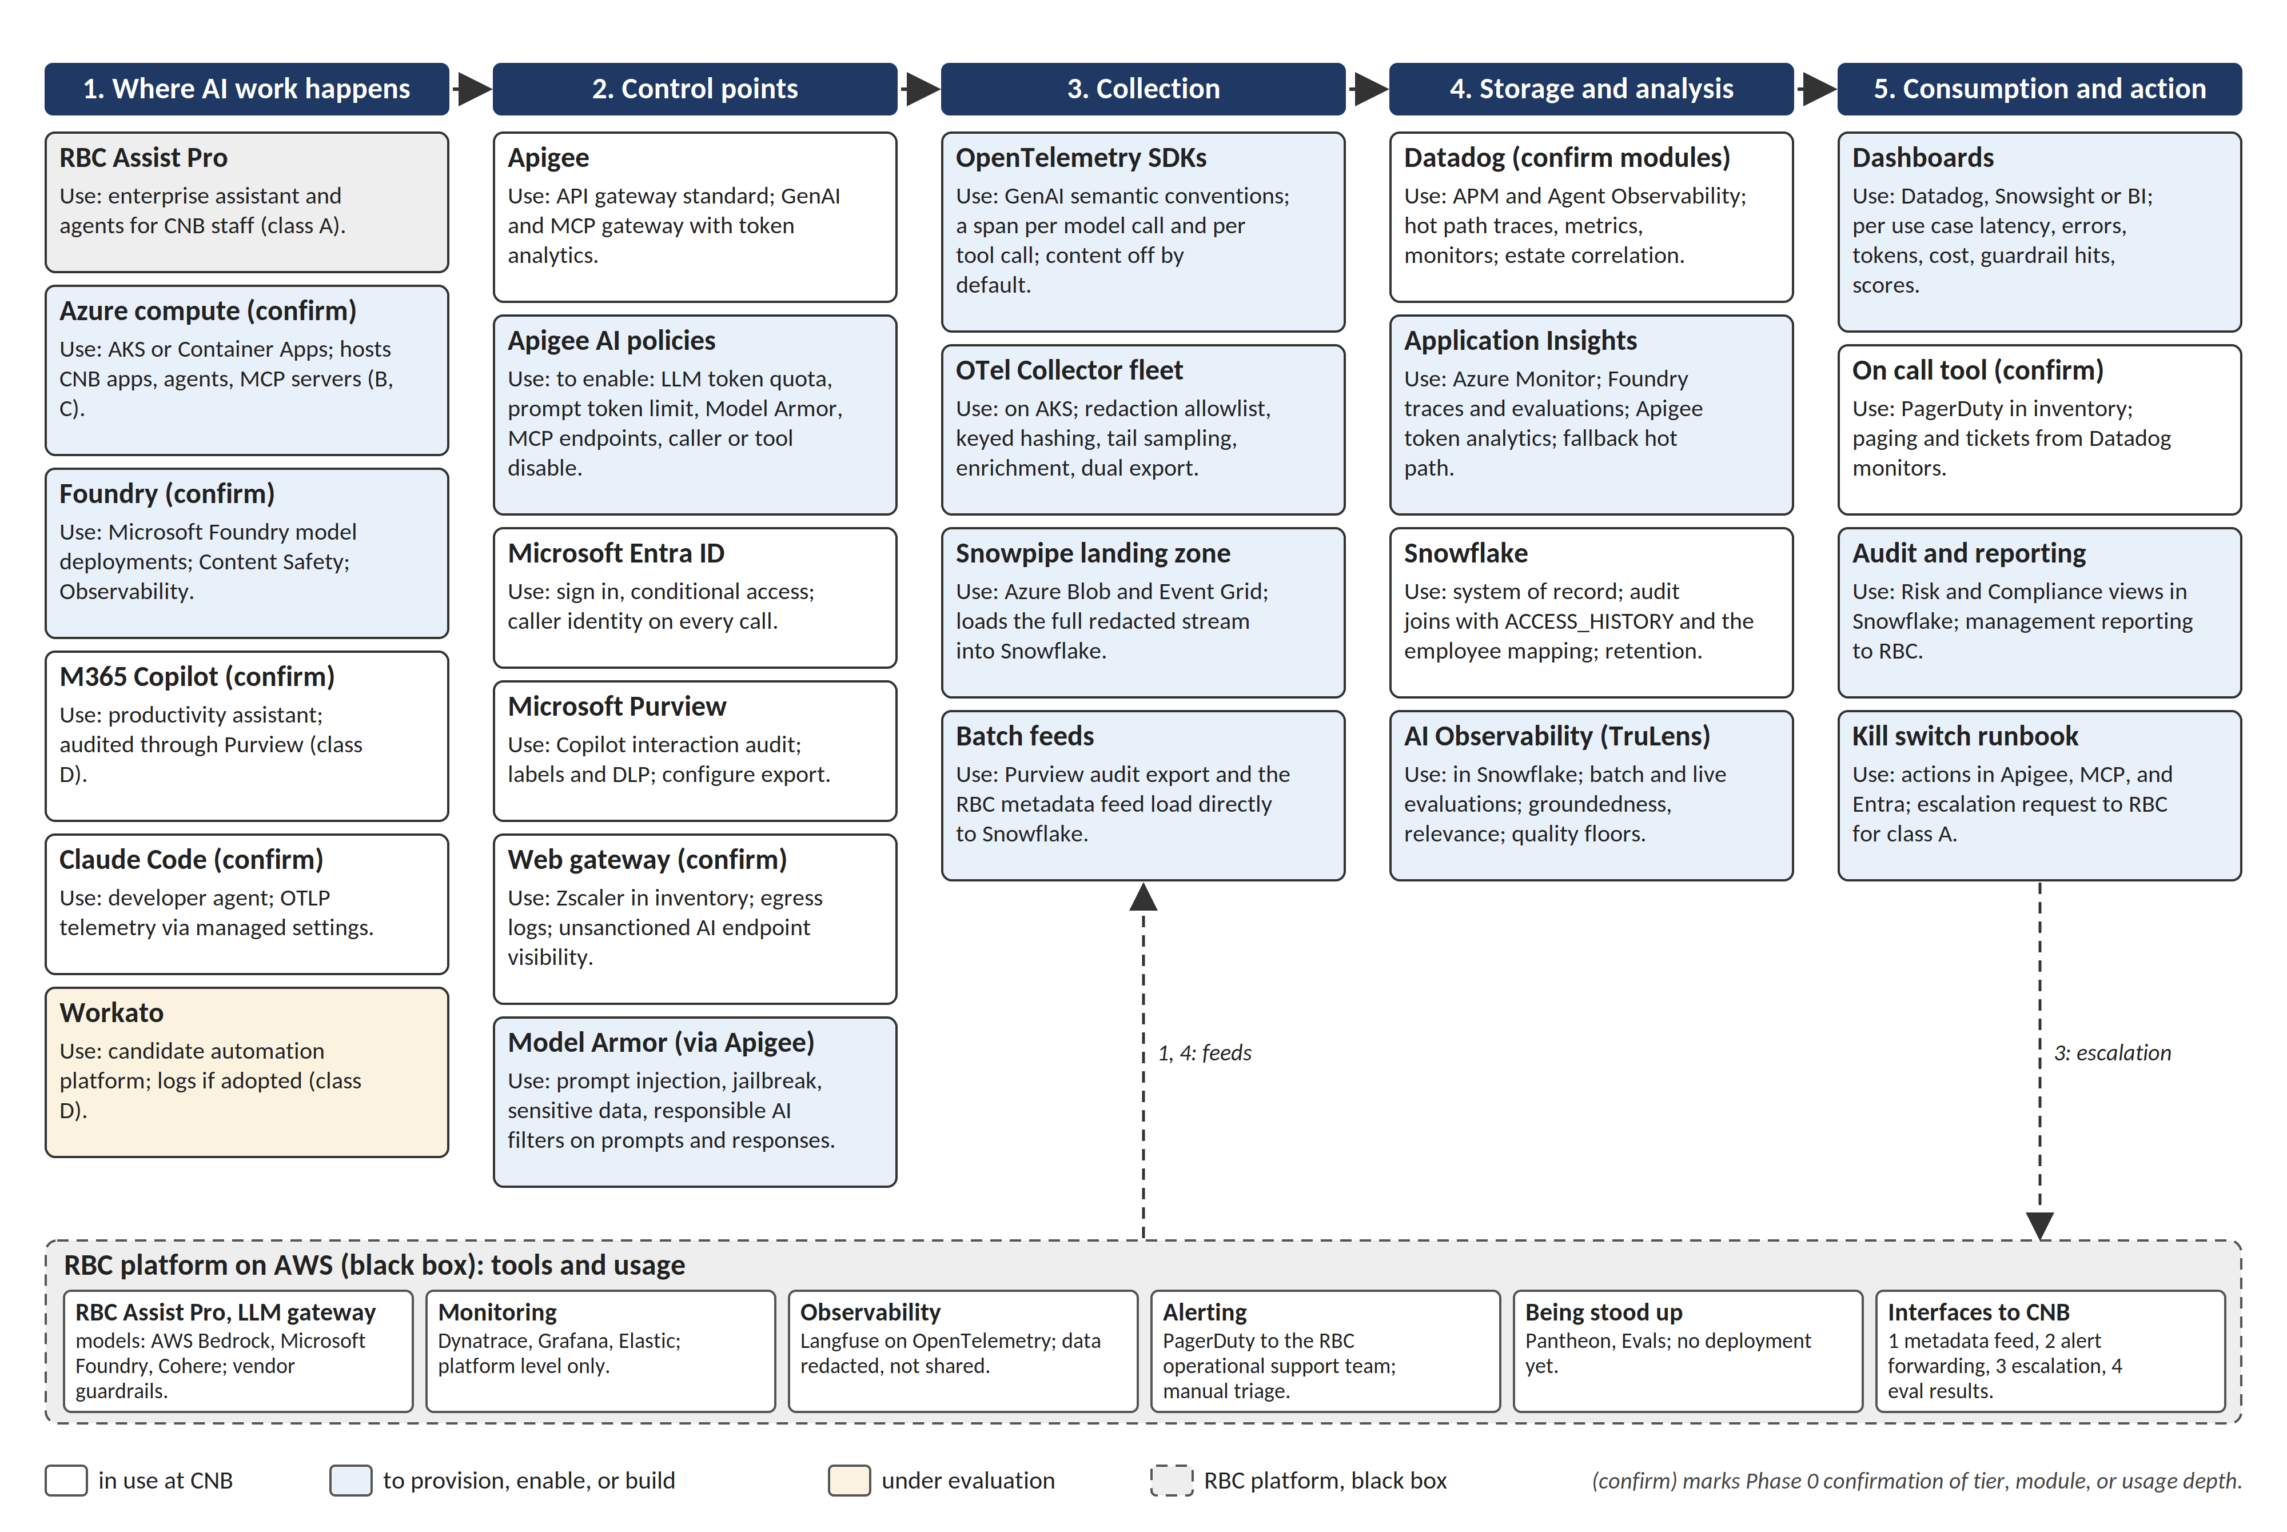
Tools and Usage
Every tool in the target state, what it is used for, and its status at CNB
In use at CNB: Apigee, Datadog, Snowflake, Entra ID, Purview, Application Insights, the web gateway
To enable or build: Apigee AI policies and Model Armor, the OpenTelemetry pipeline, Snowflake AI Observability, Foundry Observability, dashboards, audit views, the kill switch runbook
Under evaluation: Workato
RBC platform: Dynatrace, Grafana, Elastic, Langfuse, PagerDuty; Pantheon and Evals being stood up
Phase 0 confirms tiers, modules, and usage depth for every card marked (confirm)
8

Slide 9
A Phased Approach to AI Monitoring and Observability
More automation and agentic depth at each version, with less manual effort
V1
Detective: Key Word and Pattern Monitoring
V2
In-line Control: Warnings, Suspensions, Gateway Enforcement
V3+
Preventative: Agentic Scale with Human Verification
Focusing first on RBC Assist and RBC Assist Pro, key word and pattern matching identifies potential unmitigated risk and the users involved; the AI product team supports integration with Compliance to take appropriate action. In parallel, CNB instruments every path it owns (Apigee, Foundry, MCP tools), loads vendor exports and RBC metadata into Snowflake, and stands up dashboards. Review and credible challenge from all three lines of defence keeps the control sustainable; as it stabilizes it rolls out to all other AI product owners.
Shifts to prevention of risk: in-line warnings, temporary suspensions, and escalation notifications, backed by ongoing detective monitoring for any non prevented risk. Apigee token quotas and Model Armor block at the gateway, the kill switch runbook maps alerts to actions, and semantic filtering reduces false positives. Agentic tooling supports the control activities, with the AI product team as the human in the loop to monitor drift and review high risk actions.
Prevention first, backed by agentic scale: an observability agent team broadens the scope of sampled conversations, users are stopped in real time, and a human verifies anything more than a temporary suspension. Multi agent teams coordinate, with specific agents adopting an adversarial review persona to keep the control aligned to objectives. Continuous evaluation and the RBC feeds (retrieval traces, Evals results) close the loop across all eight capabilities.
Capabilities delivered
Capabilities delivered
Capabilities delivered
Usage and Access, Cost and Performance, Compliance and Audit at baseline
Prompts and Content: detective key word monitoring
Agents and Tool Calls, Retrieval: logging and audit joins
Prompts and Content, Agents and Tool Calls, Security: enforced at the control points
Retrieval: entitlement checks; RBC retrieval traces
Quality: sampled continuous evaluation with quality floors
All eight capabilities at target maturity
Quality and Drift: continuous evaluation and drift review by agents
Compliance and Audit: quarterly review of the framework and agent output
1st, 2nd and 3rd LOD coordinate on ongoing review and sustainability of risk mitigation
9

Slide 10
Capability Maturity by Version
What each capability delivers at V1 Detective, V2 In-line control, and V3 Preventative
Capability | V1 Detective | V2 In-line control | V3 Preventative
Usage and Access | Usage by application and user from Entra ID, Purview, and vendor exports; shadow AI from the web gateway | Entitlement checks at Apigee; conditional access actions on findings | Automated access review; anomaly driven suspension with human verification
Prompts and Content | Key word, toxic combination, and sentiment match on logged interactions; monitoring report review | In-line warning; Model Armor blocks injection and sensitive data; semantic filters cut false positives | Prompt monitoring agents; real time censoring and blocking; adversarial review persona
Agents and Tool Calls | Tool call logging at MCP servers; token spend visibility per agent | Token quotas and tool allowlists at Apigee; kill switch runbook; temporary suspension | Automated suspension of runaway agents; agent to agent chain review
Retrieval and Data (RAG) | ACCESS_HISTORY joins; retrieval query log for CNB tools | Entitlement check on retrieved content; RBC retrieval traces integrated | Groundedness checked per answer; index and embedding drift alerts
Quality and Drift | Evaluation baseline per use case in Snowflake AI Observability | Sampled continuous evaluation; quality floors raise alerts | Continuous evaluation and drift review by agents; RBC Evals results
Cost and Performance | Tokens, latency, and errors in Datadog per use case | Quota and rate limit headroom alerts; vendor SLA tracking | Cost anomaly detection; automated throttling
Security and Threats | SIEM feed of AI events; Purview DLP | Gateway injection and DLP blocks; secret exposure detection | Adversarial testing agents; provenance checks on models and plugins
Compliance and Audit | Redacted record of interactions and control actions in Snowflake; quarterly pattern and key word revision | Every enforcement action recorded with its escalation trail | Regulator ready reporting; quarterly review of the monitoring framework and agent output
10

Slide 11










AI Monitoring and Observability V1
Detective: key word and pattern monitoring on baseline telemetry
End User
Monitoring Inputs
Monitoring Review
Key Words
Key-Word Report Review
Generative / Agentic Tool
Toxic Combinations
Chat Interface
Sentiment Refinement
New Pattern Identification
Agent Builder
RBC Assist and Assist Pro first; Helios, AgilLink, Rovo AI, Foundry apps, and MCP tools follow
Verification of AI Output
RBC Assist and RBC Assist Pro initiate the control first, with remaining CNB AI tools (e.g. Helios) to follow through the V2 release. Vendor hosted applications are observed through vendor exports, identity, and data side access records.
Monitoring
Compliance Review
Interaction Logging: OpenTelemetry traces to Datadog and Snowflake
Employee Action Initiation
logs
Key Word Match on logged interactions
Monitoring
Report
Report Generation: Snowflake audit views and Datadog monitors
End User
Telemetry: Apigee and Foundry traces, MCP tool logs, vendor exports, and RBC feeds enter the OpenTelemetry Collector, then Datadog (hot path) and Snowflake (system of record).
Quarterly: Pattern Review & Key-Word Revision
Key:
AI Agent
End User
T&I Teams
AI Product Team
Risk Team
Audit Team
Business SMAs
RBC Borealis
Compliance Team
11

Slide 12
AI Monitoring and Observability V2
In-line control: warnings, suspensions, and gateway enforcement
End User
Monitoring Inputs
Monitoring Review
Key Words and Semantic Filters
Key-Word Report Review
Generative / Agentic Tool
Toxic Combinations
Chat Interface
Sentiment Refinement
New Pattern Identification
Agent Builder
Token Thresholds and Tool Allowlists
Real Time
Messaging
Verification of AI Output
RBC Assist and Assist Pro first; Helios, AgilLink, Rovo AI, Foundry apps, and MCP tools follow
In-Line Warning
Monitoring
Compliance Review
Temporary Suspension
Interaction Logging: OpenTelemetry traces to Datadog and Snowflake
Employee Management
Escalation Notification
logs
Key Word and Semantic Match; Model Armor and token quotas at Apigee
Monitoring
Report
Agent Deletion
Report Generation: Snowflake audit views and Datadog monitors
End User
Telemetry: Apigee and Foundry traces, MCP tool logs, vendor exports, and RBC feeds enter the OpenTelemetry Collector, then Datadog (hot path) and Snowflake (system of record).
Quarterly: Pattern Review & Key-Word Revision
Key:
AI Agent
End User
T&I Teams
AI Product Team
Risk Team
Audit Team
Business SMAs
RBC Borealis
Compliance Team
12

Slide 13

AI Monitoring and Observability V3+
Preventative: agentic review at scale with human verification
End User
Observability Agent Team
Monitoring Review
Prompt Monitoring
Suspension Review
Generative / Agentic Tool
Sentiment Analysis
Chat Interface
Suspension Confirmation
New Pattern Identification
Agent Builder
RBC Assist and Assist Pro first; Helios, AgilLink, Rovo AI, Foundry apps, and MCP tools follow
Session Review
Verification of AI Output
Shared Semantic Context
Shared Semantic Context
User Review
Compliance Review
In-Line Warning
Temporary Suspension
Adversarial Review
Sustainability Review
Employee Management
Escalation Notification
Agent Deletion
Action Review & Escalation
End User
Telemetry: Apigee and Foundry traces, MCP tool logs, vendor exports, and RBC feeds enter the OpenTelemetry Collector, then Datadog (hot path) and Snowflake (system of record).
Quarterly: Review Monitoring Framework & Agent Output
Key:
AI Agent
End User
T&I Teams
AI Product Team
Risk Team
Audit Team
Business SMAs
RBC Borealis
Compliance Team
13

Slide 14
Appendix
AI Monitoring and Observability
14

Slide 15
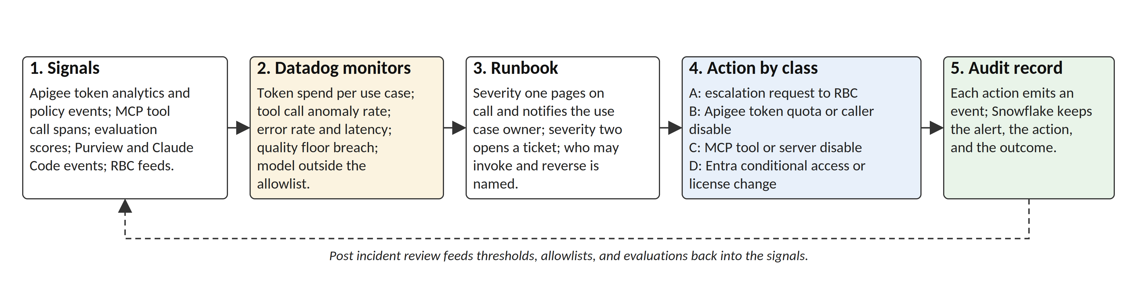
Policy Loop and Kill Switch
How a signal becomes an action and an audit record, and where the kill switch lives for each class
Steps 1, 2, and 5 run in the shared pipeline; step 3 is a human decision with a named authority and a reversal procedure; step 4 executes at the control point for the class
Near real time for CNB built apps, MCP tools, and third party tools, because CNB owns both the signals and the actions
For RBC Assist Pro, step 4 is an escalation request to RBC and the loop closes at the cadence RBC supports; the operating model defines the response target
Token threshold termination is an Apigee quota action; unauthorized tool use is an MCP allowlist or server disable; every action emits an event kept in Snowflake with the alert and the outcome
15

Slide 16
Operating Model and Ownership
Who owns each capability, and how the three lines of defence coordinate
Area | Owner | Responsibility
Apigee policies, MCP platform, collector fleet, Snowflake observability schema | T&I: CNB AI platform team | Build and run the control points and the pipeline; publish the span checklist
Instrumentation of each AI application | AI Product Team | Instrument against the checklist; no production release without it; human in the loop for drift and high risk actions
Datadog monitors and on call | T&I: SRE and operations | Severity one pages on call and notifies the use case owner; severity two opens a ticket
Key words, toxic combinations, sentiment rules, semantic filters | Compliance Team with Business SMAs | Maintain the monitoring inputs; quarterly pattern review and key word revision
Audit views, retention schedule, employee action | Compliance Team and Risk Team | Own the audit views and records schedule; initiate employee action; credible challenge
Independent review | Audit Team | Third line review of the control and its evidence
RBC interface and operating model | Gen AI leadership, named liaison; RBC Borealis and Lumina counterparts | Agree the RBC capabilities, cadence, and escalation path
Signals and floors
Each registered use case declares availability and latency objectives, a token budget, a quality floor from a named evaluation, and its approved model list
The approved model list is monitored, not only documented; only whitelisted open weight models are approved
Prompts, model versions, tool definitions, and gateway policies are versioned under change control
Alerting and the kill switch
The runbook states who may invoke the kill switch (use case owner, or on call for severity one), the reversal procedure, and the post incident review
Anything more than a temporary suspension is verified by a human before it stands
1st, 2nd and 3rd LOD coordinate on ongoing review and sustainability of risk mitigation
16

Slide 17
Assumptions and Open Questions
To be confirmed in Phase 0 and under the RBC operating model
Assumptions
Open questions
Apigee is the CNB API gateway standard; its LLM token quota, prompt token limit, Model Armor, and MCP policies are available at CNB's tier
Datadog is in use; licensed modules and coverage depth are confirmed in Phase 0, with Application Insights as the fallback hot path
RBC Assist Pro traffic runs browser to RBC with no CNB component in the path; AgilLink and Rovo AI reach the RBC gateway directly, not through Apigee
Vendor audit feeds are the standard exports vendors provide enterprise customers
Snowflake is the system of record; Event Hub and DataHub are out of scope for now and can be added later
Regulatory mapping is a separate deliverable with Risk and Compliance; jurisdictional differences are a design driver here
Which RBC capabilities are available today, in the RBC pipeline, or to be agreed, and at what cadence
What Pantheon and Evals will provide once deployed; the vendor scan addendum naming to be corrected
Functions Assist: model path and control point; Omilia: non LLM monitoring approach
Workato: adopt or not; job and audit log integration if adopted
Response target for the RBC escalation path that serves as the Assist Pro kill switch
Retention periods per records schedule and the opt in list for prompt and completion capture
17

