Slide 1

Machine Learning
Deep Learning & Fine-Tuning Techniques
Comprehensive Workshop
Focus on Modern Fine-Tuning Methods

Slide 2
What is Deep Learning?
Core Concepts
Key Advantages
Subset of machine learning using neural networks
Multiple layers learn representations at different abstraction levels
Automatic feature extraction from raw data
End-to-end learning without manual feature engineering
Handles complex, high-dimensional data
Scalable with data and compute
State-of-the-art performance across domains
Transfer learning capabilities

Slide 3
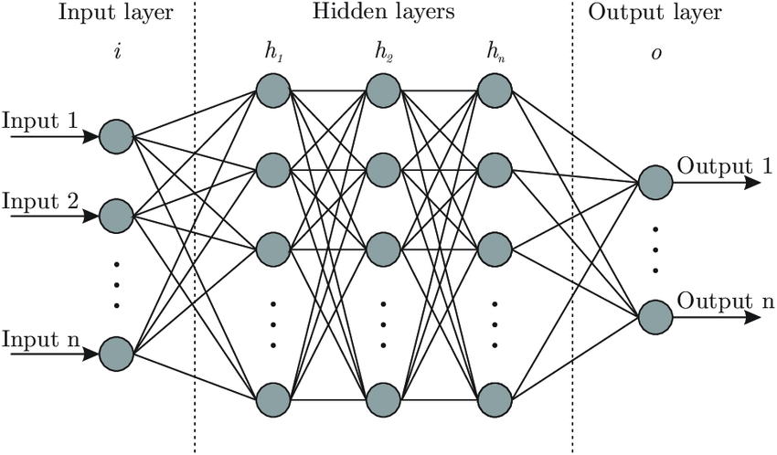
Neural Network Fundamentals
Building Blocks
Neurons: Basic computational units
Weights & Biases: Learnable parameters
Activation Functions: Non-linear transformations
Layers: Organized groups of neurons
Loss Function: Measures prediction error
Neural Network Architecture

Slide 4
Introduction to Transformers
The Architecture That Changed Everything
Introduced in 2017: "Attention is All You Need"
Self-Attention Mechanism: Process entire sequences simultaneously
Parallelizable: Unlike RNNs, no sequential bottleneck
Positional Encoding: Inject sequence order information
Encoder-Decoder Architecture: Flexible design
Multi-Head Attention: Capture different relationships
Feed-Forward Networks: Process representations
Layer Normalization: Stable training

Slide 5
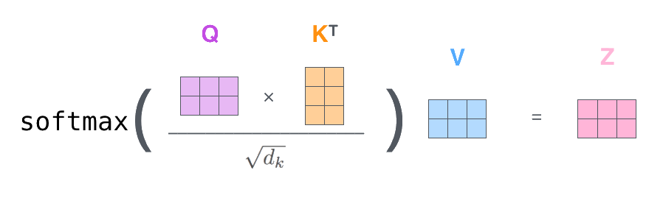
Attention Mechanism
Self-Attention: The Core Innovation
Query, Key, Value
Query (Q): What information am I looking for?
Key (K): What information do I contain?
Value (V): The actual information content
Attention Score: Softmax(Q·K/√d)
Attention Visualization

Slide 6
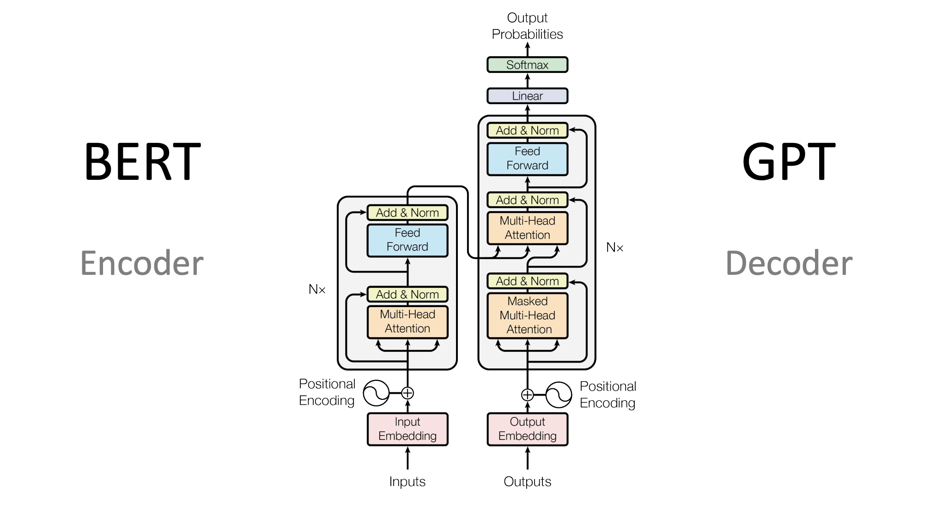
Transformer Architecture
Encoder Stack
Decoder Stack
6 identical layers (typically)
Multi-head self-attention
Position-wise feed-forward
Residual connections
Layer normalization
6 identical layers
Masked self-attention
Encoder-decoder attention
Feed-forward network
Auto-regressive generation

Slide 7
Why Transformers Dominate
Key Success Factors
Scalability
Pre-training
Performance improves predictably with more data and compute
Learn general representations from massive unlabeled data
Transfer Learning
Versatility
Fine-tune pre-trained models for specific tasks
Excel at NLP, vision, audio, and multimodal tasks

Slide 8
Data for Training Deep Neural Networks
Data Requirements
Scale Matters
Data Sources
Pre-training: Billions to trillions of tokens
Fine-tuning: Thousands to millions of examples
Few-shot: Tens to hundreds of examples
Quality > Quantity for specialized tasks
Web crawls (Common Crawl, C4)
Books and literature
Scientific papers and code
Domain-specific datasets

Slide 9
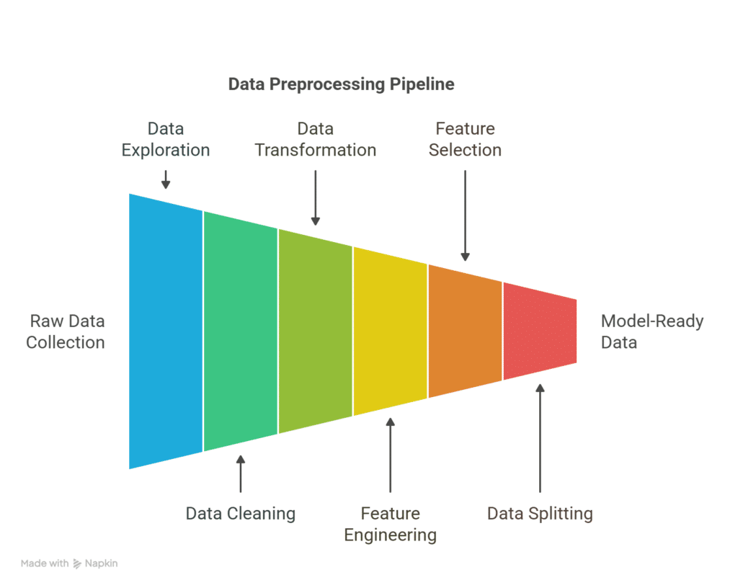
Data Preprocessing Pipeline
Essential Steps
Cleaning: Remove duplicates, filter low-quality content
Tokenization: Convert text to model input format
Normalization: Consistent formatting and encoding
Augmentation: Synthetic data generation
Balancing: Handle class imbalance
Splitting: Train/validation/test sets
Data Pipeline Flow

Slide 10
Data Quality Considerations
Diversity
Deduplication
Broad coverage of domains and styles
Remove exact and near duplicates
Bias Mitigation
Privacy
Address demographic and cultural biases
Remove PII and sensitive information
Key Insight: Data quality directly impacts model performance and behavior

Slide 11

Pre-training vs Fine-tuning
Pre-training
Fine-tuning
Objective: Learn general representations
Data: Large, diverse, unlabeled
Duration: Weeks to months
Cost: $100K - $100M+
Methods: MLM, CLM, Denoising
Objective: Adapt to specific tasks
Data: Smaller, labeled, task-specific
Duration: Hours to days
Cost: $10 - $10K
Methods: Full, LoRA, PEFT, Prompting

Slide 12
Training Best Practices
Key Recommendations
Start Small
Monitor Metrics
Test with subset before full training
Track loss, perplexity, and task metrics
Save Checkpoints
Validate Often
Regular saves for recovery and analysis
Prevent overfitting with validation sets
Experiment Tracking
Reproducibility
Use MLflow, W&B, or TensorBoard
Set seeds, log configurations

Slide 13

What is Fine-tuning?
Fine-tuning: Adapting a pre-trained model to a specific task or domain by continuing training on task-specific data
Process
Benefits
Start with pre-trained weights
Continue training on new data
Update all or some parameters
Typically use smaller learning rate
Leverage learned representations
Require less task-specific data
Faster convergence
Better performance than training from scratch

Slide 14
When to Fine-tune?
Fine-tune When:
Avoid When:
Have domain-specific data
Need consistent output format
Require specialized knowledge
Performance gaps exist
Privacy/security concerns
Limited training data (<100 examples)
Prompting works well
Task changes frequently
No compute resources
Need quick iterations

Slide 15
P-Tuning: Prompt Tuning Evolution
P-Tuning: Learn continuous prompt embeddings instead of discrete prompt tokens
Key Concepts
Advantages
Trainable continuous prompts
Freeze model parameters
Optimize prompt embeddings
Task-specific virtual tokens
Extremely parameter efficient
No model weight updates
Multiple tasks, one model
Fast task switching

Slide 16
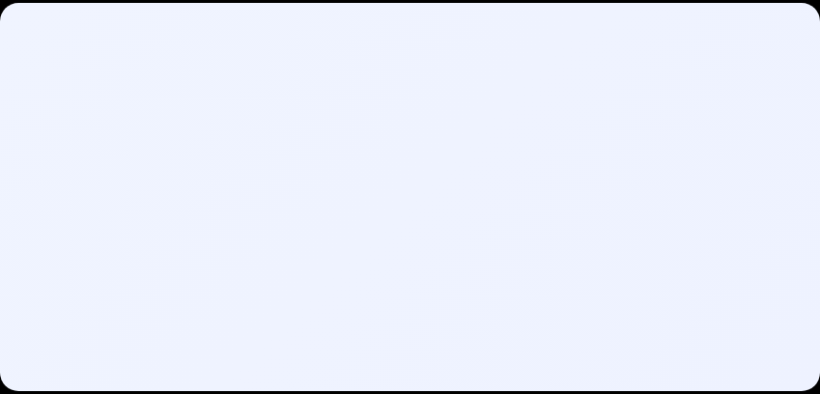
Prompt Tuning vs P-Tuning
Evolution of Prompt-based Methods
Manual Prompting
Prompt Tuning
P-Tuning v2
Hand-crafted text prompts
Continuous prompt embeddings
Prompts at every layer
❌ Manual effort
✓ Learnable
✓ More capacity
❌ Suboptimal
❌ Input only
✓ Better performance

Slide 17
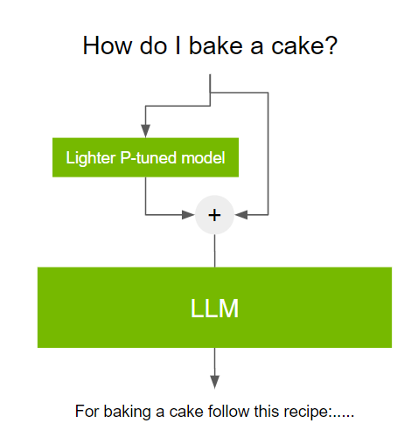
P-Tuning v2 Architecture
Deep Prompt Tuning
Prefix Tuning: Add tunable prefixes to keys and values
Multi-layer Prompts: Insert at every transformer layer
Reparameterization: Use MLP to generate prompts
Task Embeddings: Learn task-specific representations
P-Tuning v2 Architecture
Key Insight: Deeper prompts capture more complex patterns

Slide 18
Parameter Efficient Fine-Tuning (PEFT)
PEFT: Family of methods that fine-tune a small number of parameters while freezing most of the pre-trained model
PEFT Methods
Benefits
LoRA: Low-rank adaptation
Prefix Tuning: Learnable prefixes
Adapter Layers: Small bottleneck modules
IA³: Infused Adapter by Inhibiting and Amplifying
BitFit: Bias-only fine-tuning
10-1000x fewer parameters
Lower memory usage
Faster training
Multiple task adapters

Slide 19
Why PEFT?
The Efficiency Revolution
Resource Efficiency
Storage Efficiency
Train on consumer GPUs
Store only small adapters
70B model → 16GB VRAM
~100MB vs 140GB
Deployment Flexibility
Training Speed
Hot-swap task adapters
3-10x faster convergence
One base, many tasks
Hours vs days

Slide 20
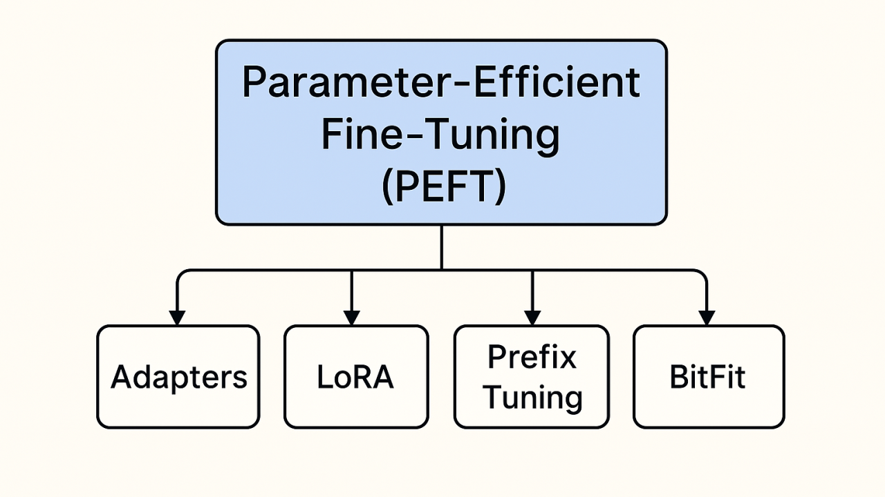
PEFT Methods Comparison
Choose the Right Method

Slide 21
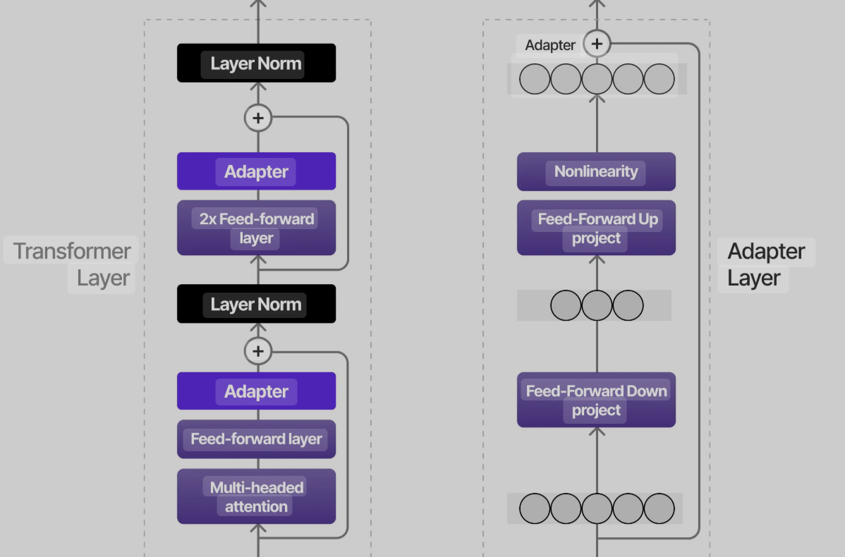
Adapter Layers
Bottleneck Architecture
Insert small modules between layers
Down-projection → Non-linearity → Up-projection
Skip connections preserve information flow
Typically 1-5% of model parameters
adapter = Sequential(
Adapter Architecture
Linear(hidden, bottleneck),
ReLU(),
Linear(bottleneck, hidden)
)

Slide 22
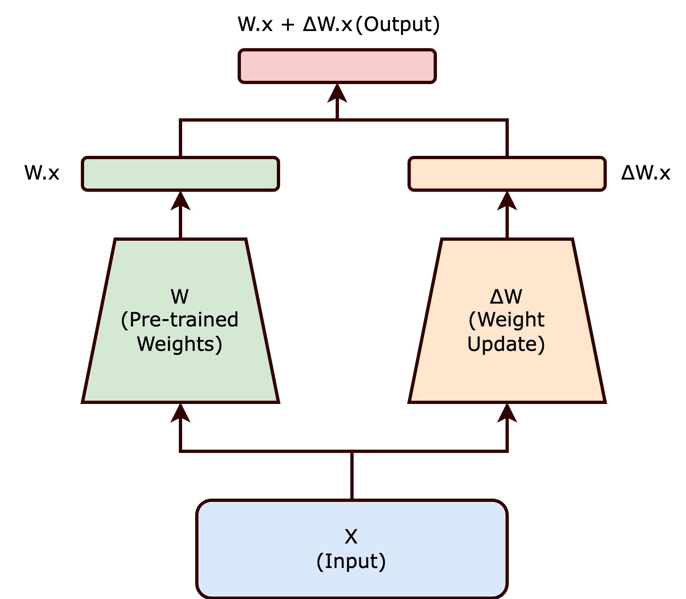
LoRA: Low-Rank Adaptation
Key Insight: Weight updates during fine-tuning have low intrinsic rank
Core Concept
Decompose weight updates: ΔW = BA
B ∈ ℝ, A ∈ ℝ, where r ≪ min(d, k)
Freeze pre-trained weights W₀
Only train low-rank matrices A and B
Inference: W = W₀ + BA
LoRA Decomposition

Slide 23
RLHF: Reinforcement Learning from Human Feedback
RLHF: Align language models with human preferences through reinforcement learning
Core Components
Goals
Supervised Fine-tuning (SFT)
Reward Model Training
Policy Optimization (PPO/DPO)
Human Preference Data
Improve helpfulness
Reduce harmful outputs
Align with human values
Better instruction following

Slide 24


DPO: Direct Preference Optimization
Simpler Alternative to PPO (Proximal Policy Optimization)
DPO Advantages
No reward model needed
Direct preference learning
More stable training
Simpler implementation
DPO Formula
L_DPO = -log σ(β log π(y_w|x)/π_ref(y_w|x)
- β log π(y_l|x)/π_ref(y_l|x))
Method | Complexity | Performance | Training Time
PPO | High | 95-100% | Slow
DPO | Low | 90-95% | Fast
PPO vs DPO Comparison

Slide 25
Fine-Tuning for Graph Neural Networks
GNNs: Neural networks designed to work with graph-structured data
GNN Architectures
Applications
Graph Convolutional Networks (GCN)
GraphSAGE
Graph Attention Networks (GAT)
Message Passing Neural Networks
Social network analysis
Molecular property prediction
Knowledge graph reasoning
Recommendation systems

Slide 26
GNN Fine-tuning Strategies
Adaptation Techniques
Node-level Fine-tuning
Edge-level Fine-tuning
Adapt for node classification tasks
Optimize for link prediction
Example: User classification in social networks
Example: Drug-drug interaction prediction
Graph-level Fine-tuning
Transfer Learning
Whole graph classification
Pre-train on large graphs, fine-tune on specific domains
Example: Molecular property prediction
Example: General → Biomedical graphs

Slide 27
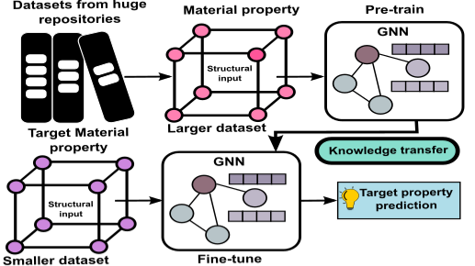
GNN Transfer Learning
Pre-training Strategies
Node Property Prediction: Mask and predict node features
Edge Prediction: Hide edges and reconstruct
Context Prediction: Predict graph context
Contrastive Learning: Learn graph representations
GNN Transfer Learning
Key Challenge: Graph structure heterogeneity across domains

Slide 28
Performance Metrics
Evaluation Framework
Task Metrics
Efficiency Metrics
Accuracy, F1, Precision, Recall
BLEU, ROUGE (generation)
Perplexity (language modeling)
BERTScore (semantic similarity)
Training time & cost
Inference latency
Memory usage
Parameters updated

Slide 29




Inference Optimization
Making Models Production-Ready
Quantization
Pruning
Reduce precision (FP16, INT8, INT4)
Remove redundant weights/neurons
2-4x speedup, 2-8x memory reduction
30-90% sparsity with minimal loss
Knowledge Distillation
Flash Attention
Train smaller student model
Optimized attention computation
10-100x smaller, 90-95% performance
2-4x faster, less memory

Slide 30
Chain of Thought Prompting
CoT: Enable models to show reasoning steps before final answers
Techniques
Benefits
Zero-shot CoT: "Let's think step by step"
Few-shot CoT: Provide reasoning examples
Self-consistency: Sample multiple paths
Least-to-Most: Decompose problems
Better accuracy on complex tasks
Interpretable reasoning
Reduced hallucination
Error diagnosis

Slide 31
Advanced Reasoning Techniques
Beyond Basic CoT
Tree of Thoughts
Graph of Thoughts
ReAct
Explore multiple reasoning paths
Non-linear reasoning graphs
Reason + Act with tools
Best for: Planning, puzzles
Best for: Complex analysis
Best for: Agent tasks
Reasoning Performance Comparison

Slide 32
Post-Training for Reasoning
Advanced Alignment Techniques
Constitutional AI
Process Supervision
Self-critique and revision
Principle-based alignment
Reduced human labeling
Reward intermediate steps
Better than outcome supervision
Improves reasoning quality
Emerging Approach: Combine RLHF with process supervision for robust reasoning

