Slide 1
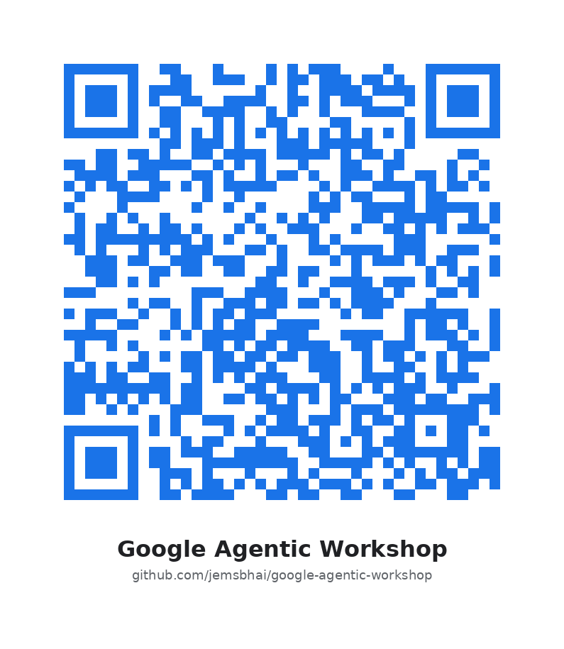
State of the Art in Agentic AI: From Scripts to Systems
A Technical Deep Dive into Google ADK, Vertex AI Agent Engine, and the A2A Protocol
Muntaser Syed
Notes:
Speaker Notes:
- Welcome to the comprehensive tutorial on Agentic AI.
- We are currently in a "phase transition" from the era of Generative AI (stateless, chat-based) to Agentic AI (stateful, autonomous workflows).
- Today we will cover the three pillars of the Google ecosystem:
1. Google ADK: The "kernel" for agent orchestration.
2. Vertex AI Agent Engine: The managed runtime for persistence and scale.
3. A2A Protocol: The standard for agent interoperability.

Slide 2
Agenda (Roadmap)
| Module 1: Foundations of Agentic Engineering
- System 2 Thinking & Cognitive Architectures
- The LlmAgent Primitive
| Module 2: Advanced Orchestration Patterns
- Workflow Agents: Sequential, Parallel, Loop
- Hierarchical Task Decomposition
| Module 3: State, Memory & The Runtime
- The Session Object and Memory Banks
- Deploying to Vertex AI Agent Engine
| Module 4: The Internet of Agents (A2A)
- Protocol Spec: JSON-RPC 2.0 & OIDC
- Discovery, Handshakes, and Task Lifecycles
| Module 5: AgentOps & Security
- Model Armor, Guardrails, and Evaluation

Slide 3
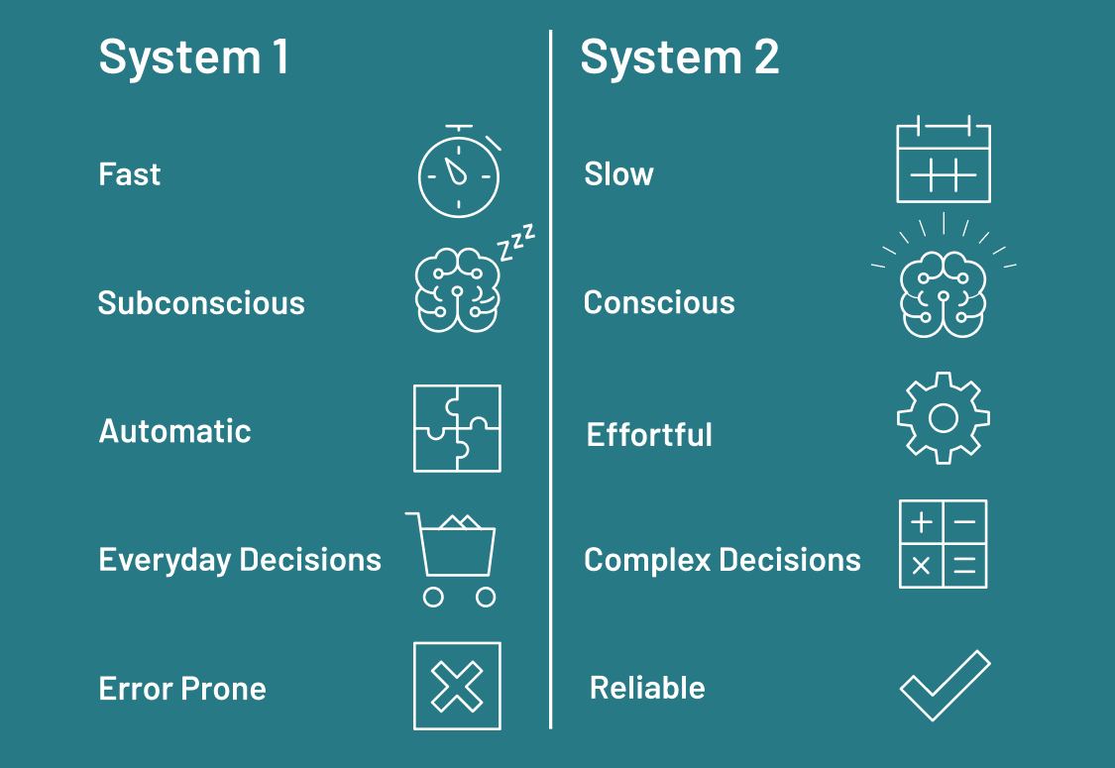
The Theoretical Shift: System 1 vs. System 2
The GenAI Era (System 1):
- Fast, instinctive, request-response.
- Prone to hallucination; stateless.
The Agentic Era (System 2):
- Deliberative, logical, multi-step.
- Internal Monologue: Models like Gemini 2.5 plan actions before execution.
Component Model:
- Profile: Immutable system instructions (Persona).
- Memory: Short-term context + Long-term semantic store.
- Planning: Reasoning engine (CoT).
- Tools: Capabilities (Search, Code Execution, APIs).

Slide 4
Introduction to Google ADK
What is it? A code-first, model-agnostic framework for building production agents.
Target Audience: Software Engineers, not just prompt engineers.
Key Philosophy: 'Everything is an Agent.'
- Treats agents as modular software objects, not magic strings.
Language Support: Python, TypeScript, Go, Java.
Installation: pip install google-adk

Slide 5
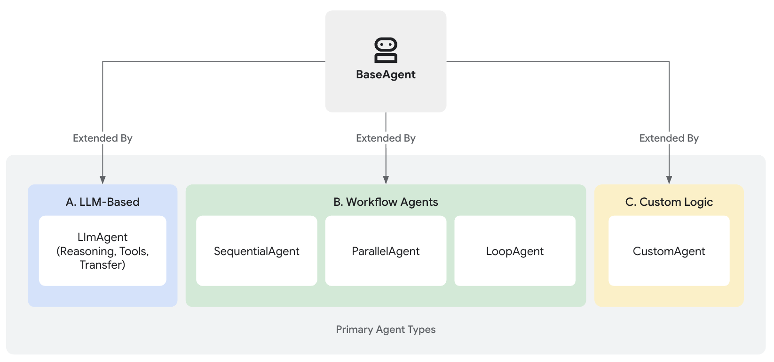
Introduction to Google ADK

Slide 6
The LlmAgent Primitive
Core Class: LlmAgent wraps the model, memory, and tools.
Configuration:
- model: e.g., gemini-2.5-pro (or non-Google models via LiteLLM).
- system_instruction: The 'Prime Directive' defining role and tone.
- tools: List of Python functions.
Code-as-Configuration:
- ADK inspects Python type hints to auto-generate OpenAPI/JSON schemas for the model.
Notes:
Review the code structure: You define a standard Python function, pass it to the agent, and ADK handles the serialization. You don't write raw JSON schemas manually.

Slide 7
Workflow Agents (Deterministic Control)
Why? Not all logic should be probabilistic. Reliability requires control flow.
SequentialAgent:
- Linear pipeline (Input -> Agent A -> Agent B -> Output).
- Use case: Research -> Write -> Edit pipelines.
ParallelAgent (Fan-Out):
- Executes multiple sub-agents concurrently.
- Swarm Architecture: e.g., Security Audit (Static Analysis + Dependency Check running simultaneously).
LoopAgent:
- Iterative logic based on state conditions (e.g., while status != 'APPROVED').

Slide 8
Design Pattern: Hierarchical Task Decomposition
The Coordinator Pattern:
- A 'Root' agent breaks down complex queries into sub-tasks.
- Routes work to specialized 'Sub-agents' (Research, Writing, Compliance).
Benefit: Solves 'Context Window Pollution' by isolating tools and prompts inside sub-agents.
Routing: Can be implicit (LLM decides) or explicit (hardcoded).

Slide 9
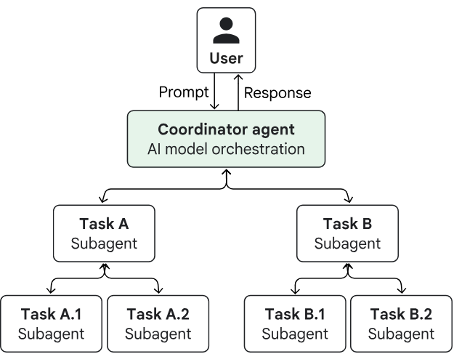
Design Pattern: Hierarchical Task Decomposition

Slide 10
Design Pattern: Reflection (Generator-Critic)
Workflow:
1. Generator: Creates an initial artifact (code/draft).
2. Critic: Evaluates against criteria (syntax, safety).
3. Loop Controller: If 'Fail', feeds feedback back to Generator. If 'Pass', terminates.
Implementation: LoopAgent wrapping a SequentialAgent.
Result: Significantly higher quality output for complex tasks like coding.

Slide 11
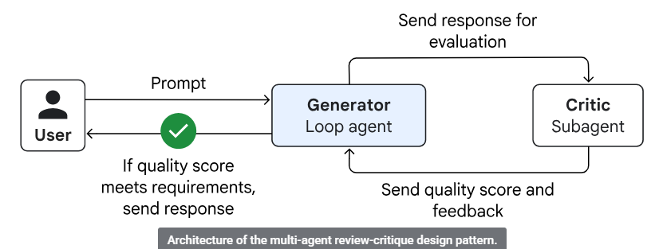
Design Pattern: Reflection (Generator-Critic)

Slide 12
Managing State with the Session Object
The Challenge: LLMs are stateless; passing full history is expensive and messy.
The ADK Solution: Session Object.
- Conversation History: Chronological log of messages.
- Session State: A structured 'Blackboard' (session.state) for sharing artifacts (files, drafts) between agents.
Persistence:
- Dev: InMemorySessionService (volatile).
- Prod: Vertex AI managed persistence (allows session resumption days later).

Slide 13
Vertex AI Agent Engine (The Runtime)
Architecture: Serverless, containerized execution environment.
'Pickling' the Agent: Captures local Python code + requirements.txt and deploys to a managed cluster.
The Memory Bank:
- Managed RAG layer for long-term storage.
- Semantic Memory: Agents can extract facts ('User prefers Python') and store them for future sessions.
Operational Quotas:
- Timeout: Default 60s (requires async for long loops).
- Concurrency: Default 100 requests/instance.

Slide 14
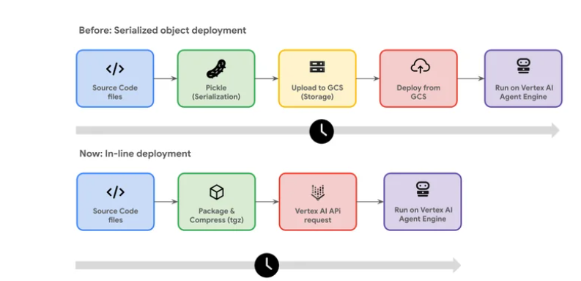
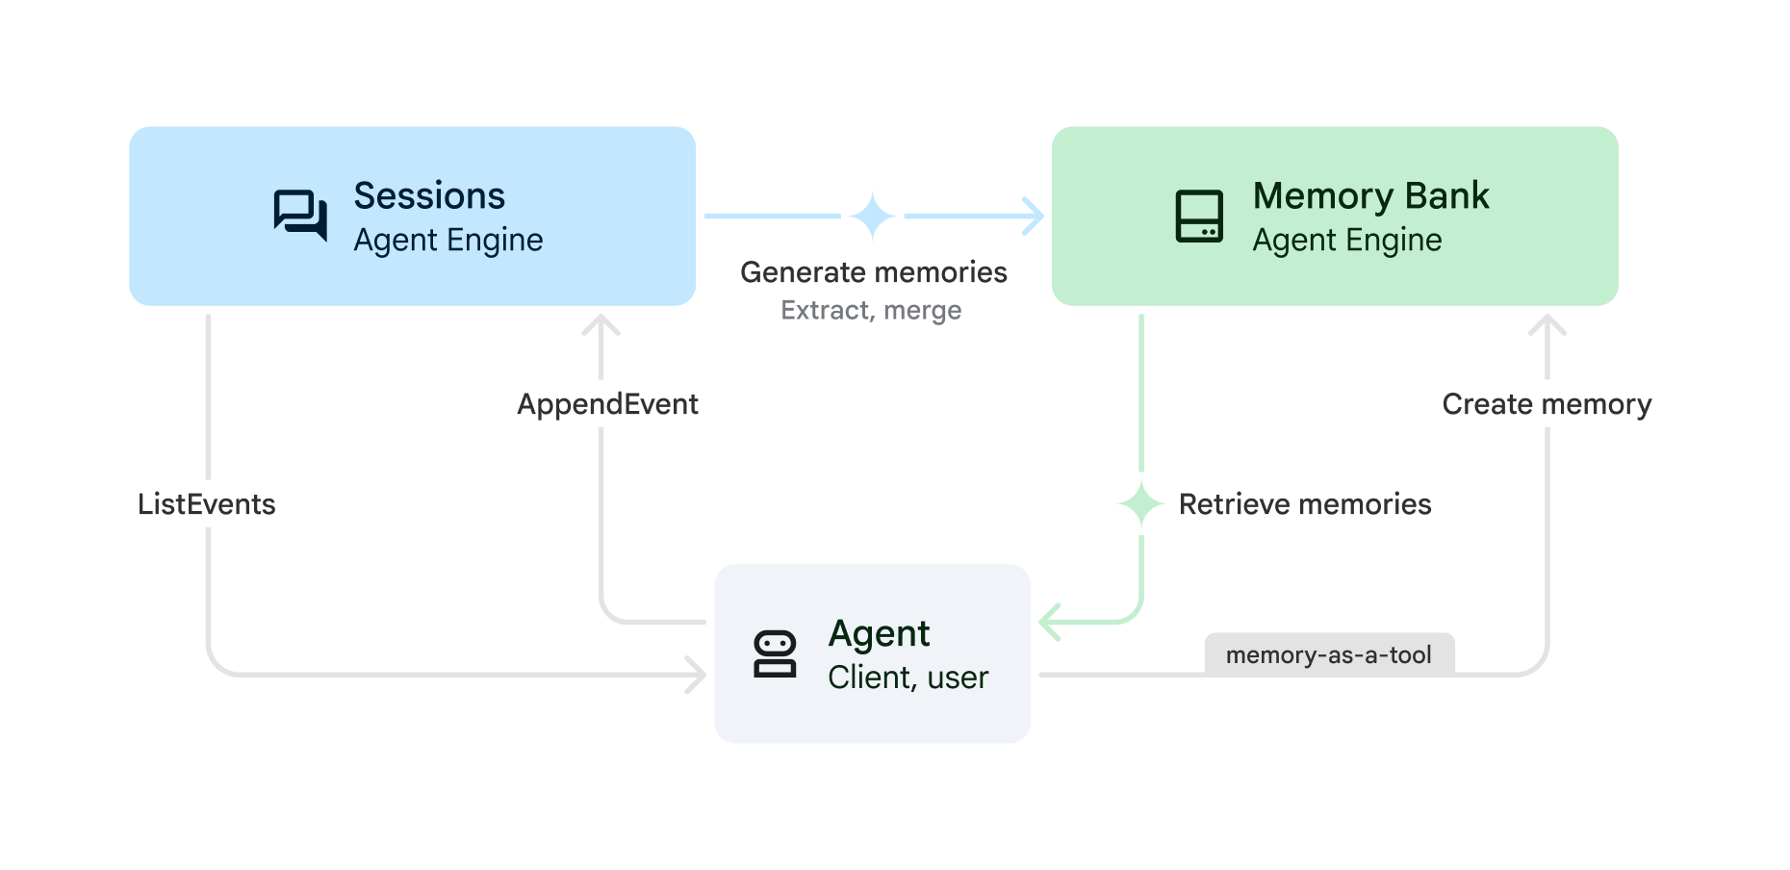
Vertex AI Agent Engine

Slide 15
The Internet of Agents: Agent2Agent (A2A)
Problem: The 'Silo Problem.' A Salesforce agent cannot talk to a Google Cloud agent.
Solution: A2A Protocol (Linux Foundation Standard).
Purpose: Standardizes how agents discover, authenticate, and task one another.
Differentiation:
- MCP (Model Context Protocol): Agent-to-Tool standard.
- A2A: Agent-to-Agent standard.

Slide 16
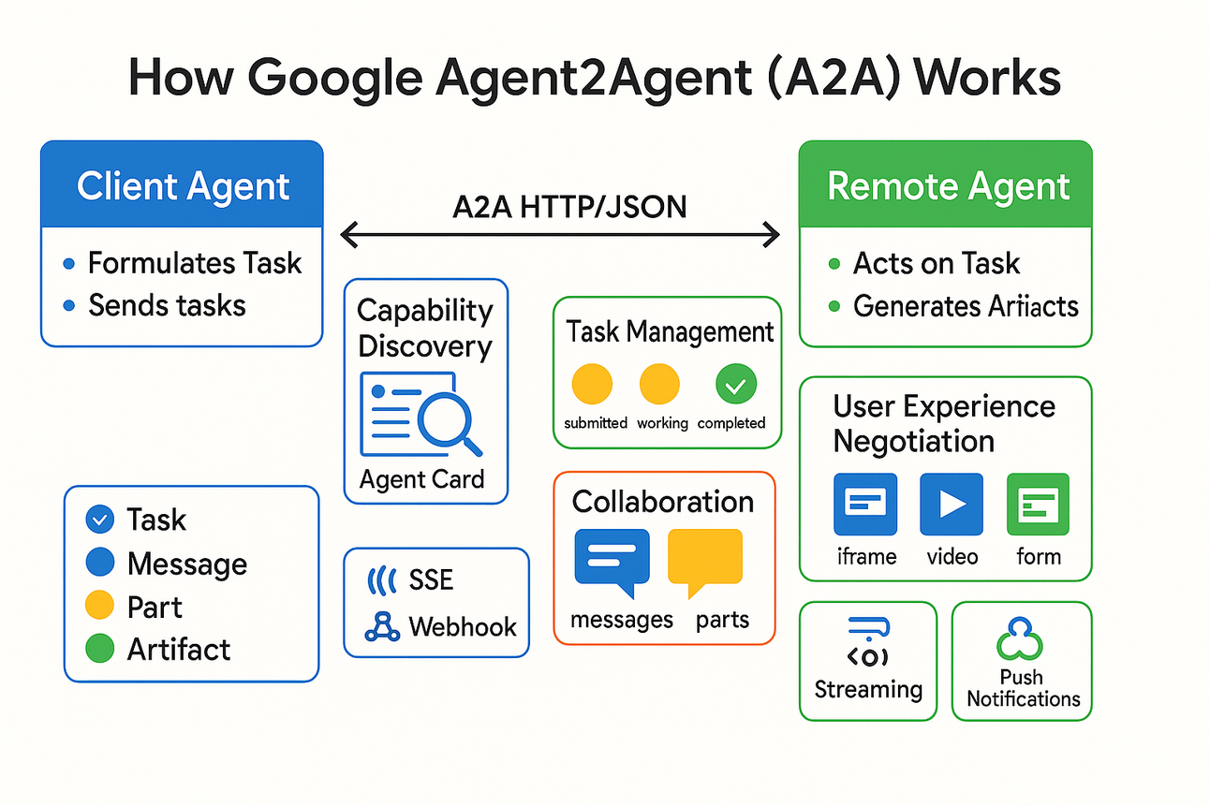
The Internet of Agents: Agent2Agent (A2A)

Slide 17
A2A Technical Specifications
Transport: JSON-RPC 2.0 over HTTP(S).
Discovery: The Agent Card.
- A JSON file hosted at a known URL listing Identity, Capabilities, and Auth Schemes.
Security (Zero Trust):
- Standardized on OIDC (OpenID Connect).
- Opacity: Agent A sends a request but *never* sees Agent B’s internal prompt or memory.

Slide 18
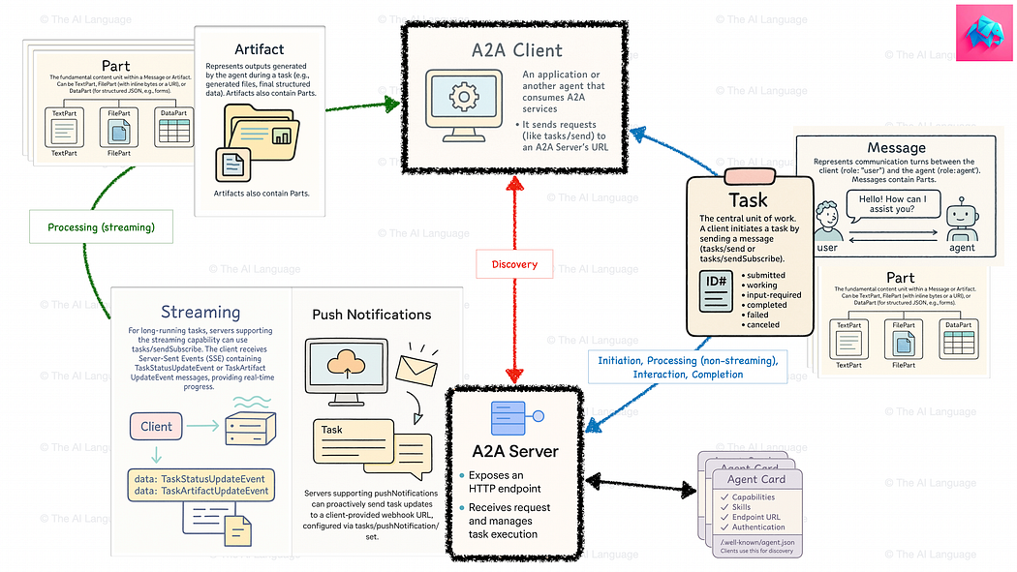
A2A Overview

Slide 19
The A2A Task Lifecycle
Asynchrony: Tasks are decoupled from results.
1. Request: Client sends JSON-RPC message/send.
2. Ack: Server returns a Task object (Status: queued).
3. Execution: Server agent processes the task.
4. Completion: Client receives result via Webhook or Server-Sent Events (SSE).
Artifact Exchange: High-fidelity data (files, datasets) exchanged separately from the conversation stream.

Slide 20
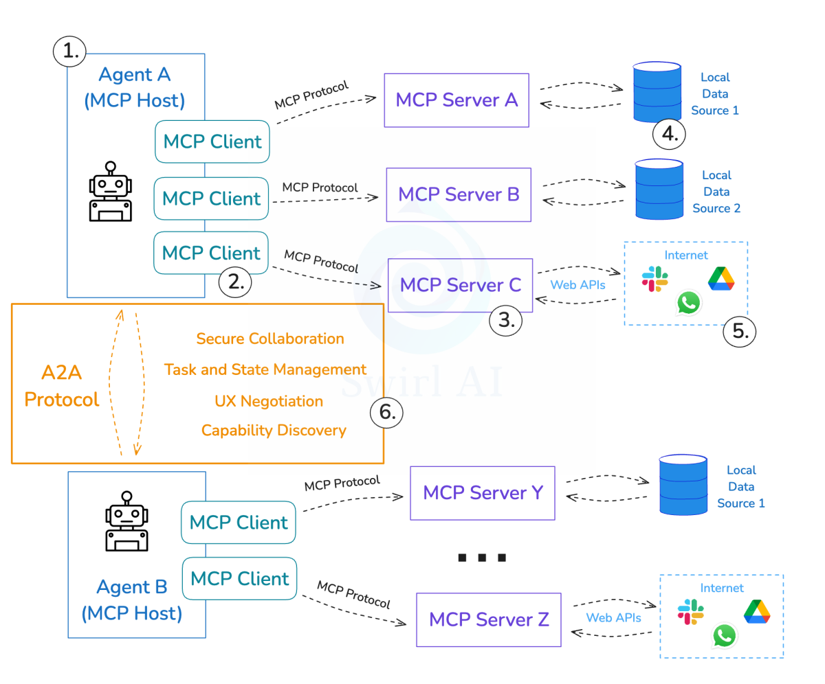
A2A with MCP

Slide 21
AgentOps: Security & 'Model Armor'
Principle: Safety cannot rely on the model alone.
Guardrails: Deterministic proxy layer checking inputs/outputs.
- Filters: PII, Hate Speech, Jailbreak attempts.
Refusal: Returns canned responses to prevent prompt injection attacks.

Slide 22
Observability & Evaluation
Cloud Trace: Visualize the 'Thought Process' as a waterfall trace.
- See latency spans for each sub-agent and tool call.
Metrics: Monitor Token Count (Cost), Tool Error Rate, and Step Count (Loop detection).
Evaluation (CI/CD):
- Golden Datasets: Regression testing with 'Judge' models scoring Fluency and Groundedness.

Slide 23
Summary & Conclusion
ADK: Use for building robust, stateful, 'Agent-as-a-Product'.
A2A: Use to connect your agents to the broader ecosystem.
The Future: Moving from 'Chatting with Machines' to 'Collaborating with Systems'.
Resources:
- https://google.github.io/adk-docs/
- https://a2a-protocol.org
- https://docs.cloud.google.com/architecture/agentic-ai-overview

Slide 24
Materials

