Slide 1
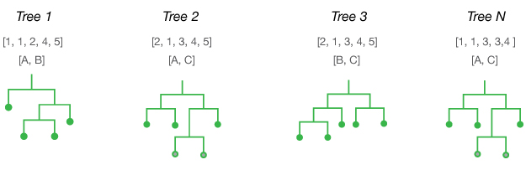
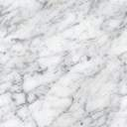
 | x₁ | … | x_{p} | y
1 | 1.4 |  |  | 1 | 1
2 | 2 |  |  | 0 | 0
3 | 1.55 |  |  | 1 | 1
4 | 1.72 |  |  | 0 | 0
5 | 1.89 |  |  | 1 | 0
…
n | 2.01 |  |  | 1 | 1
Tree 1
Tree M
Inbag + oob of tree 1
Permuted oob obs. of x₁
Inbag + oob of tree 1
Permuted oob obs. of x₁
 | x₁ | … | x_{p} | y
1 | 1.4 |  |  | 1
2 | 2 |  |  | 0
3 | 1.55 |  |  | 1 | 1
4 | 1.72 |  |  | 0 | 0
5 | 1.89 |  |  | 1
…
n | 2.01 |  |  | 1 | 1
 | x₁ | … | x_{p} | y
1 | 1.4 |  |  | 1
2 | 2 |  |  | 0
3 | 2.01 |  |  | 1 | 0
4 | 1.55 |  |  | 0 | 0
5 | 1.89 |  |  | 1
…
n | 1.72 |  |  | 1 | 0
 | x₁ | … | x_{p} | y
1 | 1.4 |  |  | 1 | 1
2 | 2 |  |  | 0
3 | 1.55 |  |  | 1 | 0
4 | 1.72 |  |  | 0
5 | 1.89 |  |  | 1 | 1
…
n | 2.01 |  |  | 1
 | x₁ | … | x_{p} | y
1 | 1.89 |  |  | 1 | 0
2 | 2 |  |  | 0
3 | 1.4 |  |  | 1 | 0
4 | 1.72 |  |  | 0
5 | 1.55 |  |  | 1 | 1
…
n | 2.01 |  |  | 1
…..

