Slide 1

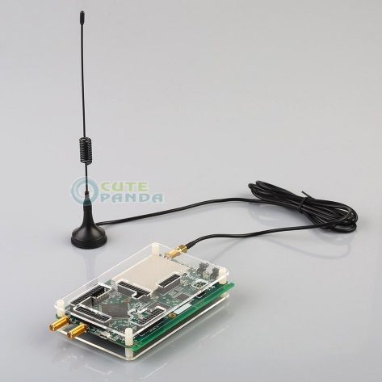
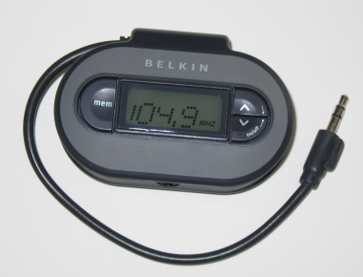
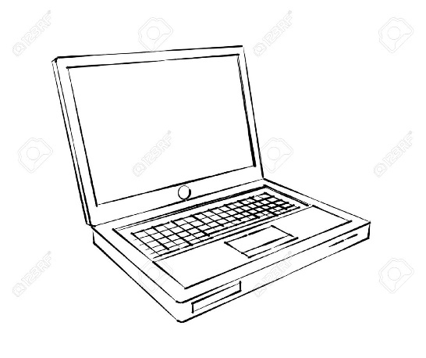

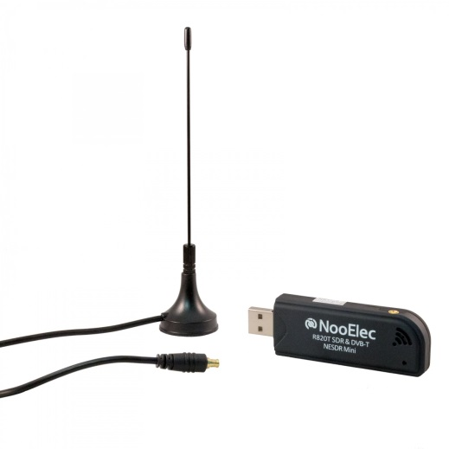
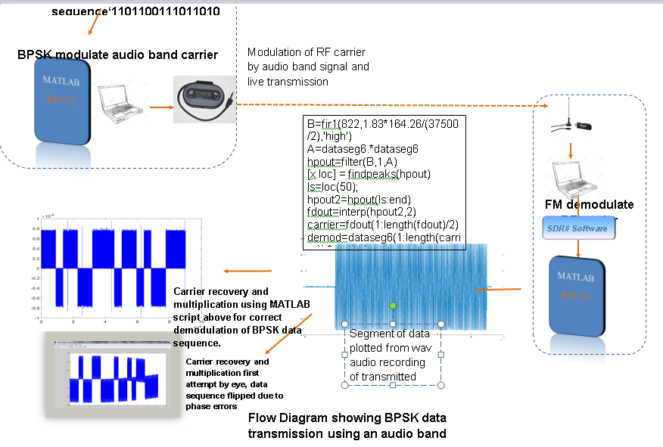
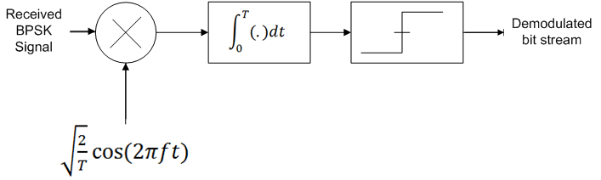
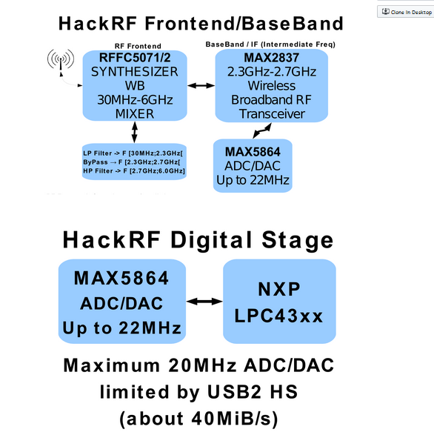
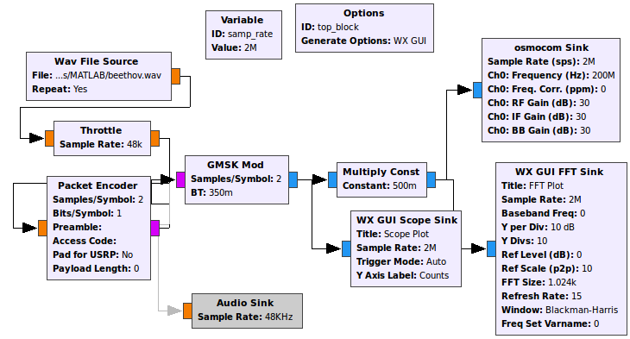
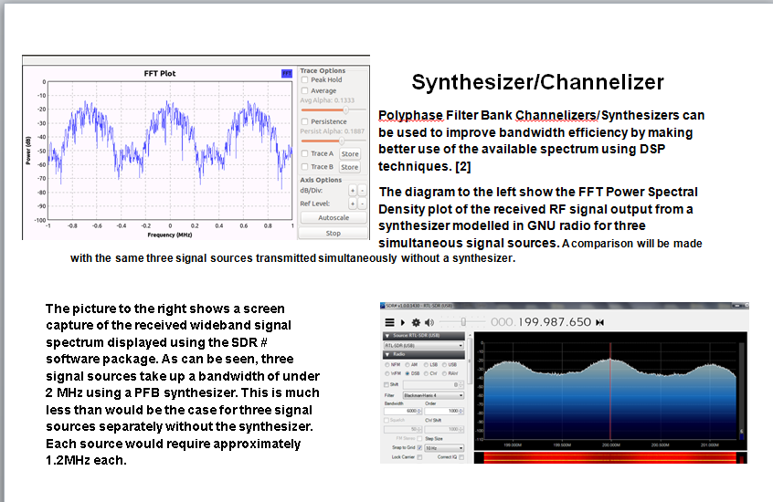

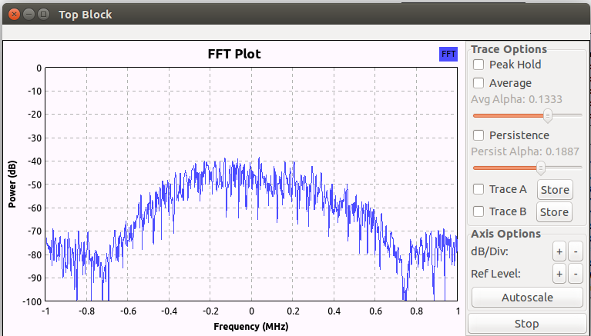
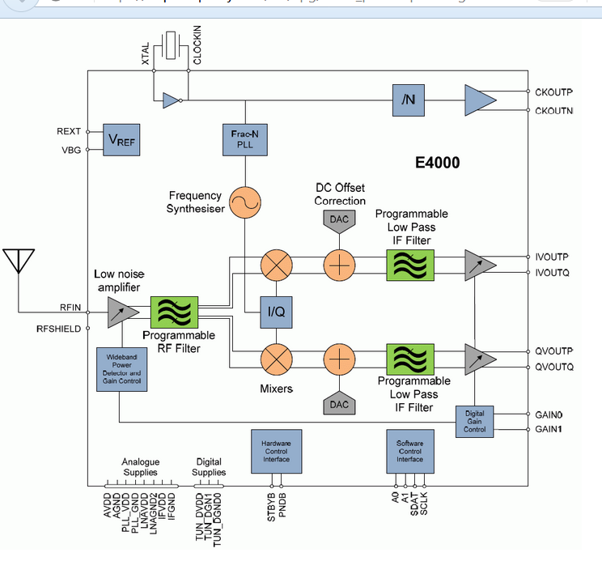
J SStudy, analysis and transmission of audio and data over FM using Software Defined Radio
By: James F. Muchechetere Supervisor: Dr. Adem Coscun
Equipment Used
Abstract
This project seeks to investigate Software Defined Radio(SDR). It demonstrates how audio and digital data can be transmitted over the air using Software Defined Radio techniques, using affordable hardware platforms and MATLAB. It explores the background theory of Software Defined Radio and key principles involved including the various modulation schemes both analogue and digital for transmission of information in a Software Defined Radio system scenario. In an SDR system, an embedded system or PC implements components typically implemented in hardware such as filters, mixers, amplifiers, modulators, demodulators, detectors, etc.[1]
Primary Goals
-Background study and collection of information and applications of Software Defined Radio, FM. AM and Digital modulation techniques and the key principles involved.
-Set up and transmit audio and data message signals by AM, FM and digital modulation of an audio band carrier using MATLAB and Simulink and an FM micro-transmitter
-Utilisation of RTL-SDR as an I/O peripheral to receive, demodulate and record samples of streaming FM band RF signals.
-Graphical presentation of results for transmitted and received waveforms of unmodulated and modulated/demodulated signals for various modulation schemes, using MATLAB and Simulink.
-Drafting of a Final Report detailing all work carried out.
Secondary Goals
- explore the effects of the addition of noise and Interference into the transmission channel to study its effects on the signal.
-Use of DSP techniques to filter out noise and interference and recover the original signal.
Transmit
1
2
Receive
3
4
Flow graph shown below in GNU Radio showing transmission of WAV files using Gaussian Minimum Shift Keying (GMSK)
BPSK receiver process[2]
Transmission of audio files using Software Defined Radio
To transmit large amounts of date whilst very inexpensive[] is not very efficient using the above described method which is more suited as a demonstration tool for teaching. Hence it was found that for larger files, the cheapest method was to use the HackRF One SDR platform in conjunction with GNU Radio Companion Software.
The HackRF One is a Software Defined Radio peripheral capable of transmission or reception of radio signals from 1 MHz to 6 GHz. It is an open source hardware platform that can be used as a USB peripheral or programmed for stand-alone operation .
5
6
GNU Radio is a free & open-source software development toolkit that provides signal processing blocks to implement software radios. It can be used with readily-available low-cost external RF hardware to create software-defined radios.
FFT power spectral density plot shown right in GNU Radio showing transmission of WAV files using Gaussian Minimum Shift Keying (GMSK) which has been shown through mathematical modelling to be an effective modulation scheme for use in SDR communications systems.[3]
Initial Findings
Low cost hardware platforms that can be used to successfully demonstrate principles of Software Defined -- Radio are: an FM micro transmitter, the NooElec NESDR Mini USB RTL-SDR dongle and the HackRF One, using -MATLAB, SDRSharp and GNU Radio Companion
Future Work
Vary known configurations of modulation and coding and explore effects
Vary input parameters in GNU Radio companion flow diagrams and MATLAB scripts to model dynamic channel conditions and observe effects
Plot results
Final Report
Resources Required
MATLAB/Simulink software access to laptop machines
GNU Radio Companion HackRF One
SDR # software FM micro transmitter
rtl-sdr RTL2832U receiver dongle
RTL-SDR RTL2832U receiver block diagram
7
8
Project Work Plan
 | Jan | Feb | March | April | May | June | July | August | September
Background Research and Literature survey
Hardware and Requirements/functionality
Modelling and Execution
Report
References
[1

Slide 2
MSc Final Presentation

