Slide 1
Supporting families with MPS IVA and MPS VI: from diagnosis to adult care
Patient educator training
01 Your role
02 Diagnosis
03 Understanding MPS
04 Starting treatment
Focus on MPS IVA (Morquio A) and MPS VI (Maroteaux-Lamy) for staff following patients in the support program
05 Infusion day
06 Follow-up
07 Living with MPS
Medical Affairs | October 2026
08 Pharmacovigilance
For internal training of patient support program staff only. Not for distribution to patients. Product information may vary by country; always refer to the local prescribing information.

Slide 2
Reviewer note: what changed from the original deck
For Medical Affairs review | Hidden in Slide Show
Change | What was done | Why
New order | Rebuilt around the patient journey: your role → diagnosis → understanding MPS → starting treatment → infusion day → follow-up → living with MPS → pharmacovigilance | Matches how educators meet families over time
New slides (8) | Role and boundaries; each family contact; how MPS is diagnosed; supporting adherence; surgery and emergencies; living with MPS; transition to adult care; plus 3 dividers | Core topics for an outsourced, educate-only program
Trial data | ~30 trial slides (MOR-004/005, MorCAP, Survey/Resurvey) cut to 3 plain-language slides; the rest moved to the appendix | Educators explain what ERT does, not study design
Diagnosis tests | 8 test and red-flag slides replaced by 1 summary; detail moved to the appendix | Educators refer; they do not diagnose
SmPC detail | Dose, dilution and infusion-rate tables moved to the appendix; ERT overview and reaction management kept | Educators do not prepare or give infusions
Biology detail | LSD and GAG chemistry and the 8-type table moved to the appendix | More than educators need day to day
Removed (1) | MOR-004 safety slide, a duplicate of the elosulfase alfa safety slide | Duplicate
Unchanged | Colours, layouts, the click-to-reveal animation on “Report or not?”, all PV and complaint slides | Brand and PV process consistency
Delete this slide before sharing with the vendor. It is hidden in Slide Show but visible when editing.

Slide 3
Agenda
01
Your role
05
Infusion day
Learning objectives
Boundaries, compliance and each family contact
Each infusion, side effects, managing reactions
Explain MPS IVA and MPS VI and their inheritance in plain words
Stay within the program’s role, compliance and privacy rules
Guide families through each step, from diagnosis to adult care
Recognise warning signs and infusion reactions, and escalate the same day
Support adherence, follow-up tests and MDT visits at every contact
Report adverse events, special situations and complaints on time
02
Diagnosis
06
Ongoing follow-up
First signs, how it is confirmed, family testing
Tests, MDT visits, adherence, warning signs
03
Understanding MPS
07
Living with MPS
Inheritance, organs affected, MPS IVA and VI
Surgery safety, daily life, move to adult care
04
Starting treatment
08
Pharmacovigilance
Care options, baseline tests, what ERT achieves
Reporting AEs, special situations, complaints
AE, adverse event; ERT, enzyme replacement therapy; MDT, multidisciplinary team; MPS, mucopolysaccharidosis

Slide 4
Your role
01
In this section
Your role and boundaries
Each family contact, step by step
What the program asks of you, its limits, and how to run every family contact

Slide 5
Your role: what you do, and what you never do
Your role
You do
You never
Before the first contact
Educate families using program-approved materials only
Remind: infusion dates, tests and MDT visits
Listen, and record every contact accurately
Escalate warning signs to the treating team the same day
Report every AE, special situation and complaint
Give medical advice or change doses, rates or premedication
Promote products or discuss off-label use
Promise outcomes or question the physician’s plan
Share patient data outside the program
Accept gifts or payments from families
Signed consent from the patient or caregiver
Referral or agreement from the treating physician
Data privacy rules applied to every record
PV training completed, and refreshed yearly
Escalation and PV contacts saved
The program is educational and non-promotional. If in doubt, stop and ask your program manager or the treating physician.
AE, adverse event; MDT, multidisciplinary team; PV, pharmacovigilance
EMA. Guideline on good pharmacovigilance practices (GVP) Module VI; ABPI. Guidance notes for patient safety and pharmacovigilance in patient support programmes; local industry code of practice.

Slide 6
Each family contact, step by step
Your role
1 Prepare
2 Open
3 Explore
4 Educate
5 Close
Read the notes from the last contact
Check the last infusion and upcoming tests
Confirm language and who will join
Ask how the patient and family are doing
Explain why you are calling and how long it takes
Ask open questions and listen
Explore barriers without blame (motivational interviewing)
One or two key messages per contact
Plain words, no jargon
Check understanding with teach-back
Agree next steps and dates
Document the contact
Escalate or report if needed
Teach-back: ask the family to explain it in their own words. If they can’t, the message wasn’t clear, so try again another way.
Respect culture and family roles, involve the patient more as they grow, and respond to anger or denial with patience and support.
Akyol MU et al. Orphanet J Rare Dis 2019;14:137; Akyol MU et al. Orphanet J Rare Dis 2019;14:118; Lampe C et al. Mol Genet Metab Rep 2019;21:100508.

Slide 7
First signs and diagnosis
02
In this section
Time to diagnosis
How MPS IVA and MPS VI are diagnosed
Why diagnosis takes years, how it is confirmed and what it means for the family

Slide 8
Time to diagnosis
First signs and diagnosis
1
Earlier treatment, better outcomes
~4 years
In MPS VI siblings, the child who started ERT at 7.5 weeks had no scoliosis at age 3.6 years; the older sibling, untreated until then, already had scoliosis.²
2
Guidelines: start ERT at diagnosis
average delay from first symptoms to diagnosis of MPS¹
International recommendations for MPS IVA and MPS VI advise starting ERT as soon as the diagnosis is confirmed.^{3,4}
3
Established damage does not reverse
Early signs are often subtle or mistaken for common childhood conditions.
ERT slows or stabilises disease, but existing bone and joint changes remain, so every delay costs function.^{3,4}
ERT, enzyme replacement therapy; MPS, mucopolysaccharidosis
1. Mitchell J et al. Presenting signs and symptoms of MPS: systematic literature analysis. WORLDSymposium 2018, poster 244. 2. McGill JJ et al. Clin Genet 2010;77:492–8. 3. Akyol MU et al. Orphanet J Rare Dis 2019;14:137. 4. Akyol MU et al. Orphanet J Rare Dis 2019;14:118.

Slide 9
How MPS IVA and MPS VI are diagnosed
First signs and diagnosis
1 Suspected
2 Confirmed
3 Family follow-up
Signs: short stature, skeletal or joint changes, corneal clouding, repeated ear or chest infections
Urine GAG test: can raise suspicion but cannot confirm MPS
Enzyme test in blood cells: the gold standard
Dried blood spot: easy to send, but needs confirmation
Genetic test: confirms the variant and the MPS type
Siblings should be offered testing; early treatment matters
Genetic counselling: carrier, premarital and prenatal options
Newborn screening is not routine in most countries
Your role: explain the steps in plain words and refer to the treating physician and genetic counsellor. You never order or interpret tests.
GAG, glycosaminoglycan; MPS, mucopolysaccharidosis. Laboratory detail is in the appendix
Wood T et al. Mol Genet Metab 2012;106:73–82; Akyol MU et al. Orphanet J Rare Dis 2019;14:137; Akyol MU et al. Orphanet J Rare Dis 2019;14:118.

Slide 10
Understanding MPS
03
In this section
What MPS is
How MPS is inherited
Organ systems affected
MPS IVA (Morquio A)
What families need to understand after the diagnosis
MPS VI (Maroteaux-Lamy)

Slide 11
What is MPS?
Understanding MPS
Gene variant
Enzyme deficiency
GAG storage
Cell damage
Multi-organ disease
Both copies of an MPS gene carry a variant (one copy in males with X-linked MPS II)
The lysosomal enzyme that breaks down GAGs is missing or works poorly
GAGs (long sugar chains) accumulate inside lysosomes
Storage triggers inflammation and disrupts cell and tissue function
Bones, joints, airway, heart, eyes and ears are progressively affected
~1 in 25,000¹
From birth²
Lifelong³
live births are affected by an MPS disorder, with wide regional variation
the enzyme defect is present at birth; most signs appear over months to years
storage continues without treatment, so the disease progresses with age
GAG, glycosaminoglycan; MPS, mucopolysaccharidosis
1. Gökdoğan C et al. Braz J Otorhinolaryngol 2016;82:281–4. 2. Muenzer J. Rheumatology (Oxford) 2011;50(Suppl 5):v4–12. 3. Neufeld EF, Muenzer J. In: The Metabolic and Molecular Bases of Inherited Disease. 8th ed. McGraw-Hill; 2001:3421–52.

Slide 12
Inheritance of MPS
Understanding MPS
R r
R r
MPS II is the exception
X-linked: a carrier mother has a 50% chance of passing the variant to each son (affected) and to each daughter (usually a carrier).
Carrier father
Carrier mother
R R
R r
R r
r r
What this means for families
Unaffected
25%
Carrier
25%
Carrier
25%
Affected
25%
Consanguinity raises the chance that both parents carry the same variant
Siblings of a patient should be offered testing, as early treatment matters
Genetic counselling supports family planning, including premarital and prenatal options
R working gene copy r copy with the disease variant
The same odds apply to every pregnancy, whatever the outcome of earlier pregnancies.
MPS, mucopolysaccharidosis
Muenzer J. Rheumatology (Oxford) 2011;50(Suppl 5):v4–12; Akyol MU et al. Orphanet J Rare Dis 2019;14:137; Akyol MU et al. Orphanet J Rare Dis 2019;14:118.

Slide 13
Organ systems affected in MPS
Understanding MPS
Bones and joints
Spine and nerves
Airway and lungs
Heart
Dysostosis multiplex, short stature, stiff (or lax in IVA) joints, hip and knee deformity
Cord compression, carpal tunnel; brain affected in MPS I, II, III, VII
Narrow airway, sleep apnoea, small rigid chest, recurrent infections
Thickened valves that leak or narrow; cardiomyopathy
Eyes
Ears
Abdomen
Teeth and mouth
Corneal clouding, glaucoma, retinal and optic-nerve disease
Recurrent ear infections; conductive and sensorineural hearing loss
Enlarged liver and spleen; umbilical and inguinal hernias
Widely spaced teeth, enamel defects, enlarged gums and tongue
GAG, glycosaminoglycan; MPS, mucopolysaccharidosis
Neufeld EF, Muenzer J. In: The Metabolic and Molecular Bases of Inherited Disease. 8th ed. McGraw-Hill; 2001:3421–52; Muenzer J. Rheumatology (Oxford) 2011;50(Suppl 5):v4–12; Clarke L et al. J Inborn Errors Metab Screen 2018;6:1–12.

Slide 14
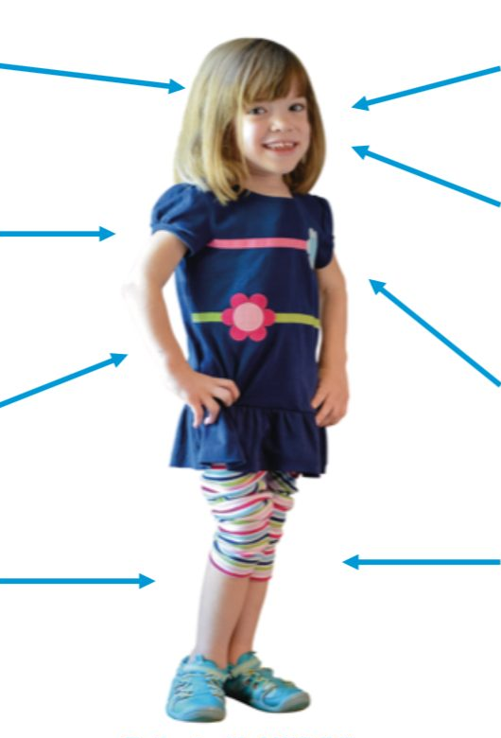
MPS IVA (Morquio A): key facts
MPS IVA and MPS VI
Key facts
Ophthalmological
Diffuse corneal clouding, cataracts, astigmatism, visual impairment^{1,2}
ENT
Conductive and neurosensory hearing loss, airway obstruction^{1,2}
Enzyme
GALNS is deficient
Stored GAGs
Keratan sulfate and chondroitin-6-sulfate
Onset
Normal at birth; skeletal signs develop progressively from about age 3
Cognition
Usually normal
Life expectancy
From the second decade to near-normal, depending on severity
Dental
Widely spaced teeth, thin enamel, frequent caries, pointed cusps, spade-shaped incisors, abnormal buccal surfaces^{2,3}
Pulmonary
Obstructive sleep apnoea, respiratory infections, respiratory failure^{2,3}
Gastrointestinal
Hepatomegaly, splenomegaly, hernias, diarrhoea, constipation^{1,2}
Cardiac
Mitral and aortic valve stenosis and regurgitation, left ventricular hypertrophy²
Neurological
Cervical myelopathy from odontoid dysplasia or cervical spine instability, tetraplegia^{1,3}
Skeletal
Short stature, spinal abnormalities, atlantoaxial instability, hip and odontoid dysplasia, genu valgum, pectus carinatum, joint abnormalities¹
Image: patient with MPS IVA. Not all signs or symptoms are present in every patient.
ENT, ear, nose and throat; GAG, glycosaminoglycan; GALNS, N-acetylgalactosamine-6-sulfatase; MPS, mucopolysaccharidosis
Image: 1. Hendriksz CJ et al. Am J Med Genet A 2015;167A:11–25. 2. Hendriksz CJ et al. J Inherit Metab Dis 2013;36:309–22. 3. Tomatsu S et al. Curr Pharm Biotechnol 2011;12:931–45. Key facts: Hendriksz CJ et al. Am J Med Genet A 2015;167A:11–25; Hendriksz CJ et al. Mol Genet Metab 2013;110:54–64; Akyol MU et al. Orphanet J Rare Dis 2019;14:137.

Slide 15
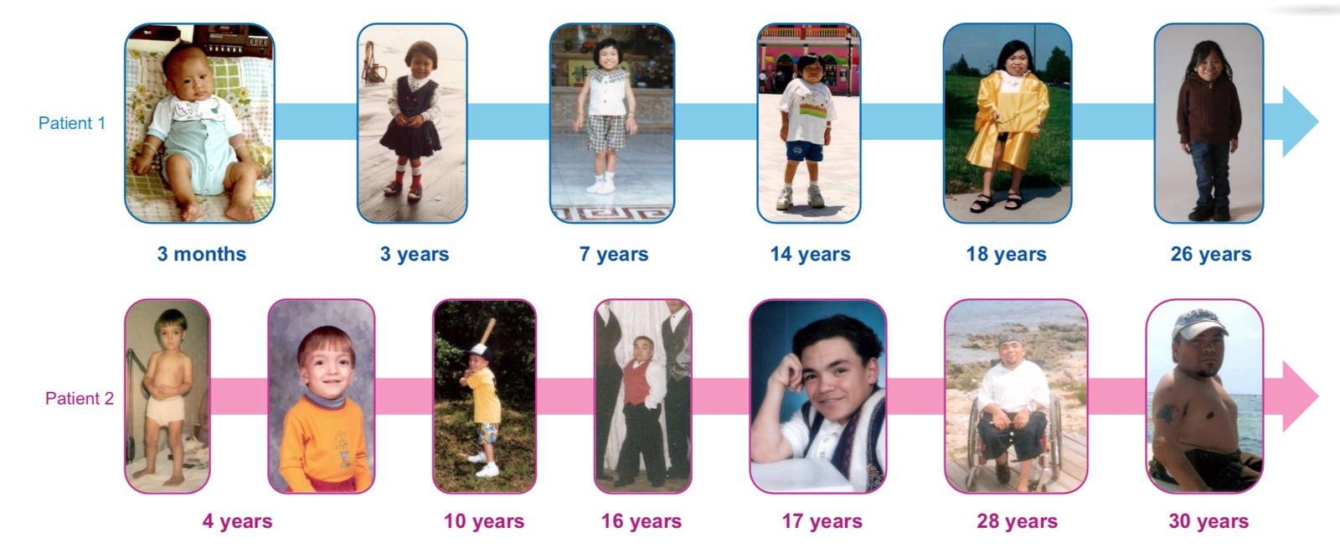
MPS IVA progression: two patients from infancy to adulthood
MPS IVA
MPS, mucopolysaccharidosis
1. Hendriksz CJ et al. Am J Med Genet A 2015;167A:11–25.

Slide 16
MPS IVA: morbidity and mortality
MPS IVA
Morbidity^{1,2}
Progressive multisystem manifestations¹
Cardiac disease
Respiratory disease
Musculoskeletal disease
Spinal cord compression
Multiple surgeries²
Reduced mobility¹
Chronic pain²
Lower quality of life²
Mortality^{2,3}
Life expectancy ranges from the second decade to a near-normal lifespan
Causes of death include:
Pulmonary complications
Neurological complications
Cardiac complications
MPS, mucopolysaccharidosis
1. Hendriksz CJ et al. Mol Genet Metab 2013;110:54–64. 2. Harmatz P et al. Mol Genet Metab 2013;109:54–61. 3. Tomatsu S et al. Curr Pharm Biotechnol 2011;12:931–45.

Slide 17
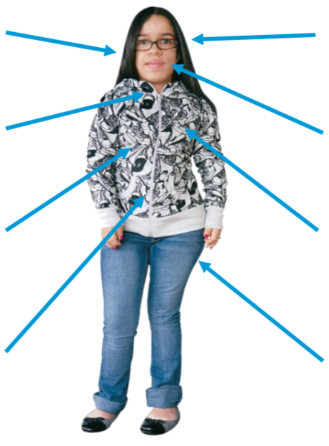
MPS VI (Maroteaux-Lamy): key facts
MPS IVA and MPS VI
Key facts
ENT
Impaired hearing, recurrent otitis media, recurrent sinusitis^{1–3}
Ophthalmological
Impaired vision, corneal clouding, glaucoma, optic nerve disease^{1,5}
Enzyme
ARSB is deficient
Stored GAG
Dermatan sulfate
Spectrum
Rapid forms show signs before age 2; slower forms may be diagnosed in adulthood
Genetics
>130 ARSB variants; symptoms appear below ~10% of normal enzyme activity
Cognition
Usually normal
Neurological
Spinal cord compression, hydrocephalus, carpal tunnel syndrome¹
Dental
Enlarged tongue, small and widely spaced teeth⁶
Pulmonary
Obstructive and restrictive airway disease, sleep apnoea, recurrent pulmonary infections^{2,3}
Cardiac
Valve disease, cardiomyopathy, cardiac arrhythmia, systemic and pulmonary hypertension^{1,7}
Abdominal
Hepatosplenomegaly, umbilical and inguinal hernias^{4,5}
Skeletal
Joint stiffness and contractures, dysostosis multiplex, hip dysplasia¹
Image: patient with MPS VI. Not all signs or symptoms are present in every patient.
ARSB, arylsulfatase B (N-acetylgalactosamine 4-sulfatase); ENT, ear, nose and throat; GAG, glycosaminoglycan; MPS, mucopolysaccharidosis
Giugliani R et al. Pediatrics 2007;120:405–18; D’Avanzo F et al. Int J Mol Sci 2021;22:13456; Akyol MU et al. Orphanet J Rare Dis 2019;14:118.

Slide 18
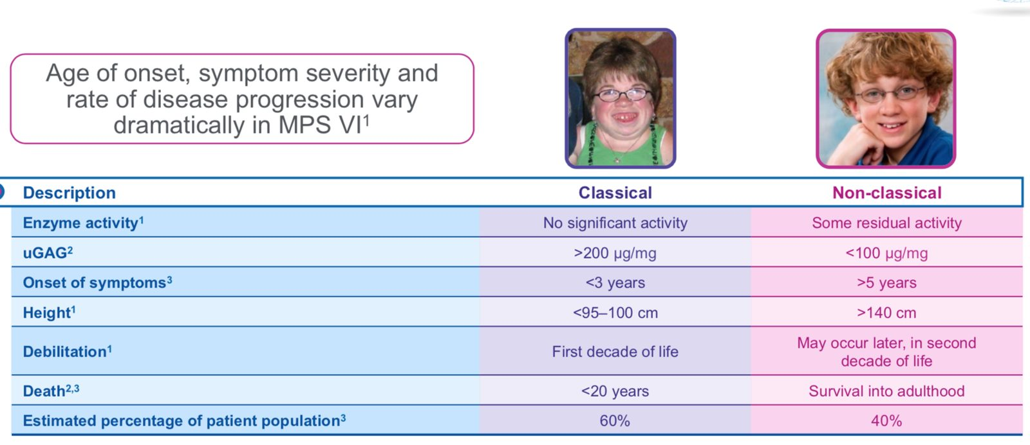
MPS VI: classical and non-classical disease
MPS VI
Feature | Classical | Non-classical
Enzyme activity¹ | No significant activity | Some residual activity
uGAG² | >200 µg/mg | <100 µg/mg
Onset of symptoms³ | <3 years | >5 years
Height¹ | <95–100 cm | >140 cm
Debilitation¹ | First decade of life | Second decade or later
Death^{2,3} | <20 years | Survival into adulthood
Share of patients³ | 60% | 40%
Debilitation, weakness. GAG, glycosaminoglycan; MPS, mucopolysaccharidosis; uGAG, urinary GAG (µg/mg creatinine)
1. Giugliani R et al. Pediatrics 2007;120:405–18. 2. Swiedler SJ et al. Am J Med Genet A 2005;134A:144–50. 3. Montaño AM et al. J Inherit Metab Dis 2007;30:165–74.

Slide 19
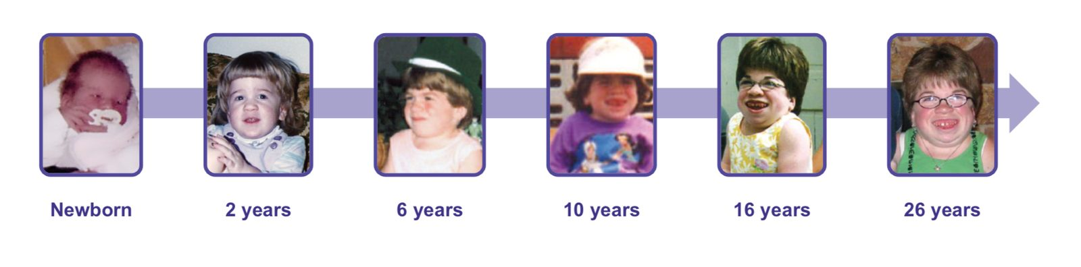
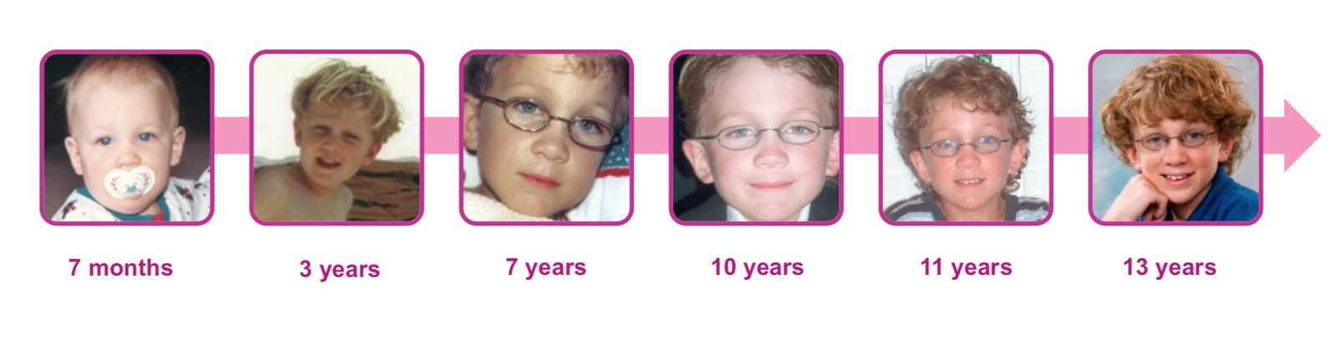
MPS VI: rapidly and slowly progressing examples
MPS IVA and MPS VI
Rapidly progressing (classical)
Features are apparent from an early age
Patient followed from birth to 26 years
Slowly progressing (non-classical)
No obvious clinical features through early adolescence
Patient followed from 7 months to 13 years
MPS, mucopolysaccharidosis
Giugliani R et al. Pediatrics 2007;120:405–18.

Slide 20
MPS VI: morbidity and mortality
MPS VI
Morbidity¹
Physical and functional well-being decline, limiting endurance and mobility
Skeletal deformities
Joint disease
Cardiopulmonary disease
Blindness
Spinal cord compression
Mortality¹
Severely affected patients: live to their early teens or early 20s
Slowly progressing patients: can live into their 40s or 50s
Causes of death include:
Infections
Surgical complications
Cardiopulmonary disease
MPS, mucopolysaccharidosis
1. Giugliani R et al. Pediatrics 2007;120:405–18.

Slide 21
Starting treatment
04
In this section
Management of MPS
Baseline assessment before ERT
Enzyme replacement therapy
What ERT can achieve
Care options, baseline tests and what ERT can and cannot do

Slide 22
Management of MPS
Starting treatment
Disease-specific therapy
Supportive and surgical care
Under investigation
Enzyme replacement therapy (ERT) is first-line for MPS IVA and MPS VI: a weekly, lifelong intravenous infusion
Haematopoietic stem cell transplant is standard for severe MPS I; it is investigational in MPS IVA and MPS VI
Surgery: cervical decompression and fusion, hip and knee, ENT, heart valve, cornea
Breathing support: CPAP or BiPAP for sleep apnoea, oxygen when needed
Daily function: pain control, physiotherapy, hearing aids, dental care, psychosocial support
Gene therapy and other new approaches are in clinical research
Not approved for MPS IVA or MPS VI; discuss only if the treating physician raises it
ERT works alongside supportive care, not instead of it: patients on ERT still need regular specialist review and often surgery.
BiPAP, bilevel positive airway pressure; CPAP, continuous positive airway pressure; ENT, ear, nose and throat; ERT, enzyme replacement therapy; MPS, mucopolysaccharidosis
Akyol MU et al. Orphanet J Rare Dis 2019;14:137; Akyol MU et al. Orphanet J Rare Dis 2019;14:118; Muenzer J. Rheumatology (Oxford) 2011;50(Suppl 5):v4–12.

Slide 23
Baseline assessment before ERT
Starting treatment
Assessment | Why at baseline | MPS IVA (before elosulfase alfa) | MPS VI (before galsulfase)
Growth and general health | Reference for growth and daily function | Height, weight; health assessment questionnaire | Height, weight
Urinary biomarker | Starting level to judge ERT response | Urinary keratan sulfate (KS) | Urinary GAGs
Spine and brain imaging | Detect cord compression early | MRI of the whole spine (neutral position) | MRI of the brain and spine
Lung function | Starting breathing capacity | FVC and MVV | FVC and FEV1
Endurance | Starting walking capacity | 6MWT; 3-minute stair climb | 12MWT
Heart | Valve and heart muscle disease | ECG and echocardiography | ECG and echocardiography
Vision and hearing are also checked at baseline. The treating physician decides the final list for each patient.
6MWT/12MWT, 6-/12-minute walk test; ECG, electrocardiogram; ERT, enzyme replacement therapy; FEV1, forced expiratory volume in 1 s; FVC, forced vital capacity; GAG, glycosaminoglycan; KS, keratan sulfate; MRI, magnetic resonance imaging; MVV, maximum voluntary ventilation
Akyol MU et al. Orphanet J Rare Dis 2019;14:137; Akyol MU et al. Orphanet J Rare Dis 2019;14:118.

Slide 24
Enzyme replacement therapy (ERT)
Starting treatment
 | Elosulfase alfa | Galsulfase
Treats | MPS IVA (Morquio A) | MPS VI (Maroteaux-Lamy)
Replaces | GALNS | ARSB
Dose | 2 mg/kg body weight, once weekly | 1 mg/kg body weight, once weekly
Infusion time | About 4 hours (3.5–4.5 h, by volume) | At least 4 hours, slower in the first hour
Premedication | Antihistamine, with or without antipyretic, 30–60 minutes before the infusion
Preparation | Dilute in 0.9% sodium chloride (100 or 250 mL by weight); rotate gently, never shake; infuse via a low-protein-binding 0.2 µm filter
Storage | Unopened vials at 2–8 °C; do not freeze; use the diluted solution promptly
Doses, rates and equipment always follow the local prescribing information and the treating centre’s infusion protocol.
ARSB, arylsulfatase B; ERT, enzyme replacement therapy; GALNS, N-acetylgalactosamine-6-sulfatase; MPS, mucopolysaccharidosis
Elosulfase alfa Summary of Product Characteristics (EMA); Galsulfase Summary of Product Characteristics (EMA); Concolino D et al. Ital J Pediatr 2018;44(Suppl 2):120.

Slide 25
ERT efficacy versus placebo at 24 weeks
Starting treatment | What ERT can achieve
Elosulfase alfa | MPS IVA
Galsulfase | MPS VI
+22.5 m
+92 m
more distance walked in 6 minutes than with placebo at week 24 (phase 3, n=176)¹
more distance walked in 12 minutes than with placebo at week 24 (phase 3, n=39); urinary GAGs fell by about 75%²
Long-term data
Registries following patients for up to 10 years (MPS IVA) and 15 years (MPS VI) report sustained falls in urinary GAGs and maintained endurance on continued weekly ERT.^{3,4}
ERT, enzyme replacement therapy; GAG, glycosaminoglycan; MPS, mucopolysaccharidosis
1. Hendriksz CJ et al. J Inherit Metab Dis 2014;37:979–90. 2. Harmatz P et al. J Pediatr 2006;148:533–9. 3. Mitchell JJ et al. MARS 10-year data. WORLDSymposium 2025, poster. 4. Burton BK et al. Mol Genet Metab 2025;145:109135.

Slide 26
MPS IVA: long-term elosulfase alfa versus untreated patients
Starting treatment | What ERT can achieve
 | Elosulfase alfa (MOR-004/005) | Untreated (MorCAP)
Endurance | Sustained improvement | Sustained deterioration
Urinary KS | Sustained reduction | Stable
Respiratory function | Sustained increase in patients aged ≤14 and >14 years | Increase in patients aged ≤14 years; deterioration in patients >14 years
KS, keratan sulfate; MorCAP, Morquio A Clinical Assessment Program
1. Hendriksz CJ et al. Mol Genet Metab 2016;119:131–43. 2. Hendriksz CJ et al. J Inherit Metab Dis 2016;39:839–47.

Slide 27
MPS VI: survival with galsulfase at 10 and 15 years
Starting treatment | What ERT can achieve
Mortality since the Survey Study, % of patients
Hazard ratio
HR 0.35
65% lower risk of death with galsulfase²
0.348 (95% CI 0.156–0.776), unadjusted
Kaplan-Meier survival
Curves separated in favour of galsulfase²
Log-rank P=0.0050; Wilcoxon P=0.0012
■ Galsulfase ■ Treatment-naïve
CI, confidence interval; HR, hazard ratio: the risk of death over time in treated versus untreated patients (1 = no difference; below 1 = lower risk with treatment). Bars to scale
1. Giugliani R et al. Am J Med Genet A 2014;164A:1953–64 (10-year data). 2. Quartel A et al. J Inborn Errors Metab Screen 2018;6:1–6, Fig 1, Table 1 (15-year data).
Notes:
Between 2013 and 2016, 8 more treated patients and 1 more naïve patient died. At 15 years, 24% of galsulfase-treated patients had died versus 57% of untreated patients. The unadjusted hazard ratio was 0.348, a 65% reduction in the risk of death. The HR is less extreme than the 0.24 seen at 10 years, which is expected as the cohort ages, but the confidence interval still sits fully below 1. The naïve group is only 14 patients, which the authors acknowledge limits how far this can be generalised.

Slide 28
Infusion day
05
In this section
Infusion day
Side effects of each ERT
Managing infusion reactions
What happens at each weekly infusion and how reactions are handled

Slide 29
Infusion day
Infusion day and reactions
1
2
3
4
5
Before
Premedicate
Prepare
Infuse
After
Ask about fever, infection or breathing problems
Weigh the patient for the dose
Record vital signs
Antihistamine, with or without antipyretic, 30–60 min before
Give only as prescribed
Inspect vials for particles or discolouration
Dilute in 0.9% sodium chloride
Rotate gently, never shake
Start slowly and step up the rate as per prescribing information
Monitor vital signs
Keep oxygen or CPAP at hand if used
Observe before discharge
Document tolerance and any reaction
Confirm the next infusion date
Check first: a patient with fever or an acute respiratory illness may need the infusion postponed. Ask the treating physician before starting.
CPAP, continuous positive airway pressure
Elosulfase alfa Summary of Product Characteristics (EMA); Galsulfase Summary of Product Characteristics (EMA); Akyol MU et al. Orphanet J Rare Dis 2019;14:137.

Slide 30
Elosulfase alfa: safety and tolerability
Infusion day and reactions | Elosulfase alfa
Patients assessed
176
aged 5–57 years in the randomised, double-blind, placebo-controlled trial (MOR-004)¹
Most adverse reactions were infusion reactions
Generally mild or moderate¹
More frequent in the first 12 weeks of treatment, then less frequent over time¹
Most common infusion-reaction symptoms¹
Serious infusion reactions¹
Headache
Nausea
Vomiting
Pyrexia
Anaphylaxis
Hypersensitivity
Vomiting
Chills
Abdominal pain
In ≥10% of treated patients and ≥5% more often than with placebo
IR, infusion reaction; MOR-004, phase 3 trial of elosulfase alfa in MPS IVA
1. Elosulfase alfa Summary of Product Characteristics.

Slide 31
Galsulfase: phase 3 safety data in numbers
Infusion day and reactions | Galsulfase
56%
had an infusion-associated reaction
33 of 59 patients treated with galsulfase¹
98%
developed IgG antibodies
53 of 54 patients tested¹
Week 1–146
when first reactions appeared
a first reaction can occur even after years of treatment¹
Most common adverse reactions
Pyrexia · rash · pruritus · urticaria · chills or rigors · nausea · headache · abdominal pain · vomiting · dyspnoea¹
Serious: laryngeal oedema, apnoea, respiratory distress, angioedema, asthma, anaphylactoid reaction¹
IgG, immunoglobulin G
1. Galsulfase Summary of Product Characteristics.

Slide 32
Managing infusion reactions
Infusion day and reactions
Mild
Moderate
Severe (anaphylaxis)
Signs
Flushing, nausea, fever, chills, itching, headache, irritability
Signs
Chest pain, hives, severe headache, vomiting, diarrhoea, abdominal cramps
Signs
Breathing difficulty, wheeze, throat or face swelling, low blood pressure, collapse
Actions
Stop or slow the infusion
Check vital signs
Inform the physician for medication
Restart slowly once settled
Actions
Stop the infusion; check vital signs
Inform the physician for medication
Reassess after 30 minutes; if settled, restart at about half the rate
Premedicate next time as prescribed
Actions
Stop the infusion immediately
Call the emergency team and follow the anaphylaxis protocol
Physician decides whether and how to restart ERT
ERT, enzyme replacement therapy
1. Hendriksz CJ et al. Mol Genet Metab 2016;119:131–43. 2. Galsulfase Summary of Product Characteristics. 3. Harmatz P et al. Mol Genet Metab 2008;94:469–75. See also: Miebach E. Int J Clin Pharmacol Ther 2009;47(Suppl 1):S100–6.

Slide 33
Ongoing follow-up
06
In this section
Follow-up assessments on ERT
The multidisciplinary team
Supporting adherence
Educator checklist
Monitoring, the care team, adherence and what to check at every contact
Warning signs that need escalation

Slide 34
Follow-up assessments on ERT
Ongoing follow-up
Assessment | What it tracks | MPS IVA (on elosulfase alfa) | MPS VI (on galsulfase)
Cervical spine imaging | Instability and cord compression | X-ray and flexion-extension MRI every 1–3 years | MRI every 2–3 years
Lung function | Breathing capacity (FVC, FEV1, MVV) | Annually until growth stops, then every 2–3 years | Annually
Endurance | Walking capacity | 6MWT annually | 12MWT every 1–2 years
Heart (ECG, echo) | Valve and heart muscle disease | Every 3 years if normal; annually if involved | Every 1–2 years
Urinary GAGs | Biochemical response to ERT | Urinary KS to track treatment response | Urinary GAGs every 1–2 years
Vision and hearing | Deficits that need support | Regular review | Regular review
Intervals are guide values; the treating physician sets each schedule. Educators remind families of upcoming tests.
6MWT/12MWT, 6-/12-minute walk test; ECG, electrocardiogram; ERT, enzyme replacement therapy; FEV1, forced expiratory volume in 1 s; FVC, forced vital capacity; GAG, glycosaminoglycan; KS, keratan sulfate; MVV, maximum voluntary ventilation
Akyol MU et al. Orphanet J Rare Dis 2019;14:137; Akyol MU et al. Orphanet J Rare Dis 2019;14:118.

Slide 35
The multidisciplinary team
Ongoing follow-up
Metabolic / genetics physician
Ophthalmology
Orthopaedics and spine surgery
Patient and family
Anaesthesia
Pulmonology and sleep medicine
Physiotherapy and rehabilitation
Cardiology
Psychology and social work
ENT and audiology
Infusion nursing
Patient educator
Reminders, adherence checks, education and escalation of warning signs
ENT, ear, nose and throat; MPS, mucopolysaccharidosis
Akyol MU et al. Orphanet J Rare Dis 2019;14:137; Akyol MU et al. Orphanet J Rare Dis 2019;14:118.

Slide 36
Supporting adherence: why infusions get missed
Ongoing follow-up
44–48%
What you can do at every contact
of MPS VI and IVA patients had ERT interruptions (n=98); drug unavailability was the main cause¹
Track infusions given versus scheduled, and ask why any were missed
Flag early supply, transport, cost or paperwork problems to the program team
Plan infusion times around school and work with the family and centre
Ill? Call first: the treating team decides whether to postpone, so don’t just skip
Reinforce: every weekly infusion counts; missed doses let GAGs build up again
Praise consistency and never blame
63%
of patients on ERT missed at least 1 dose in 6 months, mostly from supply problems or illness²
64%
of those in school or work missed a full day every week for infusions²
Most missed doses are about access, not motivation. Ask about barriers before you give advice.
ERT, enzyme replacement therapy; GAG, glycosaminoglycan; MPS, mucopolysaccharidosis
1. Solano Villarreal M et al. Mol Genet Metab Rep 2021;28:100769 (Latin America). 2. Yildiz Y, Sivri HS. Turk Arch Pediatr 2021;56:602–9 (Turkey, n=54).

Slide 37
Educator checklist
Ongoing follow-up
Adherence
Tolerance
Symptoms
Assessments
Wellbeing
Infusions given vs scheduled; reasons for missed doses such as travel, illness or transport
Any reaction since the last infusion; premedication taken as prescribed
New or worsening problems, especially the five warning signs
Upcoming tests and clinic visits; help the family plan and attend
Pain, sleep, school or work, mood and caregiver strain
Record every contact. Pass any suspected adverse event to pharmacovigilance within the program’s reporting timeline, even if it seems minor or unrelated.
Akyol MU et al. Orphanet J Rare Dis 2019;14:137; Akyol MU et al. Orphanet J Rare Dis 2019;14:118; Lampe C et al. Mol Genet Metab Rep 2019;21:100508.

Slide 38
Warning signs that need escalation
Ongoing follow-up
Warning sign | What the patient or family may report | Why it matters
Spinal cord compression | Neck pain, new weakness, numbness or tingling, clumsy walking, falls, change in bladder or bowel control | Can cause permanent paralysis; needs urgent assessment
Breathing and sleep | Loud snoring, pauses in breathing, gasping, daytime sleepiness, morning headache | Signals airway obstruction or declining lung function
Heart | Breathlessness on effort, chest pain, palpitations, leg swelling, fainting | May indicate progressing valve disease or heart failure
Planned surgery or sedation | Any operation, dental work or imaging that needs anaesthesia or sedation | High airway and anaesthetic risk; MPS team must plan it
Delayed infusion reaction | Rash, fever, wheeze or swelling in the hours after an infusion | Late-phase reactions need medical review
Escalation rule: report any of these to the treating physician the same day, following the program’s escalation procedure.
MPS, mucopolysaccharidosis
Akyol MU et al. Orphanet J Rare Dis 2019;14:137; Akyol MU et al. Orphanet J Rare Dis 2019;14:118; Miebach E. Int J Clin Pharmacol Ther 2009;47(Suppl 1):S100–6.

Slide 39
Living with MPS
07
In this section
Surgery, anaesthesia and emergencies
Living with MPS
Moving to adult care
Key messages for families
Safety, daily life and the move to adult care

Slide 40
Surgery, anaesthesia and emergencies
Living with MPS
Situation | What families should do | Why
Planned surgery, dental work or sedated scans | Tell the MPS team early; have it done at a centre experienced in MPS | Narrow, stiff airways make anaesthesia high-risk
Neck and spine, especially in MPS IVA | Keep the neck neutral during procedures, lifting and transfers | An unstable neck can injure the spinal cord
Emergency department visit | Show the MPS alert card and give the treating centre’s number | Staff may not know MPS airway and neck risks
Breathing support at home | Bring CPAP or BiPAP to every admission | Keeps the airway open after sedation
After surgery | Report delayed infusions, new weakness or breathing changes | Surgery often interrupts ERT; problems need early review
Alert card: help every family carry one with the diagnosis, ERT, airway and neck risks, and the treating physician’s number.
BiPAP, bilevel positive airway pressure; CPAP, continuous positive airway pressure; ERT, enzyme replacement therapy; MPS, mucopolysaccharidosis
Walker R et al. J Inherit Metab Dis 2013;36:211–9; Akyol MU et al. Orphanet J Rare Dis 2019;14:137; Akyol MU et al. Orphanet J Rare Dis 2019;14:118.

Slide 41
Living with MPS: beyond the infusion
Living with MPS
Emotional wellbeing
School and work
Practical support
Diagnosis brings grief, worry and sometimes denial: listen first
Watch for caregiver exhaustion and low mood
Offer psychology or social work through the treating team
Weekly infusions can cost a day each week: plan schedules early
Suggest school letters for access, rest and absences
Encourage independence, hobbies and friendships
Home and school adaptations: ramps, seating, rails
Mobility, hearing and vision aids as advised
Link families with MPS patient associations
Cognition is usually normal in MPS IVA and VI: school, work and independent adult life are realistic goals.
MPS, mucopolysaccharidosis
Yildiz Y, Sivri HS. Turk Arch Pediatr 2021;56:602–9; Akyol MU et al. Orphanet J Rare Dis 2019;14:137; Akyol MU et al. Orphanet J Rare Dis 2019;14:118.

Slide 42
Moving from paediatric to adult care
Living with MPS
1 ~12 years
2 12–14
3 14–16
4 16–18
5 18+
Start talking about adult care
Name it as a normal step
Teen learns their diagnosis, ERT and warning signs
Sees the doctor alone for part of the visit
Books own appointments
Adult team named
Joint clinic if possible
Medical summary ready
First adult visits attended
ERT continues with no gaps
Gaps happen around the transfer. In the first adult year, check ERT continuity and visit attendance closely.
ERT, enzyme replacement therapy. Ages are a guide; the treating teams set the timing
Lampe C et al. Transition of patients with mucopolysaccharidosis from paediatric to adult care. Mol Genet Metab Rep 2019;21:100508.

Slide 43
Key messages for families
Living with MPS
1
“Every weekly infusion counts.”
The effect of ERT is temporary, so missed doses let GAGs build up again
Stay within your role
2
“ERT slows MPS; it does not undo damage.”
Refer clinical questions to the treating physician
Never change doses, rates or premedication
Discuss only approved uses of medicines
Do not promise specific outcomes
Use program-approved materials only
Set realistic expectations from the start
3
“Tell us early.”
Report warning signs and reactions without waiting for the next visit
4
“Mention MPS before any procedure.”
Doctors, dentists and anaesthetists must know; carry an alert card
5
“Keep every check-up.”
Regular tests show how the disease and treatment are going
6
“Plan early for adult care.”
Preparation for transition starts around age 12
ERT, enzyme replacement therapy; GAG, glycosaminoglycan; MPS, mucopolysaccharidosis
Concolino D et al. Ital J Pediatr 2018;44(Suppl 2):120; Akyol MU et al. Orphanet J Rare Dis 2019;14:137; Akyol MU et al. Orphanet J Rare Dis 2019;14:118; Lampe C et al. Mol Genet Metab Rep 2019;21:100508.

Slide 44
Pharmacovigilance
08
In this section
Why pharmacovigilance matters
Adverse events and special situations
Your role and what to collect
Report or not? Three scenarios
Reporting adverse events, special situations and product complaints
Product complaints

Slide 45
Why pharmacovigilance matters
Pharmacovigilance
Why we collect adverse event and special situation reports
To keep evaluating the product's safety (signal detection): identify, evaluate, communicate and manage new safety information as quickly as possible
1
Collect
Every source counts: patients and caregivers, HCPs, medical information, support programmes, field staff, registries, literature and social media
2
Review
All safety data are used for signal detection, looking for changes in the risk–benefit profile
3
Act
If a new concern emerges: communicate to physicians (Dear Doctor letters) and update the prescribing information (label)
HCP, healthcare professional
Source: BioMarin adverse event identification and reporting training.

Slide 46
Adverse events and special situation events
Pharmacovigilance
Adverse event (AE)
Any untoward medical occurrence in a patient given a medicinal product, whether or not it is considered related to the product: an unfavourable sign, symptom or disease linked in time to its use
Special situation event (SSE)
A situation that is not necessarily linked to an adverse event but must still be reported to support continuous monitoring of patient safety
Special situation events to report
Overdose*
Dose above the maximum recommended
Off-label use*
Use for a purpose not in the product information
Misuse or abuse*
Intentional, inappropriate or excessive use with harmful effects
Occupational exposure*
Exposure through one's job
Infection transmission
Infection suspected from a contaminated product
Product complaint*
Alleged problem with quality, label, stability, purity, appearance or effectiveness
Lack of effect*
Product does not produce the expected effect
Medication error*
Error in prescribing, dispensing or giving the product
Interaction
Drug–drug or drug–food interaction changing the effect
Pregnancy or breastfeeding*
Exposure at conception, during pregnancy, delivery or breastfeeding
*Reportable even if not associated with an AE. AE, adverse event; SSE, special situation event
Source: BioMarin adverse event identification and reporting training.

Slide 47
Your role: report within 1 business day
Pharmacovigilance
1 business day
to forward any AE or special situation event to BioMarin Pharmacovigilance once you become aware of it
Record the date you became aware of the event (the initial receipt date)
Four key data points to collect
1 An identifiable reporter
Name and occupation, address, phone, email or other contact details if available
2 An identifiable patient
Age, date of birth, age group, initials and/or gender
3 The suspected product
BioMarin product name, dose, treatment duration, indication and lot number if available
4 At least one adverse event
A brief summary of the event
AE, adverse event
Source: BioMarin adverse event identification and reporting training.

Slide 48
Report or not? Three scenarios
Pharmacovigilance
Scenario 1
Pregnancy
A patient has just found out she is pregnant and asks whether it is safe to continue her BioMarin product
Scenario 2
Missed infusion
A mother tells you her daughter on a BioMarin product was hospitalised with bronchitis and will miss her weekly infusion
Scenario 3
Infusion reactions
A patient on a BioMarin product has coughing, breathing difficulty, nausea and vomiting at every infusion and is thinking of stopping
REPORT
Pregnancy, with or without an AE, is a special situation event
REPORT
The patient had an adverse event while on a BioMarin product
REPORT
Infusion reactions are adverse events
AE, adverse event. “BioMarin product” is the product the patient was prescribed. Click to reveal each answer
Source: BioMarin adverse event identification and reporting training.

Slide 49
Product complaints
Pharmacovigilance
A product complaint is any information expressing dissatisfaction that alleges a deficiency in a drug product's identity, quality, durability, labelling, purity, stability, appearance, performance, effectiveness, safety or design after release for distribution
Particles in solution
Container or closure
Bent needle
Syringe malfunction
Appearance
Discolouration
Damaged product or packaging
Labelling
Missing, unreadable or damaged label
Product
Extra
Missing
Tampered
1 Received
QAPC receives the complaint by fax, phone or email and gives it a unique tracking number
2 Assessed
QAPC assesses it, alerts Pharmacovigilance if an AE may be involved, and acknowledges receipt
3 Investigated
Cross-functional review: QA lot release, QC testing, Pharmacovigilance, clinicians; trends reviewed quarterly
AE, adverse event; QA, quality assurance; QAPC, Quality Assurance Product Complaints; QC, quality control
Source: BioMarin product complaint training.

Slide 50
Reporting a product complaint
Pharmacovigilance
5 business days
to notify BioMarin of a product complaint
productcomplaint@bmrn.com
1 Document the details
Nature of the complaint
Complainant and contact information
Product information, including lot number and storage conditions if available
2 Notify BioMarin
Within 5 business days, by email to productcomplaint@bmrn.com
3 Support the investigation
Coordinated by BioMarin QAPC
Document findings, keep records and send copies to BioMarin
Train employees and agents on complaint reporting
QAPC, Quality Assurance Product Complaints
Source: BioMarin product complaint training.

Slide 51
References
Akyol MU et al. Recommendations for the management of MPS IVA. Orphanet J Rare Dis 2019;14:137.
Akyol MU et al. Recommendations for the management of MPS VI. Orphanet J Rare Dis 2019;14:118.
Burton BK et al. Mol Genet Metab 2025;145:109135.
Clarke L et al. J Inborn Errors Metab Screen 2018;6:1–12.
Concolino D et al. Ital J Pediatr 2018;44(Suppl 2):120.
D’Avanzo F et al. Int J Mol Sci 2021;22:13456.
Elosulfase alfa Summary of Product Characteristics.
Galsulfase Summary of Product Characteristics.
Giugliani R et al. Pediatrics 2007;120:405–18.
Gökdoğan C et al. Braz J Otorhinolaryngol 2016;82:281–4.
Harmatz P et al. J Pediatr 2006;148:533–9.
Harmatz P et al. Mol Genet Metab 2008;94:469–75.
Hendriksz CJ et al. Mol Genet Metab 2013;110:54–64.
Hendriksz CJ et al. J Inherit Metab Dis 2014;37:979–90.
Hendriksz CJ et al. Am J Med Genet A 2015;167A:11–25.
Hendriksz CJ et al. Mol Genet Metab 2016;119:131–43.
Lampe C et al. Mol Genet Metab Rep 2019;21:100508.
McGill JJ et al. Clin Genet 2010;77:492–8.
Miebach E. Int J Clin Pharmacol Ther 2009;47(Suppl 1):S100–6.
Mitchell J et al. Presenting signs and symptoms of MPS. WORLDSymposium 2018, poster 244.
Mitchell JJ et al. Morquio A Registry Study (MARS) 10-year data. WORLDSymposium 2025, poster.
Muenzer J. Rheumatology (Oxford) 2011;50(Suppl 5):v4–12.
Neufeld EF, Muenzer J. In: The Metabolic and Molecular Bases of Inherited Disease. 8th ed. McGraw-Hill; 2001:3421–52.

Slide 52
References (continued)
ABPI. Guidance notes for patient safety and pharmacovigilance in patient support programmes.
EMA. Guideline on good pharmacovigilance practices (GVP), Module VI.
Lampe C et al. Transition of patients with mucopolysaccharidosis from paediatric to adult care. Mol Genet Metab Rep 2019;21:100508.
Solano Villarreal M et al. Mol Genet Metab Rep 2021;28:100769.
Walker R et al. Anaesthesia and airway management in mucopolysaccharidosis. J Inherit Metab Dis 2013;36:211–9.
Wood T et al. Mol Genet Metab 2012;106:73–82.
Yildiz Y, Sivri HS. Difficulties associated with enzyme replacement therapy for mucopolysaccharidoses. Turk Arch Pediatr 2021;56:602–9.

Slide 53
Appendix
In this section
Glossary of terms
Diagnosis and laboratory tests
For reference
Biology of MPS
Skeletal and radiology detail
Reference material for questions and further reading
SmPC dosing and infusion detail
Clinical trial evidence

Slide 54
Glossary
Appendix
6MWT / 12MWT
Distance walked in 6 or 12 minutes; a measure of endurance
HSCT
Haematopoietic stem cell transplantation
ARSB
Arylsulfatase B, the enzyme missing in MPS VI
IAR
Infusion-associated reaction
CPAP / BiPAP
Machines that keep the airway open with air pressure during sleep
KS / DS
Keratan sulfate / dermatan sulfate, the GAGs stored in MPS IVA / VI
Dysostosis multiplex
Pattern of bone changes seen on X-ray in MPS
Lysosome
Compartment of the cell where GAGs are normally broken down
ERT
Enzyme replacement therapy
MVV
Maximum voluntary ventilation, a test of breathing capacity
FVC / FEV1
Air breathed out forcefully: total, and in the first second
Odontoid hypoplasia
Underdeveloped peg of the second neck bone, causing instability
GAG
Glycosaminoglycan: long sugar chains stored in MPS
Pharmacovigilance
Collecting and reporting side effects of medicines
GALNS
N-acetylgalactosamine-6-sulfatase, the enzyme missing in MPS IVA
uGAG / uKS
Urinary GAG / keratan sulfate levels

Slide 55
Summary: signs of MPS by specialty
Complications | Summary
Specialty | Signs to look for | Key point
Paediatrics | Subtle, varied early signs; MPS IVA starts at 1–3 years, MPS VI in early childhood | Diagnosis takes about 4 years on average
Orthopaedics and rheumatology | Dysostosis multiplex, kyphosis or scoliosis, hip dysplasia, claw hands, short stature | Hypermobile joints suggest MPS IVA; stiff joints and carpal tunnel suggest MPS VI
ENT and pulmonology | Recurrent ENT infection, enlarged tonsils, hearing loss, sleep apnoea, macroglossia | Airway problems are often the first sign and worsen over time
Cardiology and ophthalmology | Thickened mitral or aortic valves; corneal clouding, optic nerve disease, glaucoma | Heart involved in 60–100% of patients
Gastroenterology | Umbilical and inguinal hernias, organomegaly, constipation or diarrhoea | Hepatosplenomegaly is typical of MPS VI
ENT, ear, nose and throat; MPS, mucopolysaccharidosis. Macroglossia, enlarged tongue. Sources as cited on the diagnosis appendix slides

Slide 56
Barriers to diagnosing MPS
Complications
01
Low disease awareness²
Few clinicians have seen MPS
02
Hard to tell MPS types apart²
Types overlap in their signs
03
Variable symptoms³
Onset and severity differ widely between patients
04
Resembles other disorders⁴
Often mistaken for common rheumatological or skeletal conditions
Knowing how MPS first presents helps clinicians recognise possible cases early, reach a timely diagnosis and manage patients well⁵
MPS, mucopolysaccharidosis
1. Muenzer J. Rheumatology (Oxford) 2011;50(Suppl 5):v4–12. 2. Clarke L et al. 13th International Congress of Inborn Errors of Metabolism, 5–8 September 2017, Rio de Janeiro, Brazil, 649. 3. Giugliani R et al. Pediatrics 2007;120:405–18. 4. Morishita K, Petty RE. Rheumatology (Oxford) 2011;50(Suppl 5):v19–25. 5. Mubarak F et al. 13th International Congress of Inborn Errors of Metabolism, 5–8 September 2017, Rio de Janeiro, Brazil, 662.

Slide 57
Screening and direct tests for MPS
Complications
Screening tests
Direct tests*
Urinary GAG analysis^{1,2}
Accuracy varies by technique; confirm results with a direct test
Enzyme activity analysis (leukocytes or fibroblasts)²
The gold-standard diagnostic test for MPS
Enzyme activity analysis (DBS)^{1,2}
Easier to collect and transport than whole blood, but can give false positives
Molecular testing²
Can confirm an MPS diagnosis; consult a geneticist
*Direct tests are laboratory tests that can confirm an MPS diagnosis. DBS, dried blood spot; GAG, glycosaminoglycan; MPS, mucopolysaccharidosis
1. Wood TC et al. J Inherit Metab Dis 2013;36:293–307. 2. Wood T et al. Mol Genet Metab 2012;106:73–82.

Slide 58
Urinary GAG analysis
Complications
Sample
Urine¹
Note: GAG levels are higher in infants and children and fall with age, sometimes into the normal range, which can lead to misreading results¹
Techniques
LC-MS/MS¹
Quantitative analysis (e.g. DMB)¹
Qualitative analysis (e.g. electrophoresis)¹
Advantages
MS/MS is increasingly available in laboratories³
Sample collection is non-invasive¹
MS/MS is highly accurate and sensitive^{2,4}
Limitations
Not all laboratories offer MS/MS yet³
A positive result must be confirmed by enzyme activity analysis
High risk of false negatives, especially with quantitative analysis alone
DMB, dimethylmethylene blue; GAG, glycosaminoglycan; LC-MS/MS, liquid chromatography–tandem mass spectrometry
1. Wood T et al. Mol Genet Metab 2012;106:73–82. 2. Kubaski F et al. Mol Genet Metab 2017;120:67–77. 3. BioMarin, data on file. 4. Gelb MH et al. J Inherit Metab Dis 2006;29:397–404.

Slide 59
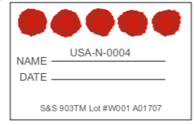
Dried blood spot (DBS) testing
Complications
Sample
Blood collected as dried spots on filter paper
Results
Complete results in 14–21 days¹
Reported by post, phone or fax, or online¹
Advantages
Easy to collect, store and transport¹
One sample supports several enzyme tests and molecular analysis²
Limitations
Cannot confirm an MPS diagnosis²
Samples are temperature-sensitive; ship without delay²
Repeat the test if results are unclear or samples unusable¹
A specialist's clinical evaluation must confirm the diagnosis¹
DBS, dried blood spot; MPS, mucopolysaccharidosis
1. Lehman TJ et al. Rheumatology (Oxford) 2011;50(Suppl 5):v41–8.

Slide 60
Molecular testing
Complications
Sample^{1,2}
Leukocytes from whole blood
Leukocytes from DBS
DNA from saliva
Advantages
Confirms the diagnosis alone when two pathogenic variants are found, one on each allele³
Can confirm the specific MPS type when enzyme results are inconclusive
Supports carrier and prenatal testing and genetic counselling once the family variant is known³
Limitations
Novel variants or variants of unknown significance need an enzyme test to confirm^{2,3}
Some sequencing methods miss certain variants²
Usually costs more than other tests³
DBS, dried blood spot; MPS, mucopolysaccharidosis
1. Lehman TJ et al. Rheumatology (Oxford) 2011;50(Suppl 5):v41–8. 2. Wood TC et al. J Inherit Metab Dis 2013;36:293–307. 3. Wood T et al. Mol Genet Metab 2012;106:73–82. 4. BioMarin, data on file.

Slide 61
Enzyme activity testing in leukocytes or fibroblasts
Complications
Sample^{1,2}
Leukocytes isolated from whole blood
Fibroblasts from skin biopsies
Advantages
Several enzymes can be tested from one sample²
Allows quicker analysis¹
Limitations
Environmental temperatures can compromise leukocyte samples²
Skin punch biopsies are invasive and slow to culture²
MPS, mucopolysaccharidosis
1. Lehman TJ et al. Rheumatology (Oxford) 2011;50(Suppl 5):v41–8. 2. Wood TC et al. J Inherit Metab Dis 2013;36:293–307. 3. Wood T et al. Mol Genet Metab 2012;106:73–82.

Slide 62
Prenatal diagnosis
Complications
Before pregnancy
Weeks 10–13
Usually weeks 15–20
Pre-implantation genetic diagnosis
Chorionic villus sampling (CVS)
Amniocentesis
Genetic profiling of embryos before implantation, sometimes of eggs before fertilisation
Used like prenatal diagnosis to screen for a specific genetic disease
Main advantage: avoids selective abortion, as the baby is very likely to be free of the disease
A sample of tissue is taken from the placenta
Done earlier than amniocentesis
Miscarriage risk slightly higher than with amniocentesis
A thin needle, guided by ultrasound, withdraws a small amount of amniotic fluid
Can be done up until birth
Results take 1 day to several weeks; very small risk of pregnancy loss
Prenatal diagnostic tests use fetal or placental cells from CVS or amniocentesis to show whether the fetus has a specific disorder
CVS, chorionic villus sampling; PGD, pre-implantation genetic diagnosis
Source: American College of Obstetricians and Gynecologists. Practice Bulletin No. 162: Prenatal diagnostic testing for genetic disorders. Obstet Gynecol 2016;127:e108–22.

Slide 63
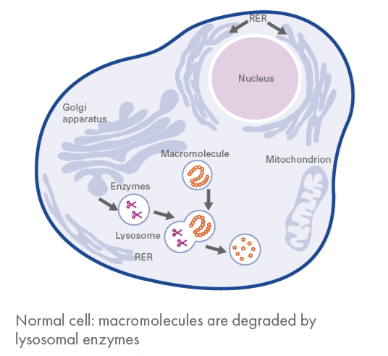
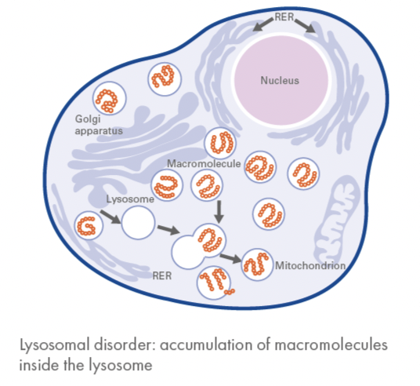
Lysosomal storage disorders (LSDs)
Understanding MPS
~50 LSDs affect the skeleton, brain, skin, heart and nervous system⁴
Batten disease
progressive neurological disorder; a form of NCL⁴
Fabry disease
GLA gene mutations; alpha-galactosidase A is deficient⁵
Gaucher disease (types I–III)
GBA gene mutations; beta-glucocerebrosidase is deficient⁶
What a lysosome does: an organelle whose digestive enzymes break down worn-out cell parts and destroy invading microbes
Mucopolysaccharidosis (MPS)
one of the enzymes that degrade GAGs is deficient³
When lysosomes fail: in most LSDs, undegraded waste cannot be removed from cells^{1,2}
GAG, glycosaminoglycan; GBA, glucosylceramidase beta; GLA, galactosidase alpha; LSD, lysosomal storage disorder; MPS, mucopolysaccharidosis; NCL, neuronal ceroid lipofuscinosis
1. Staretz-Chacham O et al. Pediatrics 2009;123:1191–207. 2. Heese BA. Semin Pediatr Neurol 2008;15:119–26. 3. Muenzer J. Rheumatology (Oxford) 2011;50(Suppl 5):v4–12. 4. Platt FM et al. Nat Rev Dis Primers 2018;4:27. 5. Germain DP. Orphanet J Rare Dis 2010;5:30. 6. Stirnemann J et al. Int J Mol Sci 2017;18:441.

Slide 64
MPS and glycosaminoglycans (GAGs)
Understanding MPS
Mucopolysaccharidoses (MPS)
A group of metabolic disorders in which GAGs accumulate because an enzyme that degrades them is deficient
Four GAG chains build up in MPS, each in different tissues¹
HS
Heparan sulfate
Connective tissue; buildup affects the brain
What GAGs are
Long, unbranched polysaccharide chains of repeating disaccharide units, found throughout the body
Components of proteoglycans that regulate many cell processes¹
Highly polar and water-attracting, so they act as lubricants and shock absorbers
DS
Dermatan sulfate
Mucosa and skin
CS
Chondroitin sulfate
Skeletal and soft tissues
KS
Keratan sulfate
Cornea, cartilage, brain and bone
CS, chondroitin sulfate; DS, dermatan sulfate; GAG, glycosaminoglycan; HS, heparan sulfate; KS, keratan sulfate; MPS, mucopolysaccharidosis
1. Islam T et al. Chemistry, biochemistry, and pharmaceutical potentials of glycosaminoglycans and related saccharides. In: Wong C-H (ed). Carbohydrate-based Drug Discovery. Weinheim: Wiley-VCH; 2003.

Slide 65
MPS types and enzyme deficiencies
Understanding MPS
Type | Common name | Deficient enzyme | Stored GAG | Hallmark features
I | Hurler, Hurler-Scheie, Scheie | α-L-iduronidase | DS, HS | Skeletal and organ disease; brain in severe form
II | Hunter | Iduronate-2-sulfatase | DS, HS | X-linked, mainly males; similar to MPS I
III | Sanfilippo A–D | Four different enzymes | HS | Mainly brain: behaviour, sleep, regression
IVA | Morquio A | GALNS | KS, C6S | Severe skeletal, lax joints; normal cognition
IVB | Morquio B | β-galactosidase | KS | Milder skeletal disease
VI | Maroteaux-Lamy | ARSB | DS | Skeleton, heart and cornea; normal cognition
VII | Sly | β-glucuronidase | DS, HS, CS | Very variable; may present before birth
IX | Natowicz | Hyaluronidase | Hyaluronan | Very rare; soft-tissue masses near joints
ARSB, arylsulfatase B; C6S, chondroitin-6-sulfate; CS, chondroitin sulfate; DS, dermatan sulfate; GAG, glycosaminoglycan; GALNS, N-acetylgalactosamine-6-sulfatase; HS, heparan sulfate; KS, keratan sulfate; MPS, mucopolysaccharidosis
Muenzer J. Rheumatology (Oxford) 2011;50(Suppl 5):v4–12; Neufeld EF, Muenzer J. In: The Metabolic and Molecular Bases of Inherited Disease. 8th ed. McGraw-Hill; 2001:3421–52.

Slide 66
Orthopaedics: skeletal involvement in MPS
Complications
Skeletal impairment ranges from mild platyspondyly (flattened vertebrae) to severe deformities that cause disability and shorten life¹
Short stature and slowed growth are typical of most MPS types¹
Dysostosis multiplex (bone abnormalities) is identified on X-ray^{2,3}
How dysostosis multiplex develops
GAGs build up in bone and cartilage cells⁴
Clusters of GAG-filled cells trigger abnormal apoptosis in the growth plate, disrupting its normal column structure⁴
Apoptosis, programmed cell death, in which the cell is packaged for removal by immune cells, unlike necrosis from injury. GAG, glycosaminoglycan; MPS, mucopolysaccharidosis
1. Neufeld EF, Muenzer J. In: The Metabolic and Molecular Bases of Inherited Disease. 8th ed. McGraw-Hill; 2001:3421–52. 2. Lachman R et al. J Pediatr Rehabil Med 2010;3:109–18. 3. White KW et al. J Pediatr Rehabil Med 2010;3:101–7. 4. Simonaro CM et al. Pediatr Res 2005;57:701–7.

Slide 67
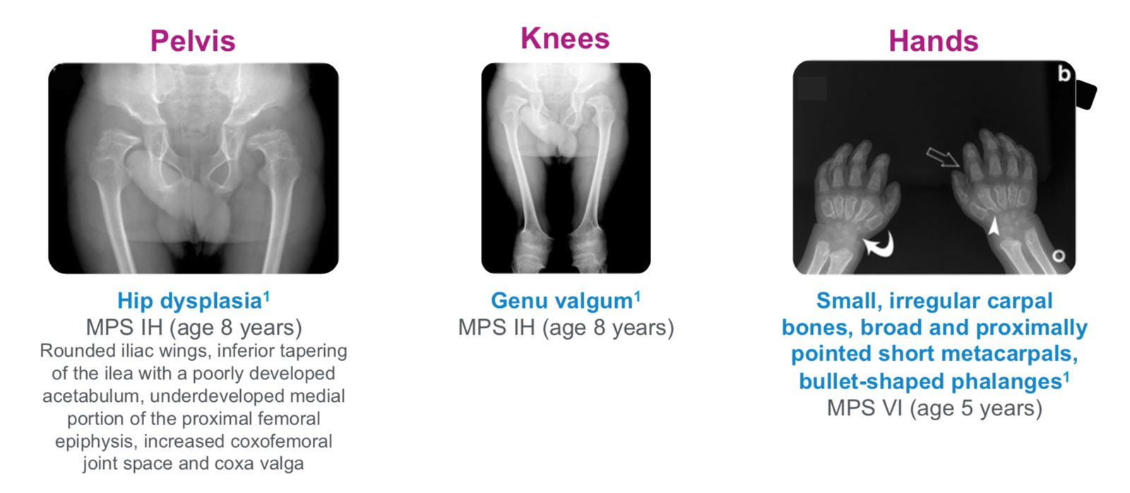
Orthopaedics: general and specialist skeletal features
Complications
General features^{1–3}
Abnormal gait, bone dysplasia, claw hands, coarse facial features, joint pain, macrocephaly, pectus carinatum, reduced endurance, short stature
Found on specialist assessment^{1–3}
Bone deformities, dysostosis multiplex, genu valgum, joint contractures or laxity without inflammation, spinal subluxation
Dysostosis multiplex: the set of radiographic changes seen in MPS, here in the pelvis, knees and hands⁴
MPS, mucopolysaccharidosis. Carpus, the wrist bones joining hand to forearm; dysplasia, abnormal growth or development of a tissue or organ; genu valgum, knock-knee
1. Lehman TJ et al. Rheumatology (Oxford) 2011;50(Suppl 5):v41–8. 2. Morishita K, Petty RE. Rheumatology (Oxford) 2011;50(Suppl 5):v19–25. 3. Lachman RS et al. Skeletal Radiol 2014;43:359–69. 4. Palmucci S et al. Insights Imaging 2013;4:443–59.

Slide 68
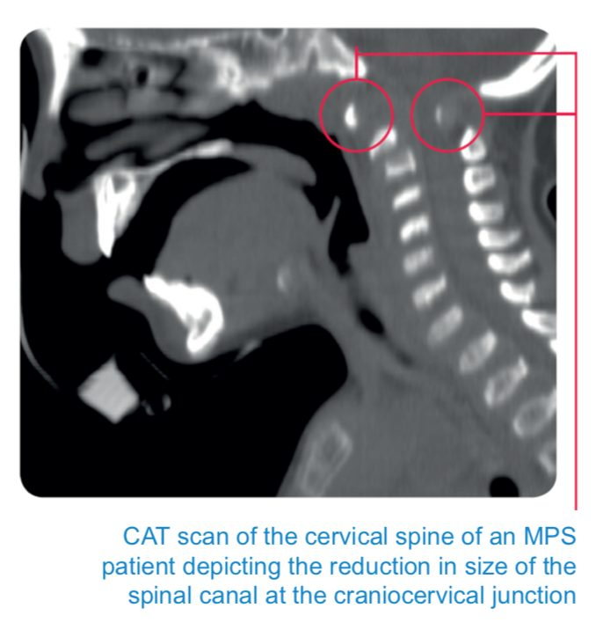
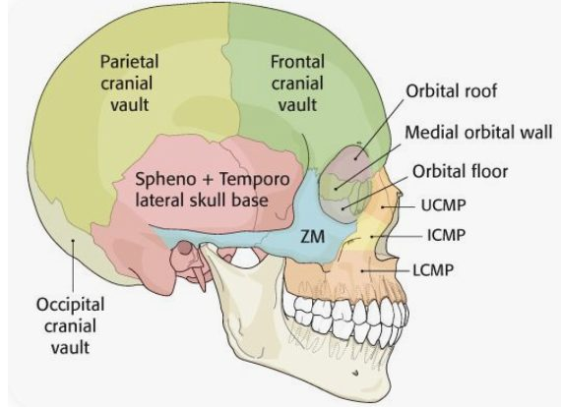
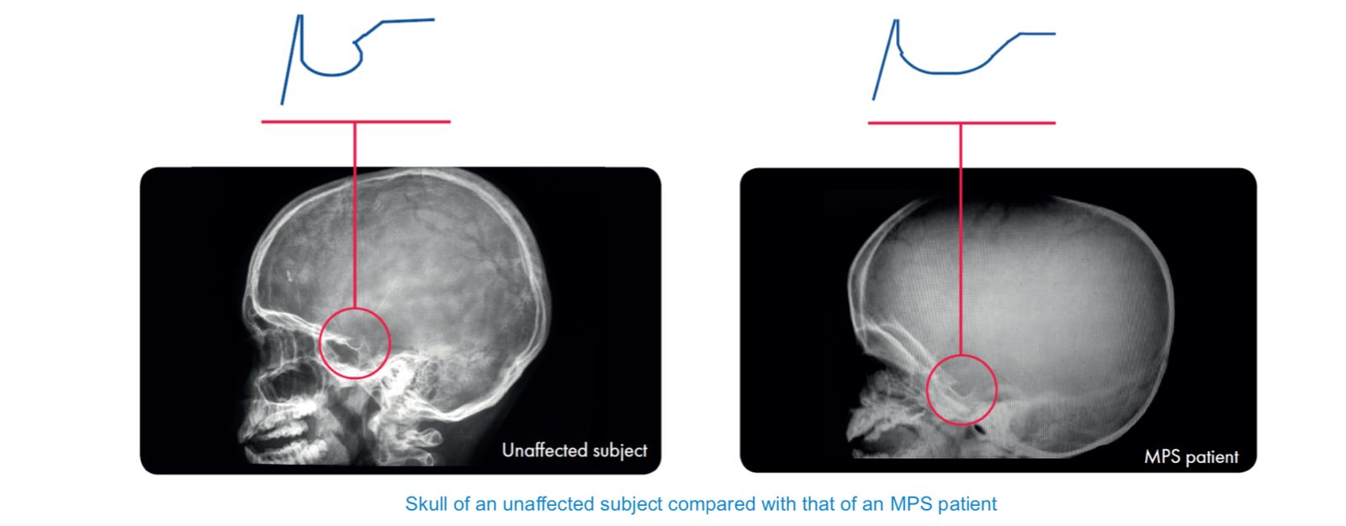
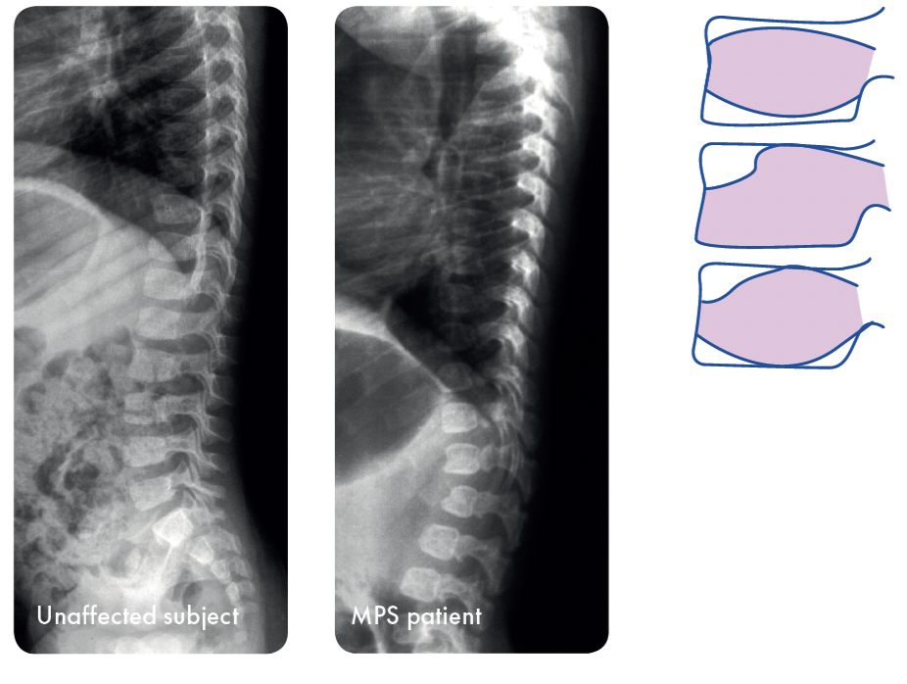
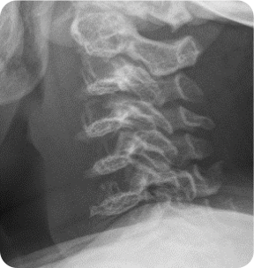
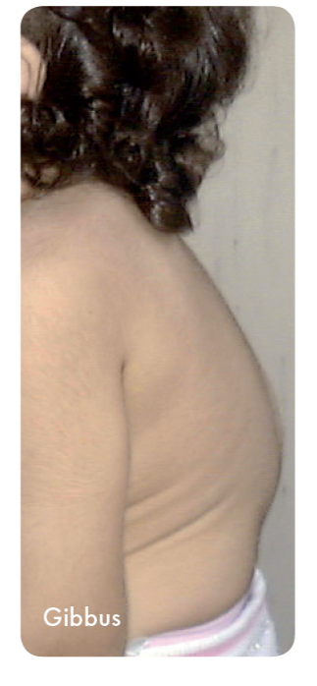
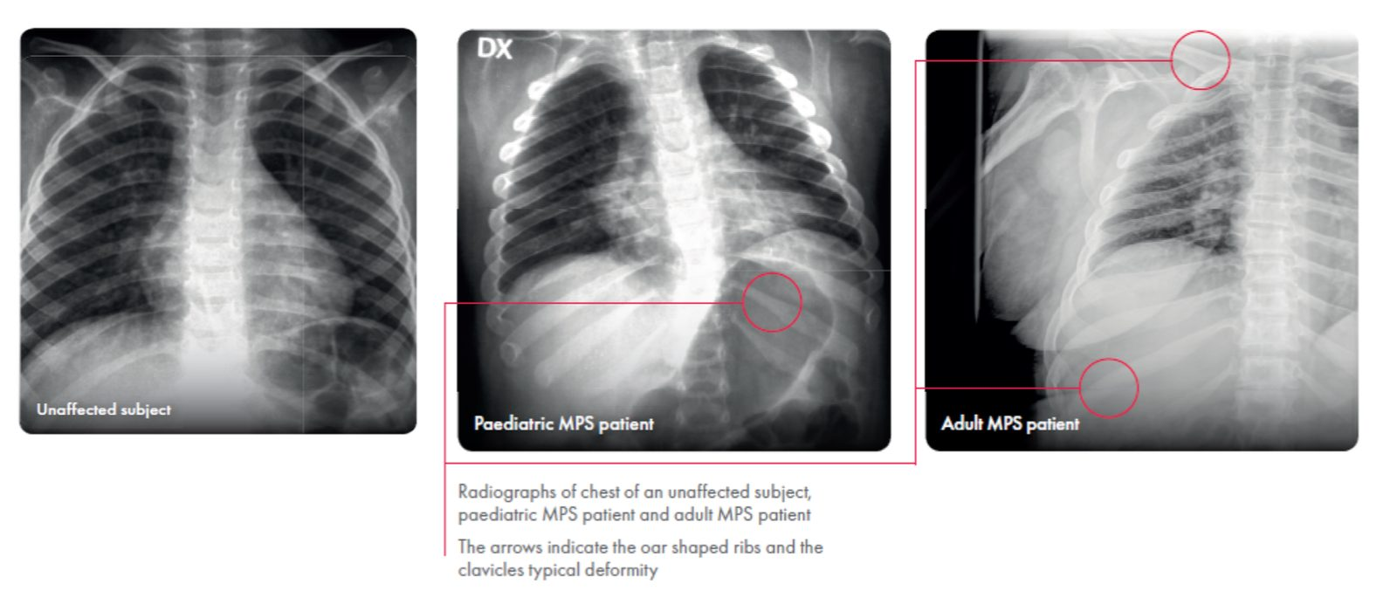

Radiology: skull, spine and chest
Complications
Skull
Macrocephaly, thick skull vault
Scaphocephaly: long, narrow head
J-shaped sella turcica, thick diploic space¹
Cervical spine
Skull-base and atlas–axis deformity^{2,3}
Cervical instability puts the cord at risk^{2,3}
Severe cases need decompression²
Vertebral column
Oval vertebrae, beaked inferiorly^{2–4}
Platyspondyly: flattened vertebrae⁴
Kyphosis, scoliosis, gibbus; worse in severe MPS^{2,3}
Chest
Oar-shaped ribs are characteristic^{2,4}
Short, thick clavicles^{2,4}
A rigid chest causes breathing problems²
MPS, mucopolysaccharidosis. Diploic space, spongy bone between the inner and outer skull tables; gibbus, a sharp spinal hump; macrocephaly, head size above the 98th percentile; platyspondyly, flattened vertebral bodies; sella turcica, the bony saddle at the skull base that holds the pituitary gland
1. Lachman R et al. J Pediatr Rehabil Med 2010;3:109–18. 2. Neufeld EF, Muenzer J. In: The Metabolic and Molecular Bases of Inherited Disease. 8th ed. McGraw-Hill; 2001:3421–52. 3. Beck M et al. J Pediatr Rehabil Med 2010;3:39–46. 4. Lachman RS et al. Skeletal Radiol 2014;43:359–69.

Slide 69

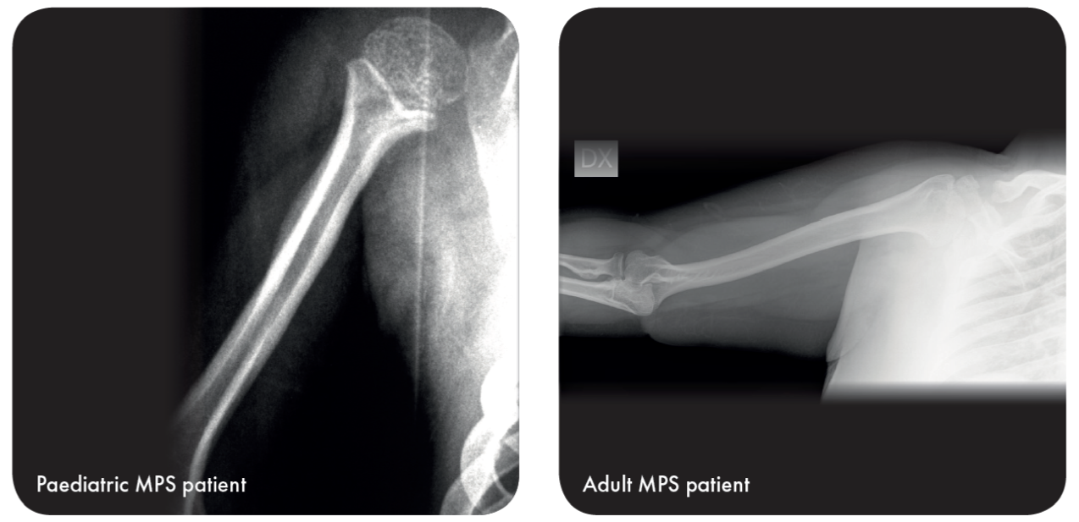
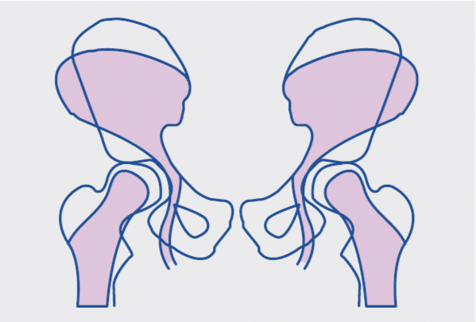
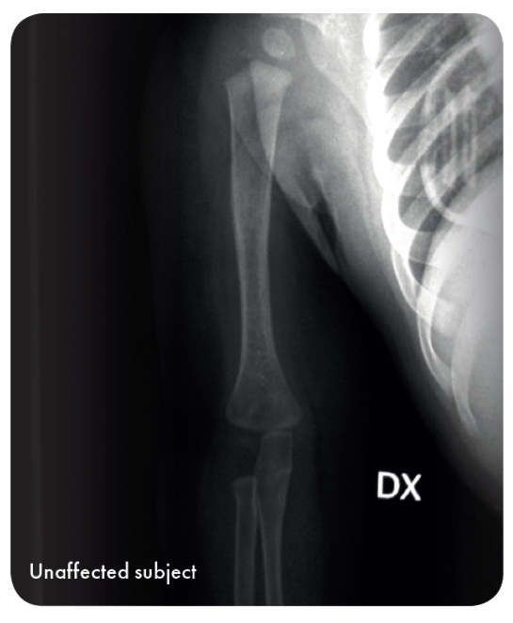
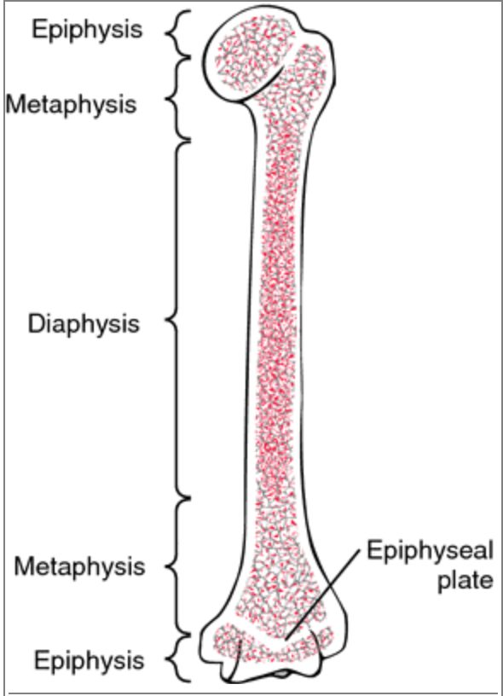

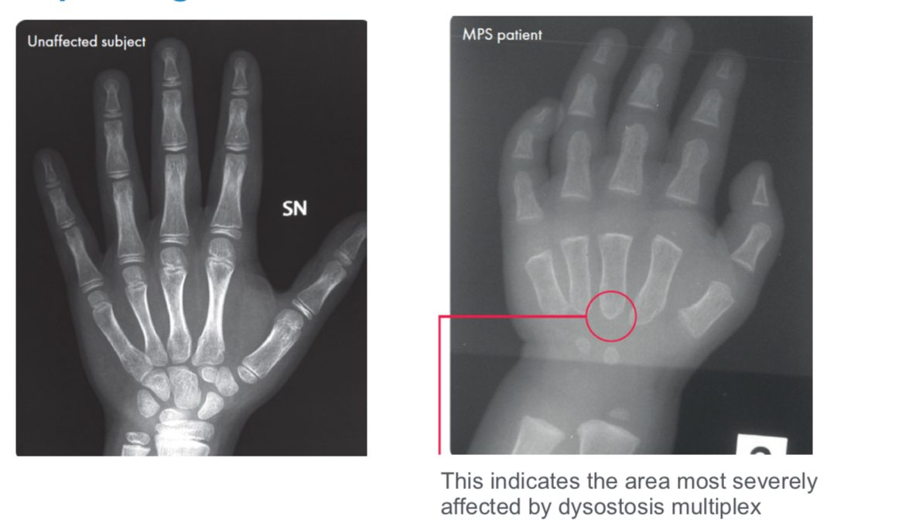
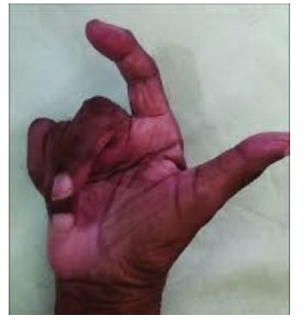
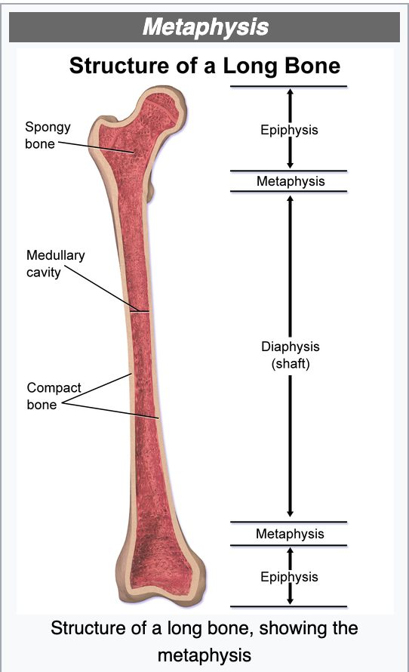
Radiology: hands, long bones and pelvis
Complications
Hands: ‘claw hands’
Short, thick fingers
Fixed flexion and poor dexterity
Irregular metaphyseal plates and wide, bullet-shaped phalanges¹
Long bones and knees
Mildly hypoplastic epiphyses, displaced growth plates¹
Thick, shortened diaphysis¹
Bent-knee posture from genu valgum plus spine and pelvis deformity^{1,2}
Pelvis
Hip dysplasia from abnormal bone growth¹
Rounded iliac wings¹
Orthopaedic surgery is often needed¹
MPS, mucopolysaccharidosis. Dexterity, skill in using the hands; diaphysis, the shaft of a long bone; epiphysis, the rounded end of a long bone; genu valgum, knock-knee; hypoplastic, underdeveloped; phalanges, the bones of the fingers and toes
1. Lachman R et al. J Pediatr Rehabil Med 2010;3:109–18. 2. Garcia P et al. J Pediatr Rehabil Med 2010;3:63–9.

Slide 70
Orthopaedics: eight signs that point to MPS^{1,2}
Complications
01
Dysostosis multiplex
02
Kyphosis or scoliosis
03
Vertebral body abnormality
hypoplasia, beaking, platyspondyly, kyphosis/gibbus
04
Bilateral hip dysplasia
or Perthes-like osteonecrosis
05
Claw hands
06
Coarse facial features
07
Joint restriction or laxity
stiffness, or hypermobility
08
Short stature
MPS, mucopolysaccharidosis
1. Lachman RS et al. Skeletal Radiol 2014;43:359–69. 2. Lachman R et al. J Pediatr Rehabil Med 2010;3:109–18.

Slide 71
Rheumatology: joints and short stature in MPS IVA and MPS VI
Complications
Joint hypermobility
Specific to MPS IVA¹
Joint stiffness and contractures
All MPS types except MPS IVA and MPS IX¹
Carpal tunnel syndrome
May be one of the first signs of MPS VI
Short stature is common in both MPS IVA (Morquio A) and MPS VI (Maroteaux-Lamy)
MPS IVA
Most patients are below the 3rd percentile on the CDC growth chart for children over 2 years (<120 cm)¹
MPS VI
Growth stalls at about 6–8 years; average adult height is <100 cm in rapidly progressing disease and 140–150 cm in slowly progressing disease^{2,3}
CDC, Centers for Disease Control and Prevention; MPS, mucopolysaccharidosis
1. Harmatz P et al. Mol Genet Metab 2013;109:54–61. 2. Giugliani R et al. Genet Mol Biol 2010;33:589–604. 3. Giugliani R et al. Pediatrics 2007;120:405–18. 4. Morishita K, Petty RE. Rheumatology (Oxford) 2011;50(Suppl 5):v19–25.

Slide 72
SmPC: presentation and dosing
Management | SmPC: elosulfase alfa and galsulfase
 | Elosulfase alfa · MPS IVA | Galsulfase · MPS VI
Presentation | 1 mg/ml concentrate for solution for infusion; 5 ml vial contains 5 mg elosulfase alfa | 1 mg/ml concentrate for solution for infusion; 5 ml vial contains 5 mg galsulfase
Active substance | Recombinant human N-acetylgalactosamine-6-sulfatase (rhGALNS), made in CHO cells | Recombinant human N-acetylgalactosamine-4-sulfatase, made in CHO cells
Appearance | Clear to slightly opalescent, colourless to pale yellow | Clear to slightly opalescent, colourless to pale yellow
Recommended dose | 2 mg/kg body weight once a week, IV | 1 mg/kg body weight once a week, IV
Infusion time | 3.5 to 4.5 hours, depending on infusion volume | Over 4 hours
Pretreatment | Antihistamines, with or without antipyretics, 30–60 min before infusion | Antihistamines, with or without antipyretics, 30–60 min before infusion
CHO, Chinese hamster ovary; ERT, enzyme replacement therapy; IV, intravenous; SmPC, Summary of Product Characteristics
1. Elosulfase alfa Summary of Product Characteristics. 2. Galsulfase Summary of Product Characteristics.

Slide 73
SmPC: storage, dilution and preparation
Management | SmPC: elosulfase alfa and galsulfase
 | Elosulfase alfa MPS IVA | Galsulfase MPS VI
Storage | 2–8 °C; do not freeze or shake; protect from light; no preservatives, so use diluted product within 48 hours
Supplies | 5 ml vials; 0.9% saline bag (100 or 250 ml); low-protein-binding set with 0.2 µm filter | 5 ml vials; 0.9% saline bag (100 or 250 ml); syringes for dilution
Bag size | <25 kg: 100 ml; ≥25 kg: 250 ml | 250 ml; 100 ml if ≤20 kg or at risk of fluid overload
Preparation: the same six steps for both products
01 Inspect: clear to pale yellow; no particles or discolouration
02 Make room: remove saline equal to the concentrate volume
03 Add: slowly add the calculated volume to the bag
04 Mix gently: rotate, do not shake; slight flocculation is acceptable
05 Label: per institution policy; do not mix with other drugs
06 Infuse: through a 0.2 µm in-line filter; discard unused product
1. Elosulfase alfa Summary of Product Characteristics. 2. Galsulfase Summary of Product Characteristics.

Slide 74
SmPC: infusion rates
Management | SmPC: elosulfase alfa and galsulfase
 | Elosulfase alfa | Galsulfase
100 ml bag | Start: 3 ml/h Increase: to 6 ml/h, then +6 ml/h every 15 min as tolerated Maximum: 36 ml/h | First hour: 3 ml/h Then: up to 39 ml/h for about 3 hours, if well tolerated
250 ml bag | Start: 6 ml/h Increase: to 12 ml/h, then +12 ml/h every 15 min as tolerated Maximum: 72 ml/h | First hour: 6 ml/h Then: up to 81 ml/h for about 3 hours, if well tolerated
Total duration | At least 3.5 hours (100 ml) or 4.5 hours (250 ml) | About 4 hours
Infusion rates by total infusion volume, per each product's SmPC
1. Elosulfase alfa Summary of Product Characteristics. 2. Galsulfase Summary of Product Characteristics.

Slide 75
SmPC: warnings and special populations
Management | SmPC: elosulfase alfa and galsulfase
 | Elosulfase alfa | Galsulfase
Warnings | Infusion reactions; spinal or cervical cord compression; 8 mg sodium per vial; contains sorbitol (avoid in hereditary fructose intolerance) | Infusion-associated reactions
Pregnancy | No data in pregnant women | Do not use unless clearly necessary
Breast-feeding | Only if benefit outweighs the risk to the infant | Stop breast-feeding during treatment
Fertility | No impairment in nonclinical studies | No impaired fertility or fetal harm in rats and rabbits
Age ≥65 years | Safety and efficacy not established; no alternative dose | Safety and efficacy not established; no alternative dose
Renal or hepatic impairment | – | Not evaluated; no alternative dose
Young children and higher doses | <5 years at 2 mg/kg/week: safety as in older children. Doses up to 4 mg/kg/week: no specific signs | <1 year at 2 mg/kg/week (n=4): safety did not differ meaningfully from 1 mg/kg/week
1. Elosulfase alfa Summary of Product Characteristics. 2. Galsulfase Summary of Product Characteristics.

Slide 76
Dose, dilution and infusion rate by ERT
Management
Elosulfase alfa | MPS IVA
Galsulfase | MPS VI
DOSE 2 mg/kg once weekly, IV
VIALS 5 mg in 5 mL; vials = weight × 2 ÷ 5, rounded up
DILUTE 0.9% NaCl: 100 mL if <25 kg; 250 mL if ≥25 kg
RATE <25 KG 3 mL/h for 15 min, then 6 mL/h; increase by 6 mL/h every 15 min to a maximum of 36 mL/h
RATE ≥25 KG 6 mL/h for 15 min, then increase by 12 mL/h every 15 min to a maximum of 72 mL/h
DURATION About 3.5 to 4.5 hours
DOSE 1 mg/kg once weekly, IV
VIALS 5 mg in 5 mL; vials = weight ÷ 5, rounded up
DILUTE 0.9% NaCl: 250 mL; 100 mL if <20 kg or at risk of fluid overload
RATE About 2.5% of the total volume in the first hour, the rest over the next 3 hours
DURATION At least 4 hours
Both products: remove saline equal to the drug volume, add the drug slowly, rotate gently and never shake; infuse through a 0.2 µm low-protein-binding in-line filter; store vials at 2–8 °C and use the diluted bag promptly.
ERT, enzyme replacement therapy; IV, intravenous; MPS, mucopolysaccharidosis; NaCl, sodium chloride. Always follow the local SmPC and hospital protocol.
1. Elosulfase alfa Summary of Product Characteristics. 2. Galsulfase Summary of Product Characteristics.

Slide 77
Morquio A clinical programme
Management | Elosulfase alfa clinical programme
Study | Design | n | Start | Duration
MOR-001^{1,2} | Observational, longitudinal, untreated natural history (registry): MorCAP | 325 | 2008 | Up to 10 years
MOR-002^{1,3} | Phase I/II, open-label, dose-escalation: safety and efficacy | 20 | 2010 | 72 weeks
MOR-100³ | Extension of MOR-002: long-term safety and efficacy | 17 | – | 192 weeks
MOR-004^{1,4} | Phase III, randomised, double-blind, placebo-controlled: efficacy and safety | 176 | 2010 | 24 weeks
MOR-005⁵ | Extension of MOR-004: long-term efficacy and safety | 173 | – | 96 weeks
MOR-006¹ | Phase II, open-label: safety and efficacy in patients with limited ambulation | 13 | 2012 | 48 weeks
MOR-007^{1,6} | Phase II, open-label: safety and efficacy in patients <5 years | 15 | 2011 | 52 weeks
MOR-008^{1,7} | Phase II, randomised, double-blind: safety and physiological effects | 25 | 2012 | 27 weeks
MARS¹ | Observational, longitudinal (registry) | Recruiting | 2014 | Up to 10 years
ERT, enzyme replacement therapy (MOR-002 to MOR-008 study elosulfase alfa); MARS, Morquio A Registry Study; MorCAP, Morquio A Clinical Assessment Program
1. ClinicalTrials.gov. 2. Harmatz P et al. Mol Genet Metab 2013;109:54–61. 3. Hendriksz CJ et al. Mol Genet Metab 2012;105:S35. 4. Hendriksz CJ et al. J Inherit Metab Dis 2014;37:979–90. 5. Hendriksz CJ et al. Mol Genet Metab 2016;119:131–43. 6. Jones SA et al. Pediatr Res 2015;78:717–22. 7. Burton BK et al. Am J Med Genet A 2015;167A:2272–81.

Slide 78
MOR-004: study design and results
Management | Elosulfase alfa efficacy
MOR-004
Phase III
Double-blind
Randomised
Study design
Phase 3, randomised, double-blind, placebo-controlled; 176 patients aged ≥5 years with MPS IVA
2 mg/kg weekly, 2 mg/kg every other week, or placebo for 24 weeks
Primary endpoint: 6MWT; secondary: 3MSCT, urinary KS, lung function
Result
Weekly dosing walked 22.5 m further than placebo at week 24 (P=0.017)
Every-other-week dosing did not differ from placebo, which is why 2 mg/kg weekly is the approved dose
Elosulfase alfa
2.0 mg/kg weekly (n=58)
Elosulfase alfa
2.0 mg/kg every other week
(n=59)
Screening
Placebo
(n=59)
0 weeks
24 weeks
3MSCT, 3-minute stair climb test; 6MWT, 6-minute walk test; KS, keratan sulfate; MPS, mucopolysaccharidosis
Hendriksz CJ et al. J Inherit Metab Dis 2014;37:979–90.

Slide 79
MOR-004: 6-minute walk test at week 24
Management | Elosulfase alfa efficacy
Weekly dosing versus placebo
+22.5 m
in the 6MWT at week 24 with elosulfase alfa 2 mg/kg weekly (P=0.0174)^{1,2}
Change in 6MWT from baseline, metres (mean ± SE)
14.3 m Every other wk
13.5 m Placebo
Every other week: 2 mg/kg every other week did not differ significantly from placebo¹
Extension trials: on 2 mg/kg weekly, endurance gains were maintained and urinary KS stayed reduced up to 156 weeks¹
Patients (n) | Baseline | Week 12 | Week 24
Weekly | 58 | 58 | 57
Every other week | 59 | 59 | 58
Placebo | 59 | 59 | 59
6MWT, 6-minute walk test: a validated measure of endurance reflecting pulmonary, cardiovascular, circulatory and neuromuscular function. KS, keratan sulfate; SE, standard error
1. Elosulfase alfa Summary of Product Characteristics. 2. Hendriksz CJ et al. J Inherit Metab Dis 2014;37:979–90. 3. ATS Committee on Proficiency Standards. Am J Respir Crit Care Med 2002;166:111–7. 4. McDonald A et al. J Pediatr Rehab Med 2010;3:119–27.

Slide 80
MOR-005: study design
Management | Elosulfase alfa efficacy
MOR-004
Phase III
Double-blind
Randomised
MOR-005
Phase III
Open-label
Part 1
Part 2
(began at a set date, not a study visit)
MOR-004, weeks 0–24
176 patients randomised to weekly (n=58), every-other-week (n=59) dosing or placebo (n=59)
Elosulfase alfa
2.0 mg/kg weekly
(n=58)
Elosulfase alfa
2.0 mg/kg weekly
(n=56)
Elosulfase alfa
2.0 mg/kg every other wk
(n=59)
Elosulfase alfa
2.0 mg/kg every other wk
(n=59)
MOR-005 part 1
Placebo patients re-randomised to weekly (n=29) or every-other-week (n=29) dosing
Screening
Elosulfase alfa
2.0 mg/kg weekly
(n=173)
Elosulfase alfa
2.0 mg/kg weekly
(n=29)
Placebo
(n=59)
Elosulfase alfa
2.0 mg/kg every other wk
(n=29)
MOR-005 part 2
All 173 patients on 2.0 mg/kg weekly; Part 2 began on a set date, not a study visit
0 weeks
24 weeks
Re-randomisation of placebo group
120 weeks
Weekly and every-other-week doses are 2.0 mg/kg elosulfase alfa
1. Hendriksz CJ et al. Mol Genet Metab 2016;119:131–43.

Slide 81
MOR-005: populations, efficacy variables and time frame
Management | Elosulfase alfa efficacy
ITT
All patients from the 24-week phase III study who received at least one dose of elosulfase alfa
Efficacy variables
Safety¹
Endurance (6MWT, 3MSCT) and urinary KS¹
Respiratory function²
MPP
Excluded patients who:
had orthopaedic surgery during the study (n=38)
missed ≥20% of scheduled infusions (n=14)
Time frame
120 weeks 24 weeks MOR-004 + 96 weeks MOR-005
Long-term outcomes were compared with those of untreated patients from MorCAP
3MSCT, 3-minute stair climb test; 6MWT, 6-minute walk test; ITT, intention to treat; KS, keratan sulfate; MorCAP, Morquio A Clinical Assessment Program; MPP, modified per protocol
1. Hendriksz CJ et al. Mol Genet Metab 2016;119:131–43. 2. Hendriksz CJ et al. J Inherit Metab Dis 2016;39:839–47.

Slide 82
MOR-005: 6-minute walk test to week 120
Management | Elosulfase alfa efficacy
Change in 6MWT from baseline, metres (mean) weeks 0–24 MOR-004, 24–120 MOR-005
+15.1 m
ITT: mean 6MWT increase from baseline to week 120
+31.7 m
MPP: mean 6MWT increase from baseline to week 120
Patients (n), week | 0 | 12 | 24 | 36 | 72 | 120
MOR-004 weekly | 58 | 58 | 57 | – | – | –
MOR-004 every other week | 59 | 59 | 58 | – | – | –
MOR-004 placebo | 59 | 59 | 59 | – | – | –
MOR-005 MPP pooled | – | – | 123 | 122 | 123 | 117
MOR-005 ITT pooled | – | – | 172 | 168 | 166 | 154
6MWT, 6-minute walk test; ITT, intention to treat; MPP, modified per protocol; pooled, weekly and every-other-week groups combined. No P values given
1. Hendriksz CJ et al. Mol Genet Metab 2016;119:131–43.

Slide 83
MOR-005: 3-minute stair climb test to week 120
Management | Elosulfase alfa efficacy
Change in 3MSCT from baseline, stairs/min (mean) weeks 0–24 MOR-004, 24–120 MOR-005
+4.3
stairs/min, ITT: mean 3MSCT increase from baseline to week 120
+6.8
stairs/min, MPP: mean 3MSCT increase from baseline to week 120
Patients (n), week | 0 | 12 | 24 | 36 | 72 | 120
MOR-004 weekly | 58 | 58 | 57 | – | – | –
MOR-004 every other week | 59 | 59 | 58 | – | – | –
MOR-004 placebo | 59 | 59 | 59 | – | – | –
MOR-005 MPP pooled | – | – | 123 | 122 | 123 | 117
MOR-005 ITT pooled | – | – | 172 | 168 | 166 | 154
3MSCT, 3-minute stair climb test; ITT, intention to treat; MPP, modified per protocol; pooled, weekly and every-other-week groups combined. No P values given
1. Hendriksz CJ et al. Mol Genet Metab 2016;119:131–43.

Slide 84
MOR-005: urinary KS to week 120
Management | Elosulfase alfa efficacy
Change in urinary KS from baseline, % (mean) weeks 0–24 MOR-004, 24–120 MOR-005
−59.4%
ITT: mean reduction in urinary KS from baseline to week 120
−62.3%
MPP: mean reduction in urinary KS from baseline to week 120
Patients (n), week | 0 | 12 | 24 | 36 | 48 | 72 | 120
MOR-004 weekly | 58 | 55 | 54 | – | – | – | –
MOR-004 every other week | 59 | 58 | 57 | – | – | – | –
MOR-004 placebo | 58 | 56 | 55 | – | – | – | –
MOR-005 weekly → weekly | – | – | 53 | 52 | 52 | 51 | 47
MOR-005 every other wk → every other wk | – | – | 57 | 56 | 56 | 56 | 49
MOR-005 placebo → weekly | – | – | 28 | 28 | 27 | 28 | 24
MOR-005 placebo → every other wk | – | – | 26 | 27 | 28 | 25 | 22
ITT, intention to treat; KS, keratan sulfate; MPP, modified per protocol. MOR-005 groups named by MOR-004 dose → MOR-005 dose. No P values given
1. Hendriksz CJ et al. Mol Genet Metab 2016;119:131–43.

Slide 85
MOR-005: lung function to week 120
Management | Elosulfase alfa efficacy
Mean % change from baseline, MOR-004/005 combined study week
FVC
FEV1
MVV
n | 0 | 24 | 72 | 120
ITT | 162 | 160 | 157 | 142
MPP | 118 | 116 | 118 | 112
n | 0 | 24 | 72 | 120
ITT | 161 | 158 | 156 | 142
MPP | 118 | 116 | 118 | 113
n | 0 | 24 | 72 | 120
ITT | 153 | 148 | 144 | 130
MPP | 112 | 108 | 111 | 105
FEV1, forced expiratory volume in 1 second; FVC, forced vital capacity; ITT, intention to treat; MPP, modified per protocol; MVV, maximum voluntary ventilation
1. Hendriksz CJ et al. Mol Genet Metab 2016;119:131–43.

Slide 86
MorCAP comparator population
Management | Elosulfase alfa efficacy
Untreated patients from the MorCAP study provided baseline data for untreated disease¹
MorCAP 1
Equivalent to the ITT population
Morquio A patients aged ≥5 years
Baseline 6MWT distance 30–325 m
Longitudinal data available at Year 1 and/or Year 2
MorCAP 2
Equivalent to the MPP population
As MorCAP 1, but excluding patients who had orthopaedic surgery within 3 months of recruitment or in the following 2 years
Both subpopulations had baseline values comparable with MOR-005¹
6MWT, 6-minute walk test; ITT, intention to treat; MorCAP, Morquio A Clinical Assessment Program; MPP, modified per protocol
1. Hendriksz CJ et al. J Inherit Metab Dis 2016;39:839–47.

Slide 87
MorCAP (MOR-001): 6-minute walk test in untreated patients
Management | Morquio A natural history
212 m
overall mean 6MWT distance (±152), against a lower limit of normal of 470–664 m for ages 4–16 and 500–580 m for adults¹
Baseline 6MWT by age group, metres (mean)
−51.3 m
22% mean difference between patients aged 5–11 (n=127) and 12–18 (n=84)¹
Why 6MWT matters: change in 6MWT reflects improvement or decline in cardiac, respiratory and musculoskeletal function, and in disease progression^{1,3}
Baseline data from MorCAP: multicentre, multinational, cross-sectional and longitudinal study of 325 patients¹
6MWT, 6-minute walk test; MorCAP, Morquio A Clinical Assessment Program. Progressive multi-organ involvement sharply reduces endurance before age 18
1. Harmatz P et al. Mol Genet Metab 2013;109:54–61. 2. Tomatsu S et al. Curr Pharm Biotechnol 2011;12:931–45. 3. McDonald A et al. J Pediatr Rehab Med 2010;3:119–27.

Slide 88
6MWT: treated patients versus MorCAP
Management | Elosulfase alfa efficacy
6MWT LS mean change from baseline, metres
Sustained effect
MOR-005 ITT and MPP groups improved 6MWT at both 1 and 2 years (P<0.05)
Patients (n) | Year 1 | Year 2
MorCAP 1 | 80 | 40
MorCAP 2 | 67 | 27
ITT pooled | 166 | 154
MPP pooled | 123 | 117
MPP weekly | 43 | 41
6MWT, 6-minute walk test; ITT, intention to treat; LS, least squares; MorCAP, Morquio A Clinical Assessment Program; MPP, modified per protocol; QW, weekly
1. Hendriksz CJ et al. Mol Genet Metab 2016;119:131–43.

Slide 89
3MSCT: treated patients versus MorCAP
Management | Elosulfase alfa efficacy
3MSCT LS mean change from baseline, stairs/min
Sustained effect
MOR-005 ITT and MPP groups improved 3MSCT at both 1 and 2 years (P<0.05)
Patients (n) | Year 1 | Year 2
MorCAP 1 | 80 | 40
MorCAP 2 | 67 | 27
ITT pooled | 164 | 154
MPP pooled | 123 | 117
MPP weekly | 43 | 41
3MSCT, 3-minute stair climb test; ITT, intention to treat; LS, least squares; MorCAP, Morquio A Clinical Assessment Program; MPP, modified per protocol; QW, weekly
1. Hendriksz CJ et al. Mol Genet Metab 2016;119:131–43.

Slide 90
Lung function: treated patients versus MorCAP
Management | Elosulfase alfa efficacy
LS mean change from baseline
FVC, L Year 1: P=0.0279 · Year 2: P=0.0429
FEV1, L Year 1: P=0.0079 · Year 2: P=0.0339
MVV, L/min Year 1: P=0.0221 · Year 2: P=0.0127
n Untreated 63 / 25 Treated 117 / 111
(Year 1 / Year 2)
n Untreated 63 / 24 Treated 117 / 112
(Year 1 / Year 2)
n Untreated 60 / 22 Treated 110 / 104
(Year 1 / Year 2)
■ Untreated (MorCAP) ■ Elosulfase alfa (MOR-004/005), MPP population
FEV1, forced expiratory volume in 1 second; FVC, forced vital capacity; LS, least squares; MorCAP, Morquio A Clinical Assessment Program; MPP, modified per protocol; MVV, maximum voluntary ventilation
1. Hendriksz CJ et al. J Inherit Metab Dis 2016;39:839–47.

Slide 91
Lung function: percentage change versus MorCAP
Management | Elosulfase alfa efficacy
LS mean % change from baseline
FVC Year 1: P=0.0215 · Year 2: NS
FEV1 Year 1: P=0.0443 · Year 2: NS
MVV Year 1: NS · Year 2: NS
n Untreated 63 / 25 Treated 117 / 111
(Year 1 / Year 2)
n Untreated 63 / 24 Treated 117 / 112
(Year 1 / Year 2)
n Untreated 60 / 22 Treated 110 / 104
(Year 1 / Year 2)
■ Untreated (MorCAP) ■ Elosulfase alfa (MOR-004/005), MPP population
FEV1, forced expiratory volume in 1 second; FVC, forced vital capacity; LS, least squares; MorCAP, Morquio A Clinical Assessment Program; MPP, modified per protocol; MVV, maximum voluntary ventilation; NS, not significant
1. Hendriksz CJ et al. J Inherit Metab Dis 2016;39:839–47.

Slide 92
Lung function by age: treated patients versus MorCAP
Management | Elosulfase alfa efficacy
Aged 14 or under
Both cohorts improved; treated patients improved more
Over 14
Treated patients improved; untreated patients deteriorated
Role of growth
FVC tracked height in younger patients; other factors likely drove gains in older ones
FVC, L ≤14 y: Year 1: P=0.01 · Year 2: NS · >14 y: Year 1: NS · Year 2: P=0.03
FEV1, L ≤14 y: Year 1: P=0.007 · Year 2: NS · >14 y: Year 1: NS · Year 2: P=0.01
■ Untreated (MorCAP) ■ Elosulfase alfa (MOR-004/005) LS mean change from baseline
FEV1, forced expiratory volume in 1 second; FVC, forced vital capacity; LS, least squares; MorCAP, Morquio A Clinical Assessment Program; NS, not significant
1. Hendriksz CJ et al. J Inherit Metab Dis 2016;39:839–47.

Slide 93
Galsulfase clinical studies
Management | Galsulfase evidence
Study | Type | Year | Patients enrolled (completed) | Duration | Refs
Phase 1/2ª | Randomised, double-blind, dose-comparison / open-label extension | 2000–2005 | 7 (5) | 240 weeks | 1,2
Phase 2ª | Open-label | 2002–2006 | 10 (10) | 144 weeks | 2,3
Phase 3ª | Randomised, double-blind, placebo-controlled / open-label extension | 2003–2006 | 39 (38) | 96 weeks | 2,4
Phase 4 | Open-label, dose-comparison (age 3.3–12.7 months) | 2012 | 4 (4) | 1–3 years | 5
CSP | Observational | 2005–ongoing | 223 (107)ᵇ | Ongoing | 6
Survey Study | Cross-sectional | 2002 | 123 (121) | Baseline | 7
Resurvey Study | 10-year follow-up of Survey Study | 2012 | 59 (efficacy); 117 (survival) | 10-year follow-up | 8
Follow-up study | 15-year follow-up of Survey Study | 2018 | 121 (111) | 15-year follow-up | 9
a. Phase 1/2, 2 and 3 trials had open-label extension phases up to 240 weeks. b. Of 223 patients enrolled in CSP, 107 had high- or low-baseline uGAG levels and received treatment for at least 6 months. CSP, Clinical Surveillance Programme; uGAG, urinary glycosaminoglycans
1. Harmatz P et al. J Pediatr 2004;144:574–80. 2. Harmatz P et al. Mol Genet Metab 2008;94:469–75. 3. Harmatz P et al. Pediatrics 2005;115:e681–9. 4. Harmatz P et al. J Pediatr 2006;148:533–9. 5. Harmatz PR et al. J Inherit Metab Dis 2014;37:277–87. 6. Harmatz P et al. J Inherit Metab Dis 2019;1–8. 7. Swiedler SJ et al. Am J Med Genet A 2005;134A:144–50. 8. Giugliani R et al. Am J Med Genet A 2014;164A:1953–64. 9. Quartel A et al. J Inborn Errors Metab Screen 2018;6:1–6.

Slide 94
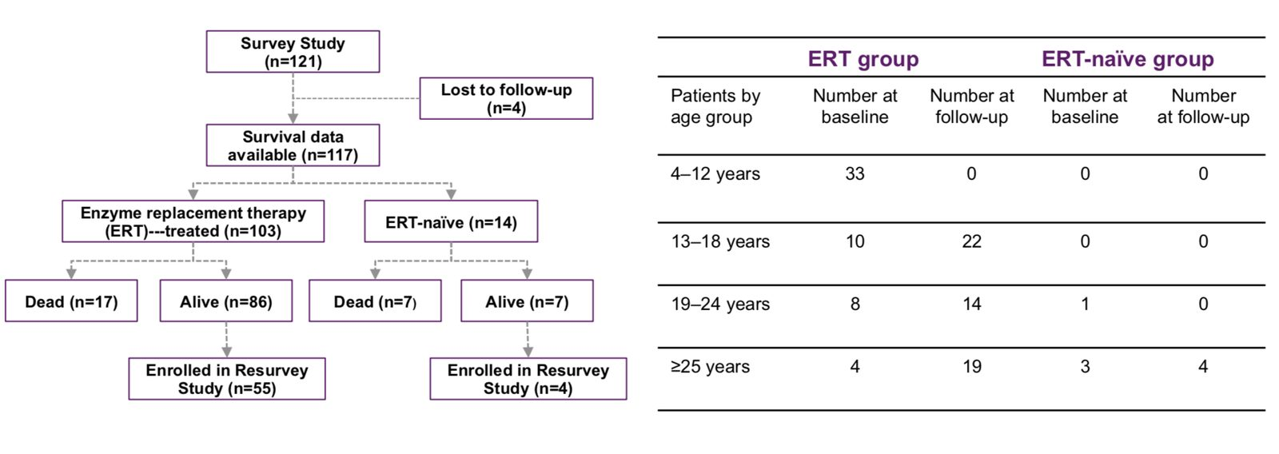
 | ERT group |  | ERT-naïve group
Age group | Baseline | Follow-up | Baseline | Follow-up
4–12 years | 33 | 0 | 0 | 0
13–18 years | 10 | 22 | 0 | 0
19–24 years | 8 | 14 | 1 | 0
≥25 years | 4 | 19 | 3 | 4
Number of patients by age group at baseline and at follow-up
1. Giugliani R et al. Am J Med Genet A 2014;164A:1953–64.

Slide 95
MPS VI Survey Study: urinary GAG levels and disease severity
Management | Galsulfase evidence
URINARY GAG LEVEL, µg/mg CREATININE
<100
low
100–200
intermediate
>200
high
Low levels
>20 years
Low uGAG levels were seen in patients over 20 years of age¹
High levels were associated with¹
Age-adjusted short stature
Low body weight
Higher level, more severe disease
Compromised lung function
Reduced joint range of motion
6MWT
Walk distance was impaired across all age groups and across all uGAG levels¹
6MWT, 6-minute walk test; GAG, glycosaminoglycan; MPS, mucopolysaccharidosis; uGAG, urinary GAG
1. Swiedler SJ et al. Am J Med Genet A 2005;134A:144–50.

Slide 96
Survey Study: 15-year follow-up
Management | Galsulfase evidence
16.5%
mortality with galsulfase
Patients who received galsulfase at any time, 10-year Resurvey¹
50%
mortality without treatment
Treatment-naïve patients in the same 10-year Resurvey¹
12.5%
5-year mortality on galsulfase
Commercial use data, 2005–2016¹
2001–2002
Survey Study: 121 patients with MPS VI
10 years later
Resurvey: same patients, 10 years on
2005–2016
Commercial-use mortality data
Galsulfase ERT can increase life expectancy in MPS VI over at least 15 years; treated patients also showed physical improvements¹
ERT, enzyme replacement therapy; MPS, mucopolysaccharidosis
1. Quartel A et al. J Inborn Errors Metab Screen 2018;6:1–6.

Slide 97
Resurvey Study: 10-year follow-up
Management | Galsulfase evidence
117
treated and untreated patients followed up¹
6.8 years
average time on galsulfase ERT¹
98%
compliance in the clinical studies²
95%
compliance in the Resurvey Study¹
About the study
10-year follow-up of medical history, clinical assessment and survival in patients from the original Survey Study¹
Results were consistent with clinical trials of long-term galsulfase use in MPS VI¹
Key message
Start galsulfase as soon as MPS VI is confirmed¹
Long-term Resurvey data and the phase 3 trial results both reaffirm early treatment and good compliance
ERT, enzyme replacement therapy; MPS, mucopolysaccharidosis
1. Giugliani R et al. Am J Med Genet A 2014;164A:1953–64. 2. Harmatz P et al. Mol Genet Metab 2008;94:469–75.

Slide 98
Resurvey Study: results after about 10 years of galsulfase
Management | Galsulfase evidence
Urinary GAGs
−87.9%
reduction in uGAG from a mean 321.3 µg/mg creatinine at baseline
All treated patients (n=55) reached uGAG <100 µg/mg creatinine¹
No P value available
Endurance (6MWT, n=46)
+65.7 m
a mean 21% increase over baseline (P<0.0001)
All age subgroups improved¹
uGAG <100: +19% (P=0.0033); 100–200: +11%; ≥200: reduced distance¹
Lung function
+29% FVC
and +18% FEV1 over baseline (P<0.0001; P=0.001)
<13 years: FVC +68% (P=0.0002), FEV1 +55% (P=0.0005)¹
≥13 years: FVC +13% (P=0.011); FEV1 stable¹
6MWT, 6-minute walk test; FEV1, forced expiratory volume in 1 second; FVC, forced vital capacity; uGAG, urinary glycosaminoglycan. No data from ERT-naïve patients for comparison
1. Giugliani R et al. Am J Med Genet A 2014;164A:1953–64.

Slide 99
Galsulfase: endurance after 10 years
Management | Galsulfase evidence
6MWT distance walked by age at baseline, metres (mean)
Patients who completed the 6MWT (n=46) walked 65.7 m further than at baseline, a mean increase of 21% (P<0.0001)^{1,a–c}
All age subgroups improved in mean distance walked (P values not available)^{1,b}
Why endurance matters: it reflects disease change, cardiopulmonary health, exercise capacity, mobility and extent of morbidity^{1,2}
■ Baseline ■ Follow-up (Resurvey, ~10 years)
a. Patients who completed the 6MWT had been on galsulfase for a mean 6.9 years (±2.2). b. Eight patients could not take part because they were not independently mobile. c. Consistent with the phase 3 trial, whose values came from the 6-minute point of the 12MWT. Chart adapted from Giugliani et al. 2014. 6MWT, 6-minute walk test; 12MWT, 12-minute walk test
1. Giugliani R et al. Am J Med Genet A 2014;164A:1953–64. 2. Morales-Blanhir JE et al. J Bras Pneumol 2011;37:110–7.

Slide 100
Galsulfase: lung function after 10 years
Management | Galsulfase evidence
FVC and FEV1 by age at baseline, litres (mean)
Overall
FVC rose 29% (P<0.0001) and FEV1 18% (P=0.001) over baseline^{1,a}
By age at baseline
Under 13: FVC +68% (P=0.0002); FEV1 +55% (P=0.0005)
13 and over: FVC +13% (P=0.011); FEV1 stable¹
■ Baseline ■ Follow-up (Resurvey, ~10 years)
a. In the phase 3 trial, FVC and FEV1 improved significantly by 17% (P=0.009) and 11% (P=0.014) at 96 weeks.² Chart adapted from Giugliani et al. 2014. FEV1, forced expiratory volume in 1 second; FVC, forced vital capacity
1. Giugliani R et al. Am J Med Genet A 2014;164A:1953–64. 2. Harmatz P et al. J Inherit Metab Dis 2010;33:51–60.

Slide 101
Galsulfase: walking by baseline uGAG level
Management | Galsulfase evidence
Change in distance walked from baseline by baseline uGAG level, metres (mean)
uGAG <100 µg/mg
Significant 19% improvement over baseline (P=0.0033)¹
uGAG 100–200 µg/mg
11% improvement over baseline*¹
uGAG ≥200 µg/mg
Reduction in distance walked; no ERT-naïve data to compare¹
■ ERT-treated ■ ERT-naïve
*No P value is available. Chart adapted from Giugliani et al. 2014. ERT, enzyme replacement therapy; uGAG, urinary glycosaminoglycans
1. Giugliani R et al. Am J Med Genet A 2014;164A:1953–64.

Slide 102
Galsulfase: safety data from phase 3 clinical trials
Management | Galsulfase evidence
Most common adverse reactions¹
56%
Pyrexia
Rash
Pruritus
Urticaria
33 of 59 patients had an infusion-associated reaction¹
Chills or rigors
Nausea
Headache
Abdominal pain
Vomiting
Dyspnoea
98%
Serious adverse reactions¹
53 of 54 patients developed IgG antibodies¹
Laryngeal oedema
Apnoea
Pyrexia
Urticaria
Respiratory distress
Angioedema
Asthma
Week 1–146
Anaphylactoid reaction
when first infusion reactions appeared¹
Symptoms of infusion reactions¹
Pruritus, vomiting, abdominal pain, nausea, hypertension, headache, chest pain, erythema, cough, hypotension, angioedema, respiratory distress, tremor, conjunctivitis, malaise, bronchospasm, arthralgia
Week 1
Week 146
IgG, immunoglobulin G
1. Galsulfase Summary of Product Characteristics.

