Slide 1



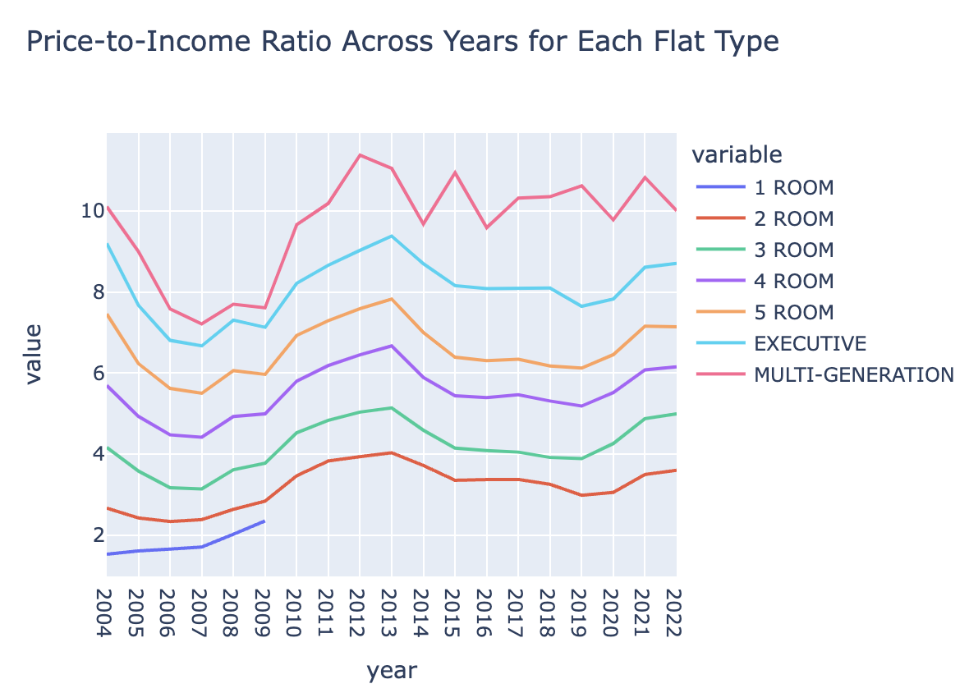
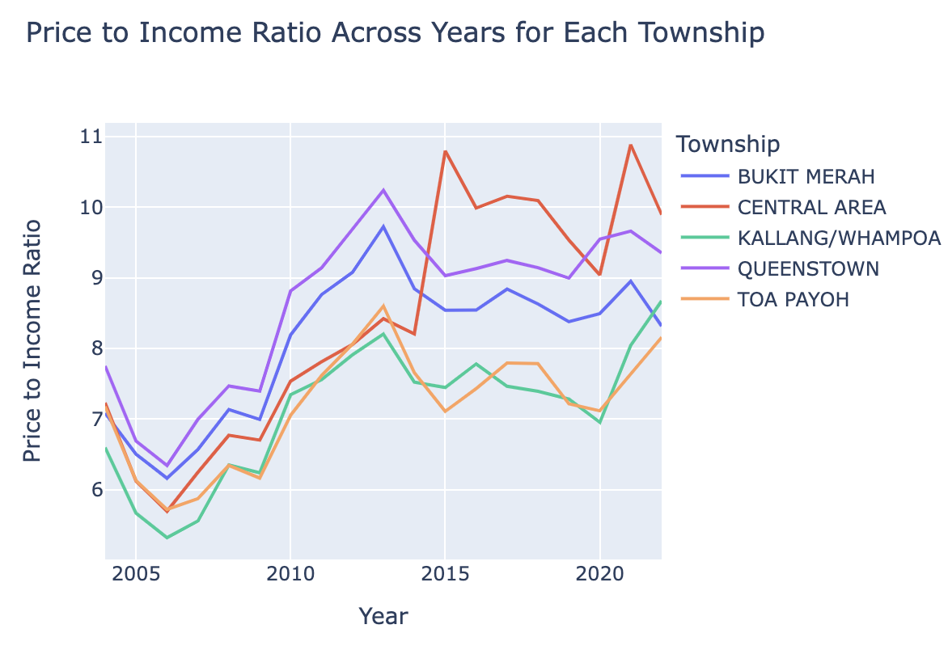
Is Singapore’s Public Housing Affordable?
Key Metric: Median resale price to mean annual income ratio
Period Studied: 2004 to 2022*
Price-to-income ratio remains relatively constant across the years for each flat type. Generally, SG’s public housing appears to be affordable
Breaking down the data to the township level, price-to-income ratios rise substantially# for a handful of townships. This could imply that some townships have become increasingly less affordable.
* 2004 will serve as the benchmark for affordability
# This analysis only applies for 4-room flat types

