Slide 1
Session Based Client Server Authentication
Client (Browser)
Server
(username, password)
Stores info in its session
Memory and generates a
session ID
Session ID
Request with Session ID
Retrieves info using
session ID
Sends the response

Slide 2
JWT Based Client Server Authentication
Client (Browser)
Server
(username, password)
JWT is generated using
secret key
JSON Web Token (JWT)
Request with JWT
Verifies JWT with the
secret key
Sends the response

Slide 3
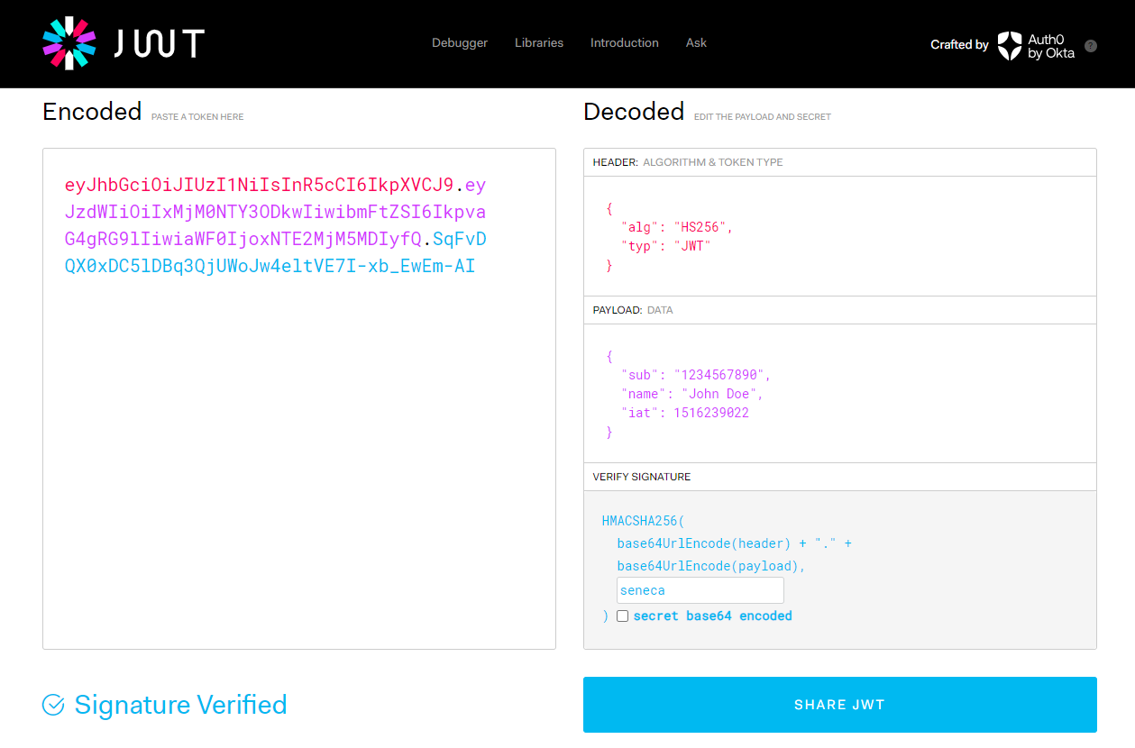

Slide 4




Why JWT?
JWT

