Slide 1
Predicting Diabetes in Women of the Pima Indigenous People
Agenda
1
Research Challenge
2
Process
3
Predictive Outcomes
4
Take Aways
Jennifer McKaig
June 28, 2019

Slide 2

Since 1965, the Indigenous Pima Community living in in southern Arizona, USA have participated in a longitudinal study of diabetes and its complications.
This population has the world’s highest prevalence of diabetes ever reported.
50% of Pima people will have diabetes by the age of 35
The Pima have Type 2 diabetes which is caused by genetics and lifestyle.
15% of diabetic Pima people develop end stage renal cancer after living with diabetes for 20 years
Notes:
Their way of life (himdagĭ, sometimes rendered in English as Him-dag) was and is centered on the river, which is considered holy.
The Gila and Salt Rivers are currently dry, due to the (San carlos Irrigation project) upstream dams that block the flow and the diversion of water by non-native farmers. They engaged in a century long legal battle with the US which they eventually won, but the river is still dry.
The diversion of the water and the introduction of non-native diet is said to have been the leading contributing factor in the high rate of diabetes among the tribe.

Slide 3

Can we use biometric data to predict the onset of diabetes?
Population Sample
Biometric Data
Additional Features
Women of the Pima tribe who are 21 years old or older.
768 Observations
Number of Pregnancies
Glucose Level
Blood Pressure
Skin Thickness
Insulin
Body Mass Index
Diabetes Pedigree Function
Age
Outcome
Healthy Number of Pregnancies < 5
Healthy Glucose Level <= 100
Healthy Blood Pressure <= 120
Healthy Insulin Level <= 100
Healthy BMI (18.5 - 24.9)
Overall Health Score

Slide 4
QUESTION
PROCESS
OUTCOME
APPLICATION
The primary metric used to predict model strength is the F1 score which is the harmonic average of precision and recall.
The secondary metric used is Recall, because it would be worse to fail to recognize whether someone is at risk for diabetes then it would be to falsely diagnose them
Random Forest Model was able to generate predictions of diagnosis with : 72% F1 & Recall
Notes:
Weighted Averages

Slide 5
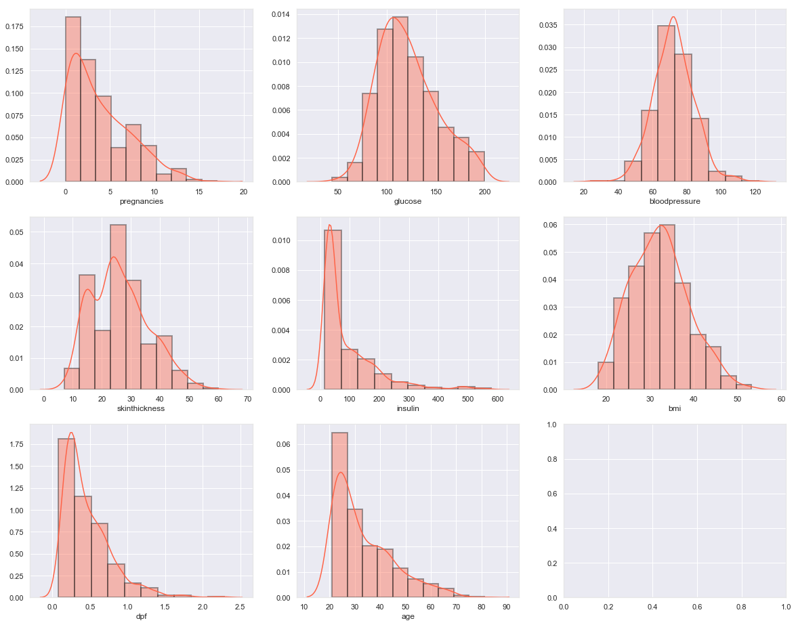
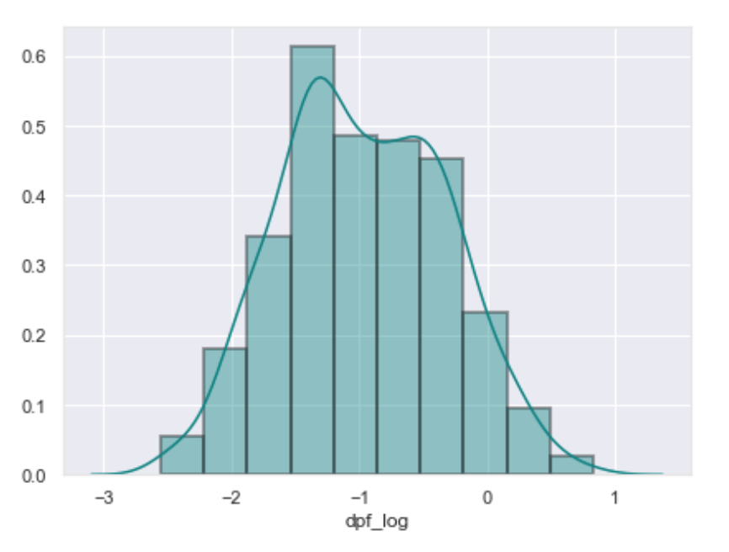
Biometric Data
Dropped Outliers
Dropped insulin > 600
Skin thickness > 70
BMI > 55
Missing Data
Dropped data with missing Glucose levels
Replaced BMI, Blood Pressure, and Insulin with Median values
Skin thickness measure was replaced by mean within BMI range
Logged DPF

Slide 6
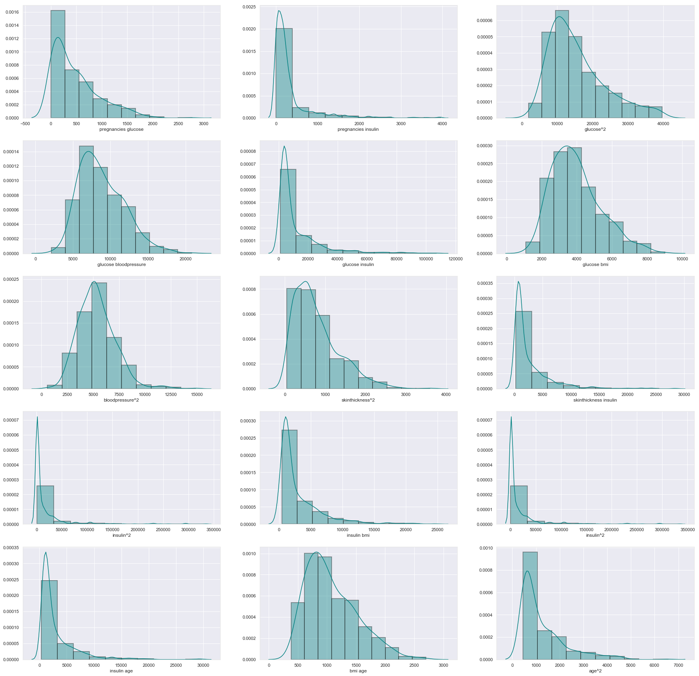
Interaction Features
After L1 Regularization (Lasso)
pregnancies - glucose
pregnancies - insulin
glucose^2
glucose - bloodpressure
glucose - insulin
glucose - bmi
blood pressure^2
blood pressure - age
skin thickness^2
skin thickness - insulin
insulin^2
insulin - bmi
insulin - age
bmi - age
age^2
Notes:
The interaction between two features is the change in the prediction that occurs by varying the features after considering the individual feature effects.

Slide 7
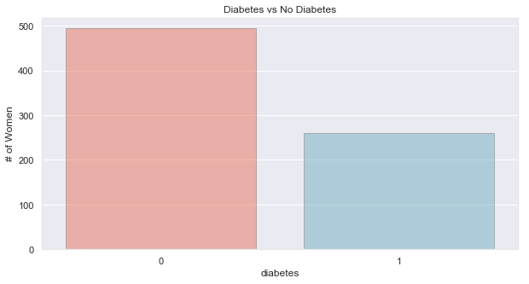
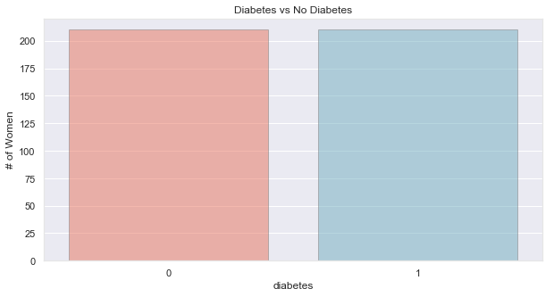
Class Imbalance
The training data was downsampled using the Resampling Method to improve the model accuracy, resultingin 420 observations.

Slide 8
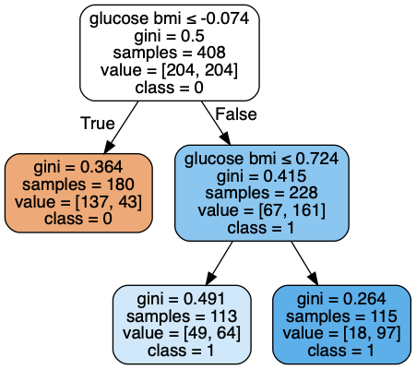
Model Testing
With GridSearch
KNN
Best Value for k: 23
F1-Score: 0.68
Recall: 0.75
Decision Tree
F1_score: 0.67
Recall : 0.73
Random Forest
F1-Score: 0.68
Recall: 0.73
XGBoost
F1-Score: 0.70
Recall: 0.69

Slide 9
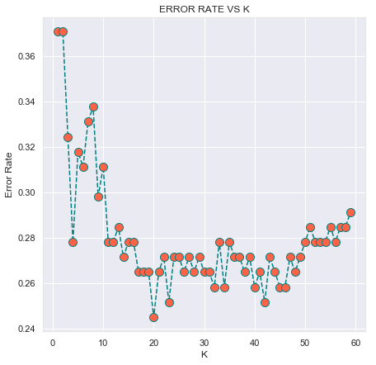
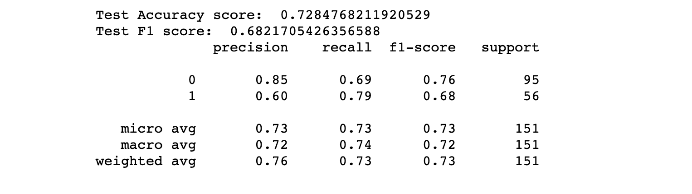
Final Model
KNN
k=23

Slide 10
Thanks
What’s Next
Cheap tools that help with the early detection of diabetes can aid in early prevention.
While there are some genetic factors, risk of Type 2 Diabetes can be significantly reduced with lifestyle changes such as diet and exercise.

Slide 11
Sources
Jack W. Smith, BS, JE Everhart, MD, MPH, WC Dickson, WC Knowler, MD, DrPH, RS Johannes, MD, MS; 1988. “Using the ADAP Learning Algorithm to Forecast the Onset of Diabetes Mellitus”.
Francesco Mercaldo, Vittoria Nardone, Antonella Santone; 2017 . “Diabetes Mellitus Affected Patients Classification and Diagnosis through Machine Learning Techniques”
https://en.wikipedia.org/wiki/Pima_people

