Slide 1



SMART AI-DRIVEN AUTONOMOUS VEHICLE WITH MULTI-PROTOCOL CONNECTIVITY AND REAL-TIME CONTROL
(MODULE 1)
Guided By: Dr. Swarna Prabha Jena
Asst. Professor
Electronics and Communication Engineering

Slide 2
Team Members
Rudransh Jena (230301132030)
LinkedIn: www.linkedin.com/in/rudransh-jena-4427a1141
Rohit Jambhulkar (230301131028)
LinkedIn: www.linkedin.com/in/rohit-jambhulkar-289440354
Ashish Kumar Singh (230301130004)
LinkedIn: https://www.linkedin.com/in/ashish-kumar-singh-5b26132ba?utm_source=share&utm_campaign=share_via&utm_content=profile&utm_medium=android_app
Ashribad Sarangi (230301130012)
LinkedIn: https://www.linkedin.com/in/ashribad-sarangi-7b2257369?utm_source=share&utm_campaign=share_via&utm_content=profile&utm_medium=android_app
Itimayee Mohapatra (230301132029)
LinkedIn: https://www.linkedin.com/in/itimayee-mohapatra-003695291?utm_source=share&utm_campaign=share_via&utm_content=profile&utm_medium=android_app

Slide 3
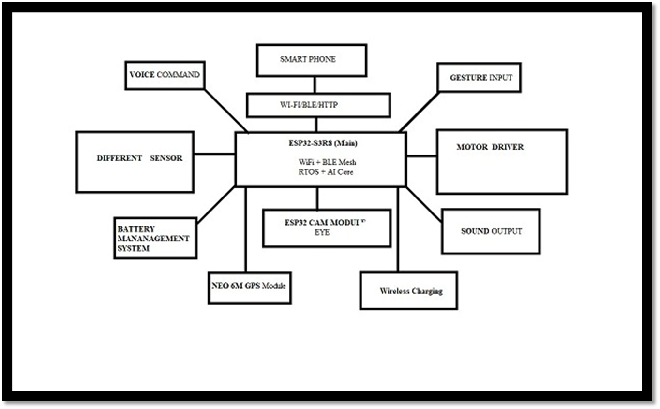
PROJECT OVERVIEW

Slide 4
CAN Communication
Controller Area Network (CAN) is a robust, multi-master serial communication protocol designed primarily for real-time data exchange in automotive and industrial systems. It uses a two-wire differential bus (CAN_H and CAN_L) to provide reliable communication even in noisy environments.

Slide 5
CAN Protocol
In ESP32 (and some other ESP family microcontrollers) which requires a CAN transceiver (e.g., SN65HVD230) to interface the differential two-wire bus.
Two-Wire Protocol: The bus consists of two wires, CAN_H and CAN_L. Data is transmitted as a differential signal:
Logic ‘0’ → CAN_L = CAN_L
Logic ‘1’ → CAN_H = CAN_H

Slide 6
Working Principle
Transmit (TXD → Bus):
ESP32 outputs CAN data (TXD pin).
SN65HVD230 converts this logic signal into a differential signal across CAN_H and CAN_L.
Receive (Bus → RXD):
The transceiver senses the differential voltage on CAN_H and CAN_L.
Converts it back into a logic-level signal (RXD) for the ESP32.
Differential Signaling (Noise Immunity):
logic ‘0’: CAN_L = CAN_L
logic ‘1’: CAN_H = CAN_H
This allows multiple nodes to share the same bus without errors.

Slide 7
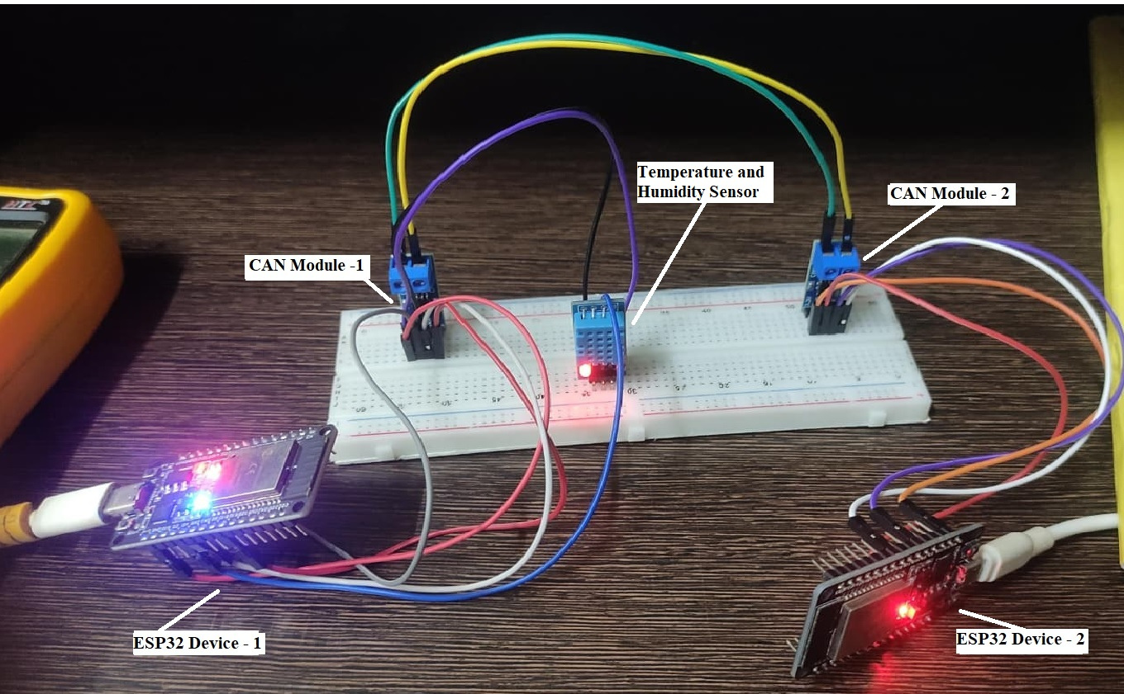
Working Model

Slide 8
Hardware Description
Connections with ESP32
TXD (SN65HVD230) → TX GPIO (ESP32 CAN TX)
RXD (SN65HVD230) → RX GPIO (ESP32 CAN RX)
CAN_H & CAN_L → CAN Bus twisted pair
VCC → 3.3V, GND → GND
RS pin controls modes:
Low = Low-speed mode
High = High-power mode
Role Summary
ESP32 = CAN controller (generates and interprets CAN frames)
SN65HVD230 = CAN transceiver (converts logic ↔ differential signals)
CAN_H & CAN_L = Physical bus lines connecting all nodes

Slide 9
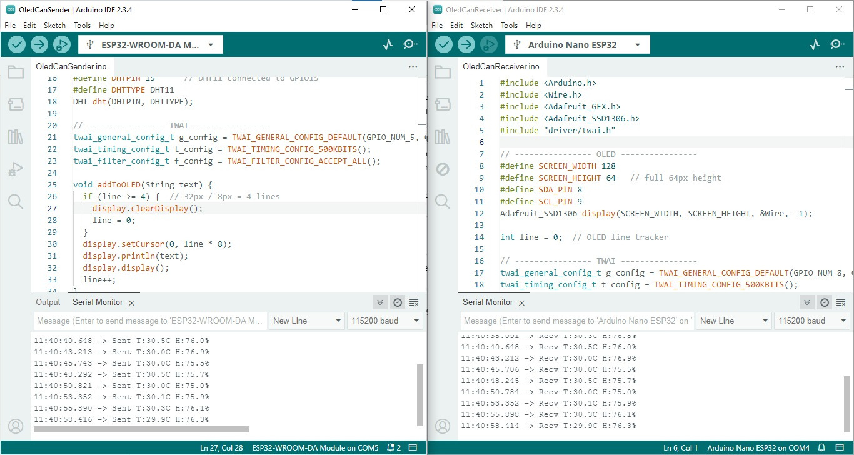
Output

