Slide 1
Smart AI-Driven Autonomous Vehicle with Multi-Protocol Connectivity and Real-Time Control

Slide 2
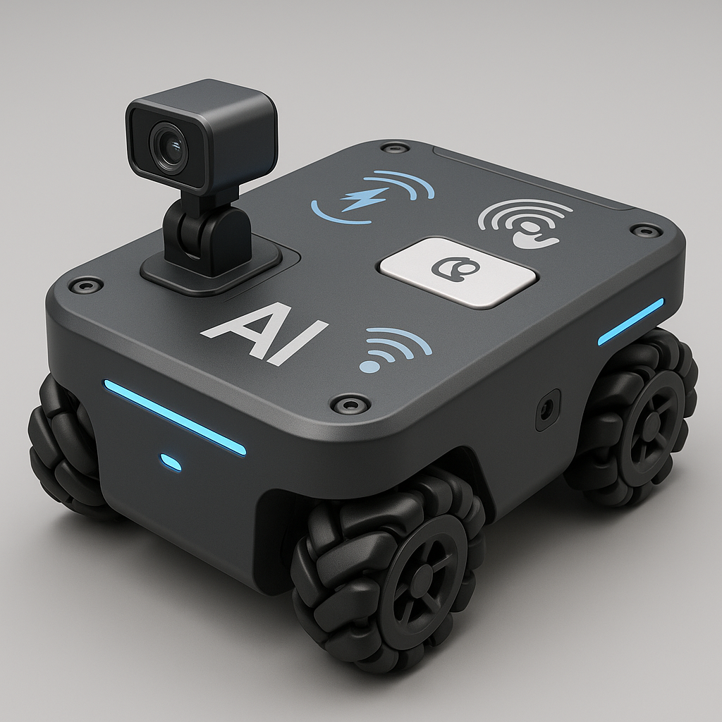
INTRODUCTION
This project presents the development of a next-generation AI-powered autonomous and remotely controllable omni-directional robotic vehicle, designed to operate in both indoor and outdoor environments. Built around the ESP32-S3R8 and ESP32-CAM, the system seamlessly integrates BLE Mesh networking and Wi-Fi for resilient local communication and global connectivity.

Slide 3
KEY FEATURES
Full Autonomous Navigation & Obstacle Avoidance
Global Remote Control from Anywhere
Local Control via BLE Mesh (even offline)
Smart Interaction via Voice & Gesture
Self-Charging, Energy-Aware Operation
Real-Time AI Decisions at the Edge
Task Learning and Replay

Slide 4
CORE PROCESSING UNITS
The ESP32-S3R8 acts as the intelligent, connected, and multitasking control center of the entire robotic system.
ESP32-S3R8
The ESP32-CAM acts as the "eye", enabling AI-powered visual recognition and live feedback for autonomous and remote functions.
ESP32-CAM

Slide 5
COMPONENTS
ESP32-S3R8 Dev Board
ESP32-S3 AI-On-The-Edge-Cam Module
ESP32-C3
4× Omni Wheels
4× BO Motors / Gear Motors
Motor Drivers (L298N)
Wheel Encoders
MPU6050 (Gyro + accelometer)
Chassis
GPS NEO M8N Module GY-GPSV3-M8N with Antenna
LiDAR Sensors (VL53LOX TOF)
Voice Recognition Module / MAX9814
MAX98357A (Voice Output)
SN65HVD230
BLE Mesh (via ESP32-S3)
Wi-Fi (built-in)
8 × 18650 Li-ion Cells
Battery Protection Circuit (BMS)
Step up module 5v
Magnetic Charging Module

Slide 6
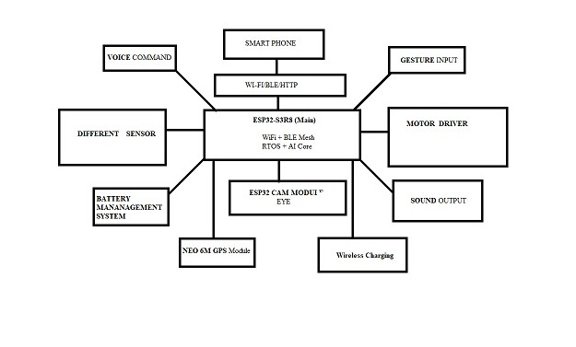
BLOCK DIAGRAM

Slide 7
USER INTERRUPTION AND DASHBOARD
The UI is built as:
A web dashboard (ReactJS + Node.js or Flask backend)
A mobile app (Flutter / Android Studio)
Optional: Blynk IoT App for quick deployment
Main Dashboard Panels:
Live Camera Feed
Manual Controls
Gesture and Voice Toggle Mode
Emergency Button
Battery Status
Sensor Data
OTA Update Button
GPS Tracker

Slide 8
BUDGET
Total Estimated Budget: 10,000 INR

