Slide 1
insights
File created on: 5/7/22 00:55:43 GMT+2

Slide 2
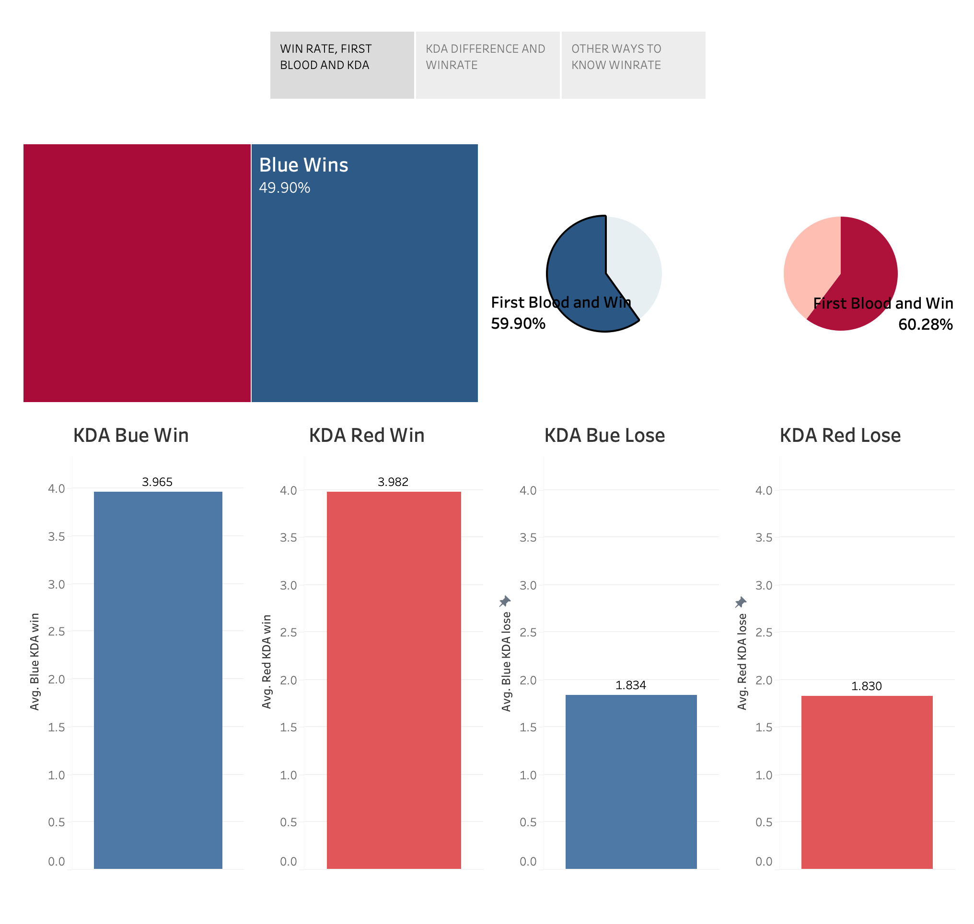

Slide 3
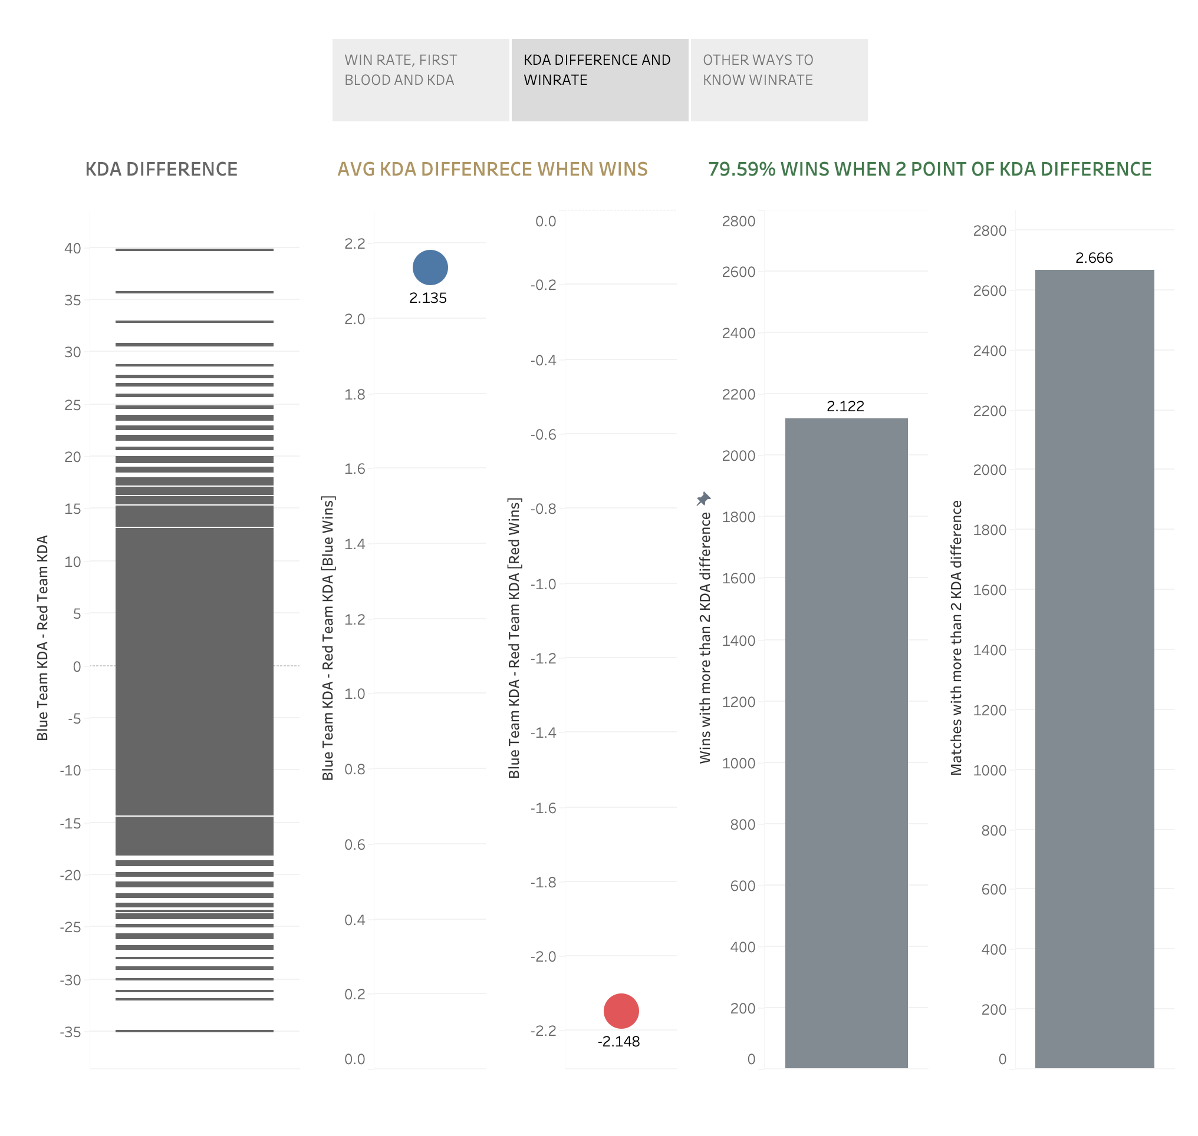

Slide 4
