Slide 1
Executive Summary
Summary of Business Problem and Model
The business aims to optimize their cross-selling to existing customers.
Data Science, Business & Data Engineering teams are working together to develop a model which can predict likelihood of a customer upgrading due to cross-sell initiatives.
Results of this model will be used to target the customers who are most likely to upgrade.

Slide 2
We have collaborated across teams
Business Intent
Data Analysis
Data Science
B Member 1
DE Member 1
Jena Vint
B Member 2
DE Member 2
Main POCs:

Slide 3

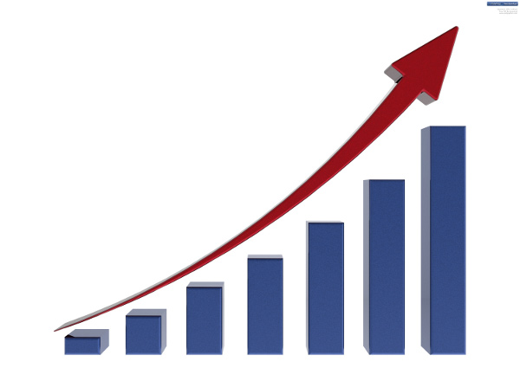
Model Overview
Input: Raw Predictors
Output: Target Variable
Customer Data Snapshot
Product Types
Indicator Variables
Etc
Etc
Likelihood of customer upgrade
Current Best Model: Random Forest Classifier
With 500 trees
110 predictors
Insight 1
Insight 2

Slide 4
Final Model Performance: KPI’s
KPI | Description | Metrics
Accuracy | % of customers who are correctly identified as upgrading via cross-sell or not | xx%
Recall | Of customers who actually upgrade: this is the % we can identify | xx%
Precision | Of customers we predict to upgrade: this % will actually attrite | xx%
0 <= AUC <= 1 | Probability that our model predicts better than random selection | 0.xx

Slide 5
Recommendations
Recommendation 1
Recommendation 2
Recommendation 3

