Slide 1

Implementation Of Price Optimization Algorithm in e-Ticket Reservation System
SARANATHAN COLLEGE OF ENGINEERING
(Affiliated to Anna University Chennai) Panjappur, Tiruchirapalli-620 012
DEPARTMENT OF COMPUTER SCIENCE & ENGINEERING
CS8811 - PROJECT WORK
By:
Project Guide LAVANYA E (201043)
MR.R.MOHAN KUMAR LOURDES JENCY S (201044)

Slide 2
Implementation of price optimization in e-ticket reservation system Abstract:
E-ticket reservation system is a web based system, used to book airline tickets through ARS website. This project is aimed at exposing the relevance of price optimization in Airline Reservation System .Also, it enhances the relationship between customers and airline agencies through the use of ARS, and thereby making a convenient for the customers to book the flights, as when they require, such that they can utilize this software to make reservations. The price of the ticket is calculate dynamically based on demand available for the left out tickets. This is mainly done to maximize the capacity utilization so that maximum number of seats gets filled. The proposed system is experimented with successful reservation and cancellation of airline tickets by implementing dynamic pricing of tickets.

Slide 3
Implementation of price optimization in e-ticket reservation system Project Overview:
The purpose of this project is to create a convenient application for the passengers , trying to buy airline tickets.
The system is based on a relational database with flight management and reservation functions.
we will have a database for storing the flight details and passenger details. Also we have implemented dynamic pricing strategy .
For this, we have constructed a mathematical model of revenue simulator so that I can simulate the demand needed for the tickets. Using this behavior I can access my pricing mechanism.

Slide 4
Implementation of price optimization in e-ticket reservation system Architectural Design:
Calculate ticket price
Revenue simulator
Search flight
View flight details
Reserve tickets
Webpage of airline reservation system
User login
View reserved tickets
Make payment
Admin login
Cancel tickets
Display ticket confirmation
View passenger list
Update flight details
Database

Slide 5
Implementation of price optimization in e-ticket reservation system How Price Optimization Works:
To get an optimal price , dynamic programming is used .It works on the field of value function .
The value function returns the best outcome achievable from any input state. In this, V( tickets_left , days_left ) returns the best revenue you can expect to achieve ,given the number of tickets you have and the number of days left before the flight.
To calculate demand ,we will take an ‘expecting value’ ,by averaging over the future revenue from a range of demand levels. For simplicity, we discretize the possible demand levels, calculating from a set of evenly spread values.

Slide 6
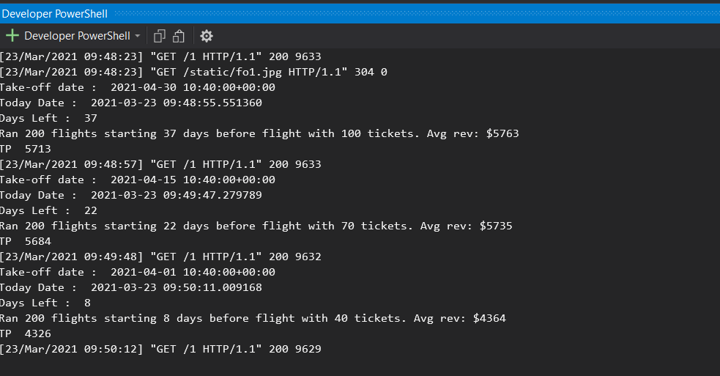
Implementation of price optimization in e-ticket reservation system
P1
Price P
P2
D1
D
D2
Q2 Q Q1
quantity

Slide 7
Implementation of price optimization in e-ticket reservation system Reserve Tickets:
The passenger has to enter the source and destination and can view the flight details with the fare amount.
To make a reservation the passenger has to enter their Name, Age, Gender and Class and has to make their payment.
After successful reservation the passenger can view their E-Ticket.

Slide 8
Implementation of price optimization in e-ticket reservation system User Login:
The user can login with the mail-id and phone ,which is entered during the reservation process. The user can view the list of bookings which he has done

Slide 9
Implementation of price optimization in e-ticket reservation system Cancel Tickets:
There are two way of cancellation of tickets. Firstly, if a passenger has reserved tickets for n number of person and want to cancel all of his ticket , he can cancel by entering his airline number along with PNR (Passenger Name Record) no which is generated while booking a flight.
Another Scenario is that , if a passenger has reserved tickets for n number of person and want cancel a particular person from the reserved ticket , he can cancel by entering his airline number , PNR (Passenger Name Record) along with the person’s name. After successful cancellation it will display the confirmation message

Slide 10
Implementation price optimization in e-ticket reservation system Admin Login:
The administrator can log in by using his username and password. The administrator can add, delete and modify flight information in the database. He can also view the list of passengers who has booked for the flight along with their flight details.

Slide 11
Implementation of price optimization in e-ticket reservation system Technology Used – Django:
Django is a High-level framework for rapid web development.
Django is a free and open-source web framework, written in Python and it follows the model-view-template (MVT) architectural pattern.
We can build High End Web Applications.
Platform : Django
Language: Python ,HTML, CSS, SQL
Database : sqlite

Slide 12
Implementation of price optimization in e-ticket reservation system Conclusion And Future scope:
We have implemented dynamic pricing approach to get an optimal fare of the tickets and a successful reservation of airline ticket. By implementing this approach of dynamic pricing , the demand of the ticket increases which leads to airline profit.
Getting accurate information about what you need is an important part of preparing for a trip or stay abroad. To help you , we can also include companies that provide visa and passport services.
Also ,by offering documentation processing , application filling services for those interested in applying for a visa.

Slide 13
Implementation of price optimization in e-ticket reservation system References:
[1] Fiig, T., R. Le Guen, and M. Gauchet. Dynamic Pricing of airline offers .
Journal of Revenue and Price Management.
[2] Andrew Pinkham., Django unleased – Working knowledge of Django with other
Frameworks
[3] https://www.kaggle.com/dansbecker/airline-price-optimization-solution
[4] C.Winston,S.Morrison., Evolution of Airline Industry. Brooking Institution
Press. Crosbt.T., How E-Tickets Work
[5] Dunleavy, H., and D. Westermann. Future of airline revenue management.
Journal of Revenue and Price Management

