Slide 1
Intruders
Notes:
অনুপ্রবেশকারী

Slide 2
Intruders
A significant security problem for networked systems is hostile or unwanted access by users or software.
- Via network or local access.
- Unauthorised logon or acquisition of privileges.
- Software intrusion: viruses, worms, Trojan horses.
• We will examine the nature of attacks and strategies for detection and prevention .
- Detection : Learning of an attack, either before or after its success.
- Prevention : Attempt to thwart all possible attacks.
Notes:
অনধিকারপ্রবেশ
Thwart... বাধা দেওয়া;

Slide 3
Classes of Intruders
• Masquerade :
Unauthorised individual who penetrates a system's access controls to exploit a legitimate user's account.
Usually outsider.
• Misfeasor :
Legitimate user who abuses privileges to access data,
programs or resources.
Usually insider.
• Clandestine user :
- Individual who seizes supervisory control and uses it to evade auditing and access controls.
- Insider or outsider.
Notes:
Masquerade …ছদ্মবেশ…. penetrates .. প্রবেশ করা…legitimate.. বৈধ.. Misfeasor .. বৈধ ক্ষমতার অপব্যবহার.. Clandestine..
গোপন..evade…এড়ানো

Slide 4
Intruders
Two types of hackers:
Benign intruders:
simply wish to explore to find out what is there.
- May seem tolerable, but still cost resources.
Malign intruders:
perform unauthorised modifications or disrupt system.
- You can't tell in advance whether an attack will be benign or malign.
- May use compromised system to launch other attacks.
Notes:
Benign.. ভদ্র.. Malign.. ক্ষতিকর

Slide 5
Two levels of hackers:
• - Sophisticated users with thorough knowledge of the technology.
Low-level 'foot soldiers', merely use available cracking programs with little understanding of the technology.
• Awareness of intruders has led to the development of Computer Emergency Response Teams (CERTs):
- Collect information about system vulnerabilities and disseminate them to IT managers.
- Hackers also have access to such reports.
Notes:
Sophisticated .. অত্যাধুনিক…'foot soldiers’, .. পদাতিক সৈন্য’.. Cracking…ফাটল ধরা, vulnerabilities…দুর্বলতা…disseminate.. প্রচার করা

Slide 6
Intrusion Techniques
Aim : Gain access and/or increase privileges on a system.
Typically involves knowledge of some info that should have been protected: e.g. a user's password.
• Systems maintain a file that associates passwords to authorised users.
Protection of password files:
One-way function
• Store value of a function based on the user's password.
• User presented password is transformed and compared with the stored value.
• In practice, system performs a one-way transformation in which the password is used to generate a key for the one-way function.
2. Access Control
• Access to password file limited to one or very few accounts.

Slide 7
Password Guessing
• One of the most common attacks.
• Attacker knows a login name (from email/web page, etc).
• Then attempts to guess password for it:
Defaults, short passwords, common word searches.
User info (variations on names, birthday, phone no, number plates, common words/hobbies).
Exhaustively searching all possible passwords.
• Success depends on password chosen by user.
Surveys show that many users choose passwords poorly.
• However, it is tedious and can be countered.
- Block users after several invalid attempts (but an attacker may copy encrypted password file and try off-line).

Slide 8
Password Capture
• Another attack involves password capture.
Use of Trojan Horse program.
• E.g. via a game.
Monitoring an insecure network login tapping the line between remote user and host system.
• E.g. Telnet, FTP, web, email.
Extracting recorded info after successful login (web history/cache, last number dialled, etc.).
• Using valid login/password can impersonate user.

Slide 9
Buffer Overflows
• Does not require learning a password.
• Intruders get access to the system by exploiting attacks such as buffer overflows on a program that runs with certain privileges.
• Privilege escalation can be done also in this way
Notes:
Privilege escalation .. cyberattack technique
একটি বাফার ওভারফ্লো বা বাফার ওভাররান একটি অসঙ্গতি যেখানে একটি প্রোগ্রাম বাফারের বরাদ্দকৃত মেমরির

Slide 10
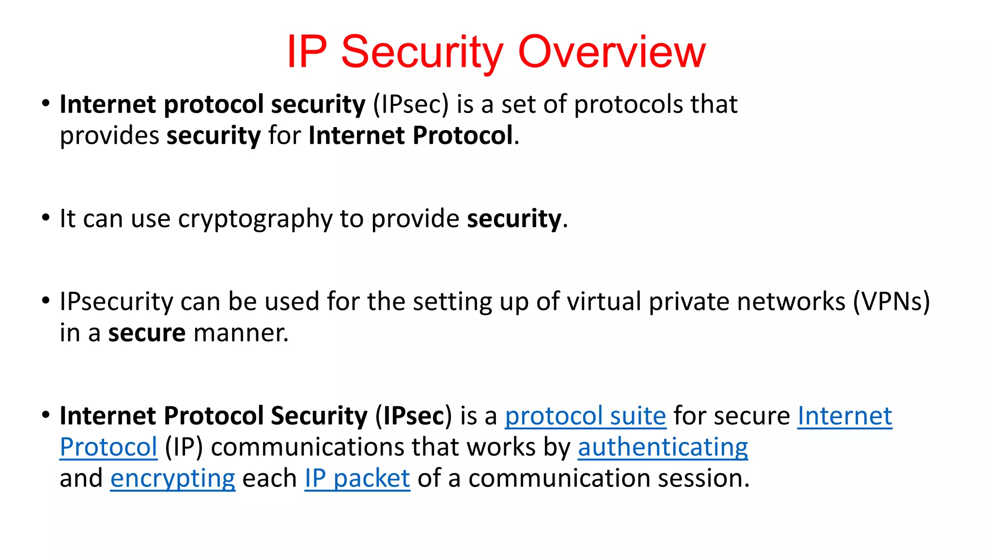

Slide 11
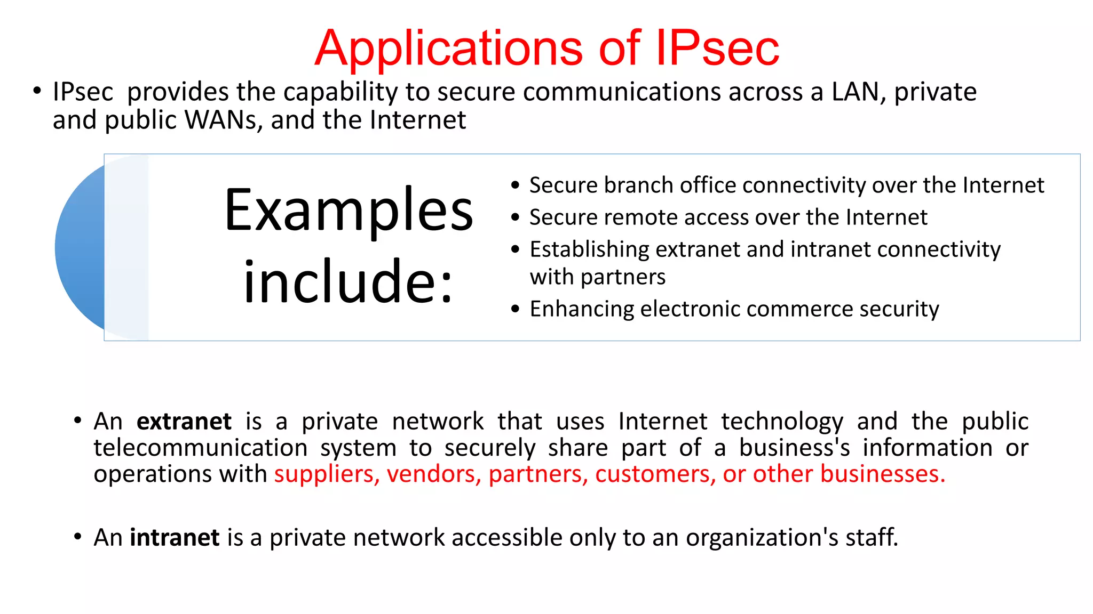

Slide 12
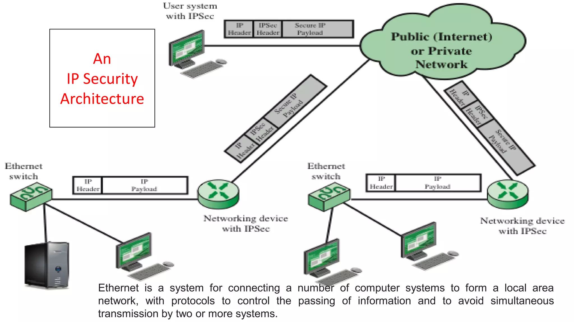
Notes:
An IP header is header information at the beginning of an Internet Protocol (IP) packet.

Slide 13
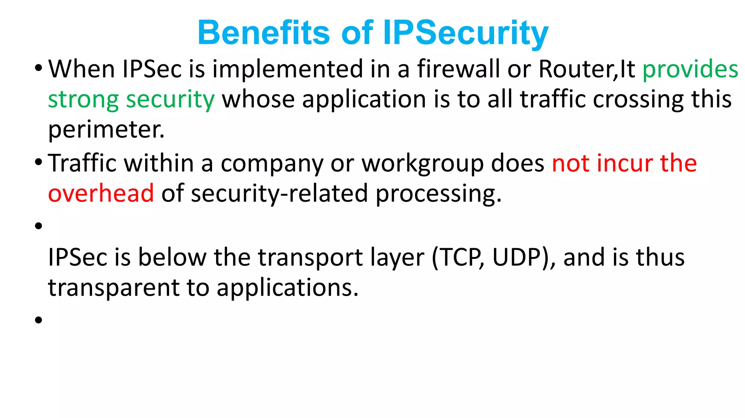
Notes:
User Datagram Protocol.

Slide 14
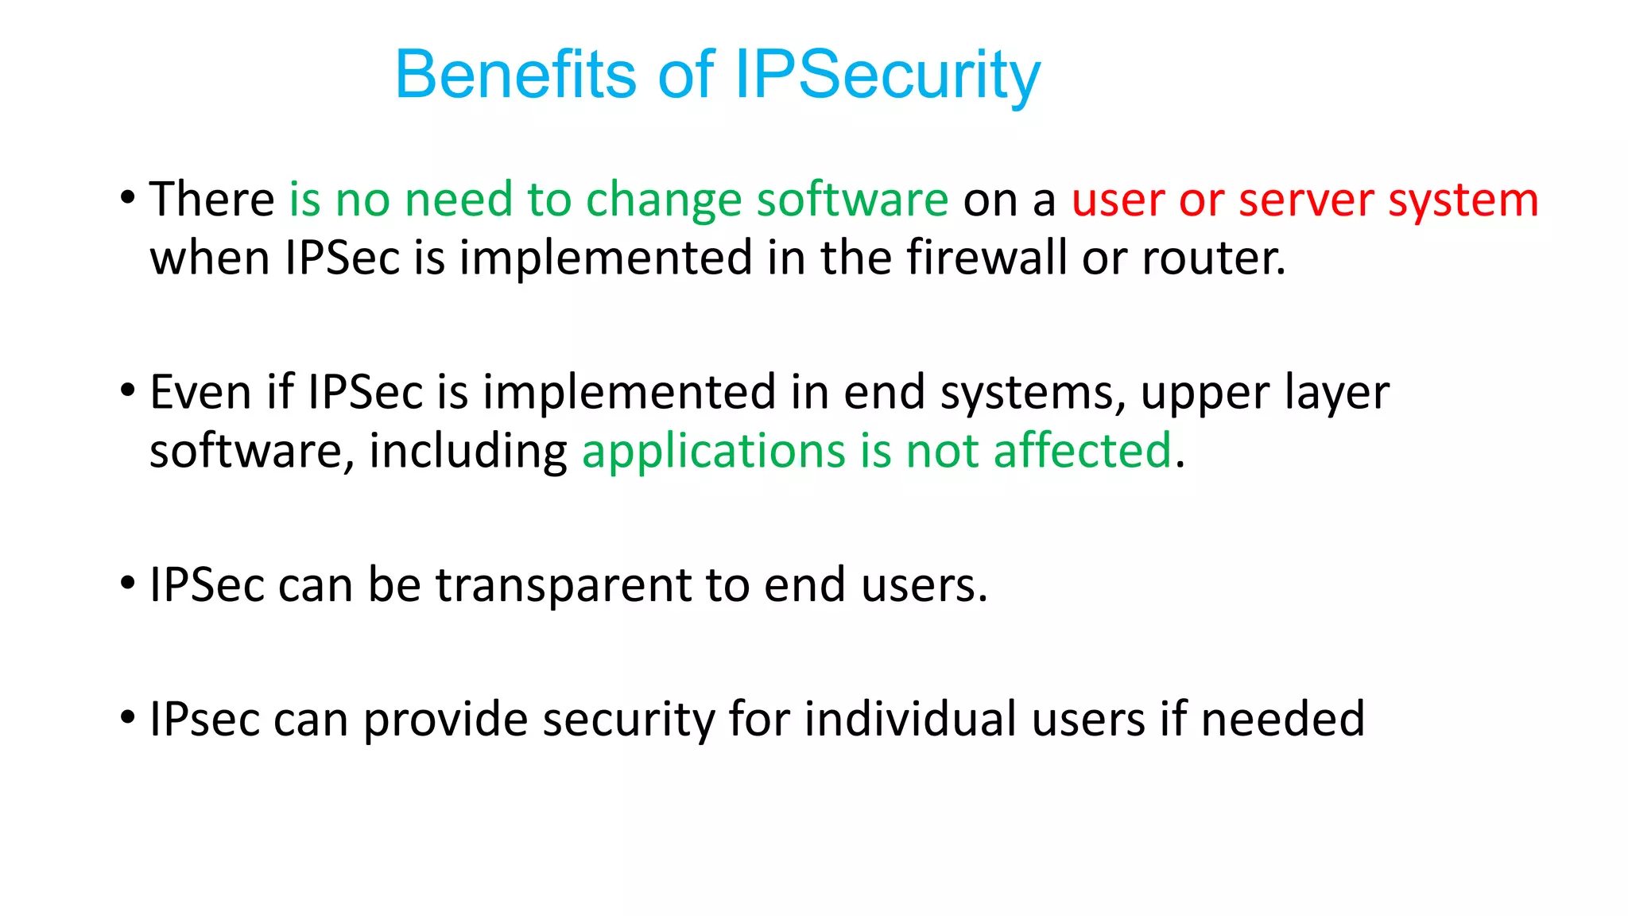

Slide 15
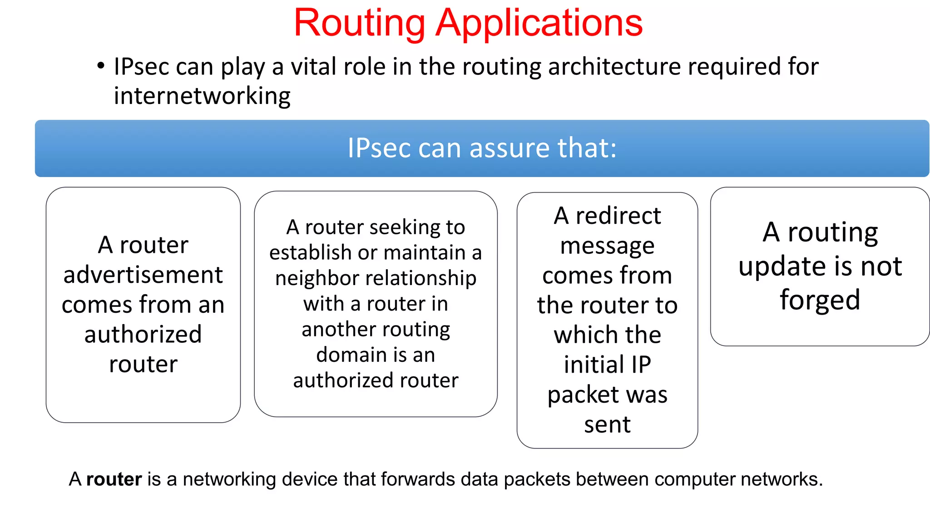
Notes:
Forged…নকল

