Slide 1
MARGOT: Mining arguments from text
What’s in it for W2O?

Slide 2
Argumentation mining (AM)
MARGOT is a first-of-a-kind tool for automatically extracting significant, argumentation-rich information from a variety of genres.
One step beyond sentiment analysis, AM seeks causes and reasons underlying opinions.
MARGOT: A web server for argumentation mining, Marco Lippi, Paolo Torroni Dipartimento di Informatica – Scienza e Ingegneria, Università degli Studi di Bologna, Italy Expert Systems with Applications Volume 65, 15 December 2016, pp. 292-303.
Try interactive UI at http://margot.disi.unibo.it/index.html

Slide 3

When & Where Arguments Matter to Clients
Trends in Discourse & News
What are experts claiming?
Do stakeholders agree?
What are the counter-arguments?
Which arguments are highest “quality”?
Who agrees with whom?
Crisis Communications
Get a quick summary??
Who is making which claims?
What “evidence” is being attested to?
Which arguments prevail in which panels?
Can we connect proponents with influencers ?
Which voices are picking up our points?
Policy Making
Have voices of impacted constituents been heard?
What are their primary assertions?
What language best represents key reasoning?
Who can best represent these views?

Slide 4

What are the arguments for and against a proposition…
Sentiment
Verbatim argument identification and extraction
Pro
Do you like the term “Warrior” better than “Survivor”? [tweet]
Every day I am a Warrior. When I get up, I do battle with my disease… [evidence score = 0.3]
Con
Nope I don’t. I don’t like to say I battle it either. If it gets the better of me , I haven't failed or lost because I'm weak. [evidence score = 0.18]
Implied proposition:
The term “Warrior”
Is appropriate for describing those diagnosed with this disease

Slide 5
Picture an Argumentation-based Application
Pro/Con tool
(topic/hashtag)
Argument detection
Claim detection
Auto
attribution
Evidence detection

Slide 6
How does MARGOT work?
Quick feasibility check

Slide 7
Pro: Data Structure & Max(EvidenceScore)
{
"document": [
{
"claim_score": -1.84769,
"evidence_score": -0.79358235,
"text": "I am a Warrior ."
},
{
"claim_score": -1.009994,
"evidence": "Every day when I get up I do battle with my disease .",
"evidence_score": 0.29674144,
"text": "Every day when I get up I do battle with my disease ."
},
…
]
}

Slide 8
Con: Data Structure & Max(EvidenceScore)
{
"document": [
{
"claim_score": -1.3276306,
"evidence_score": -0.33023891,
"text": "Personally nope..."
},
…
{
"claim_score": -0.8002849,
"evidence": "I do n't like to say I battle it either , when it gets the better , I have n't failed or lost cos I 'm weak",
"evidence_score": 0.18164326,
"text": "I do n't like to say I battle it either , when it gets the better , I have n't failed or lost cos I 'm weak"
}
]
}
Notes:
I don't like to say I battle it either , when it gets the better , I haven't failed or lost cos I'm weak
Thank you for submitting your query. Results should appear in a minute. Wait patiently or come back later at this permanent URL: http://margot.disi.unibo.it/answers/WZ9bgkoC9i.html

Slide 9
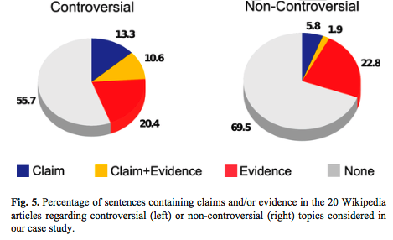
MARGOT Background
Algorithm designed to detect argumentation in ANY context
Results promising on
Out-of-sample Wikipedia articles
News articles
Reddit
(anecdotally, Twitter)
“If we want to dig out arguments from vastly diversified corpora, such as social media (the application potential there is enormous), then we might need to seek arguments in sources where “the” topic is not at all defined, posts may contribute to several topics, and the discussion may often shift from topic to topic.”
– Lippi & Torroni,
Context-Independent Claim Detection for Argument Mining 2015

Slide 10
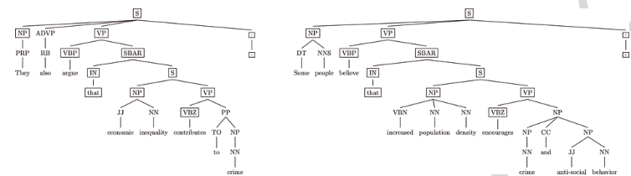
MARGOT Background, cont.
Trained on IBM Research’s “Debater” project dataset (Aharoni et al., 2014)
Thousands of annotated claims and evidence from Wikipedia articles
Classifier first detects whether statement is argumentative (1=yes, 0=no)
Features leading to “claim” and/or “evidence” scores per instance include parse-tree similarities among argumentative sentences

Slide 11
MARGOT Background, cont.
Claim detection pipeline (Lippi &Torroni, 2015)
the given text document is split into sentences using a tokenizer that detects sentence boundaries;
each sentence is parsed, to obtain a constituency tree, using the Stanford CoreNLP 3.5.0 software (available at https://stanfordnlp.github.io/CoreNLP/);
sentences not containing a verb (VP tag) are discarded;
in order to improve generalization, words at leaves are substituted with their stemmed versions;
an SVM classifies each sentence as possibly containing a claim or not.
Their approach can optionally add a query topic (e.g. a hashtag of interest)

Slide 12
Limitations & Considerations
English-only
Sentiment and attribution must be layered on separately on W2O side
Tune-ability TBD
Speed/scalability TBD
Web server returns results in a few seconds at inference time
Speed could matter a lot for *crisis communications*
Authors’ proposed API hasn’t yet appeared. Options meanwhile:
Text submissions provided unique URL for result retrieval, like http://margot.disi.unibo.it/answers/tqWQjZCzVY.json
PACKAGE DOWNLOAD offered:
“We are happy to distribute a standalone package for MARGOT. Please send an e-mail to marco.lippi@unimore.it.”

