Slide 1
Real Relevant Reviews (R³)
Only The Most Helpful Product Reviews
W266 Section 003
Jen Darrouzet & Bradley Nott
GoogleSlidesPPT.com _ 30+ Slides Google Slides & PowerPoint Templates for Free

Slide 2
The R³ Project
The Problem
1
Too many online reviews
The Data
2
8 Million book reviews from Amazon.com
The Approach
3
Helpful Vote Arrival Rates + Neural Nets
The Results
4
To be revealed...
The Next Steps
5
Real, relevant, crowd-sourced advice for buyers

Slide 3
R³ System
Notes:
Reviews come in 24/7
R3 classifies them, keeping helpful and jettisoning unhelpful
Shopper arrives with a product interest and a query
R3 selects relevant reviews from within the helpful ones
Shopper gets just the on-point reviews to support their buying decision

Slide 4
The Problem
Need an efficient method to make product reviews useful
Notes:
So finding the right reviews is challenging!
Currently, many websites require shoppers to filter product reviews using keyword tags and rating categories.
That’s a cumbersome search strategy, and we’d prefer a more-efficient and guided approach
Previous research on this problem uses extracted features and metadata to produce structured summaries, or to assess review helpfulness.
We also want to identify reviews that are helpful, and we envision a system that can do that automatically

Slide 5
The Data
8 Million book reviews from Amazon.com (2006-2014) that contain a helpful vote tally
Notes:
In our research we make use of a “snapshot” of Amazon product reviews that contain a helpful vote tally
We imagine that if these crowdsourced helpfulness votes consistently reflect the type of information needed to make a classification decision, then it might be possible to harness these relationships to train a model without additional feature engineering.

Slide 6
The Approach
Transform the helpful vote tally into a metric that enables comparisons
Notes:
In our approach we transformed the helpful vote tallies into a metric that enables assignment of binary classification labels.
We don’t believe the helpfulness votes are a perfect “signal”, so let's talk about sources of bias...

Slide 7
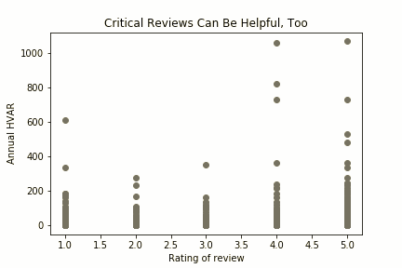
Notes:
Reviews receive their votes in various ways that are mostly unknown.
For example, some vote tallies could be biased if Amazon gave certain reviews more visibility due to a high star-rating.
This can lead to a “rich-get-richer” pattern where reviews with many helpful votes continue to receive them because of being featured, and not necessarily due to review quality.
We cannot correct the for that kind of bias, and we have no data on other sources of bias.
However, we did normalize for time because reviews that are older have had more time to accumulate votes.

Slide 8
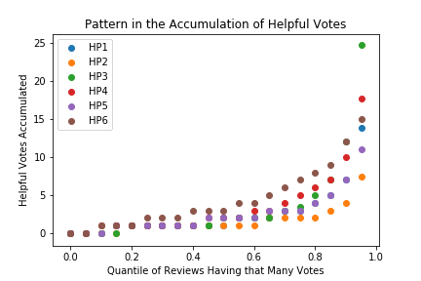
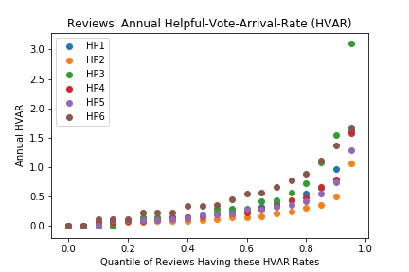
How to Train for Helpfulness
Counts? Proportions? Apples-to-apples?
Notes:
Through this normalization we created a metric called annual helpfulness vote arrival rate, or HVAR
This arrival rate serves to represent the strength of a helpfulness signal within a particular review.
To assign classification labels we standardized the HVAR values within-product groups, and then ungrouped the data and clustered all values into 2 classes.
Why standardize within-group and then cluster across groups?
This approach does not get each book’s HVAR values on the same scale, but it’s a vast improvement over not scaling the values. It results in conservative and meaningful groupings for binary classification. In addition to standardizing within-group HVAR values, we also tried within-group min-max scaling followed by clustering across groups, and simply labeling using a within-group percentile-based threshold (no clustering). Neither approach produced labels that were as reasonable as standardizing and then clustering.

Slide 9
Experiments
Data is noisy and the signal is rare
What is “means” to be helpful varies
Difficult to be confident about signal
Smaller models have a hard time with variations in review length
Notes:
Through EDA and experiments we learned…
Common Forms of Error:
Longer unhelpful reviews misclassified as helpful; shorter helpful reviews misclassified as unhelpful
Subject matter not specifically about product sometimes still classified as helpful
Opinion tone and condescending tone sometimes misclassified as helpful
Data is noisy and the signal is rare:
This a highly imbalanced problem!
Oversampling the underrepresented “helpful” class shows some promise
Stratification of training data to represent signal in different ways also helps
What is “means” to be helpful also varies:
As expected larger models trained on more data perform better
How “much” review is needed to accumulate evidence and tip the scale in one direction
It’s difficult to be confident about signal:
It’s easy to assess very helpful and not very helpful (edges of spectrum)
It’s hard to asses “somewhat” helpful (middle ground)
We compromised by training on a 50/50 helpful/unhelpful split (52132 examples) with 4 “high” signal groups:
5-star rating + helpful
5-star rating + unhelpful
1-star rating + helpful
1-star rating + unhelpful
As a result, some but not all, misclassifications fall close to predicted probability of 0.5
This approach is a compromise, and future approaches that make better use of “middle” ground data might prove useful
Smaller models have a hard time with variations in review length:
On average helpful reviews are longer
And models need the opportunity to learn that helpful, and unhelpful, reviews can be long or short

Slide 10
The Results

Slide 11
Classifier Performance
Predicting helpfulness of a review, given review text and 1-5★ rating
Accuracy
F1
80
Modeling Notes
70
None of the models fit the noisy data well.
Sorting by probability of helpfulness yields good top N.
Asking shoppers if we got it right could help, too.
60
50
1 tf.idf & LogReg
Super fast; unlimited vocab was 1M+
40
2 Bi-LSTM
Insanely slow (used alt CuDNNLSTM); 200 tokens
30
20
3 BERT
Medium speed; 200 tokens; 30K vocab; extra benefit of NSP
10
BERT’s added benefit
0
If BERT is substantially same, get relevance for “free”
1
2
3
Notes:
[Jen]
Here we present results evaluated on a test set that’s a 50/50 mix of helpful/unhelpful reviews. Flipping a coin would get 50% correct on average.
None of the 3 models are stellar.
But RANKING by probability of being helpful means top returned reviews should be helpful.
Can ask shopper: WAS THIS HELPFUL?
→ if get same performance, then prefer getting relevance for free

Slide 12
Query: Is Water for Elephants
appropriate for a teenager headed
off to veterinary school?
4★: ...Jacob’s parents died just as he was about to write his final exams in veterinary school at Cornell University....because of his vet training, he ends up hired on to care for the horses and other animals...I read it quickly and found it very sweet and entertaining; recommended for teens and adults... Caveat: there are descriptions of mistreatment and abuse of animals in this book. If that is unpalatable to you, you should skip this book...
2★: Jacob, now an old man, begins the book by going back into his youth to the time he was attending vet school. ... He winds up with a circus and becomes the circus vet, although, he rarely spent any time with or working on the animals. He just stood and watched animals be slaughtered and then felt bad that he did not do anything...
Query Relevance
with BERT’s Next Sentence Prediction (NSP)
Notes:
A key benefit of the BERT model is its ability to predict whether text segment 2 follows text segment 1
So in addition to using BERT for classification, we also explored using BERT to find reviews most relevant to a shopper query.
If I want guidance on whether this book is good for a teen,
BERT returns in the TOP10 2 helpful reviews I highlight here:
1 is positive and the other is negative.
As a parent, I find both reviews really on-point.
Good food for thought; I know what I think my teen can handle and can quickly place my order.

Slide 13
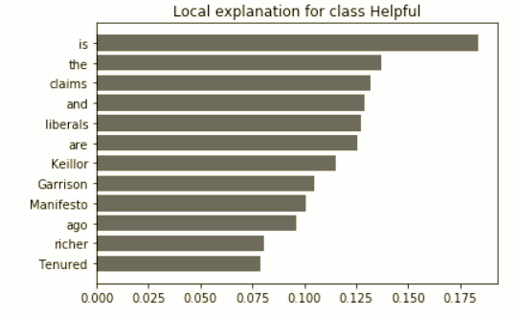
Helpfulness indicator
LIME helped identify that reviews with claims were >80% helpful
Easy to change colors, photos and Text.
Easy to change colors, photos and Text. Get a modern PowerPoint Presentation that is beautifully designed. I hope and I believe that this Template will your Time, Money and Reputation. Easy to change colors, photos and Text. Easy to change colors, photos and Text. Get a modern PowerPoint Presentation that is beautifully designed. You can simply impress your audience and add a unique zing and appeal to your Presentations. Easy to change colors, photos and Text. I hope and I believe that this Template will your Time, Money and Reputation. You can simply impress your audience and add a unique zing and appeal to your Presentations.
I hope and I believe that this Template will your Time, Money and Reputation. Easy to change colors, photos and Text. Easy to change colors, photos and Text.
Get a modern PowerPoint Presentation that is beautifully designed. You can simply impress your audience and add a unique zing and appeal to your Presentations. Easy to change colors, photos and Text.
Notes:
We used LIME (locally-interpretable model-agnostic evaluation) for classification introspection.
The presence of “claims” increases the odds of a review being helpful.
Which is backed up by argumentation mining theory (certain discourse includes claims and evidence).

Slide 14
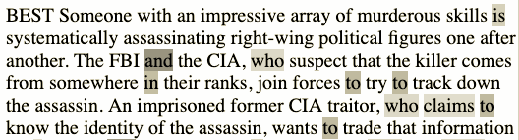
Claims
Not just for nonfiction reviews, either
Notes:
Claims are even helpful in fiction reviews, which surprised us.

Slide 15
Next steps
Tune R³ for identified model weaknesses (e.g. length)
Customer tolerance for review length may be product-category dependent
  📚📖 Book lovers embrace long-form text
  💄💋 Beauty product shoppers could prefer short text/user-submitted photos
Evaluate R³’s ranked reviews using IR metrics like Mean Average Precision (MAP)
Could not automatically measure precision/recall as dataset did not have relevance labels
Optimize R³ for shopper happiness (both useful and fast)
Once we can reliably deliver a TOP N HELPFUL + RELEVANT review list, SPEED is paramount
  Can we process new reviews immediately upon submission? (Important for new releases.)
  What is the fastest BERT model to compare most helpful reviews to a shopper query?
  Confident we can pre-calculate a BERT representation of each incoming review such that shoppers’ query-time comparisons are fast...but how fast is the question.
⏱
Notes:
Evaluating ranked reviews & relevance

