Slide 1
Big Data: acquisition
https://github.com/jendralhxr/bigdata

Slide 2
Karakteristik (5+3...V)
Volume (tera-petabyte, lah)
Velocity (terus bertambah)
Variety (berbagai jenis bacaan/kolom sekaligus)
Veracity (tingkat keakuratan dan keandalan data)
Value (knowledge yang bisa dikulik)
Variability (perubahan pola)
Volatility (kadang ada, kadang tiada)
Visualization (digest, cuplikan informatif)

Slide 3
Cara cari-cari data:
Data stream publik
Public/open data repository
Public API*
Scraping*
Bikin sendiri (sensor IoT, instrumentasi, dlsb)
Kaggle tidak cukup big

Slide 4
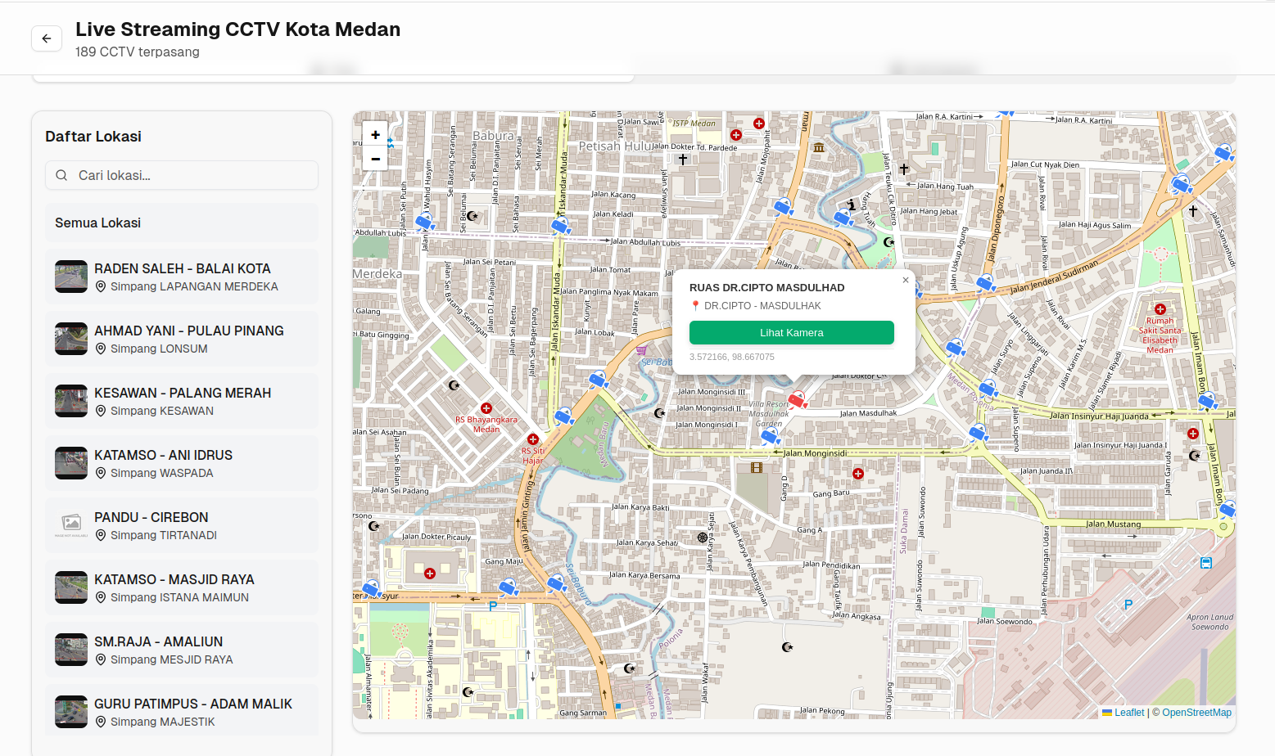
Data stream

Slide 5
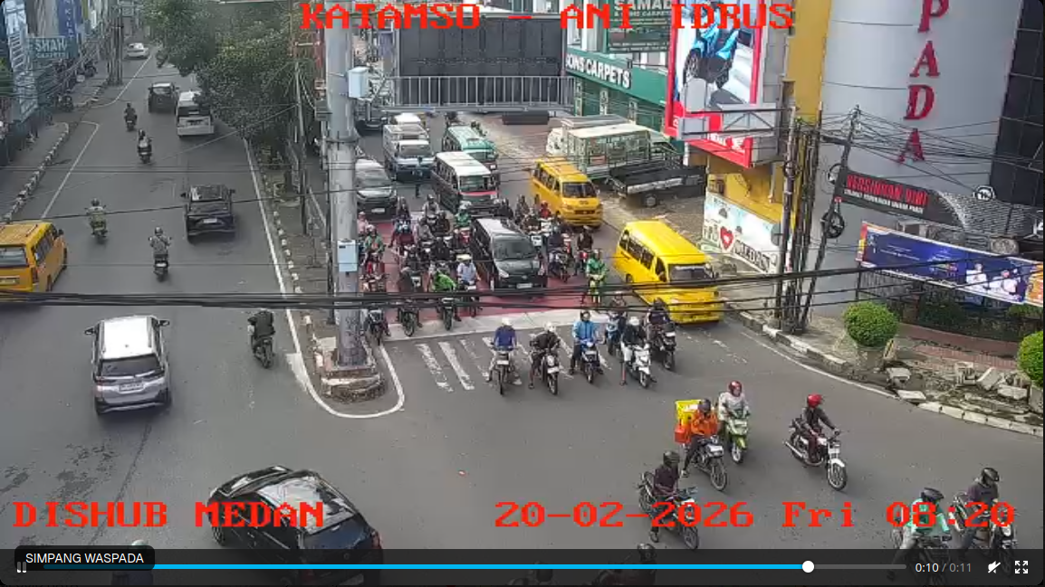
Data stream

Slide 6
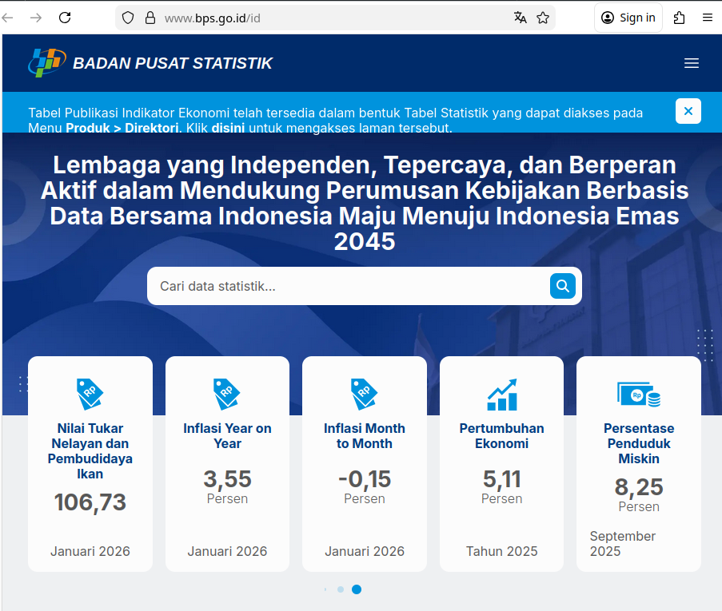
Public repository

Slide 7
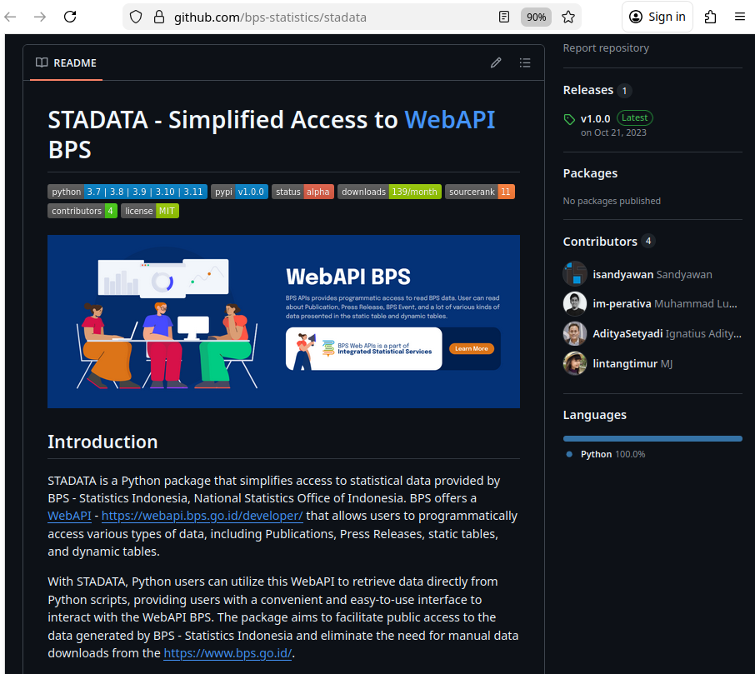
Public repository (API)

Slide 8
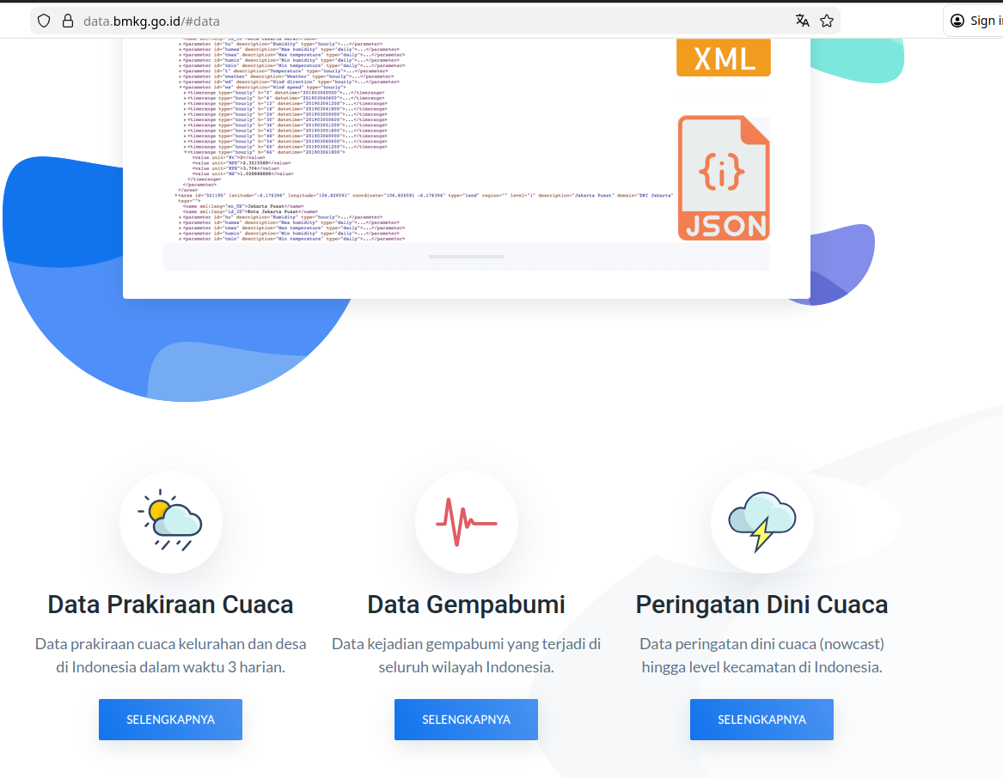
API call (biasanya jadi JSON)
https://github.com/infoBMKG/data-cuaca
https://github.com/infoBMKG/data-gempabumi
https://github.com/infoBMKG/data-cap

Slide 9
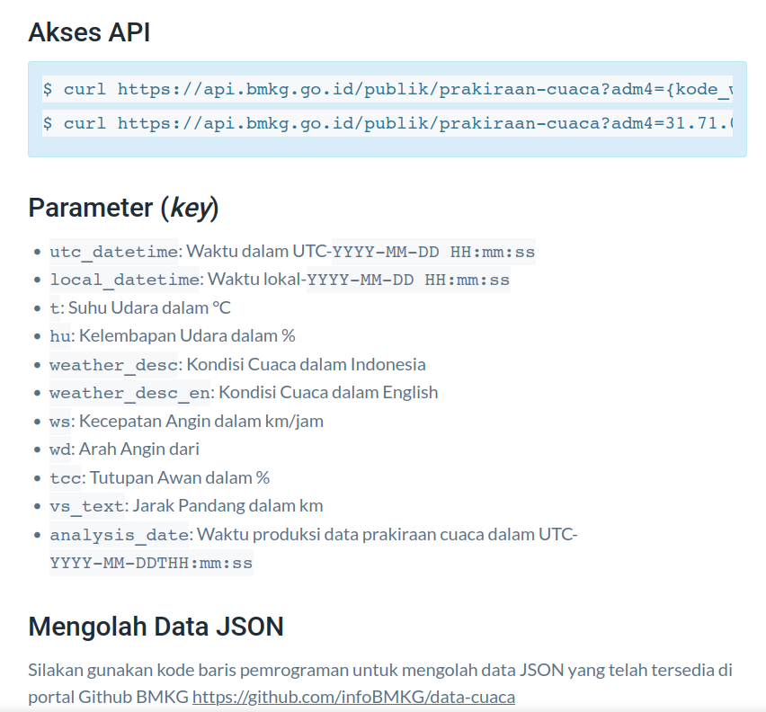
API call (biasanya jadi JSON atau halaman terpaginasi)

Slide 10
Scraping* :
Download dengan terotomasi
Terstruktur
Terencana
Tapi bisa “memberatkan” server kalau keterlaluan

Slide 11
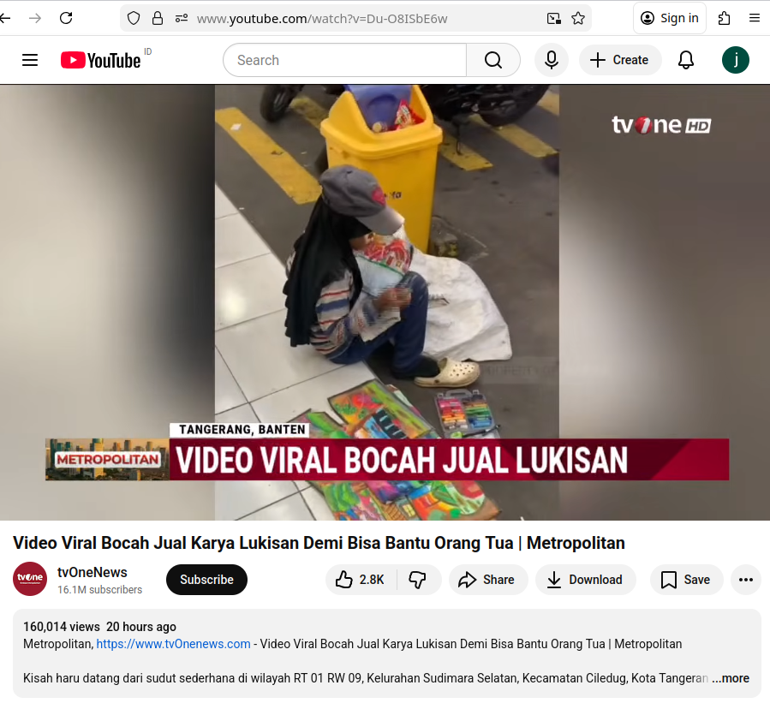

Slide 12
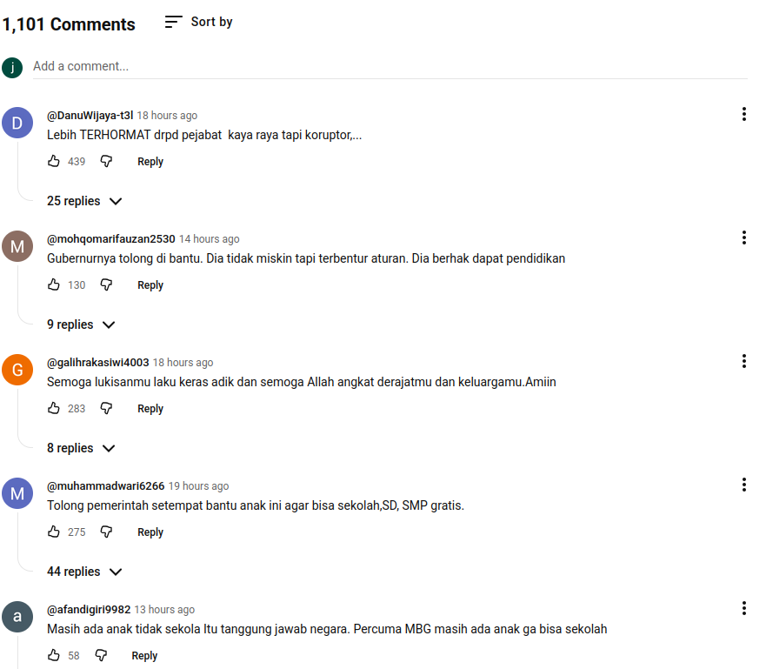

Slide 13
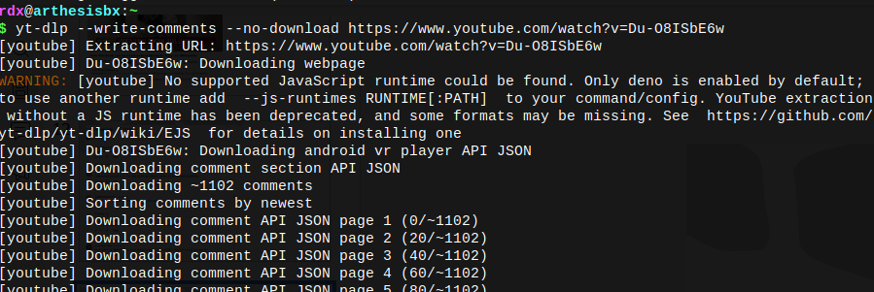
"https://yt3.ggpht.com/ytc/AIdro_nIdVepKJ-Jr3FWQ9WkiiCplmF5mBtADYRg5kNsL3VsMKI=s88-c-k-c0x00ffffff-no-rj", "author_is_uploader": false, "author_is_verified": false, "author_url": "https://www.youtube.com/@toyoto40", "is_favorited": false, "_time_text": "20 hours ago", "timestamp": 1771480800, "is_pinned": false}, {"id": "Ugwk2isPPRVBw3q2mI94AaABAg", "parent": "root", "text": "Ternyata di Tangerang,yang dekat dengan Ibu Kota,ada anak yang tidak bisa melanjutkan sekolah dasar. Tidak disangka.", "like_count": 42, "author_id": "UC8mrgngLy0s3zb8ocUf-82g", "author": "@erpansori7341", "author_thumbnail": "https://yt3.ggpht.com/ytc/AIdro_kg13DucspDHJiYT-11UocjDuZksSTFmCcrpVMvjAfBZg=s88-c-k-c0x00ffffff-no-rj", "author_is_uploader": false, "author_is_verified": false, "author_url": "https://www.youtube.com/@erpansori7341", "is_favorited": false, "_time_text": "20 hours ago", "timestamp": 1771480800, "is_pinned": false}, {"id": "Ugwk2isPPRVBw3q2mI94AaABAg.ATOq1VY8c-zATP0vAdzHA_", "parent": "Ugwk2isPPRVBw3q2mI94AaABAg", "text": "Presiden ny mlh ke luar negeri mlu tuh", "like_count": 3, "author_id": "UCdVp31u5LjESNC5zuT27AaA", "author": "@novandarizki8049", "author_thumbnail":

Slide 14
Ayok diskusi
silahkan tanya

Slide 15
https://github.com/jendralhxr/bigdata

