Slide 1
Big Data: artikel ilmiah
https://github.com/jendralhxr/bigdata

Slide 2


Slide 3
Jurnal?
Artikel?
Paper?
Conference?

Slide 4
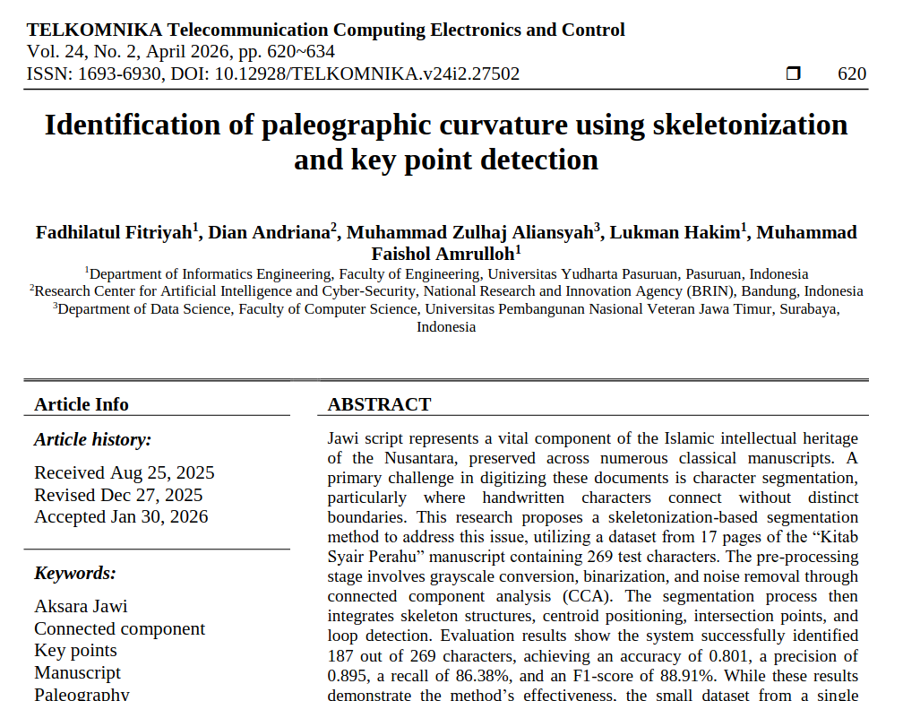
jurnal
judul
article/artikel
paper

Slide 5
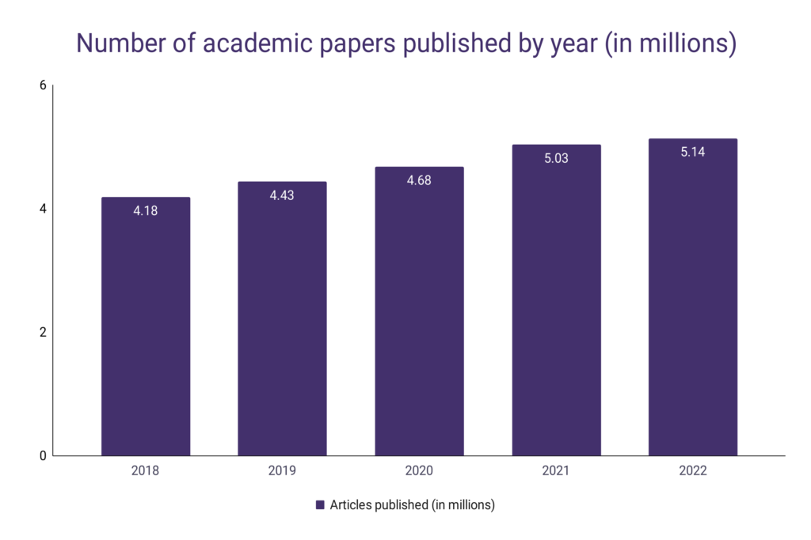
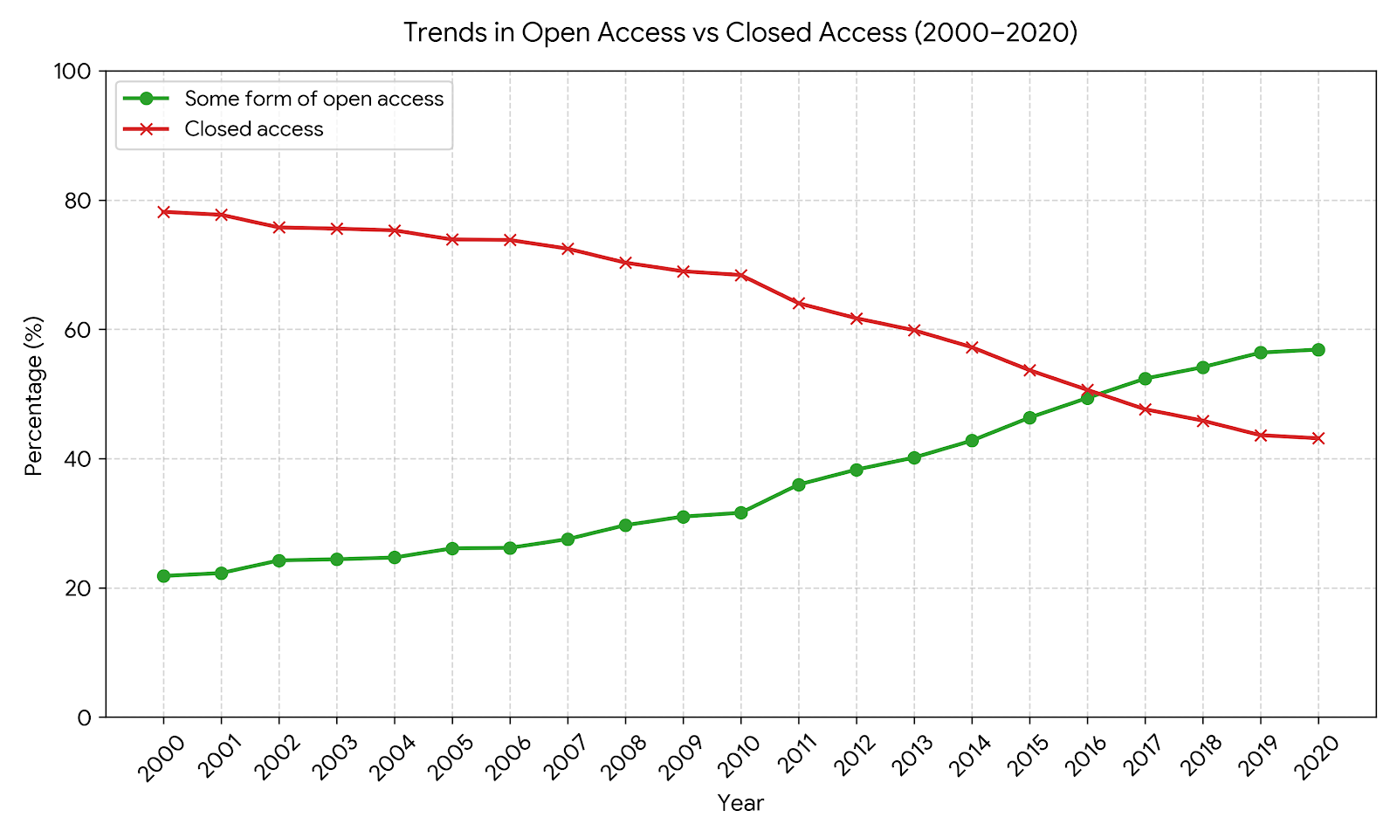
Volume, Velocity
https://wordsrated.com/number-of-academic-papers-published-per-year/
https://wordsrated.com/open-access-publishing-statistics/

Slide 6









Veracity
Banyak pengindeks dan perangking berbeda:
Google Scholar
GARUDA (artikel ilmiah dari Indonesia), SINTA (dosen-administratif), ARJUNA (portal akreditasi jurnal)
BRIN
Scopus (elsevier)
SCI (Clarivate)
Crossref, Zotero, EndNote
CSCD (ChinaScience)
dst

Slide 7
Veracity: Jurnal nakal/predator
Mementingkan keuntungan daripada integritas akademik.
Berbagai kriteria:
Beall (2008-2010an, updated 2024) https://beallslist.net/
Norwegian Scientific Index https://kanalregister.hkdir.no
Memon (medis, 2019) https://pmc.ncbi.nlm.nih.gov/articles/PMC6449603/
Eriksson and Helgesson (medis, 2016) https://pmc.ncbi.nlm.nih.gov/articles/PMC5487745/

Slide 8
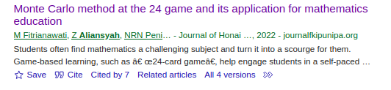
Variety
@article{fitrianawati2022monte, title={Monte Carlo method at the 24 game and its application for mathematics education}, author={Fitrianawati, Meita and Aliansyah, Zulhaj and Peni, Nur Robiah Nofikusumawati and Farid, Imam Wahyudi and Hakim, Lukman and others}, journal={Journal of Honai Math}, volume={5}, number={2}, pages={83--94}, year={2022} }
{"status":"ok","message-type":"work","message-version":"1.0.0","message":{"indexed":{"date-parts":[[2024,3,14]],"date-time":"2024-03-14T02:52:24Z","timestamp":1710384744118},"reference-count":0,"publisher":"Universitas Papua","issue":"2","license":[{"start":{"date-parts":[[2022,3,26]],"date-time":"2022-03-26T00:00:00Z","timestamp":1648252800000},"content-version":"unspecified","delay-in-days":0,"URL":"https:\/\/creativecommons.org\/licenses\/by-nc-sa\/4.0"}],"content-domain":{"domain":[],"crossmark-restriction":false},"short-container-title":["J. Honai Math"],"abstract":"<jats:p>Students often find mathematics a challenging subject and turn it into a scourge for them. Game-based learning, such as \u201c24-card game\u201d, help engage students in a self-paced and fun learning process and thus may overcome students\u2019 math anxiety and promote mental math skills. This research aims to examine how the 24-card game works using the Monte Carlo method and the possibility to overcome students' mathematics anxiety. The meta-analysis method was used to explain Monte Carlo\u2019s simulation to solve the solution for all possible combinations of cards in the game and respectively assign difficulty levels. The student's proficiency level was evaluated based on the divergence value in the number of guesses required to solve the dealt combination at 87% to show full proficiency. The evaluation could also show the math difficulty of advanced operations, such as fractions and grouping games. This game is more efficient in developing students' mental math skills compared to a conventional and rigidly structured classroom lecture.<\/jats:p>","DOI":"10.30862\/jhm.v5i2.250","type":"journal-article","created":{"date-parts":[[2022,8,14]],"date-time":"2022-08-14T03:10:12Z","timestamp":1660446612000},"page":"83-94","source":"Crossref","is-referenced-by-count":1,"title":["Monte Carlo method at the 24 game and its application for mathematics education"],"prefix":"10.30862","volume":"5","author":[{"given":"Meita","family":"Fitrianawati","sequence":"first","affiliation":[]},{"given":"Zulhaj","family":"Aliansyah","sequence":"additional","affiliation":[]},{"given":"Nur Robiah Nofikusumawati","family":"Peni","sequence":"additional","affiliation":[]},{"given":"Imam Wahyudi","family":"Farid","sequence":"additional","affiliation":[]},{"given":"Lukman","family":"Hakim","sequence":"additional","affiliation":[]}],"member":"12309","published-online":{"date-parts":[[2022,3,26]]},"container-title":["Journal of Honai Math"],"original-title":[],"link":[{"URL":"https:\/\/journalfkipunipa.org\/index.php\/jhm\/article\/viewFile\/250\/142","content-type":"application\/pdf","content-version":"vor","intended-application":"text-mining"},{"URL":"https:\/\/journalfkipunipa.org\/index.php\/jhm\/article\/viewFile\/250\/142","content-type":"unspecified","content-version":"vor","intended-application":"similarity-checking"}],"deposited":{"date-parts":[[2022,8,14]],"date-time":"2022-08-14T03:10:13Z","timestamp":1660446613000},"score":1,"resource":{"primary":{"URL":"https:\/\/journalfkipunipa.org\/index.php\/jhm\/article\/view\/250"}},"subtitle":[],"short-title":[],"issued":{"date-parts":[[2022,3,26]]},"references-count":0,"journal-issue":{"issue":"2","published-online":{"date-parts":[[2022,3,26]]}},"URL":"https:\/\/doi.org\/10.30862\/jhm.v5i2.250","relation":{},"ISSN":["2615-2193","2615-2185"],"issn-type":[{"value":"2615-2193","type":"electronic"},{"value":"2615-2185","type":"print"}],"subject":[],"published":{"date-parts":[[2022,3,26]]}}}
https://api.crossref.org/works/10.30862/jhm.v5i2.250

Slide 9
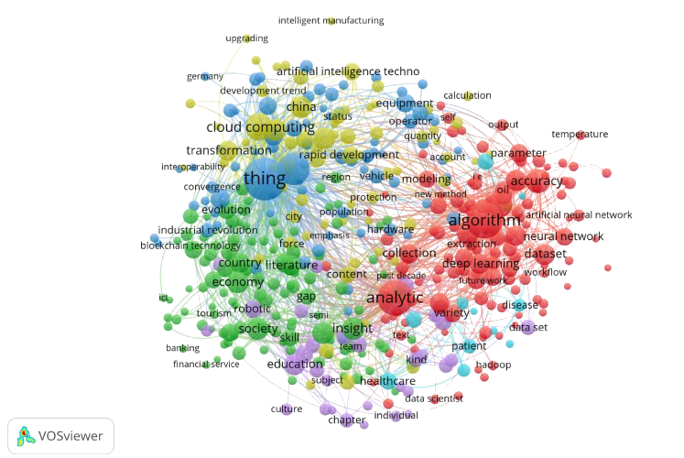
Visualization
https://eprints.unmer.ac.id/id/eprint/3906/1/Lampiran%20IIC.C9%20Scientometric_Analysis_in_the_Field_of_Big_Data_and_Artificial_Intelligence_in_Industry.pdf

Slide 10
Value
Nulis skripsi
Cari teman/perbandingan/rujukan untuk evaluasi dan pengembangan
semestinya bukan untuk sombong
semestinya bukan kendala administratif
semestinya bukan publish or perish

Slide 11
(even deeper) Value
novelty: kebaruan ide, metode, data, atau temuan hasil analisis/diskusi
teori: metode/framework yang sudah ada 'dimainkan' lagi supaya lebih 'sakti'
sintesis : kombinasi beberapa metode untuk menjawab kompleksitas masalah, mencari 'hubungan' antar domain/dispilin
kontektualisasi : menerapkan teori/metode eksisting untuk domain masalah baru (yang dirasa penting), barangkali juga dampaknya di konteks masalah asli di lapangan
kritik: interpretasi atau evaluasi ulang dari hasil sebelumnya (yang dirasa kurang 'clep')

