Slide 1
Big Data: [otak kita butuh] Tidur
https://github.com/jendralhxr/bigdata

Slide 2
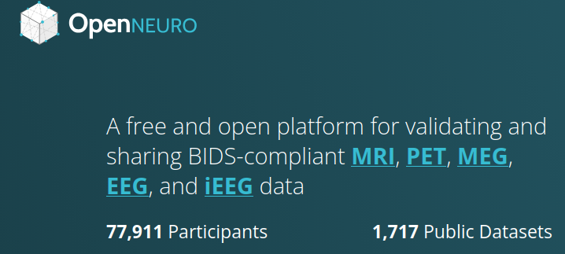
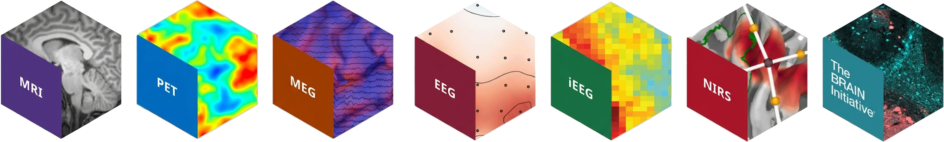
https://openneuro.org

Slide 3
Instumentasi akuisisi sekitaran kepala
MRI (magnetic resonance imaging)
PET (positron emission tomography)
MEG (magnetoencephalography)
EEG (electroencephalography)
iEEG (intracranial electroencephalography)
NIRS (near infrared spectroscopy)

Slide 4
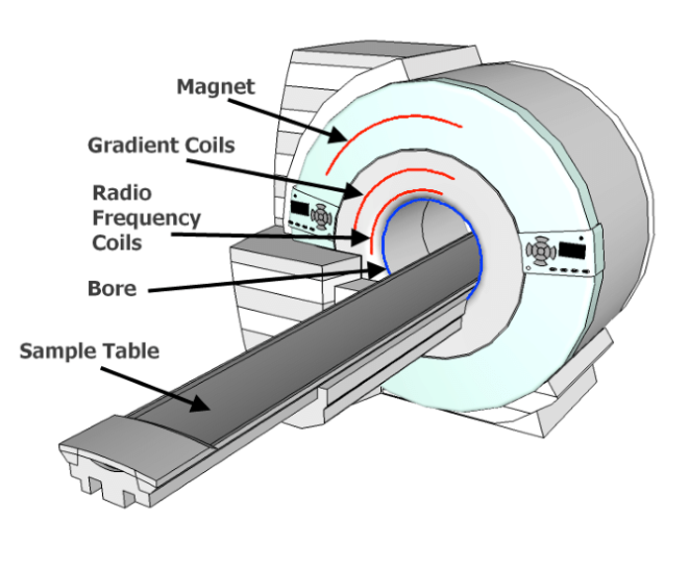
MRI
Menembakkan medan magnet BUUUESAR
Mengukur scan propagasi radial medan magnet, konsentrasi air (atau agen kontras)
oven microwave

Slide 5
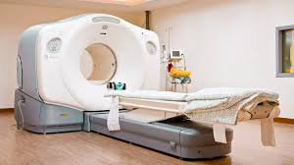
PET/CT scan
Menangkap citra dari gelombang gamma (PET) atau Rontgen/X-ray (CT)
Bisa diperkuat dengan kontras agen radioaktif (memancarkan positron)

Slide 6
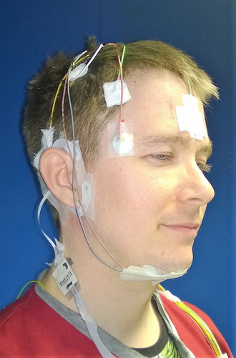
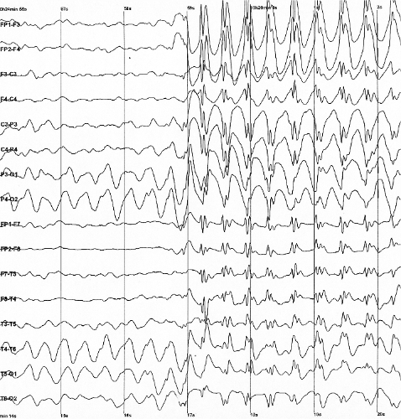
EEG (elektroda tegangan <~100 μV)
Intracranial?
https://onlinelibrary.wiley.com/doi/10.1111/jsr.12786

Slide 7
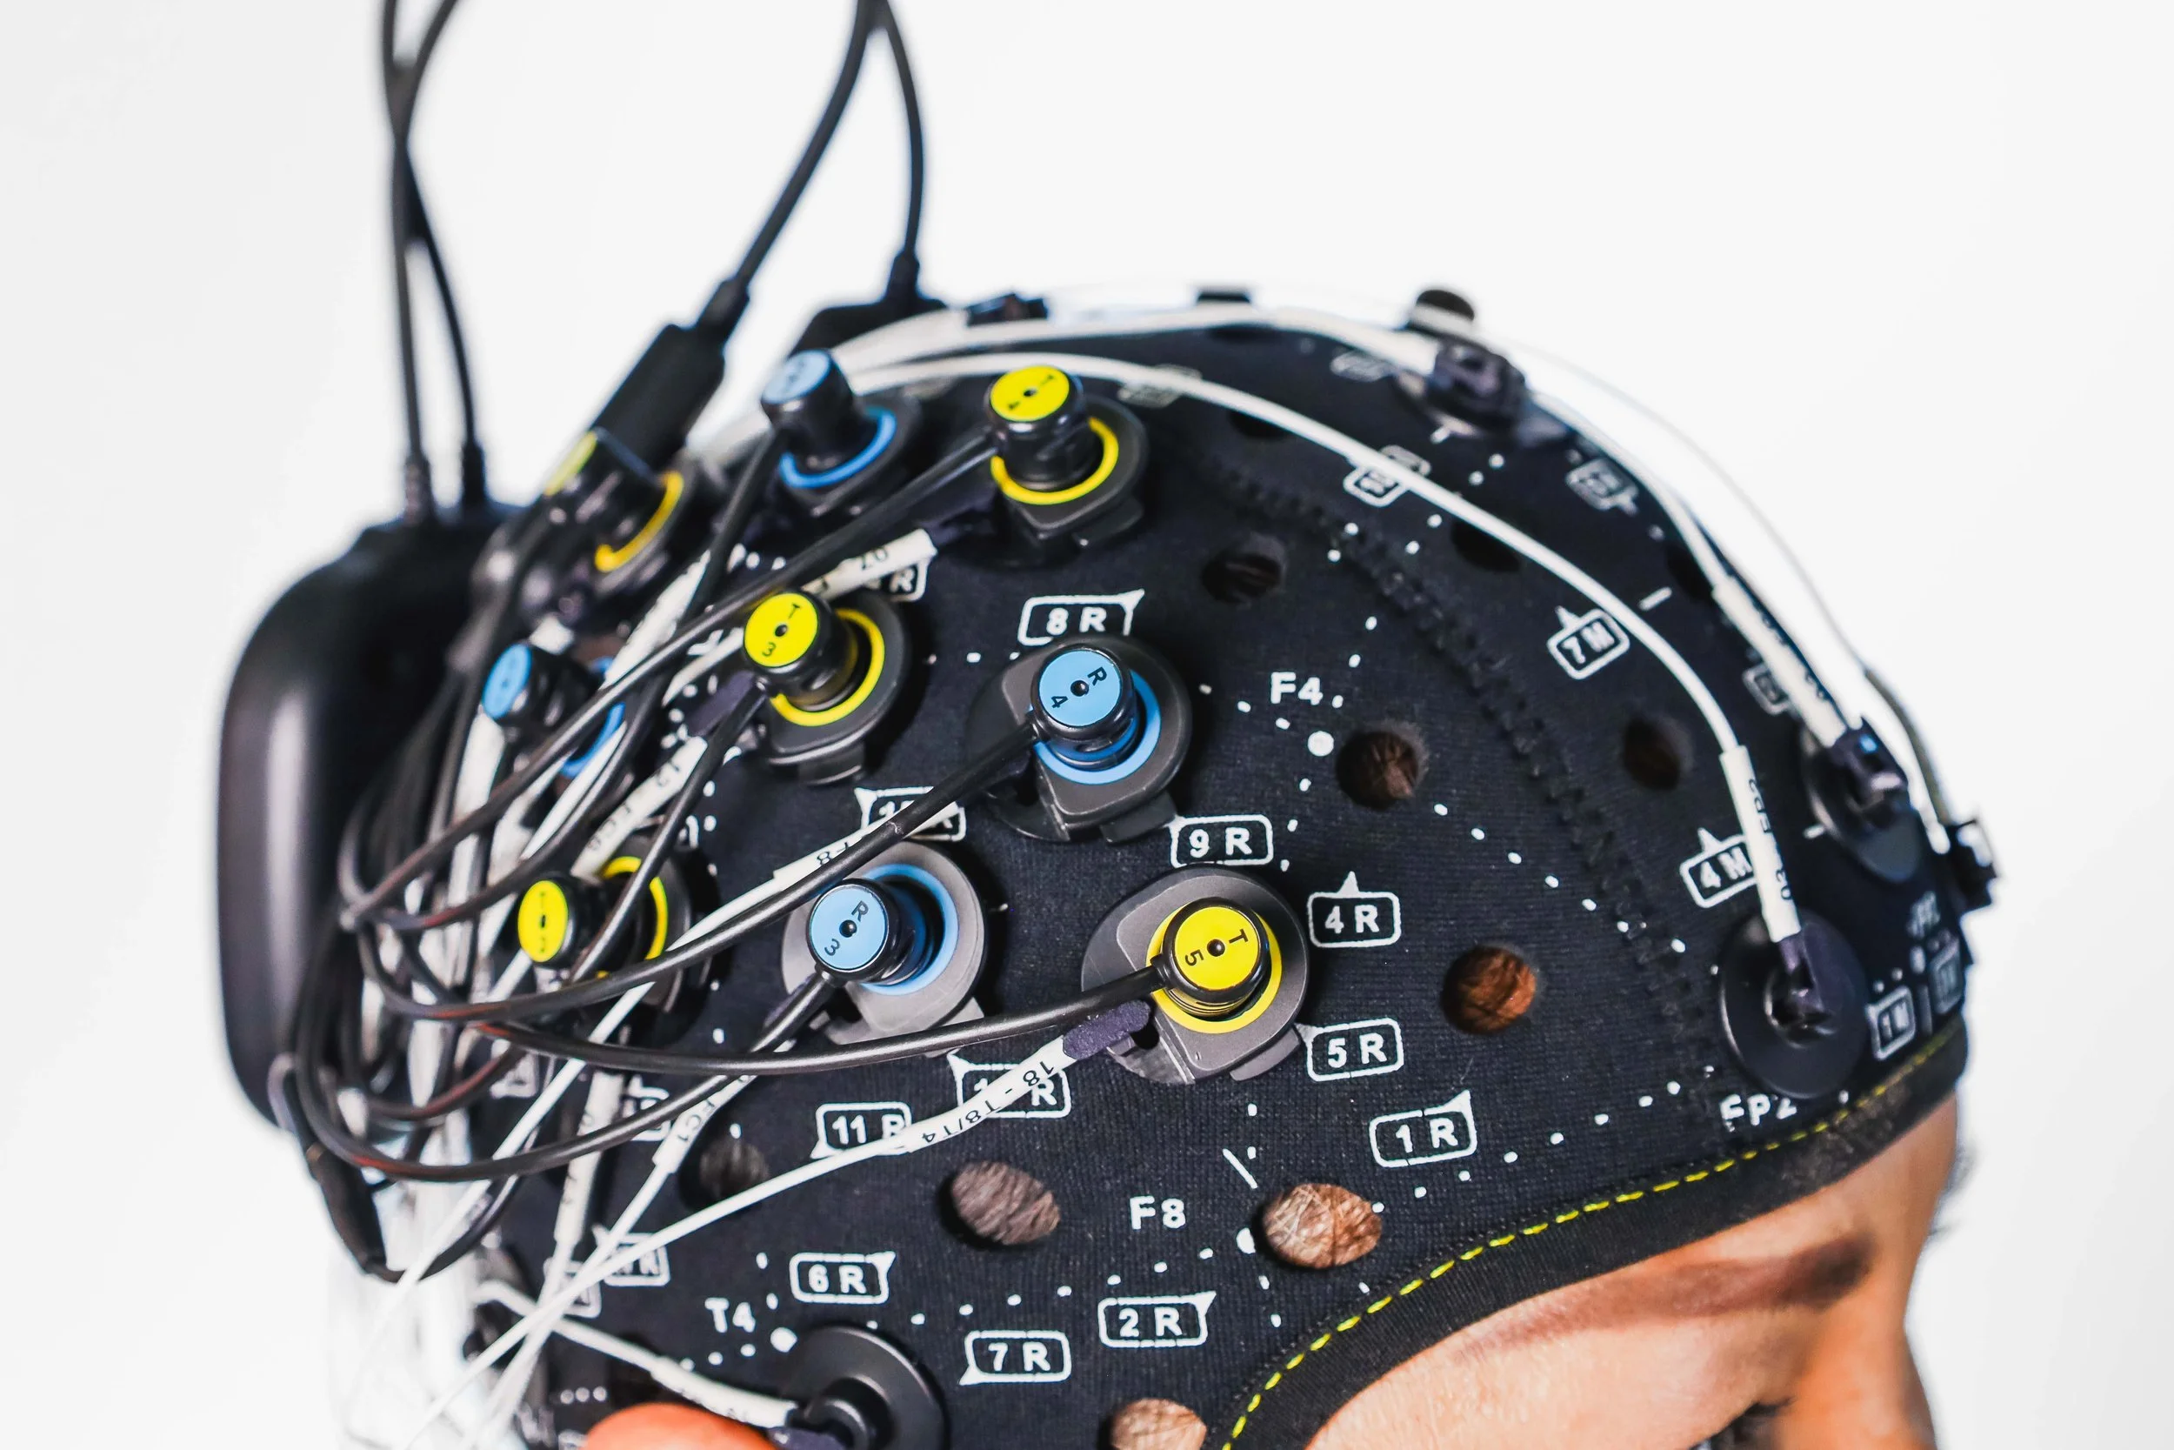
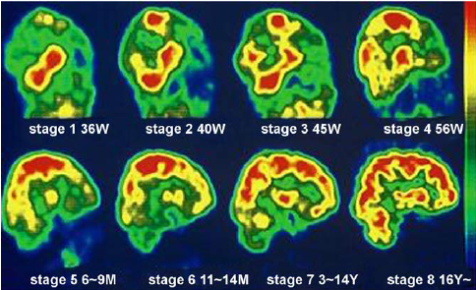
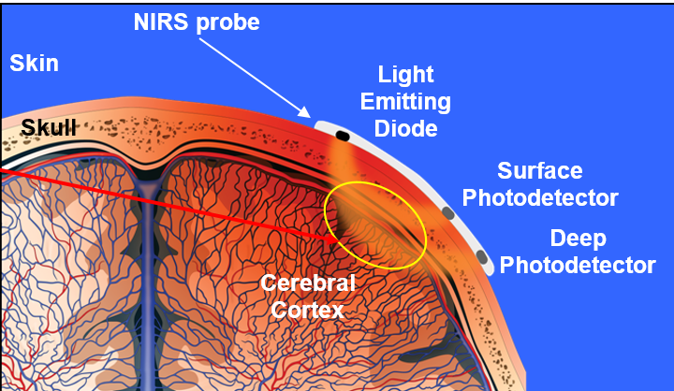
NIRS (near-infrared, aliran darah)
10.1016/j.ics.2004.05.052
https://www.artinis.com/nirs-eeg-package
near-infrared-spectroscopy-guideline-1072

Slide 8
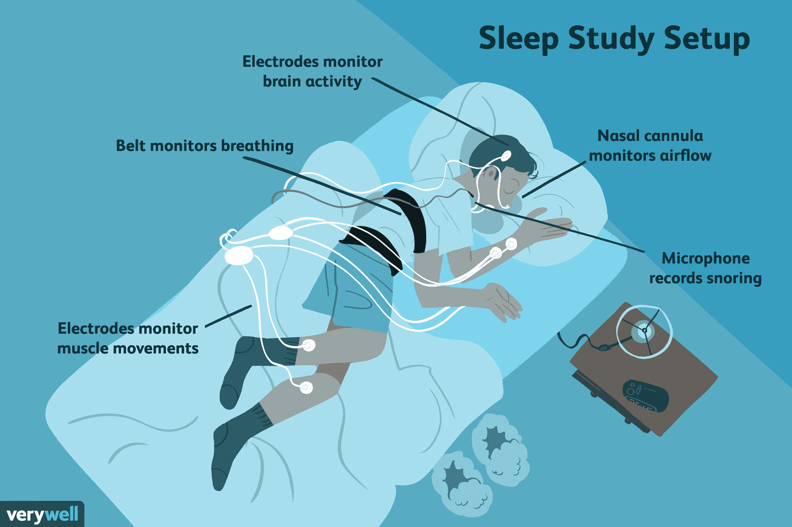
https://openneuro.org/datasets/ds005207/versions/1.0.0 https://github.com/OpenNeuroDatasets/ds005207
Some recordings are full polysomnography measurements, others are cEEGrid measurements. Most subjects have both PSG and ceegrid recordings from the same night, though a few are missing one or the other.

Slide 9
Volume, Velocity
20 responden, 29 ‘sesi’ tidur\
Tiap orang tiap malam tidur

Slide 10
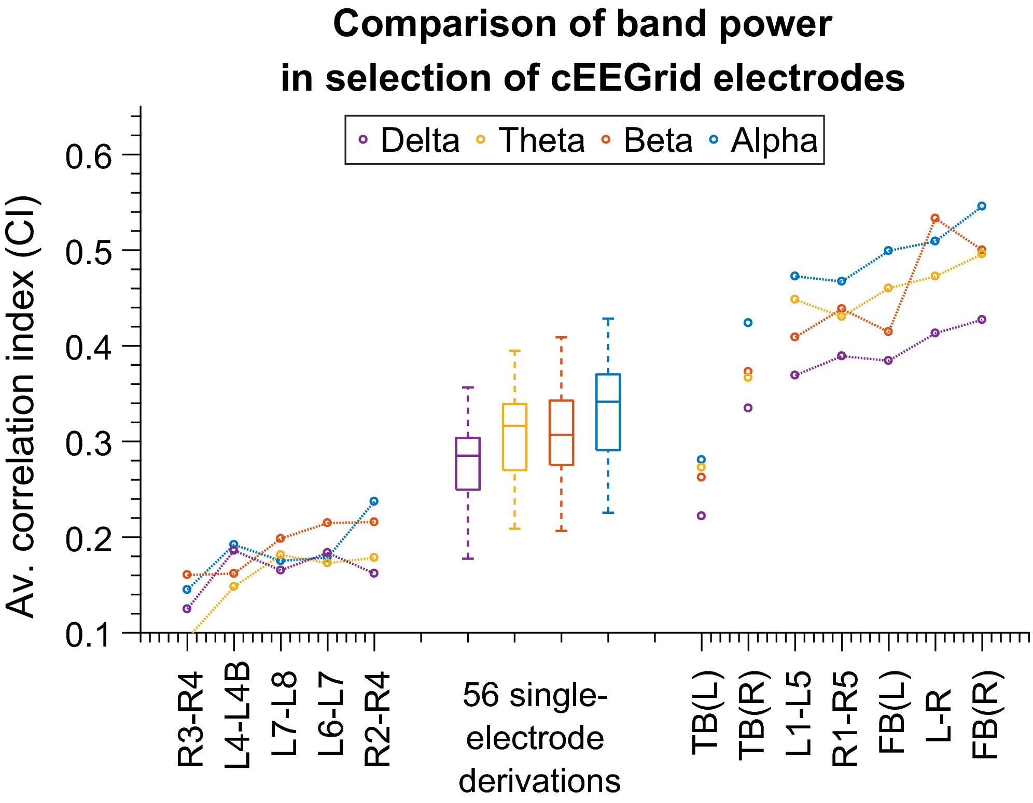
Variety, Veracity https://onlinelibrary.wiley.com/doi/10.1111/jsr.12786
256 Hz sample
Band alpha (8–16 Hz), beta (16–32 Hz), theta (4–8 Hz) and delta (1–4 Hz)
Feature Short description
F1 Signal skewness EEG time domain
F2 Signal kurtosis
F3 Zero crossing rate
...
F27 Peak power frequency
F28 Spectral entropy
F29 Spindle probability Sleep event proxies
F30 Frequency stationarity
F31 Lowest adj. frequency similarity
F32 Largest CWT value
F33 Longest sleep spindle

Slide 11
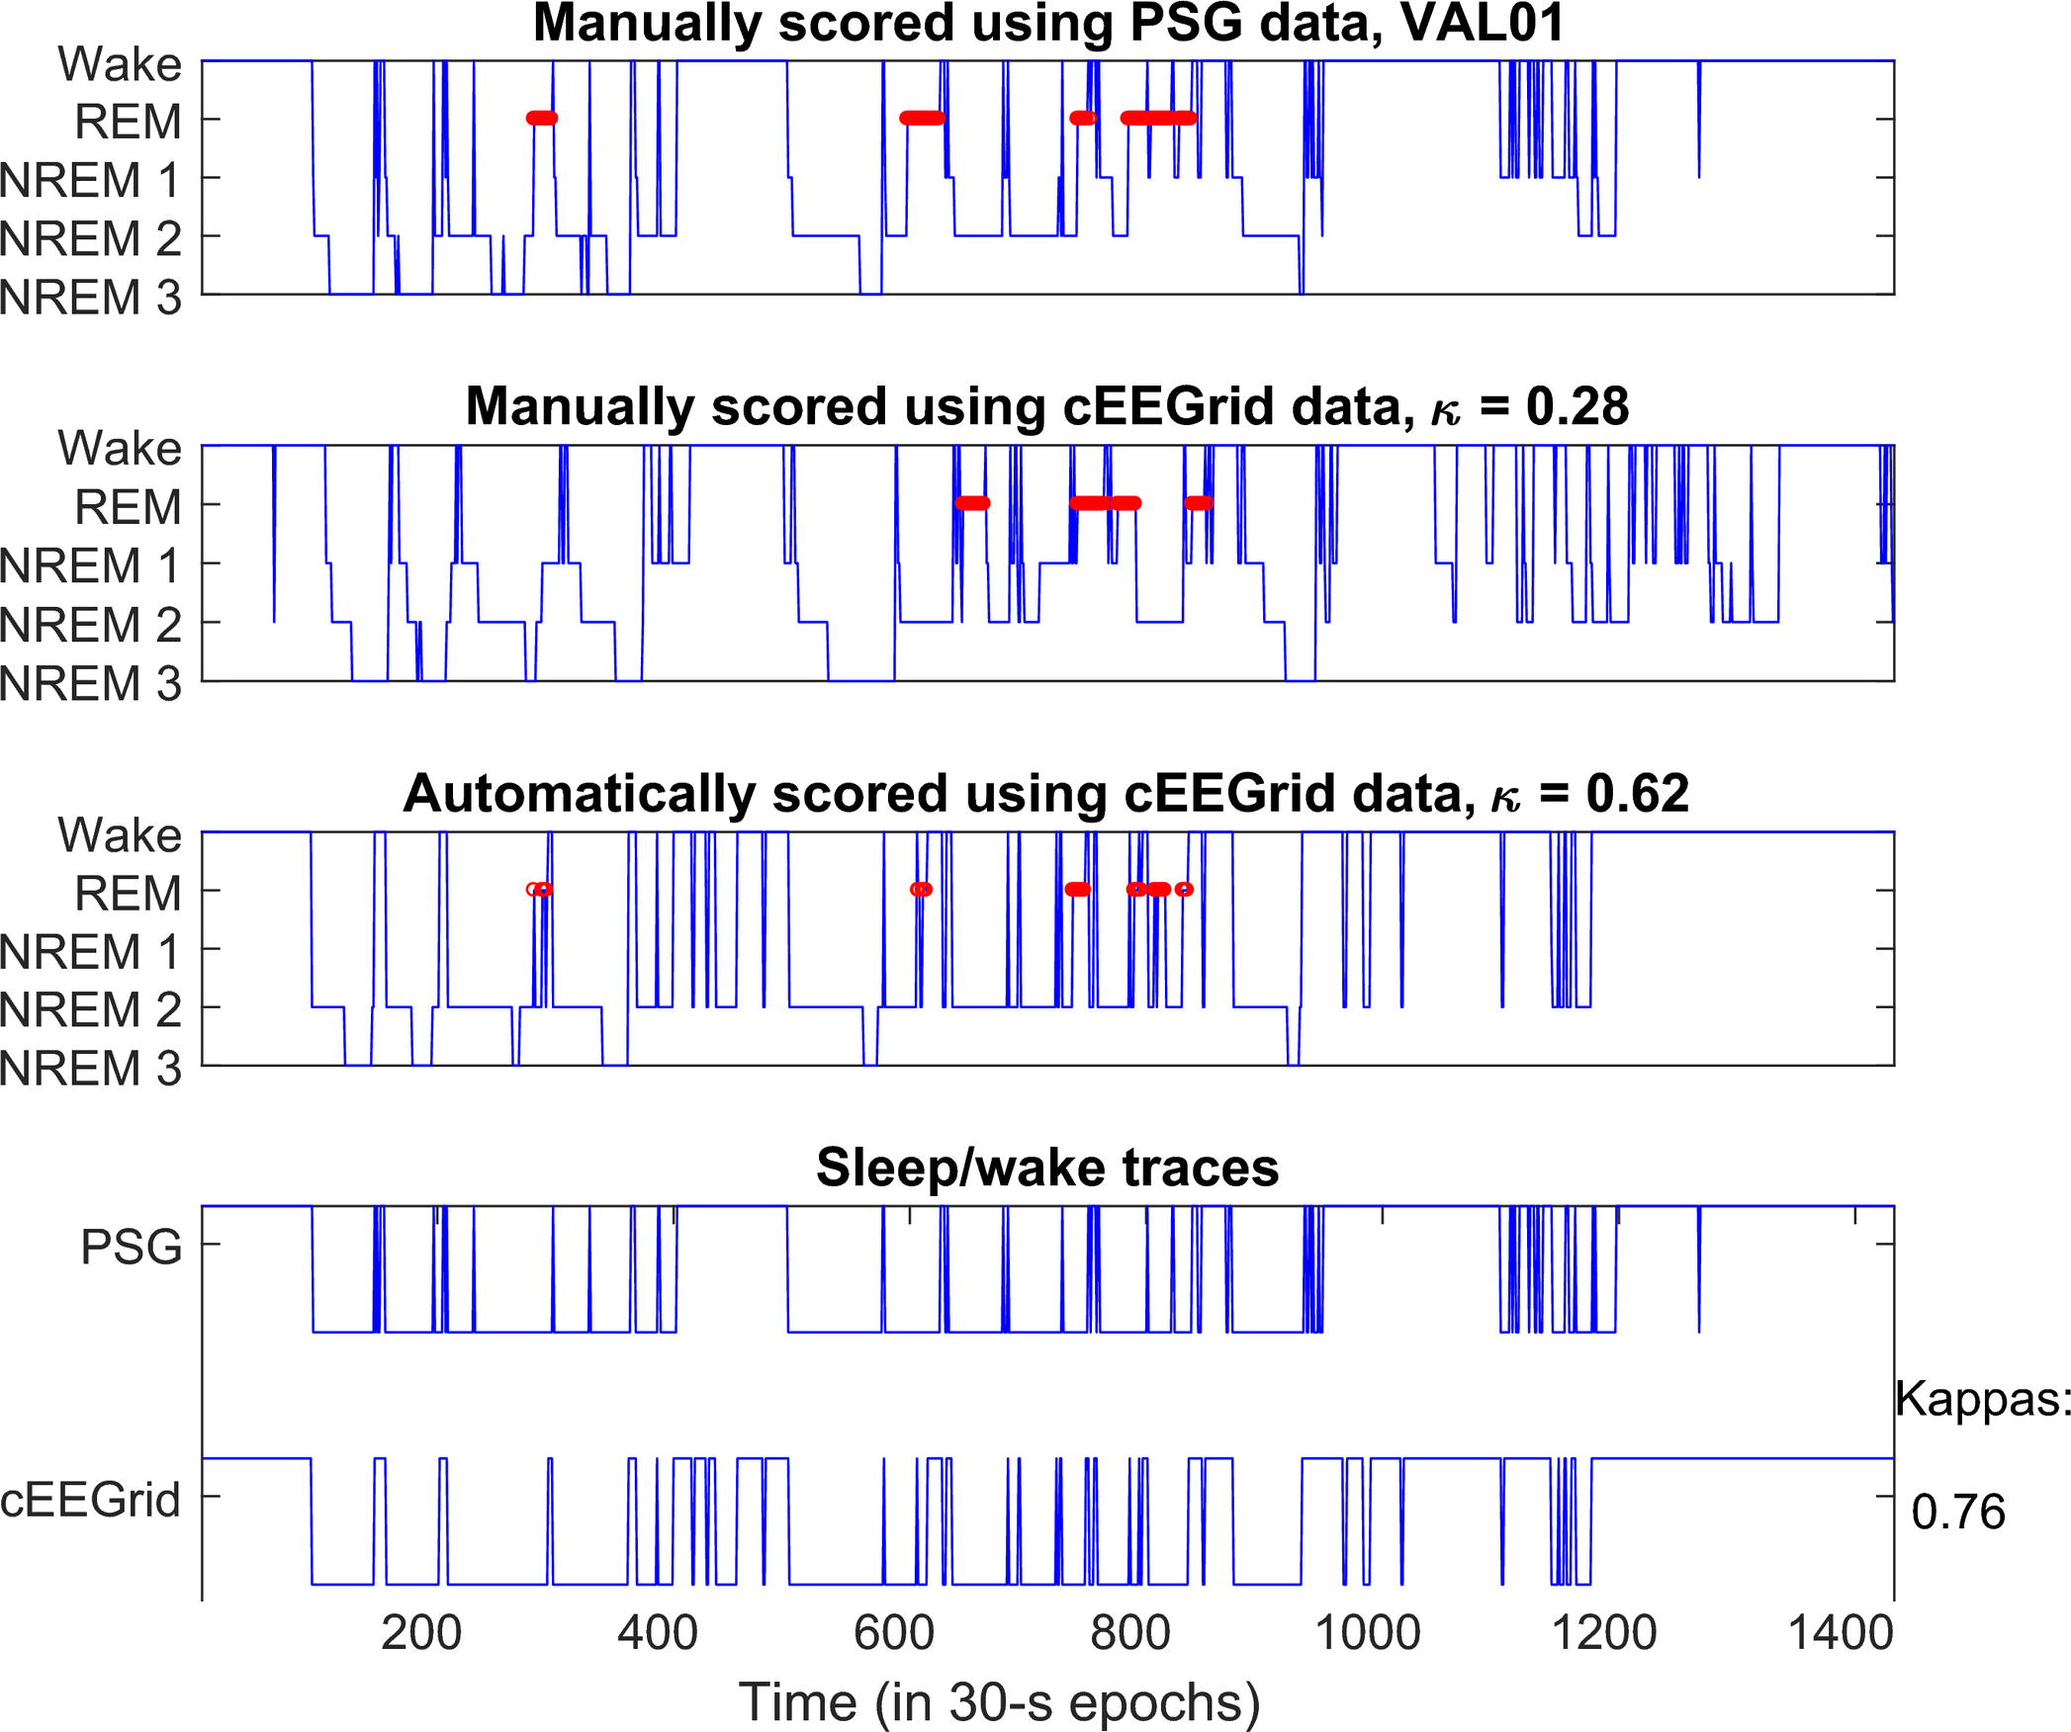
Value: tidur nyenyak berapa lama?

Slide 12
More EEGs (biasanya dikaitkan dengan suatu aktivitas)
https://nemar.org/
https://bdsp.io/content/hsp/2.0/ Human Sleep Project
https://sccn.ucsd.edu/~arno/fam2data/publicly_available_EEG_data.html
https://www.kaggle.com/datasets/quands/eeg-dataset
https://archive.ics.uci.edu/dataset/264/eeg+eye+state

