Slide 1
Morphological Operations
IF221126 Digital Image Processing
Zulhaj Aliansyah
2025-12-03

Slide 2
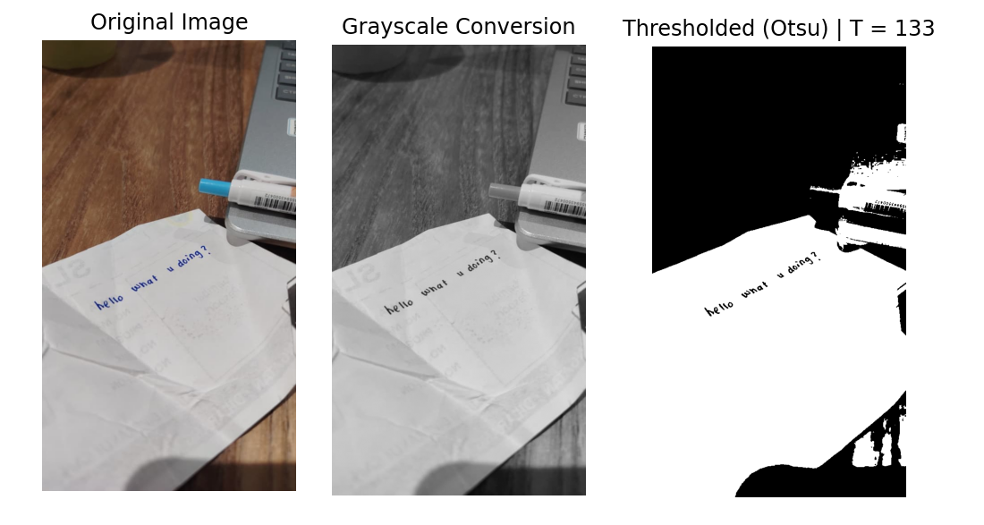
Recap: acquired information
works well

Slide 3
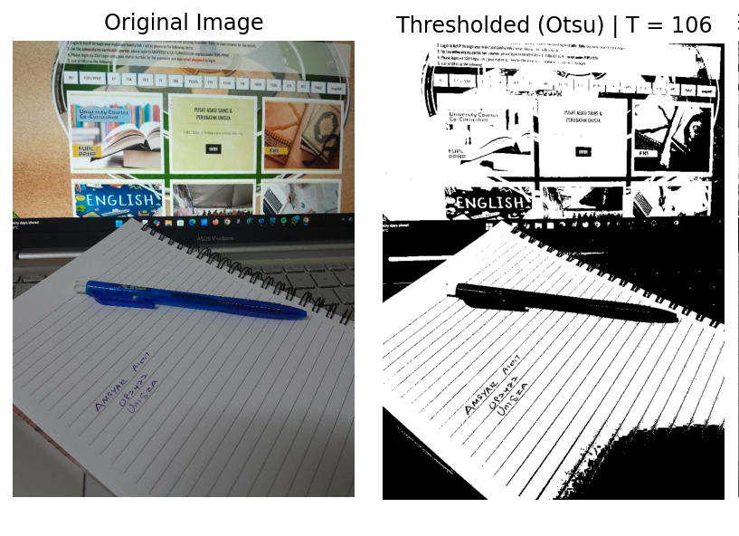
Recap: the lines
unwanted feature (the lines) is extracted along the intended information (handwriting)

Slide 4

Attendance List
Attendance List "Digital Image Processing" 2025-12-10
Link: https://forms.gle/88JrpTiLDJZxtg9e7
I am sorry for the asynchronous setting of the class

Slide 5
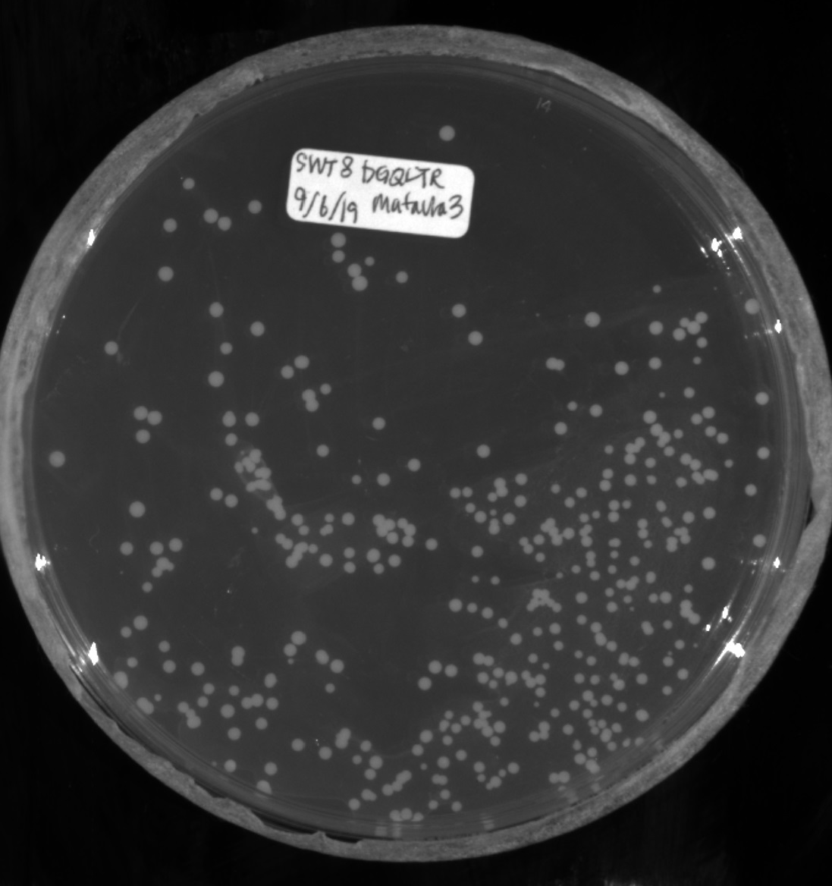
Use case: count many cells?
Bacteria Colony Counting Based on Machine Learning Algorithms
Jihyun Park, Edward Bateh, Jackson Harmon, Yang Zhang, Weiyao Tang
https://tang111111.github.io/ColonyCountingML/images/generated_images.jpg
machine learning can be too fancy at times

Slide 6
Considerations
Observations:
The [bacterial] cell colonies are round, white
Slight brighter whitish background around the colonies (allelopathic network)
Sizes can be a bit varying (slightly smaller/bigger)
any else?
Concerns:
The bacteria can be densely populated at times, possible overlapping? touching?
We won’t need the area of the petri dish, but quite as white at the cells

Slide 7
Assignment
Take a photo of densely packed small objects (coins, beans, grains, rice) using your phone with ample/good lighting (daylight is good, just be careful about the shadows and overexposure brightness).
Pre-process the image: convert to grayscale, apply suitable thresholding.
Segment the objects using morphological operations (erosion/dilation) or watershed to separate touching items.
Count objects via connected-component labeling or contour detection.
Report your results:

