Slide 1
Geometric Transformation (2)
IF221126 Digital Image Processing
Zulhaj Aliansyah
2025-11-19

Slide 2

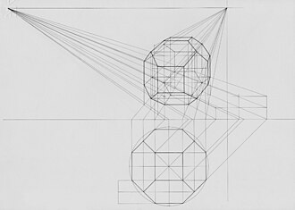
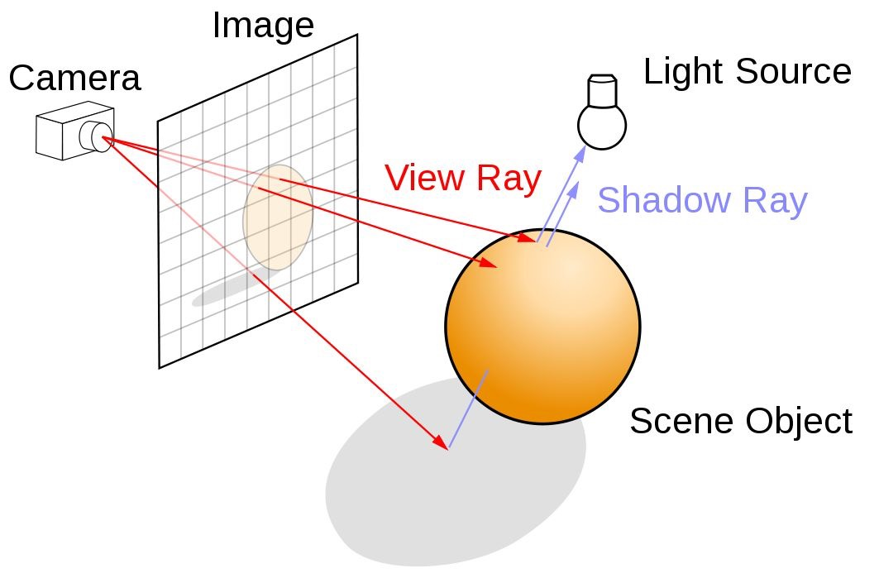
Ray Tracing?
https://developer.nvidia.com/discover/ray-tracing
https://commons.wikimedia.org/wiki/File:Distance_point.jpg

Slide 3
Distortion/warp
Image can warp or distort
any geometric transformation(s) that change the spatial arrangement of pixels which alters an object’s shape rather than just its position or orientation
due to local processing of an pixel group(s); local processing kernel
When to do?
Image correction, i.e. applying the same distortion in reverse to estimate the [so-called] ideal image

Slide 4

Attendance List
Attendance List
"Digital Image Processing" 19-11-2025
https://forms.gle/RyNyPdYFJ71pKr8NA

Slide 5

Perspective transformation
Simulates viewing an image from a different focal plane (angle, depth/distance)
parallel lines to appear to converge and objects to change size with distance
also varies due to optics

Slide 6



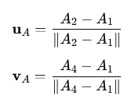

Perspective distortion
Homography matrix
u for width
v for height
A is the focal plane (input)
B is the image plane (output)

Slide 7
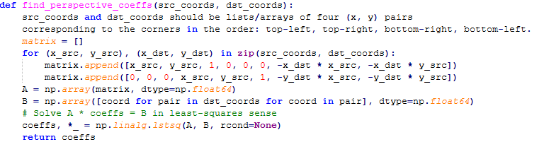
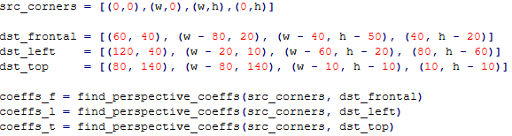
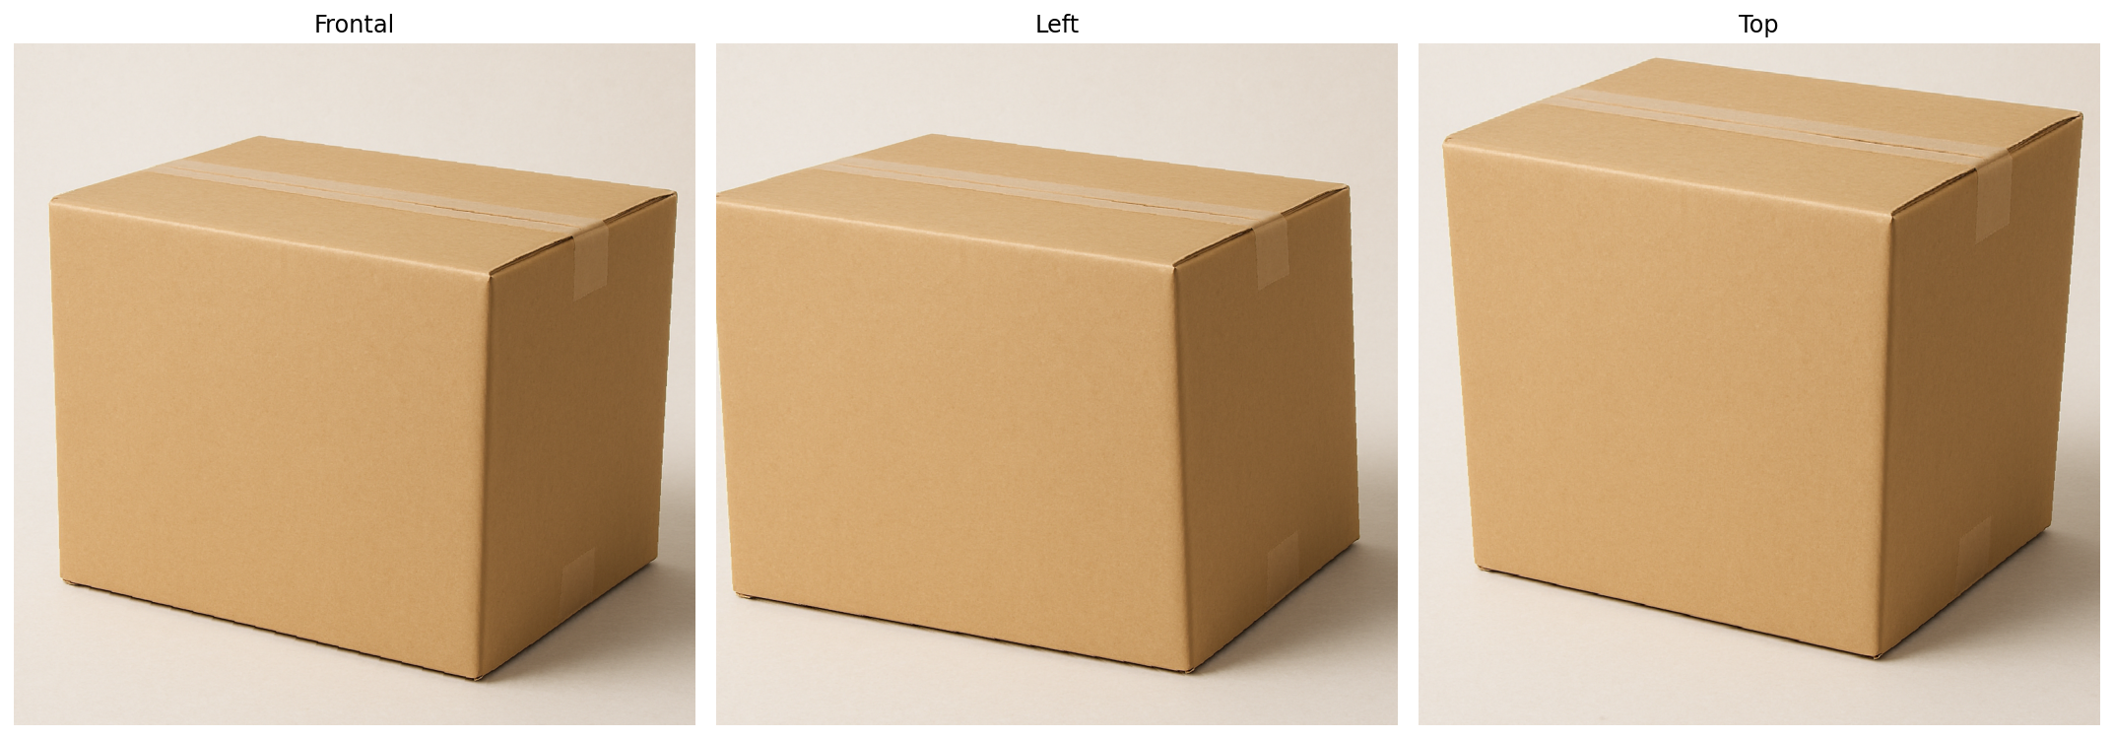

Slide 8
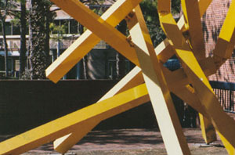
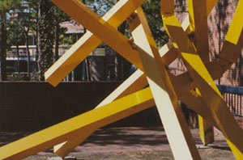
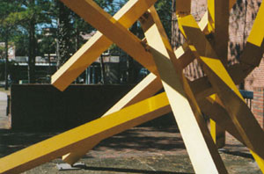
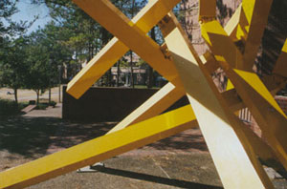
Perspective transformation
Optics may also play part to induce uneven magnification within the image plane
100 mm
70 mm
50 mm
28 mm

Slide 9


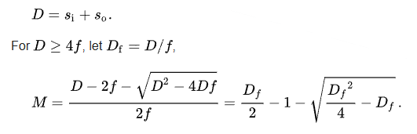
Perspective distortion
Thin lens equation
Magnification
Distance between object (focal) plane and image plane
Macro image

Slide 10


Perspective distortion
denominator of the homography matrix
local magnification factor

Slide 11
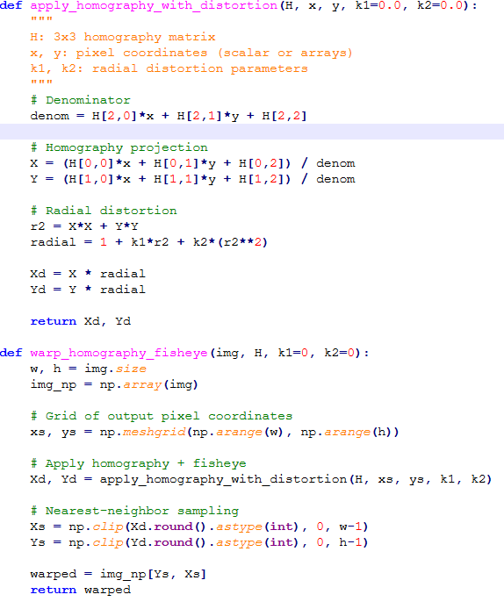
Perspective distortion (analytical)

Slide 12
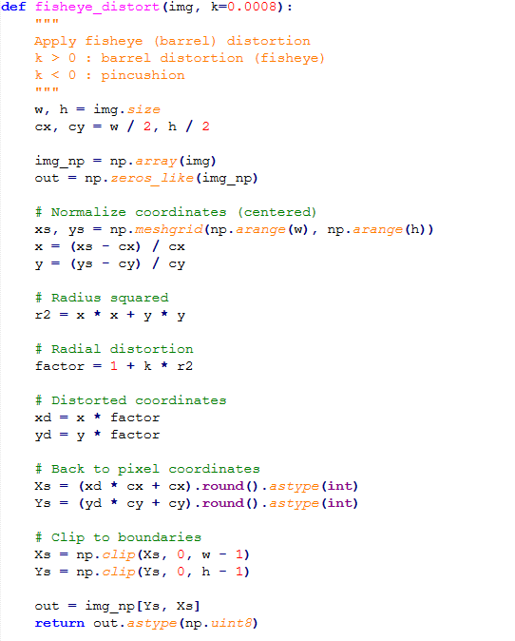
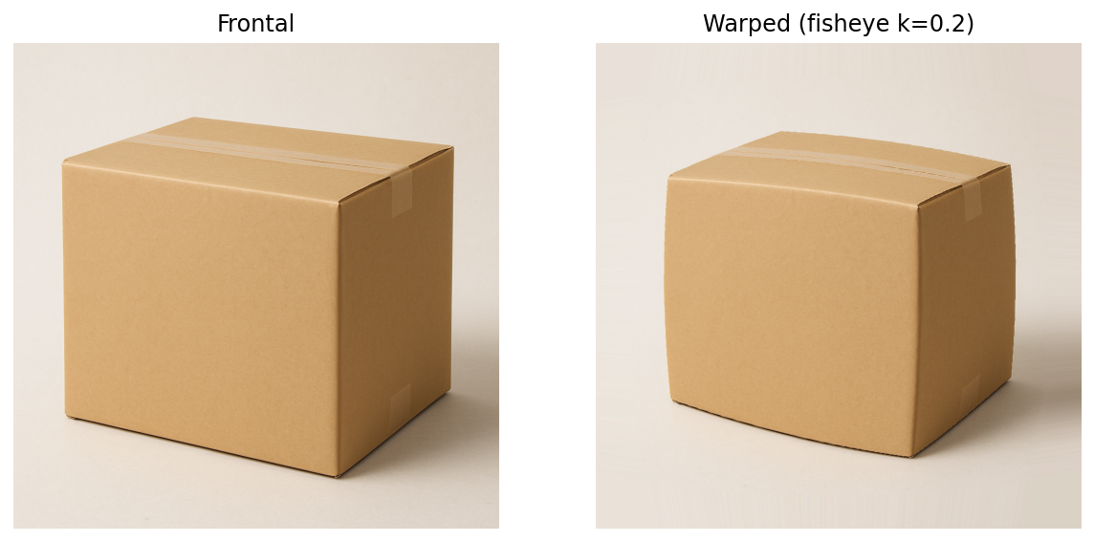
Perspective distortion (discrete)

