Slide 1
Geometric Transformation (1)
IF221126 Digital Image Processing
Zulhaj Aliansyah

Slide 2
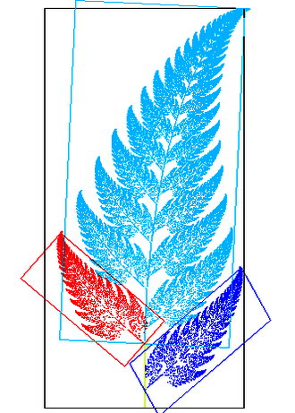
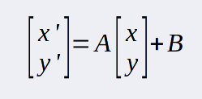
Affine Transformation
Geometrically change image/object without altering its general shape identity
Straight lines stay intact (not distorted/bent)
Parallel lines stay parallel
Distances/position and angles/orientation may change
Can be done globally or locally/selectively using mask
m = An + B
m is the resulting position
n is the position from the original image
A is linear transformation vector
B is translation vector

Slide 3

Attendance List
Attendance List Digital Image Processing
12-11-2025: https://forms.gle/egZaZVKvcCFa76Pt7

Slide 4
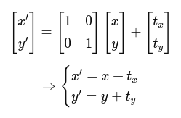
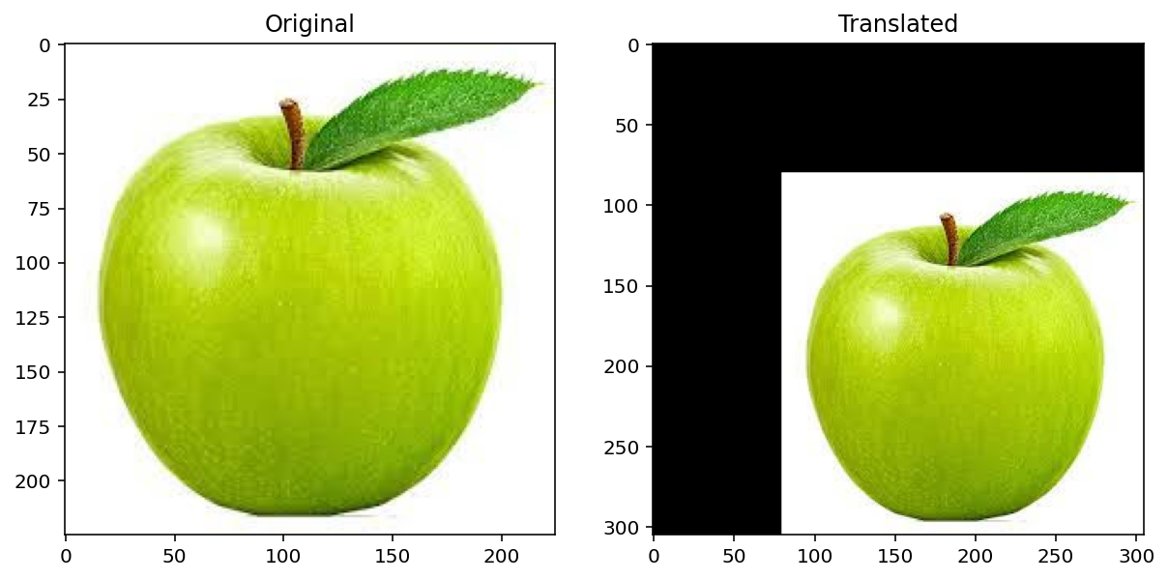
Translation
Shift the pixels either horizontally or vertically

Slide 5
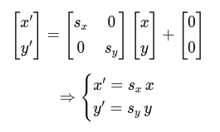
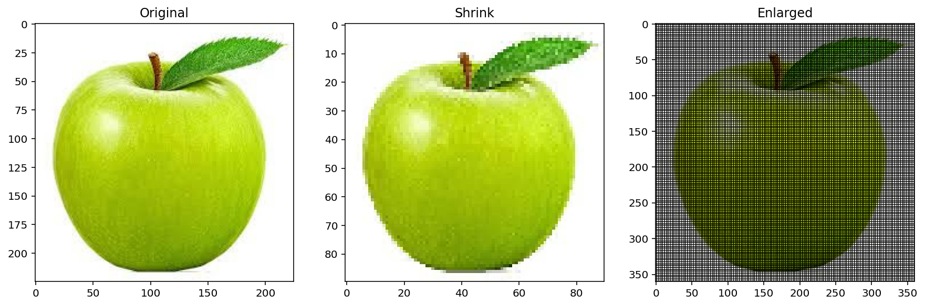
Scaling
Enlarge/shrink the image
Void in-between pixels intervals can [later] be filled-in using various interpolation methods

Slide 6
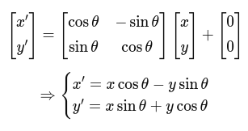
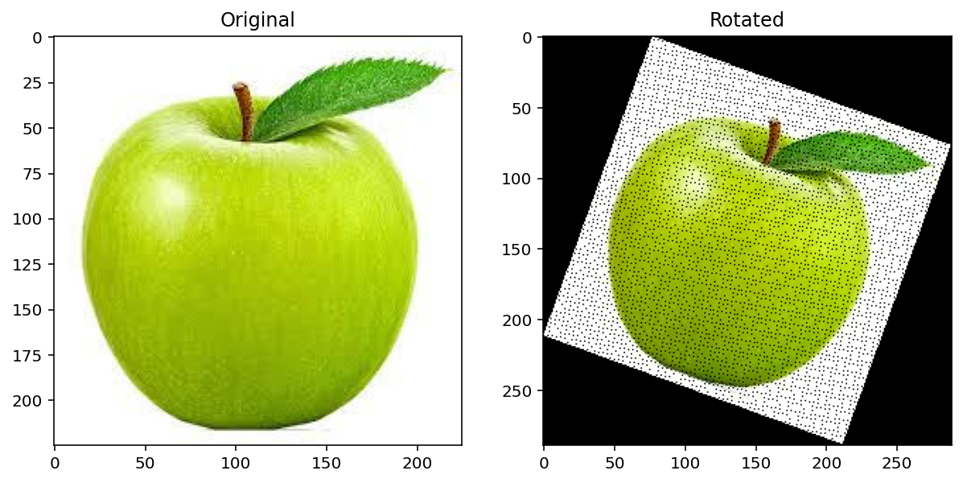
Rotation
Trigonometric shift

Slide 7
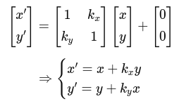
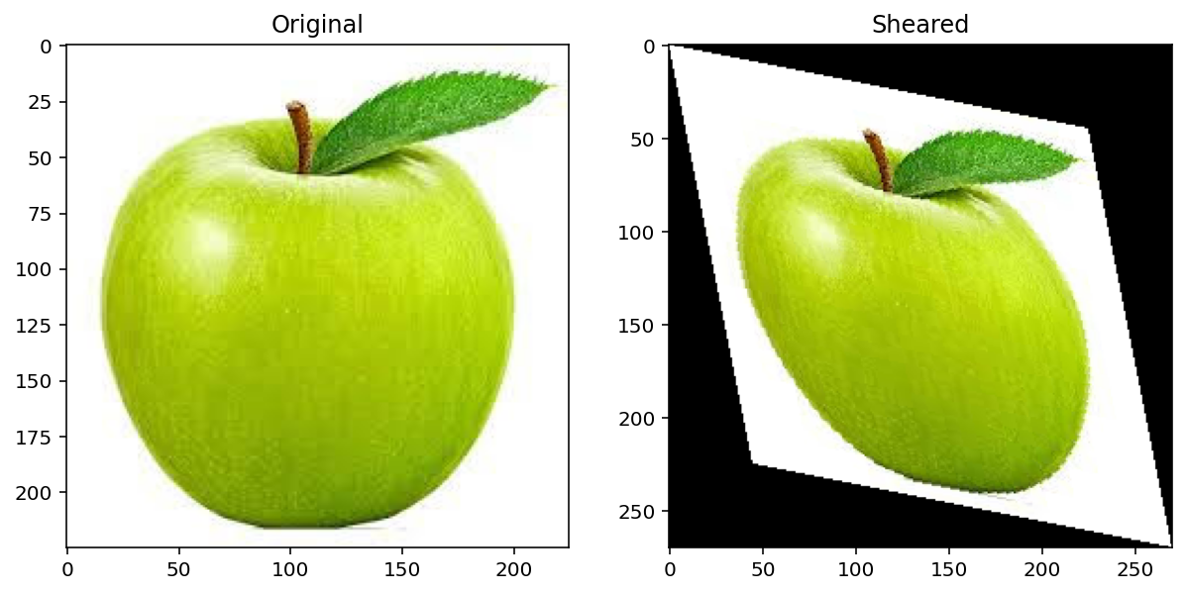
Shear/slant
Compensated scale

Slide 8

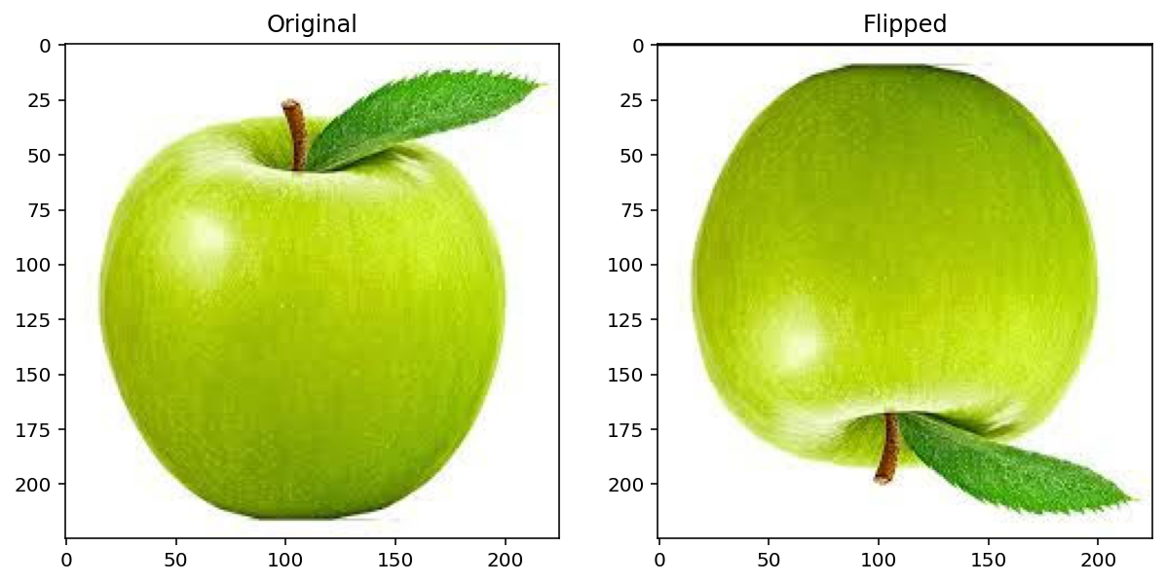
Reflection
Swapping sign on the identity matrix

Slide 9
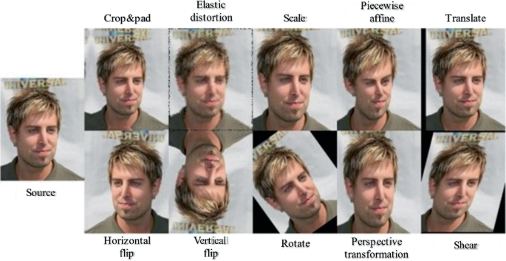

When/what/where to use Affine Transformation
Machine learning data augmentation: adding more possible visual perspectives from the same data
Animation (making small sprite movement)
https://link.springer.com/chapter/10.1007/978-3-031-38325-0_9

