Slide 1
Morphological Segmentation
IF221126 Digital Image Processing
Zulhaj Aliansyah
2025-12-03

Slide 2
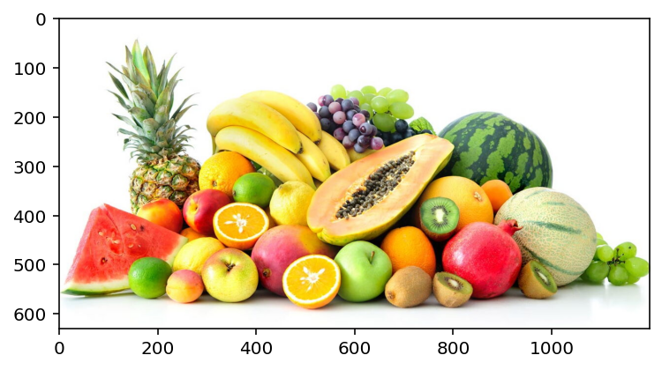
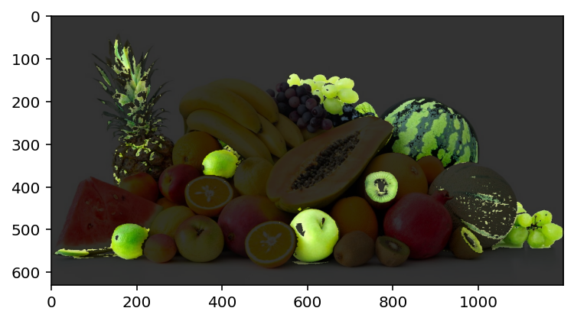
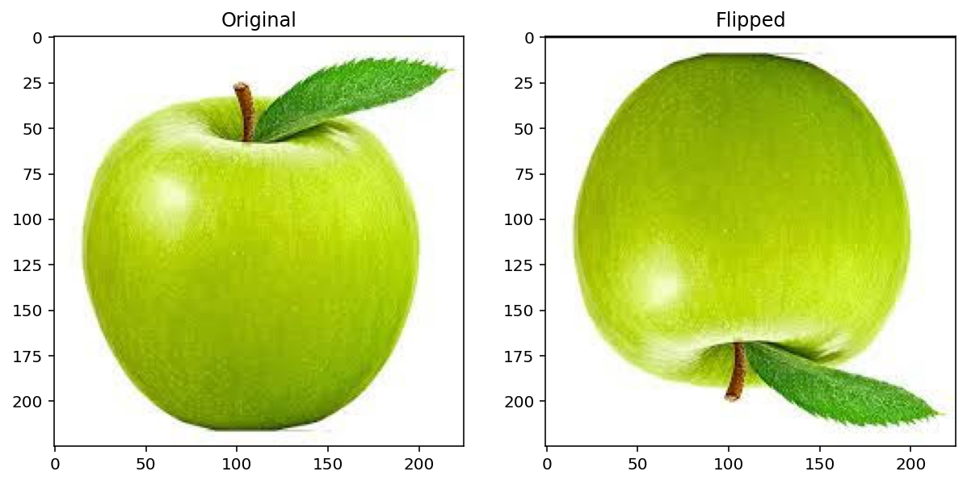
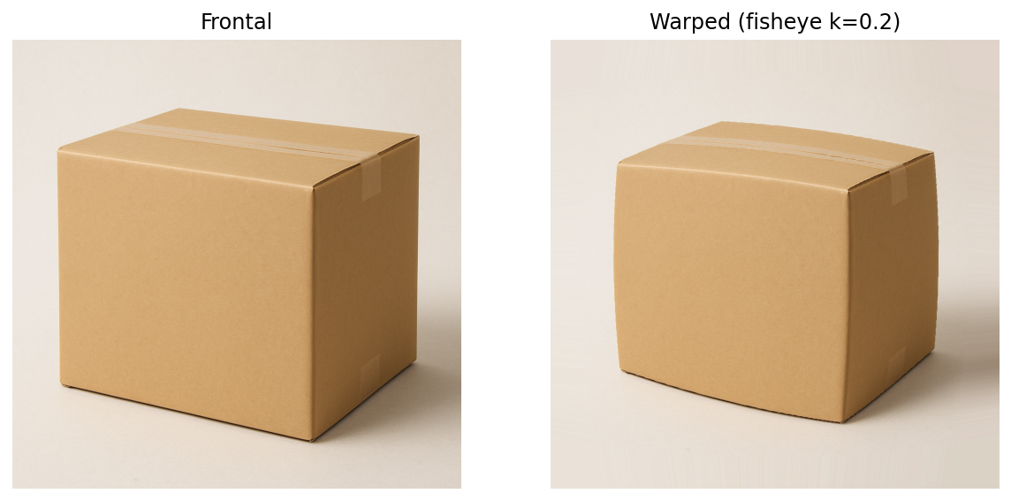
Recap

Slide 3
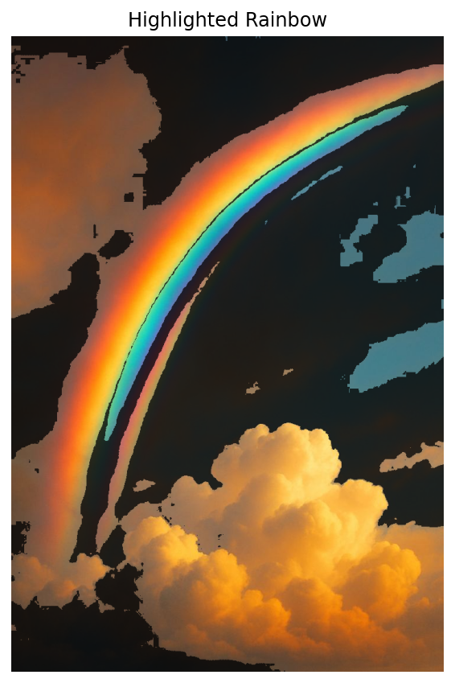
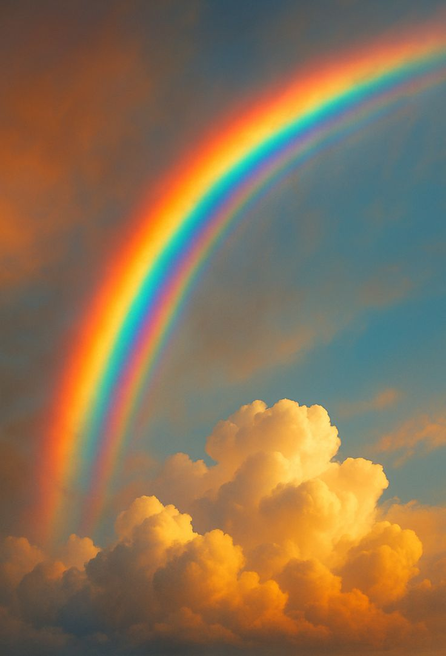
Digital Artworks are done using mathematical functions

Slide 4
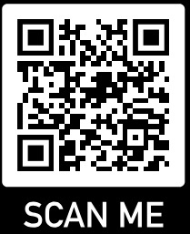
Attendance List
Attendance List "Digital Image Processing"
2025-12-03
https://forms.gle/ysoogz4zYG6bBURN8

Slide 5
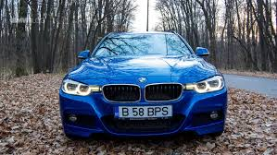
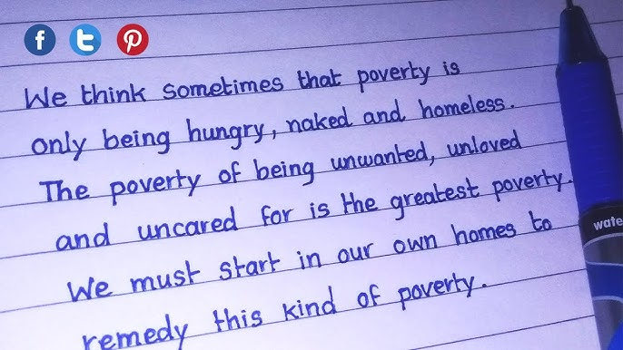
Extracting visual information from printed/written media

Slide 6
The information is basically-usually-sufficiently-technically-probably
can still be recognized in black-white term, but encoded in grayscale

Slide 7
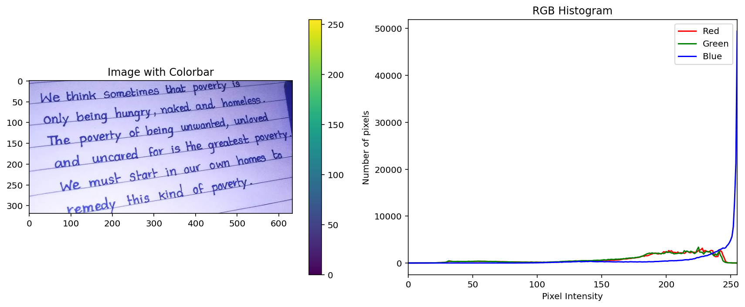
Statistical representation of the pixels

Slide 8
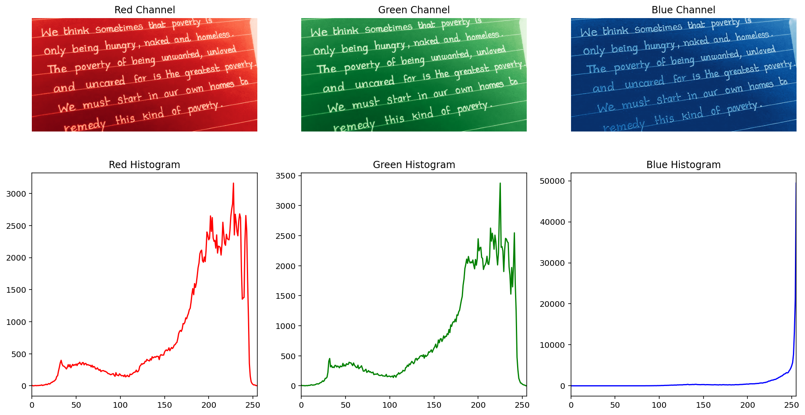
Statistical representation of the pixels
8-bit (0-255) of each RGB channel
histogram

Slide 9
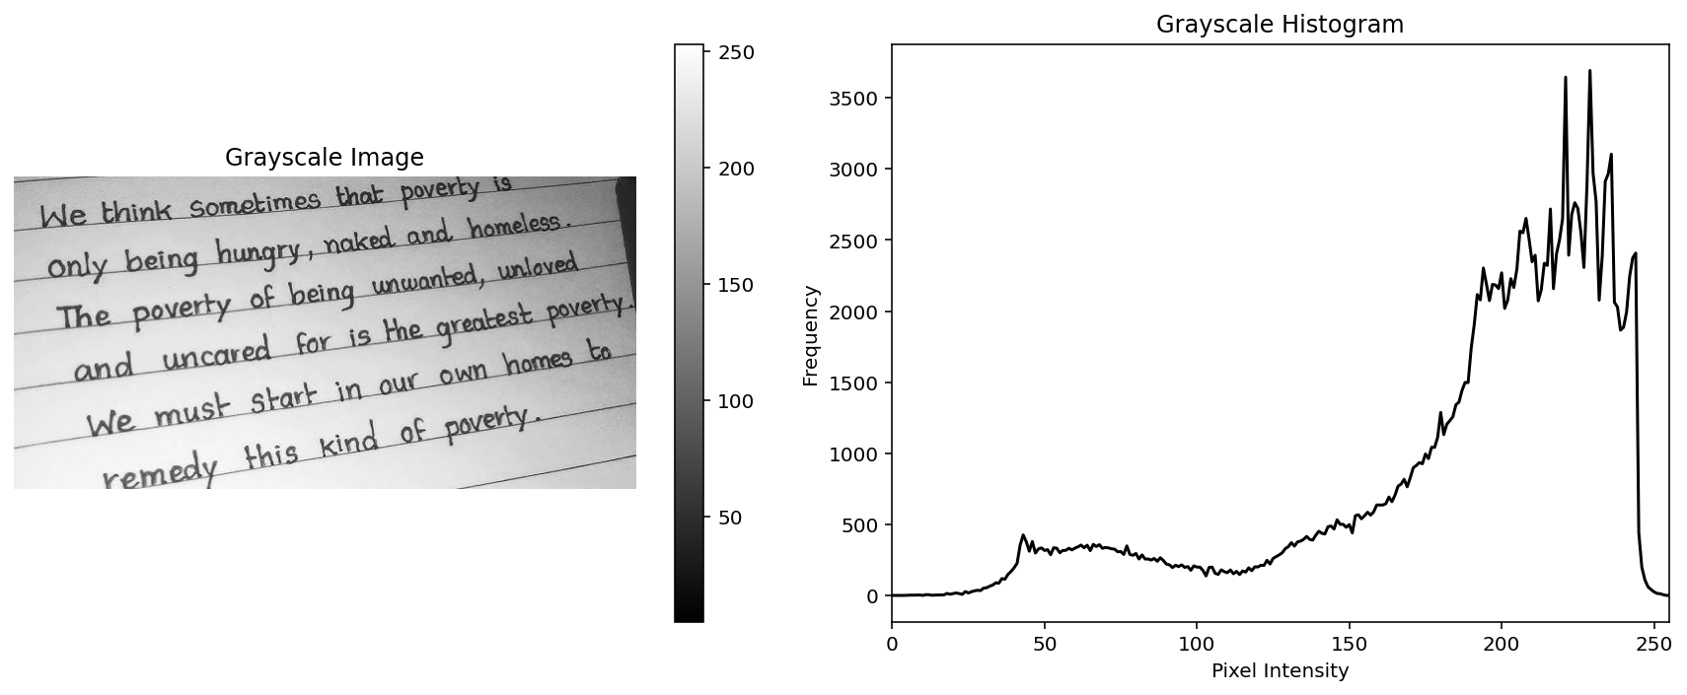


Human vision is more adapted to green
old TV (PAL, NTSC)
Digital HDTV
HDR
R = img[:, :, 0]
G = img[:, :, 1]
B = img[:, :, 2]
gray = 0.299 * R + 0.587 * G + 0.114 * B
gray = gray.astype(np.uint8)
hist, bins = np.histogram(gray.flatten(), bins=256, range=(0, 255))

Slide 10
How to extract only-solely the text?
Statistical threshold/limit

Slide 11
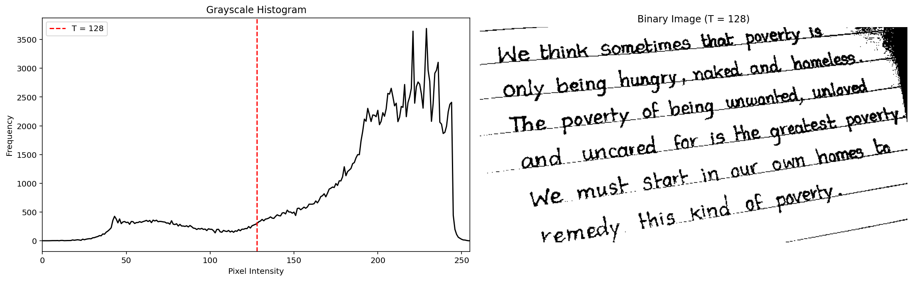
Static threshold (just put a number)

Slide 12
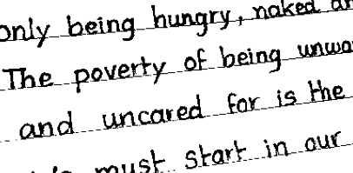
Static threshold: details

Slide 13
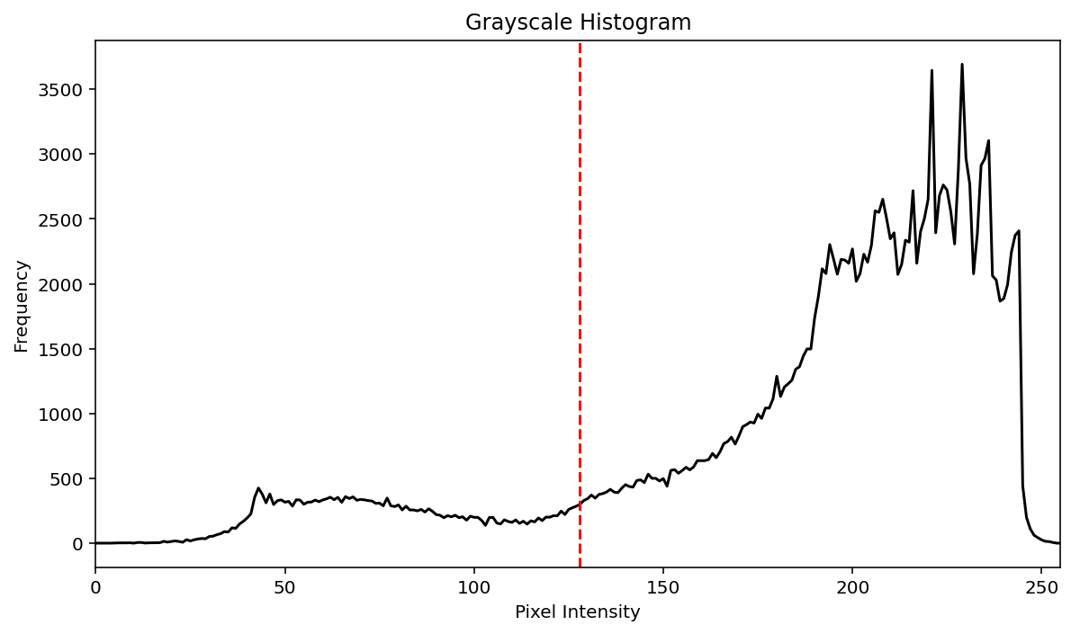
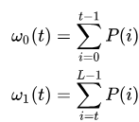
Otsu threshold (1979), designed for handwriting/fingerprint
Define t by minimizing difference between ω0 and ω1
t
L

Slide 14
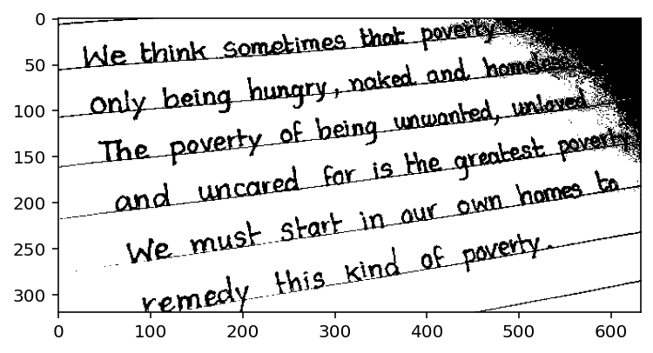
Otsu threshold

Slide 15
Static threshold (t=128)
Otsu threshold

Slide 16
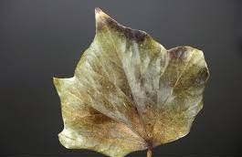

Slide 17
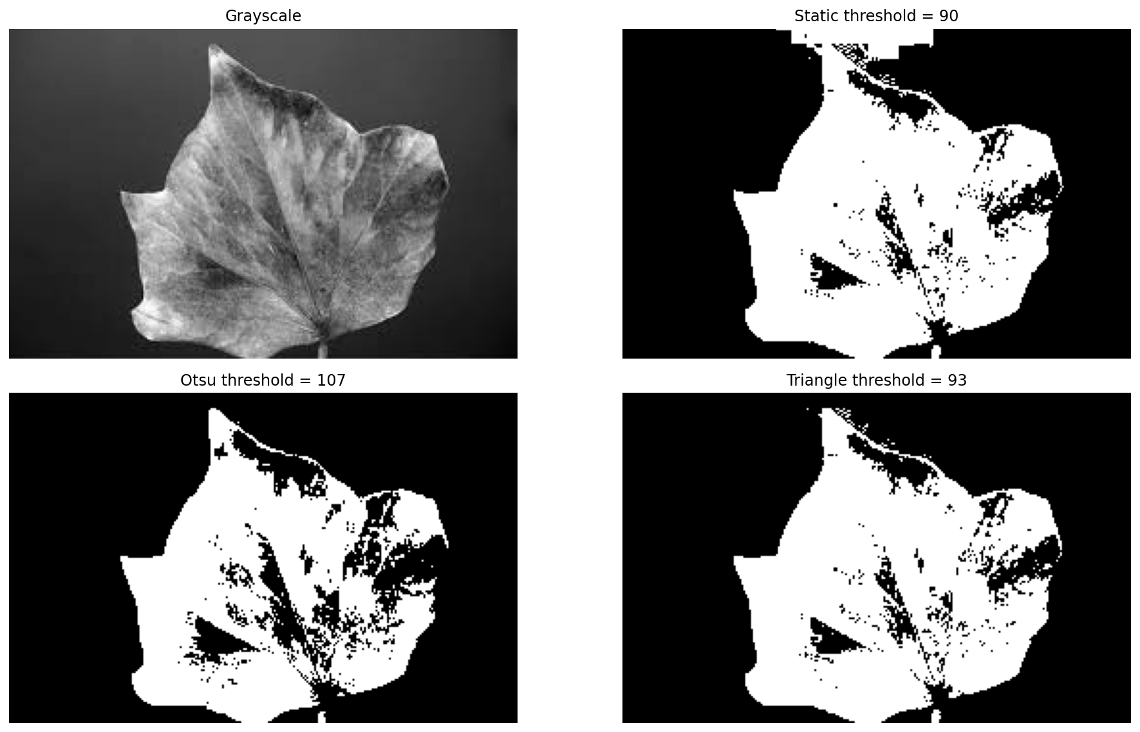
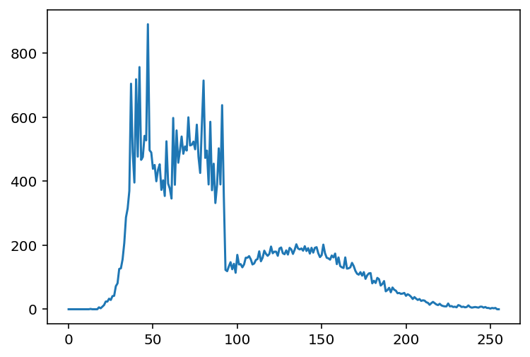
Other thresholding methods do exist

Slide 18
Assignment
Take a picture of your own handwriting/drawing and some random objects within a scene
Apply grayscale conversion and thresholding (use any algorithm you find suitable, can be either bimodal or multi-modal)
Grayscale inversion is optional
Write the program in python
Include the original photos and the resulting thresholded images
Code submission can be in *.py, *.pdf, or *.ipynb
Submit to muhammad_zulhaj.sada@upnjatim.ac.id
Subject: UNISZA HANDWRITING <your name>
Before 2025-12-10 10:00 AM Malaysia Time
(late submission will have deducted points)

