Slide 1
Image Processing Libraries
IF221126 Digital Image Processing
Zulhaj Aliansyah

Slide 2
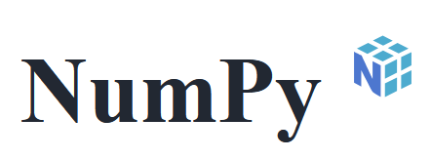

Image processing basics
Everything in image processing is just set of mathematical functions, but convoluted.
Common tasks: segmentation and recognition, feature detection (color, edge, corner, contours), filters (enhancement, compression, etc)
So, theoretically, can be broken down to just pixel array manipulation and visualization. (and data structure management)
import PIL
import numpy as np
import matplotlib.pyplot as plt

Slide 3
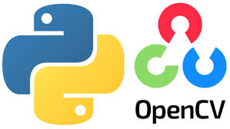
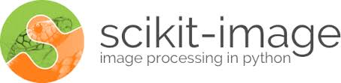
Image processing libraries
But libraries do exists.
compiled packages already written by some very cool people wizards
libraries are often built on top of another libraries
https://pypi.org/ (the one you install using pip, by default)

Slide 4
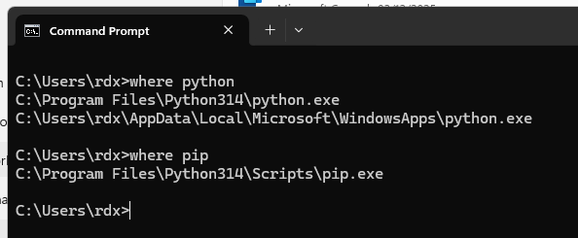
Python Execution Environment
python is interpreted programming language, code is run by scripts
using some kind of virtual machine, more akin to java than C/C++
the interpreter/virtual machine is the executable python.exe or python
package installer is pip

Slide 5
Let’s setup python for image processing
python is interpreted programming language, code is run by scripts
using some kind of virtual machine, more akin to java than C/C++
the interpreter/virtual machine is the executable python.exe or python
package installer is pip

Slide 6
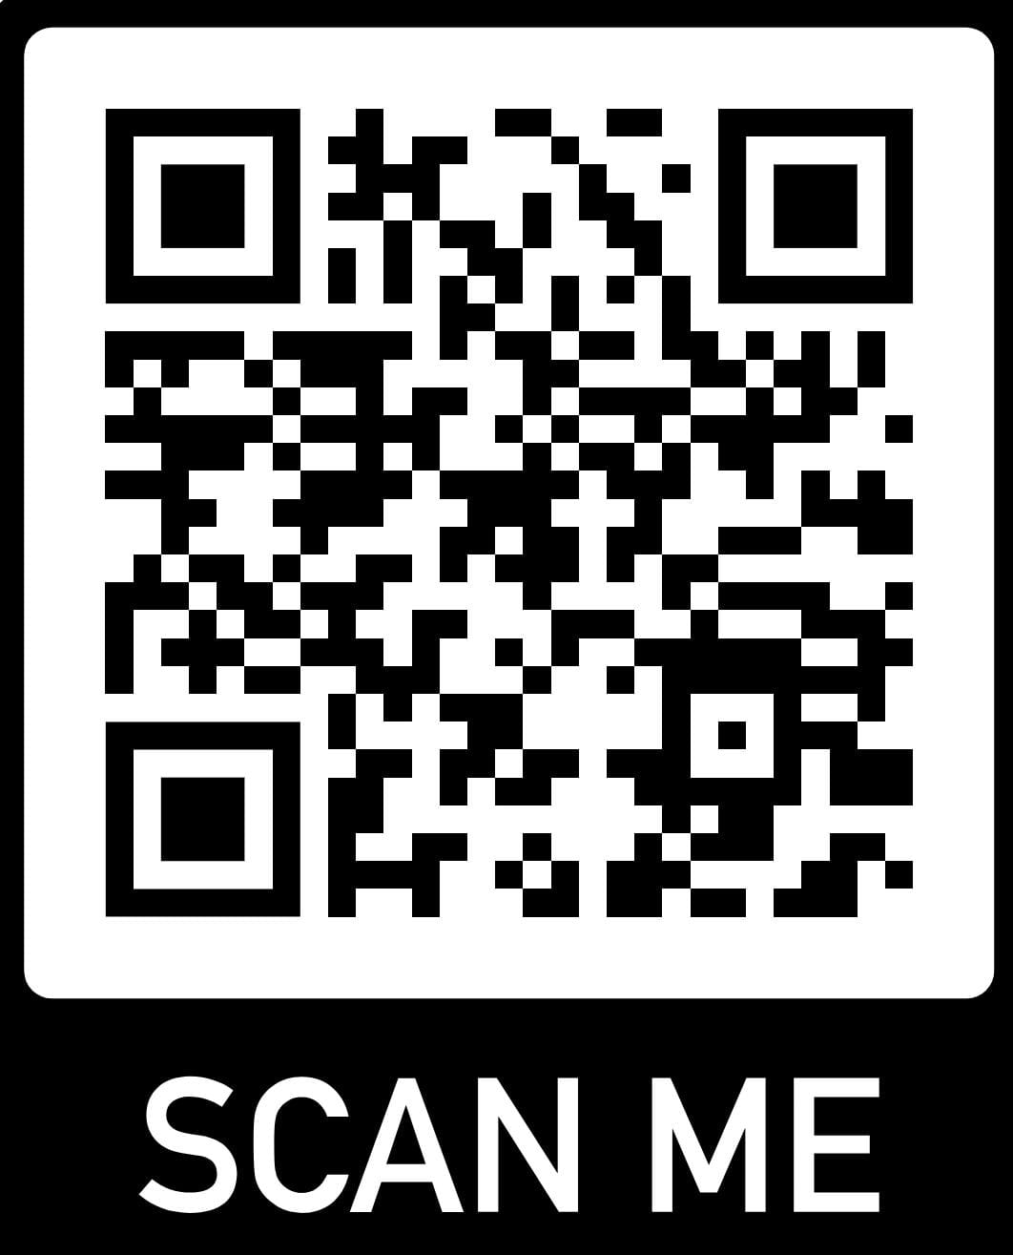
Today’s Attendance List
https://forms.gle/9JBZS2A1EAbJyDdh9

Slide 7
What to do today
install python the proper way(s)
install image processing libraries
install python IDE of our liking (spyder, again)
caveat: python is everywhere and the development is very fast. so package version can be an issues at time
try out things (while asking chatGPT) 🤣

Slide 8
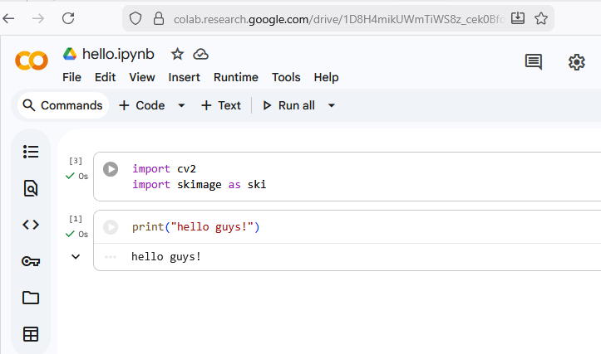
Google Colab
installed libraries
decent computing resource
but need internet connect at all times, code is not stored locally

Slide 9
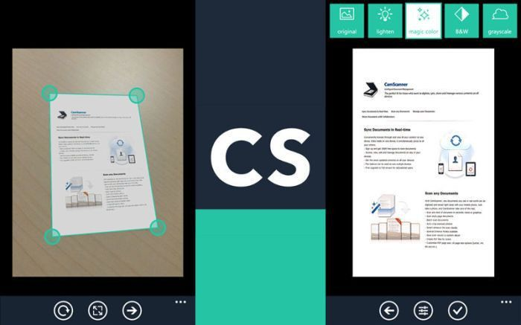
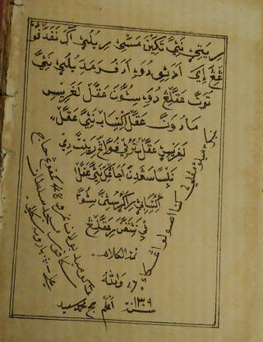
Use case: scanmypdf for ancient/historic manuscript
https://chenhuijing.com/blog/tales-of-the-malay-world

